Slide 1


Modeling the Dynamical and Radiative Evolution of a Pulsar Wind Nebula inside a Supernova Remnant
Joseph Gelfand (NYU / NSF)
Patrick Slane (CfA), Weiqun Zhang (NYU)
arxiv:0904.4053

Slide 2
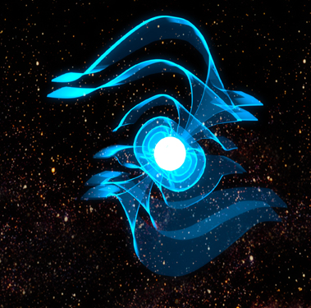
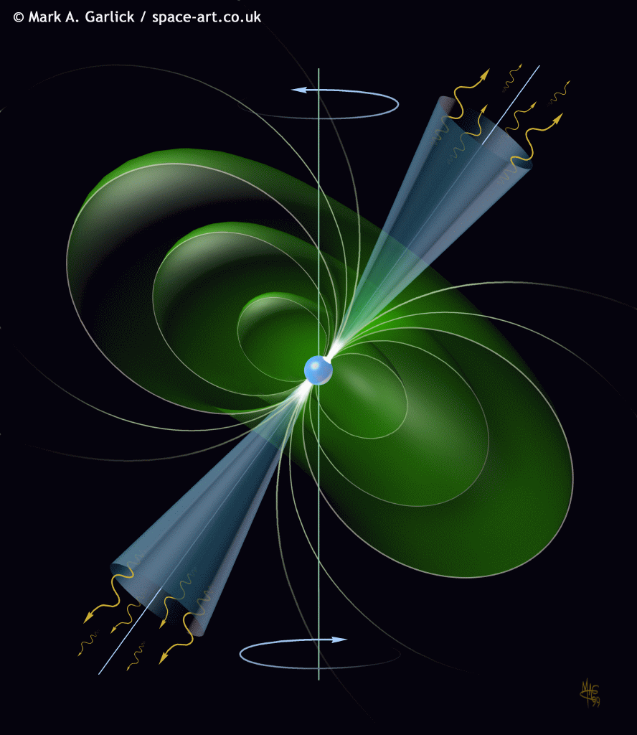
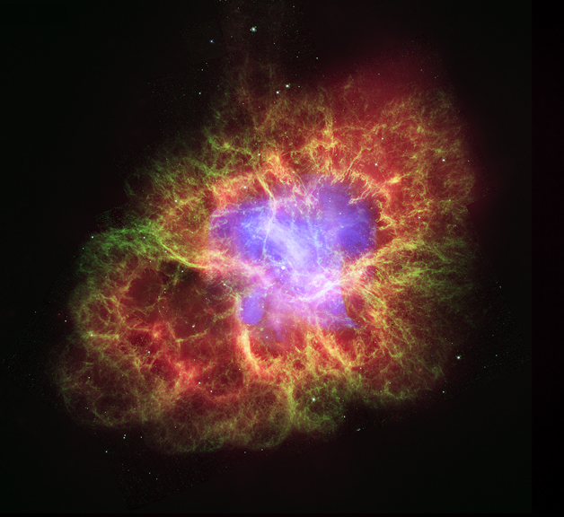
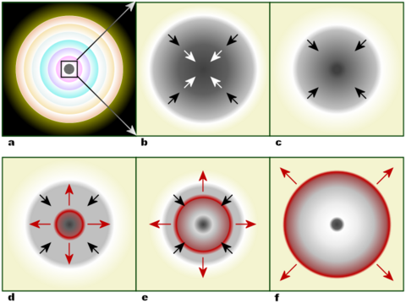
Pulsar Wind Nebula inside a Supernova Remnant
Neutron Star
  Initial Spin Period and Spin-down Luminosity
  Spin-down Timescale
  Braking Index
Pulsar Wind
  Fraction of energy in magnetic field, electrons, and ions
  Acceleration mechanism: minimum and maximum particle energy, energy spectrum
Progenitor Supernova
  Ejecta Mass
  Initial Kinetic Energy

Slide 3
Schematic of a Pulsar Wind Nebula inside a Supernova Remnant
4πR_{pwn}²P_{pwn}
Neutron Star
4πR_{pwn}²P_{snr}(R_{pwn})
Termination Shock
Magnetic Field: η_{B}Ė
Electrons: η_{e}Ė
Ions: η_{i}Ė
Injection Spectrum
Emission:
Synchrotron
Inverse Compton off CMB
Synchrotron Self-Compton
Inverse Compton off Starlight
Supernova Remnant
Pressure: P_{snr}(R_{pwn})
Velocity: v_{snr}(R_{pwn})
Density: ρ_{snr}(R_{pwn})
Ejecta mass: M_{ej}
Kinetic energy: E_{sn}
Density ISM: n_{ism}
Pulsar Wind
Pulsar Wind Nebula
Pressure: P_{pwn}
Magnetic Field: B_{pwn}
Swept-up Material
Mass: M_{sw,pwn}
Velocity: v_{pwn}
(Gelfand et al. 2009, ApJ submitted)

Slide 4
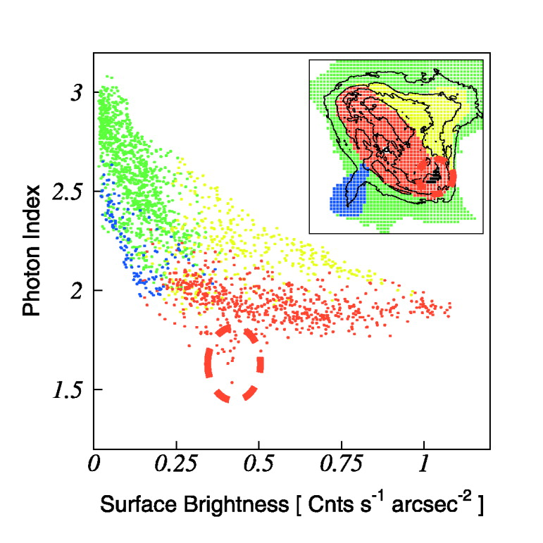
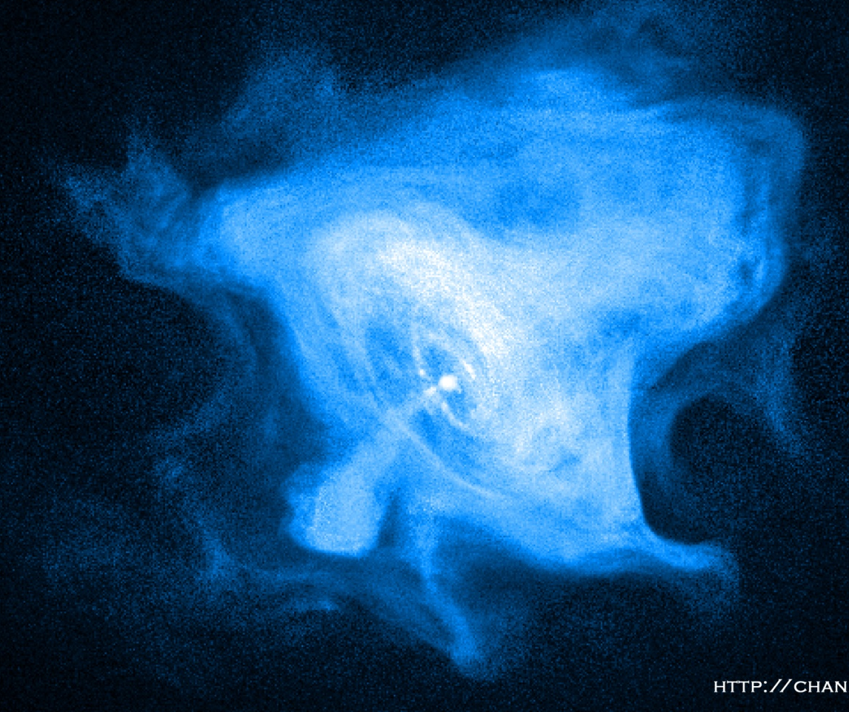
Model Limitations and Advantages
Model Limitations:
  Can not reproduce morphological features inside the PWN (e.g. jets and torus)
  Can not reproduce spectral variations inside PWN
  Can only estimate effect of instabilities (e.g. Raleigh-Taylor) on PWN.
Model Advantages:
  Simultaneously predict both dynamical and radiative properties of PWN
  Computationally inexpensive
  Easily adjustable
  Well suited for parameter exploration, error analysis
  Applicable to many systems
(Figure 3; Mori et al. 2004)

Slide 5
Dynamical and Radiative Evolution for a Trial Set of Parameters
Neutron Star properties:
  Ė₀ = 10⁴⁰ ergs/s
  τ_{sd} = 500 years
  p = 3
  v_{psr} = 120 km/s
Pulsar Wind properties:
  η_{e} = 0.999, η_{B} = 0.001, η_{i} = 0
  E_{min} = 511 keV, E_{max} = 500 TeV, γ_{e} = 1.6
Supernova properties:
  E_{sn} = 10⁵¹ ergs
  M_{ej} = 8 M☼
  Initial ejecta density profile: constant density core + ρ∝r⁻⁹ envelope
ISM properties:
  Constant density
  n = 0.1 cm⁻³
-γ_{e}
Number per Unit Energy
E_{max}
E_{min}
Energy

Slide 6
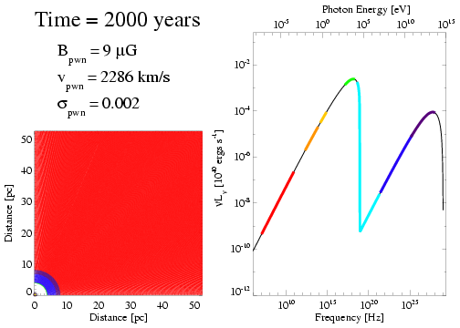
Model Output
Soft X-ray
Optical /
Near-IR
TeV γ-ray
Mid-IR
ISM
Shocked Ejecta & ISM
GeV γ-ray
Unshocked Ejecta
Radio
Pulsar + Termination
Shock
Hard X-ray

Slide 7
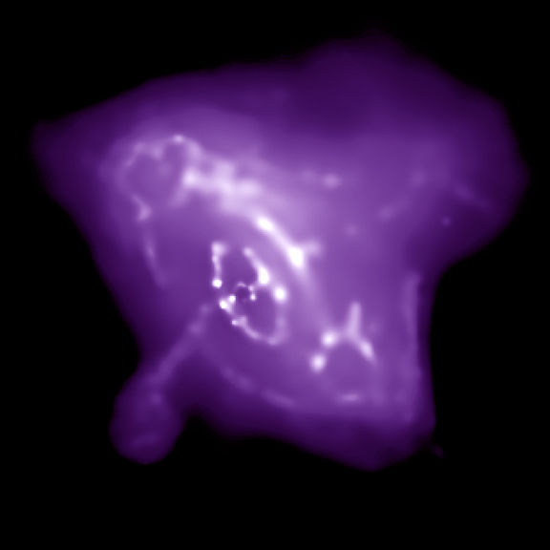
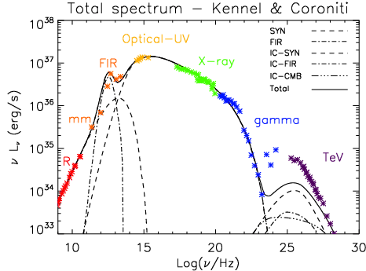
Example: Crab Nebula
Dynamical Properties
  PWN Radius
  Expansion Velocity
  Termination Shock Radius
Radiative Properties
  Radio Luminosity and Spectral Index
  X-ray Luminosity and Spectral Index
Pulsar Properties fully determined by age, radio timing observations
Pulsar Wind
  Magnetization at termination shock
  Minimum and Maximum Energy, Spectrum of Injected Electrons
Supernova Explosion
  Mass and initial kinetic energy of ejecta
ISM Density
Termination Shock
R_{pwn}
R_{pwn}
(Figure 1; Volpi et al. 2008)

Slide 8
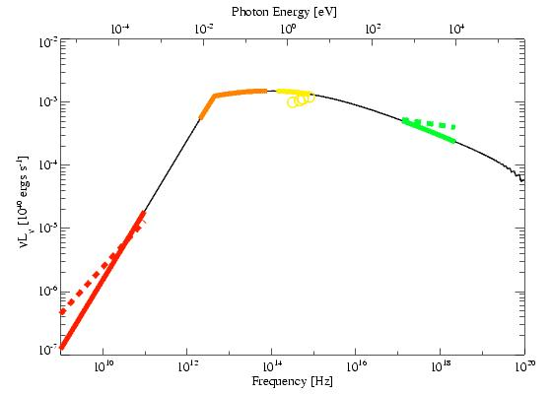
Best Fit: Single Power-law Injection Spectrum
Quantity | Observed | Predicted
R_{pwn} | 1.5-2.0 pc | 1.3 pc
v_{pwn} | 1125 –1500 km/s | 1570 km/s
Termination Shock Radius | 0.14 pc | 0.12 pc
Radio Luminosity | 1.8×10³⁵ ergs/s | 1.76×10³⁵ ergs/s
Radio Spectral Index | -0.26 | +0.1
X-ray Luminosity | 1.3×10³⁷ ergs/s | 1.0×10³⁷ erg
X-ray Photon Index | 2.1 (1.8 – 3) | 2.26

Slide 9
Best Fit: Single Power-law Injection Spectrum
Best-fit parameters from MCMC fit
  Pulsar Wind Properties
  Magnetization η_{B}=0.05_{-0.03}^{+0.1}
  Electron Injection Energy 60 GeV – 600 TeV
  Injection Power Law index 2.5 ± 0.2
  Supernova Explosion
  Ejecta Mass = 8 ± 1 M☼
  Initial KE = 0.6_{-0.2}^{+2.0}×10⁵¹ ergs
  Low density (n < 1 cm⁻³) environment

Slide 10
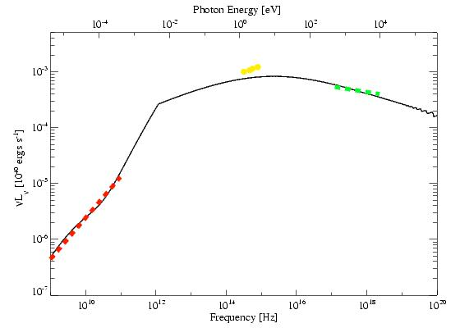
Crab Nebula: Maxwellian + Power-Law Injection Spectrum
Quantity | Observed | Predicted
R_{pwn} | 1.5-2.0 pc | 1.3 pc
v_{pwn} | 1125 –1500 km/s | 1600 km/s
Termination Shock Radius | 0.14 pc | 0.12 pc
Radio Luminosity | 1.8×10³⁵ ergs/s | 1.83×10³⁵ ergs/s
Radio Spectral Index | -0.26 | -0.30
X-ray Luminosity | 1.3×10³⁷ ergs/s | 1.4×10³⁷ erg
X-ray Photon Index | 2.1 (1.8 – 3) | 2.2

Slide 11
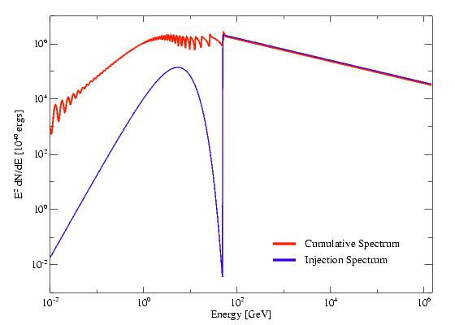
Crab Nebula: Maxwellian + Power-Law Injection Spectrum
Pulsar Wind Properties
  Magnetization η_{B}=0.015
  Power Law: 96% Ė
  Injection Energy
    50 GeV – 1500 TeV
Injection Index 2.4
  Maxwellian: 4% Ė
  kT = 1.8 keV ( γ = 3500)
Supernova Explosion
  Ejecta Mass = 8 M☼
  Initial KE = 10⁵¹ ergs
ISM n = 0.01 cm⁻³
Problems:
  Not most realistic injection spectrum
MCMC fit in progress
Will also try broken power-law and PL+PL injection spectrum
PRELIMINARY!

Slide 12
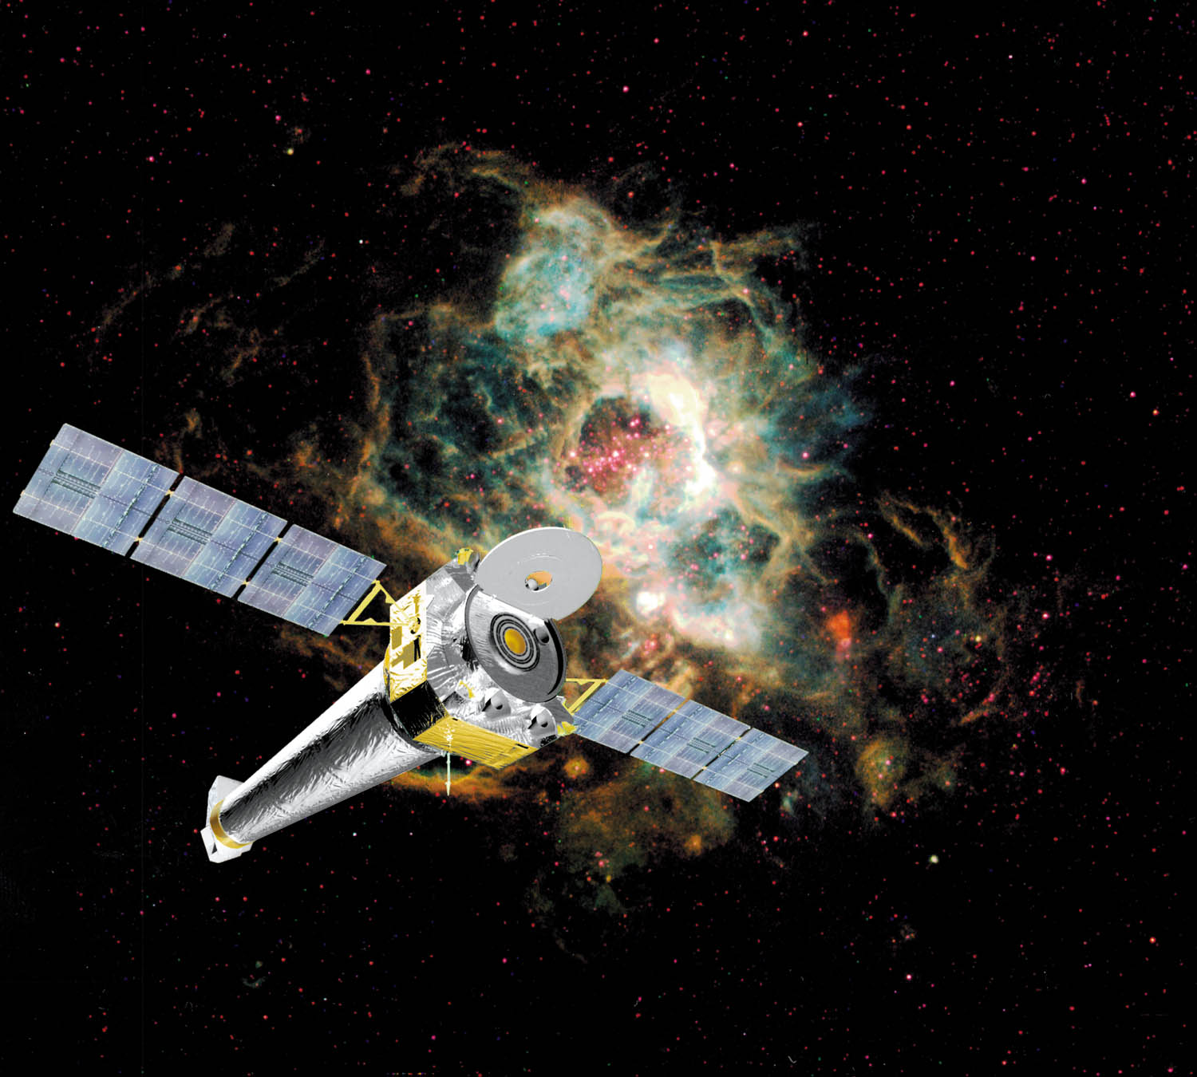
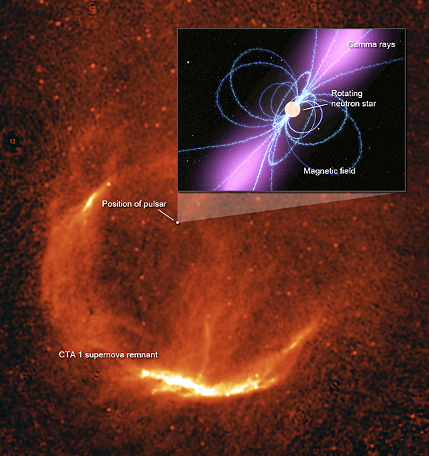
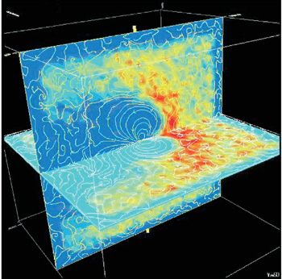
Future Directions
Apply model to other systems
  New pulsar, PWN, SNR discoveries by new and existing facilities help considerably
Distinguish between injection scenarios
Better incorporate results form multi-D simulations
  Magnetic field structure
  Growth and effect of instabilities

Slide 13
Thank you!

Slide 14
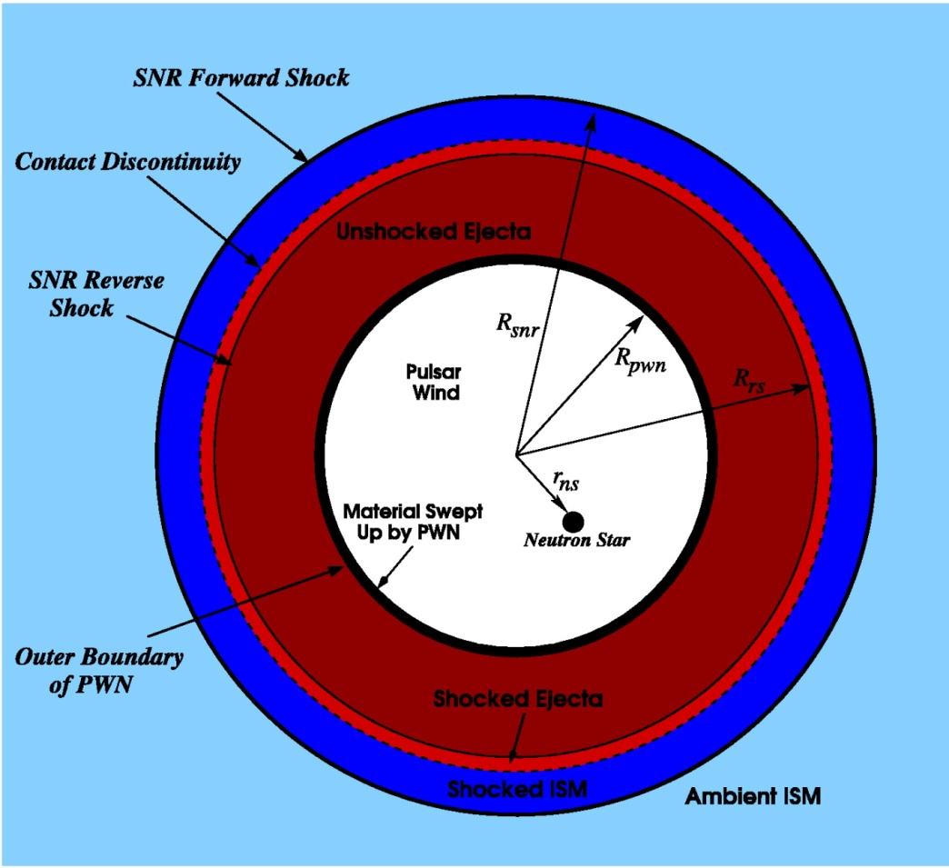
Evolutionary Model for a Pulsar Wind Nebula Inside a Supernova Remnant
Homogeneous ISM, PWN
  1D problem
Dynamical evolution of PWN determined by dynamics of swept-up material
  Force result of pressure difference between PWN and SNR
  Momentum conserved
PWN’s radiative losses dominated by synchrotron, IC scattering off CMB
Pulsar Wind Nebula
4πR_{pwn}²P_{pwn}
4πR_{pwn}²P_{snr}(R_{pwn})
(Gelfand et al. 2009, ApJ submitted)
Supernova Remnant
(Figure 6; Gelfand et al. 2007)

Slide 15
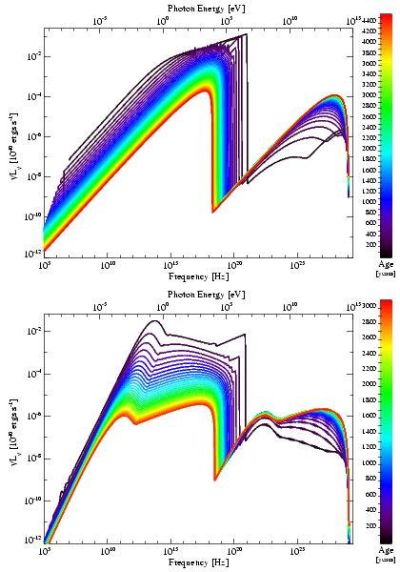
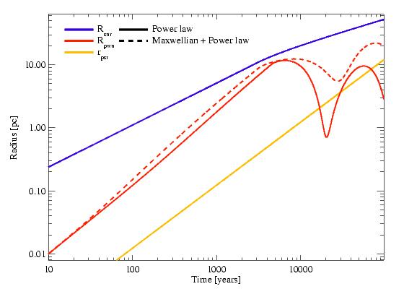
Importance of Injection Spectrum
Single Power Law unlikely to be correct
Two component models:
  Broken Power-law
  Maxwellian + Power-law
  Two power-laws?
Very different spectral and dynamical evolution
SNR Radius
PWN Radius
(Gelfand et al., in prep.)

