Slide 1
AGN and their Environments
Brian Morsony
UW Madison
7/12/2011
Collaborators:
Sebastian Heinz
Jake Miller
Eric Wilcots
Emily Freeland

Slide 2
Outline
AGN in clusters
  Bubbles
  Jet breakup
  Series of bubbles
AGN in groups
  Moving AGN
  Jet curvature
  Cocoon
  X-rays from shocks

Slide 3
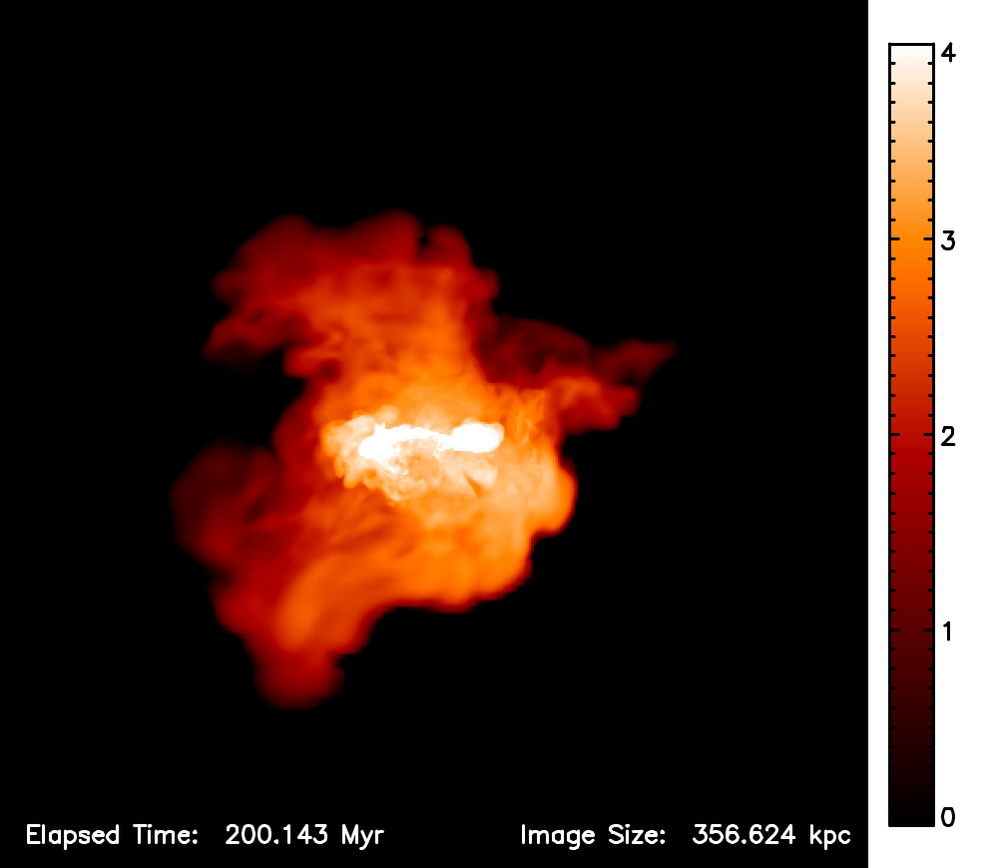
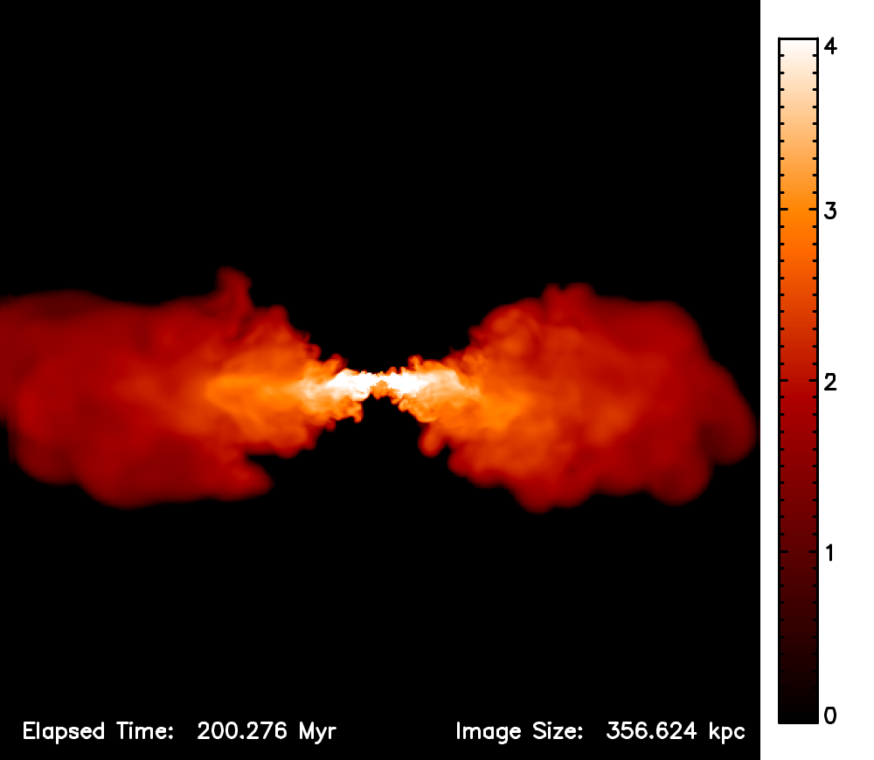
Dynamic vs. Hydrostatic Cluster

Slide 4
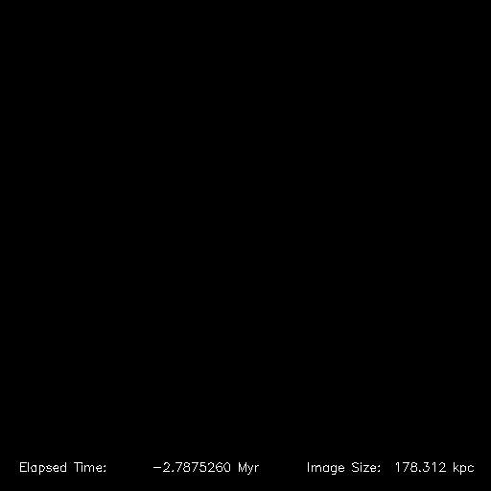
Dynamic Cluster Radio

Slide 5
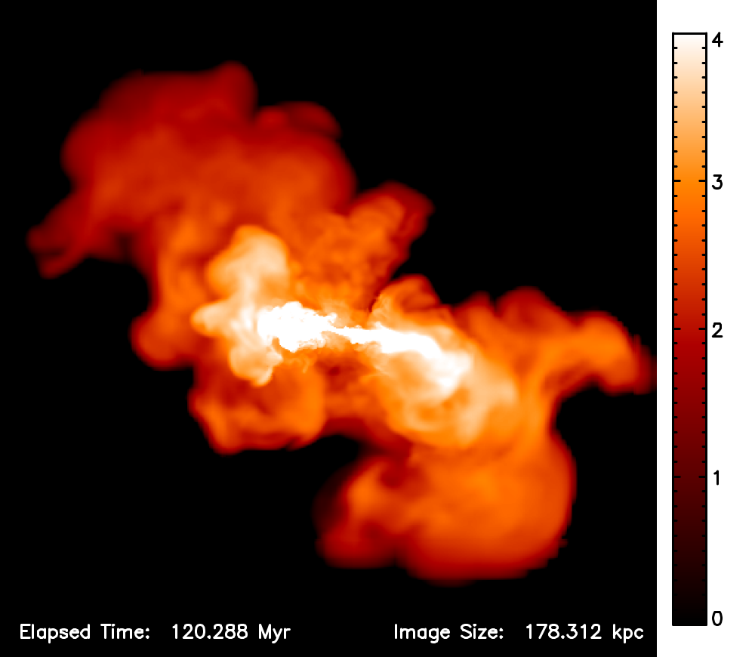
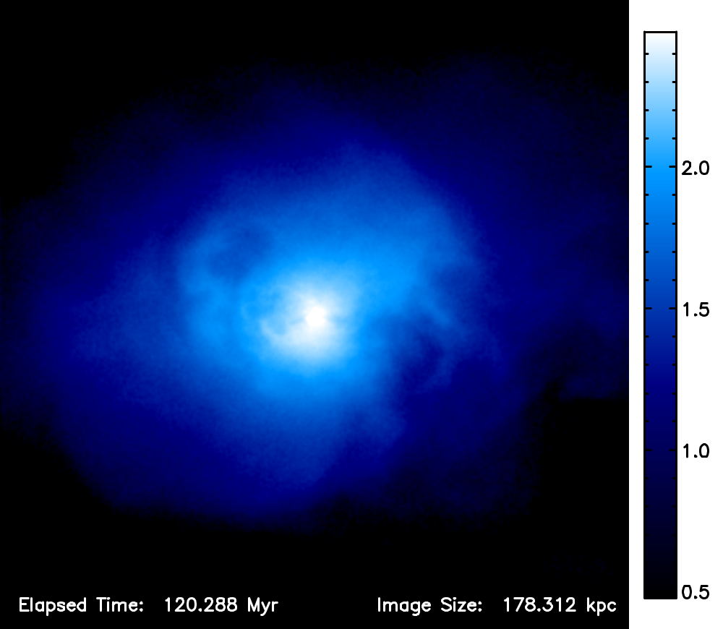
Radio and X-ray

Slide 6
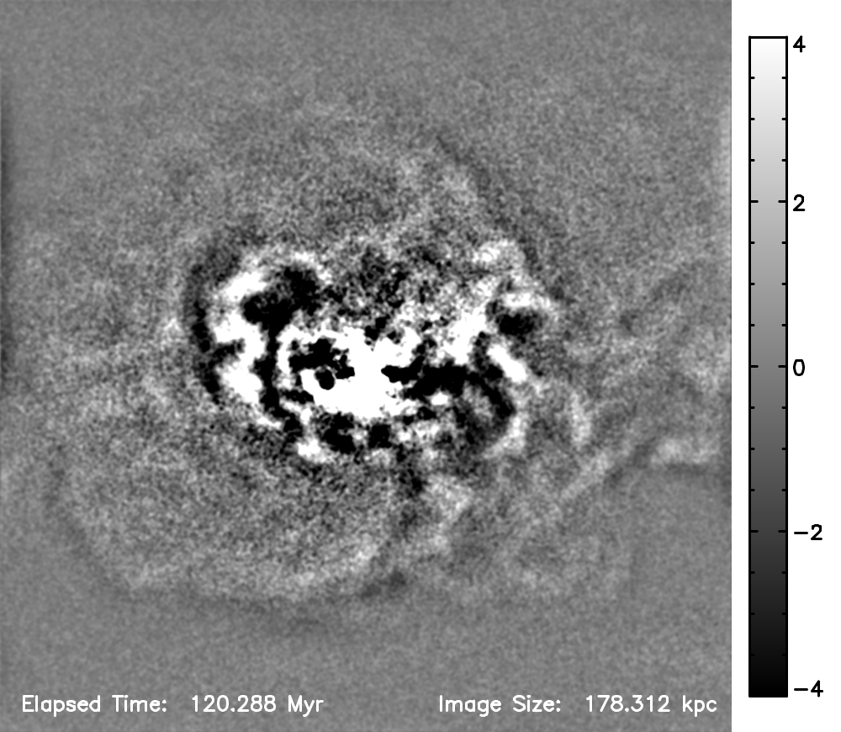
Radio and X-ray

Slide 7
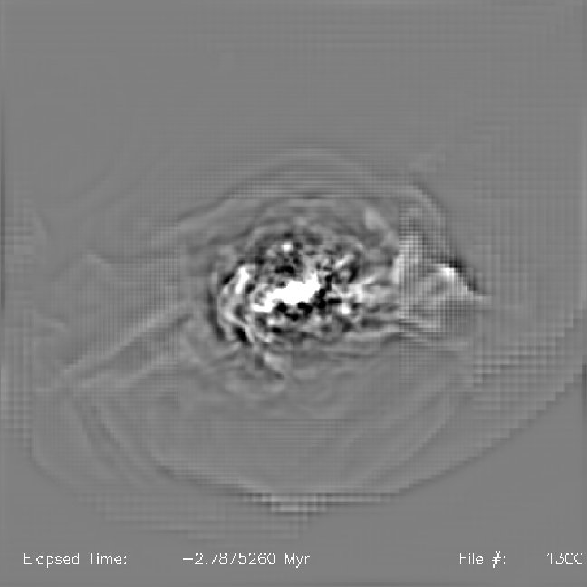
Dynamic Cluster X-ray

Slide 8
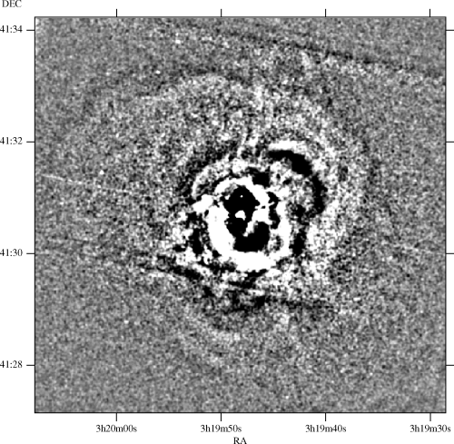
X-ray Comparison
Fabian et al. 2003
Perseus, 131 kpc

Slide 9
X-ray Comparison
Fabian et al. 2003
Perseus, 131 kpc

Slide 10
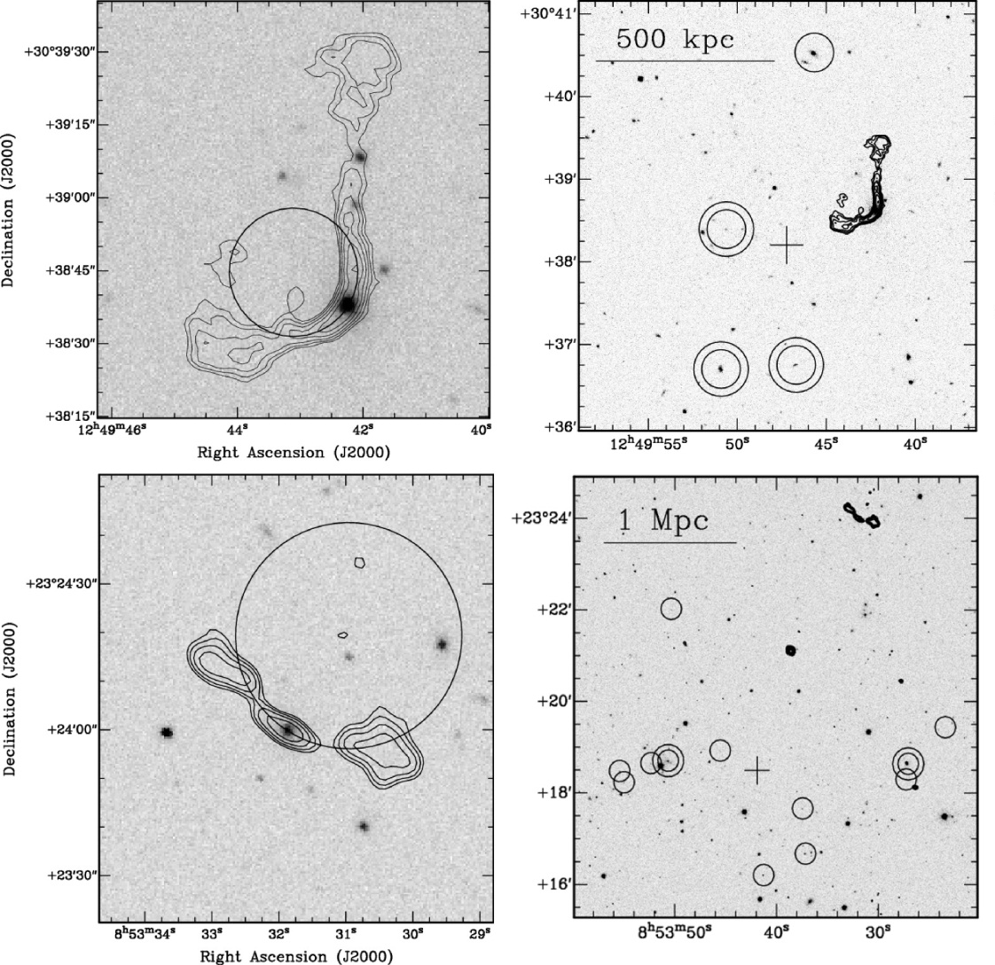
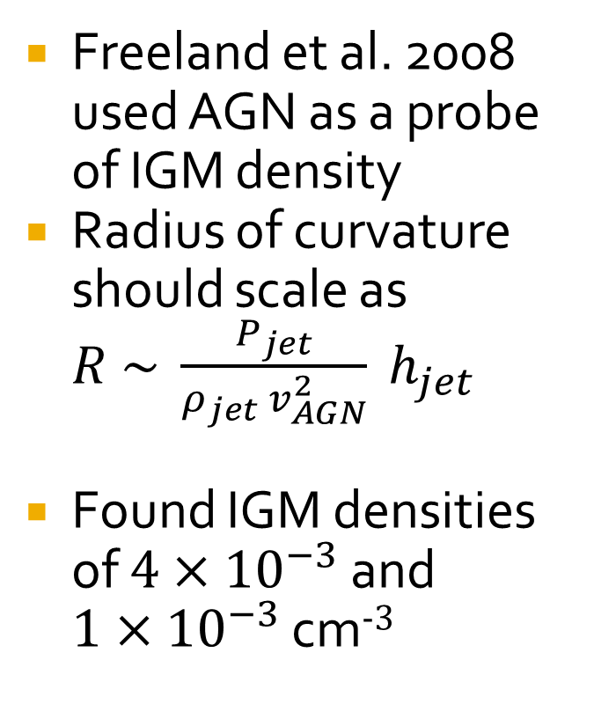
Moving AGN in groups
Freeland et al. 2008 used AGN as a probe of IGM density
Radius of curvature should scale as $R \sim \frac{P_{jet}}{ρ_{jet} v_{AGN}^{2}} h_{jet}$
Found IGM densities of $4×{10}^{−3}$ and $1×{10}^{−3}$ cm⁻³

Slide 11
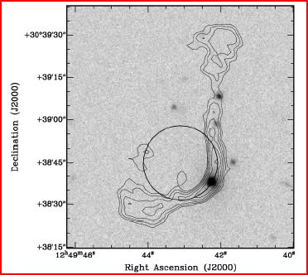
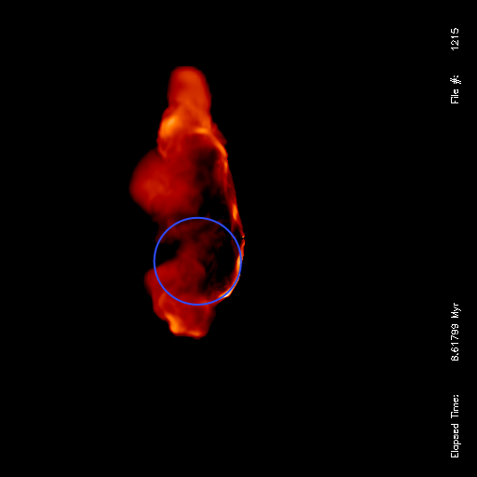
Comparison to Observation
Freeland, Cardoso, & Wilcots 2008
From simulation in cluster
Notes:
Here’s a radio image of one such actual observation. On the left you see an AGN observed by Freeland, Cardoso, & Wilcots from the University of Wisconsin in Madison. By the use of alternate methods, they estimated a density of the surrounding medium to be a full order of magnitude higher than what would typically be expected this far out from the center of a cluster. By using radius of curvature measurements of the AGN as corroborating evidence, the conclusion now is that this galaxy is actually passing through a dark matter filament which carries with it a correspondingly higher than normal IGM density.

Slide 12
Simulations Setup
FLASH adaptive mesh hydro code
AGN modeled as 2 nozzles back to back
Kinetic luminosity = 10⁴⁴ ergs/s
Typical IGM density = 10⁻³
Typical galaxy velocity = 1000 km/s
Internal Mach number = 10
Jet velocity = 3 × 10⁹ cm/s
Adiabatic, gamma = 5/3

Slide 13
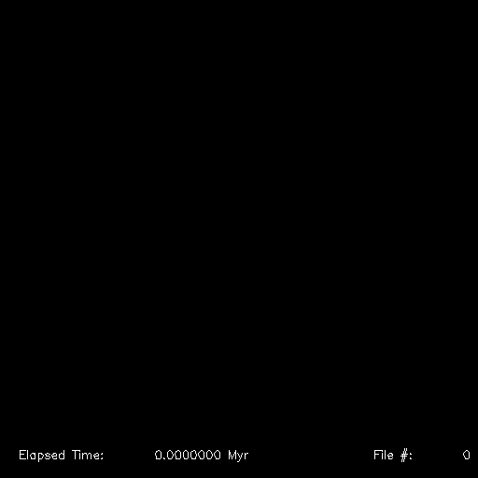
Moving AGN Simulation

Slide 14
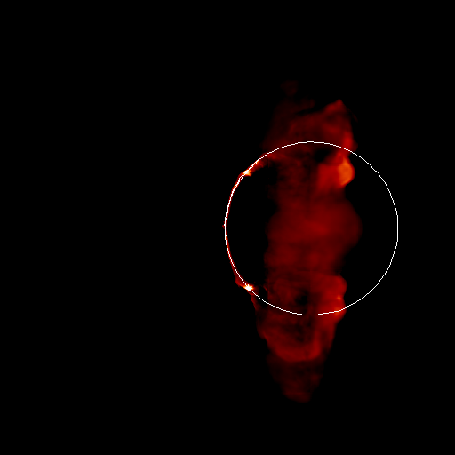
Moving AGN Curvature
A curve can be fit to the jet
Matches expectations reasonably well
Also a lot of diffuse trailing radio emission

Slide 15
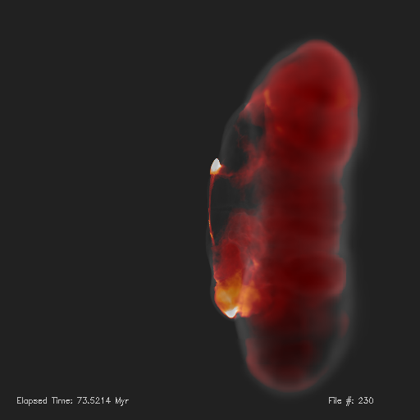
Radio + Density
Radio plasma inside cocoon created by AGN

Slide 16
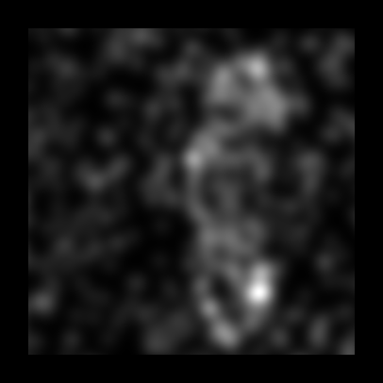
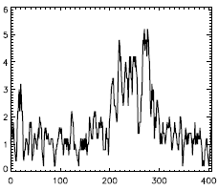
Moving AGN X-rays
Cocoon shock heats and compresses gas, making it detectable

Slide 17
Conclusions
Environment determines AGN jet morphology
Moving gas curves and breaks up jets, creating series of bubbles, bent doubles and radio trails
Bubbles created by AGN lead to an x-ray deficit in clusters, but an x-ray enhancement in groups

Slide 19
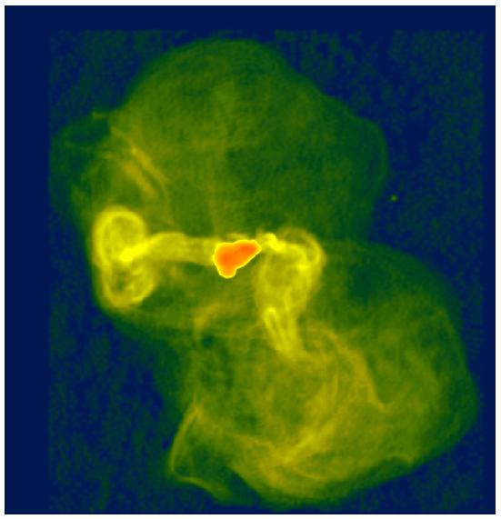
Radio Comparison
M87, 61 kpc
Owen et al. 2000

