Slide 1



Core Gas Sloshing in a Sample of Chandra Clusters
A talk for the workshop “Diffuse Emission from Galaxy Clusters in the Chandra Era”
by
Ryan E. Johnson
in collaboration with
Christine Jones & Bill Forman
Maxim Markevitch & John Zuhone

Slide 2
Outline
Gas Sloshing
Merger histories of Abell 1644 and RXJ1347.5-1145
Sloshing in a flux limited sample of clusters beyond Coma
Conclusions

Slide 3
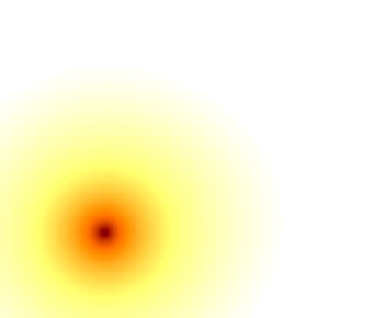
Simulations of Gas Sloshing
Interaction of two cluster sized halos
M_{p}/M_{s} = 5
b = 500 kpc
Slices of gas density
10 kpc cell size
Zuhone, Markevitch & Johnson (2010)

Slide 4
Simulations of Gas Sloshing
The spiral pattern is a “contact discontinuity”
Requires a cool core
Discontinuous density and temperature

Slide 5
Characteristics of Sloshing
Simulations allow different viewing angles
  unique morphology depends on inclination

Slide 6
Flux Limited Sample
Project impetus was to determine frequency of sloshing in galaxy clusters
HiFLUGCS (Reiprich & Bohringer 2002) - complete, all sky, X-ray flux limited sample of galaxy clusters (ROSAT, ASCA)
Sample variation:
  low redshift cut at Coma
  also includes some low galactic latitude objects

Slide 7
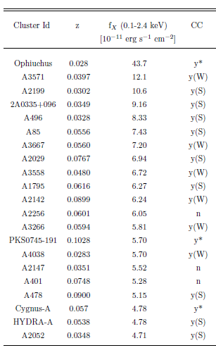
Flux Limited Sample
Sloshing may occur in any cool core (CC) cluster
Of the 21 brightest clusters beyond Coma:
  18 are cool core (Hudson et al. 2010)
Method: Identify edges in S_{x}, measure T, ρ, P across edges

Slide 8
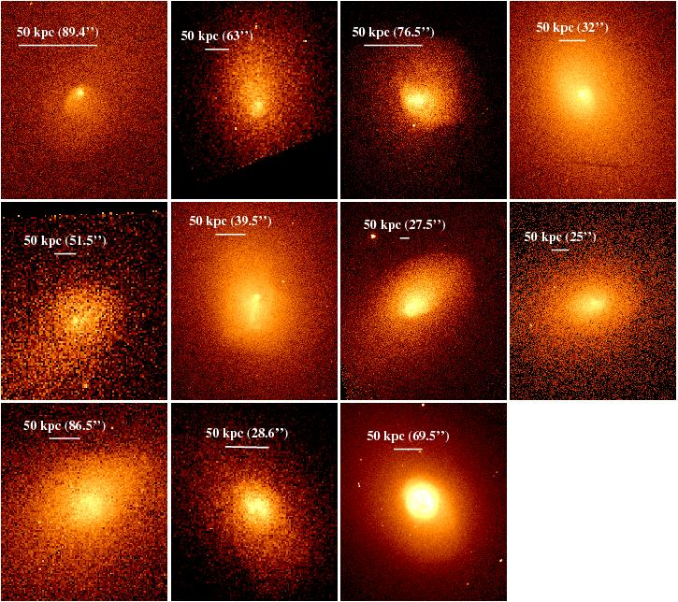
Flux Limited Sample
Of the CC clusters, 9 have sloshing type cold fronts

Slide 9
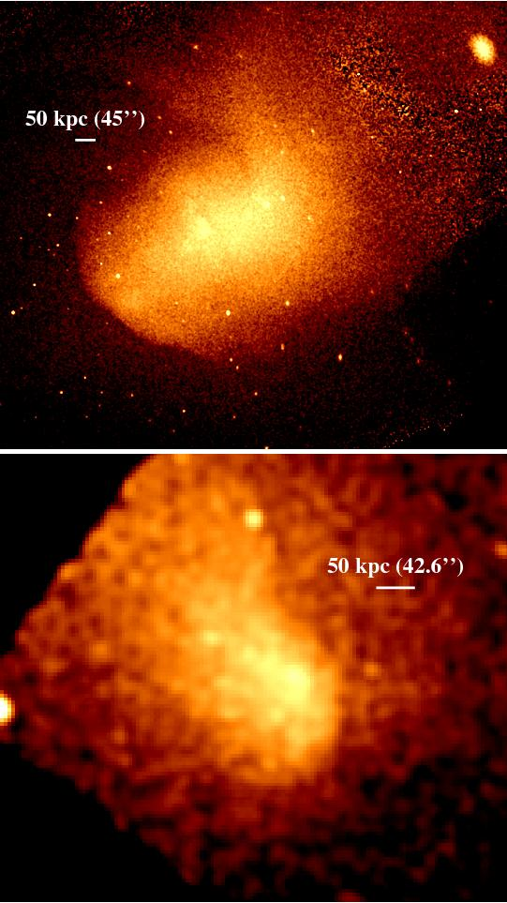
Flux Limited Sample
The remainder have CC but no sloshing
Two are mergers

Slide 10
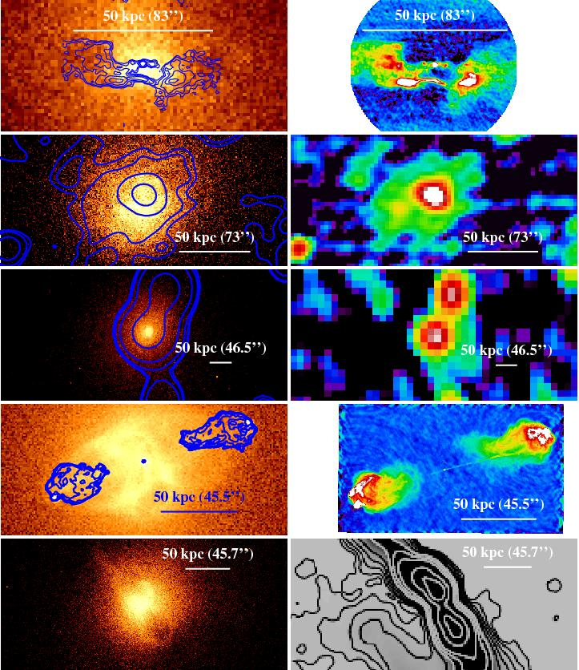
Flux Limited Sample
Four (+Cygnus-A) are dominated by AGN

Slide 11
Initial Results
In a complete, flux limited sample, we see evidence of gas sloshing in 9 / 18 clusters
Since we only expect to see sloshing in CC clusters, the fraction of CC clusters with sloshing is 9 / 15 (60%)
This represents a minimum value as AGN complicate sloshing detection
  model predicts most clusters should be sloshing

Slide 12
Summary and Future Work
Sloshing gas is common in the cores of galaxy clusters
Gas sloshing develops over predictable time scales, putting constraints on when the cluster was disturbed (Johnson & Zuhone 2011 in prep)
With a time for the disturbance, we may also constrain the location of the disturbing object (Johnson et al. 2010, 2011 in prep)
Building up a large sample of these objects will allow the most complete observational constraint on merger rates of clusters

Slide 13
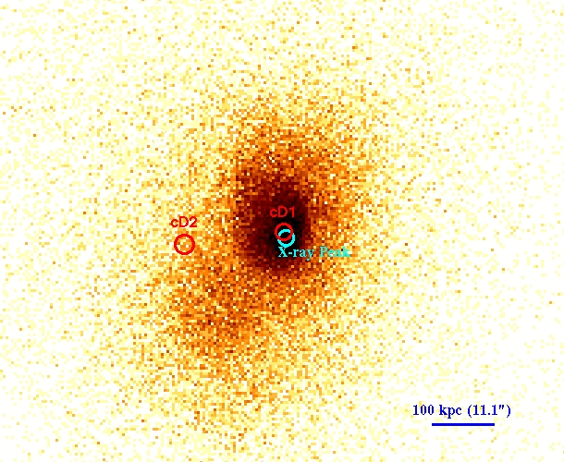
The Merger History of
RXJ1347.5-1145
Most Luminous X-ray Cluster
Published works agreed this was a merger, with the subcluster moving northward

Slide 14
The Merger History of
RXJ1347.5-1145
The identification of sloshing gas requires a modification to this interpretation

Slide 15
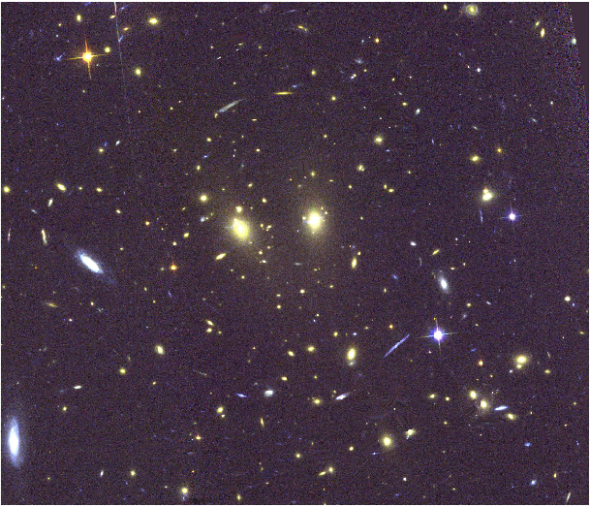
The Merger History of
RXJ1347.5-1145
Unique morphology, and extensive multiwavelength coverage

Slide 16
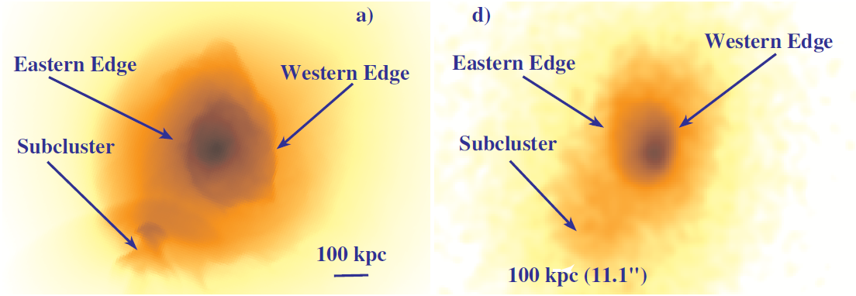
RXJ1347.5-1145: Comparison with Simulations
Two sloshing edges identified, and a gaseous subcluster

Slide 17
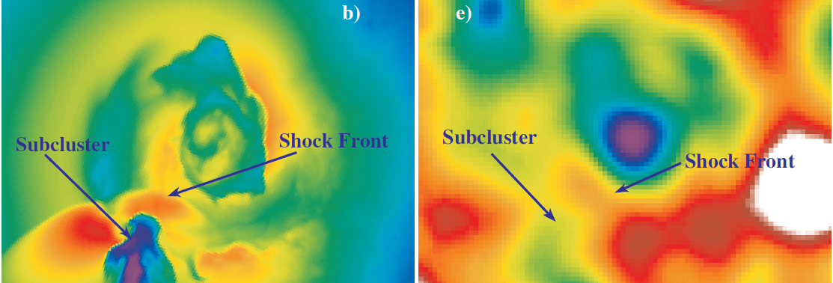
RXJ1347.5-1145: Comparison with Simulations
Temperature maps: Cool core, subcluster and shock front

Slide 18
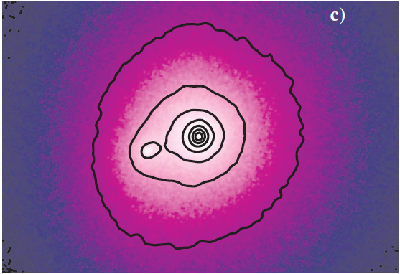
RXJ1347.5-1145: Comparison with Simulations
Collisionless dark matter distribution agrees with galaxy distribution

Slide 19
The Merger History of
RXJ1347.5-1145
The data are consistent with the subcluster crossing for the 2nd time and a merger in the plane of the sky
Sloshing model constrains subcluster orbit (axes and inclination)
Results to be submitted to ApJ later this month (Johnson et al. 2011)

Slide 21
Astronomically Speaking
Physical scales are expressed in kiloparsecs (kpc), where 1 kpc ~ 3000 ly ~ 3 x 10²¹ cm
Temperatures are expressed in keV, where 1 keV ~ 11 x 10⁶ K
Masses are expressed in solar masses (M⨀), where 1 M⨀ ~ 2 x 10³⁰ kg
Surface brightness (S_{X}) is a measurement of how bright an object appears at a given wavelength at our location (∝ 1/d² )

Slide 22
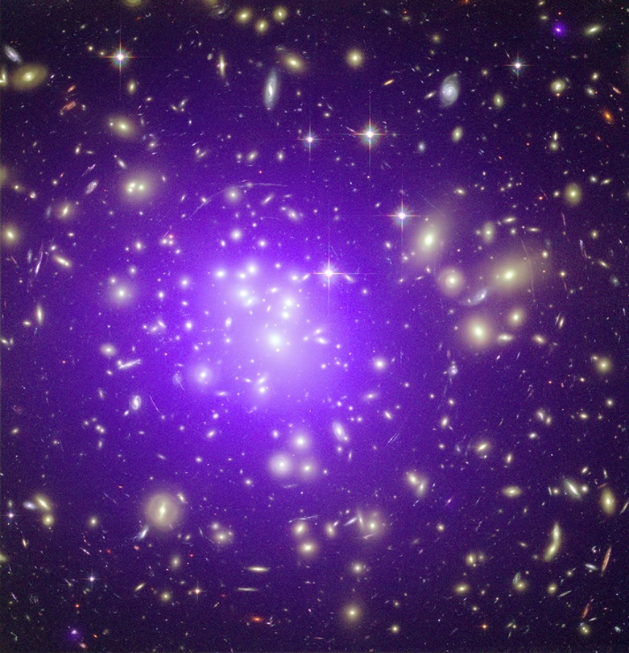
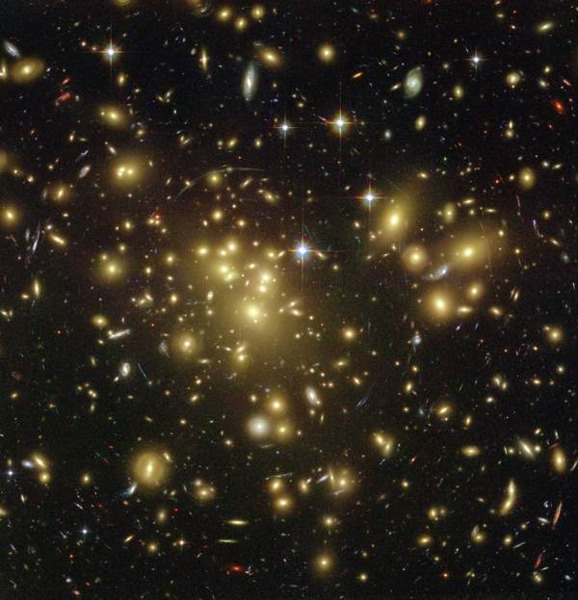
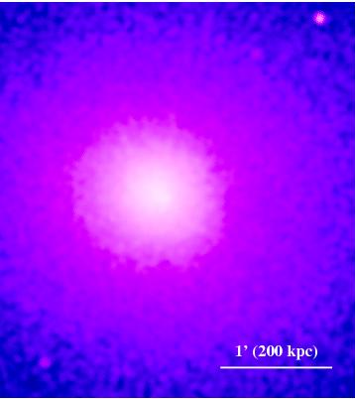
Galaxy Clusters
Galaxy clusters are most often associated with their optical richness
Abell 1689
X-ray (0.5-2.5 keV)
Optical Hubble Image

Slide 23
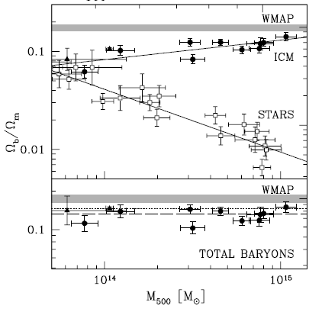
Cluster Gas in X-rays
To produce the high X-ray luminosities observed, the total mass contained in the gas should be extremely high (M_{gas}~10¹³-10¹⁴ M⨀)
~70% of the luminous mass in clusters is in this form
Gonzales et al. (2007)

Slide 24
Outline
Background
  Galaxy Clusters and X-rays
Gas Sloshing
Merger histories of Abell 1644 and RXJ1347.5-1145
Sloshing in a flux limited sample of cluster beyond Coma
Conclusions

Slide 25

Gas Sloshing
Sloshing occurs when a cluster’s gas is perturbed

Slide 26
Characteristics of Sloshing
Simulations allow different viewing angles
  unique morphology depends on inclination

Slide 27
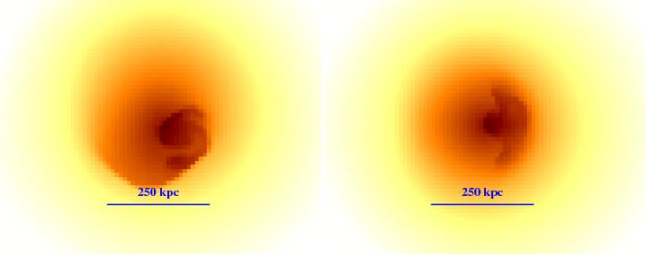
Characteristics of Sloshing
Simulations allow different viewing angles
  unique morphology depends on inclination

Slide 28
Characteristics of Sloshing
Time evolution of cold fronts (radial/azimuthal motion)

Slide 29
Characteristics of Sloshing
Number of edges, and their radial distance can tell us when the merger occurred

Slide 30
Neat pictures… so what?
One of the foundations of modern cosmology is the idea that the universe began in a “big bang”
Since then, gravity has goverened the build up of matter through mergers of small systems to create larger ones
If the rate at which various systems merge could be observationally determined, a constraint could be placed on how fast they grow

Slide 31
Neat pictures… so what?
My thesis uses simulations and observations of sloshing to determine the merger histories of clusters

Slide 32
Outline
Background
  Galaxy Clusters and X-rays
Gas Sloshing
Merger histories of Abell 1644 and RXJ1347.5-1145
Sloshing in a flux limited sample of clusters beyond Coma
Conclusions

Slide 33
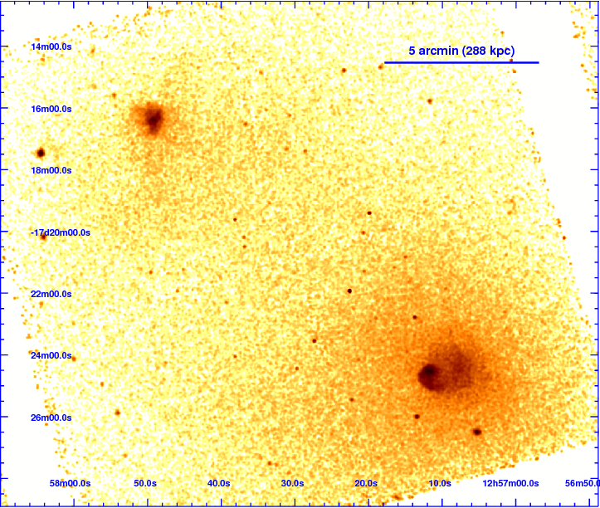
Abell 1644
(Johnson et al., 2010, ApJ, 710, 1776)

Slide 34
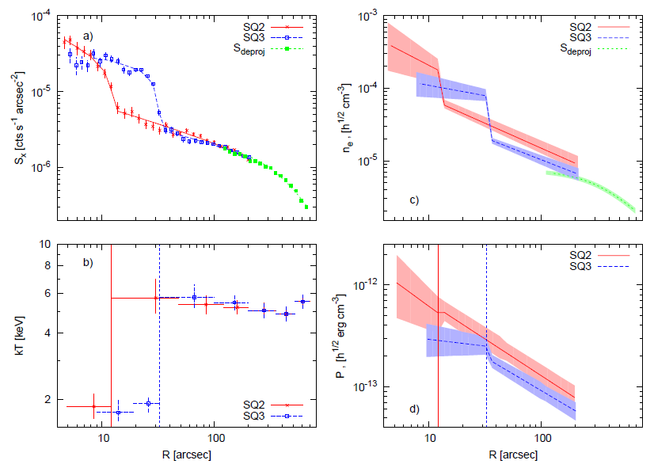
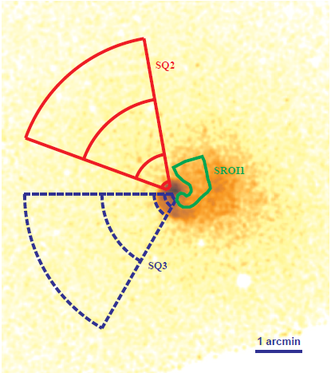
Abell 1644
(Johnson et al., 2010, ApJ, 710, 1776)

Slide 35
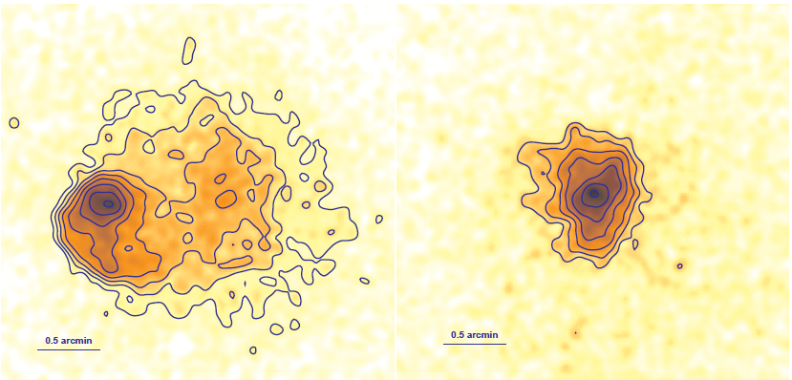
Abell 1644
X-ray morphology informs us about interaction history (spiral morphology in A1644-S, isophotal compression in A1644-N)

Slide 36
Abell 1644
The location of the companion along with sloshing constrains the merger

Slide 37
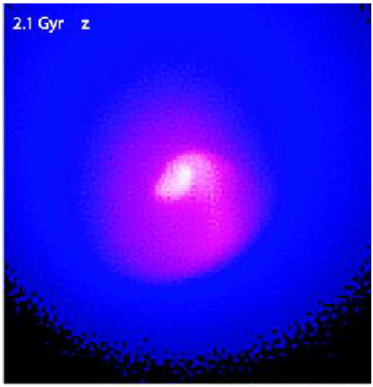
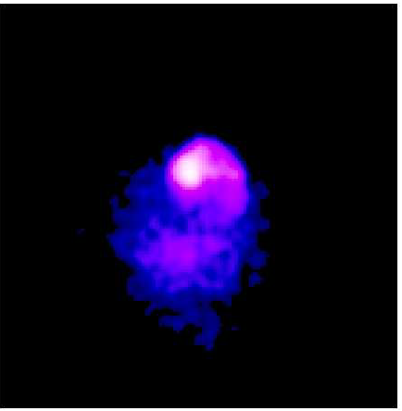
Abell 1644
The location of the companion along with sloshing constrains the merger
Sloshing predicts ~600 Myr ago, and the location of the subcluster, ~750 Myr ago

Slide 38
Abell 1644
(Johnson et al., 2010, ApJ, 710, 1776)

Slide 39
Thanks!

Slide 41
Comparison With XMM
Ghizzardi et al. 2010 examined CFs in the B55 sample (Edge et al. 1990)
Found that 19/45 clusters had cold fronts
Normalizing our sample and theirs changes this to: 9/30 for XMM-Newton 9/17 clusters have CFs with Chandra
Difference is primarily due to selection of CC clusters, and detection efficiency of fronts

Slide 42
Future Work
RXJ1347 paper to be submitted in June
Expand flux limited sample (e.g. A2204, A4059), look for perturbers (paper submitted by August)
Use higher resolution simulations (already in hand) to measure density/temperature contrasts over time

Slide 43
The Impulse Approximation
If the crossing times for objects (galaxies, DM particles) is much greater than the crossing time for the interaction, then the impulse approximation holds
t_{enc} ~ 100 kpc / 3.5 kpc Myr⁻¹ ~ 30 Myr
t_{i} ~ 600 kpc / 1 kpc Myr⁻¹ ~ 600 Myr
Impulse approximation holds

Slide 44
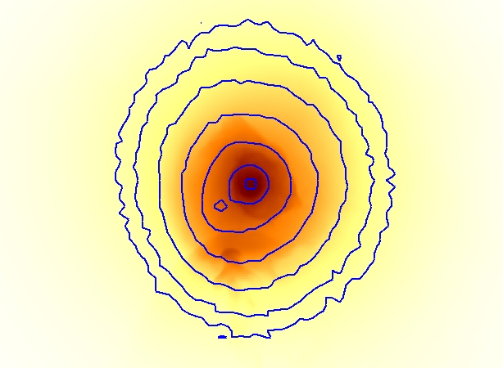
The Merger History of
RXJ1347.5-1145
Comparison with simulations

Slide 45
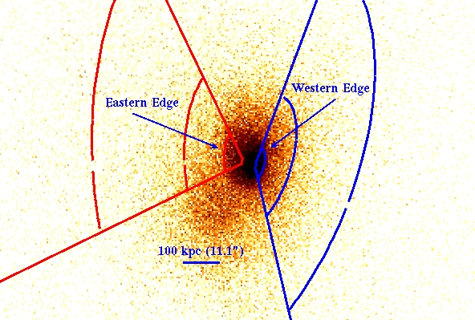
The Merger History of
RXJ1347.5-1145
Observing sloshing in the core makes interpretation of its merger history possible

Slide 46
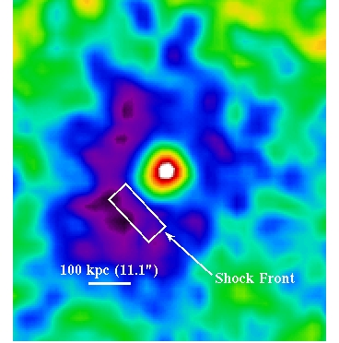
The Merger History of
RXJ1347.5-1145
High pressure ridge between cluster and subcluster

Slide 47
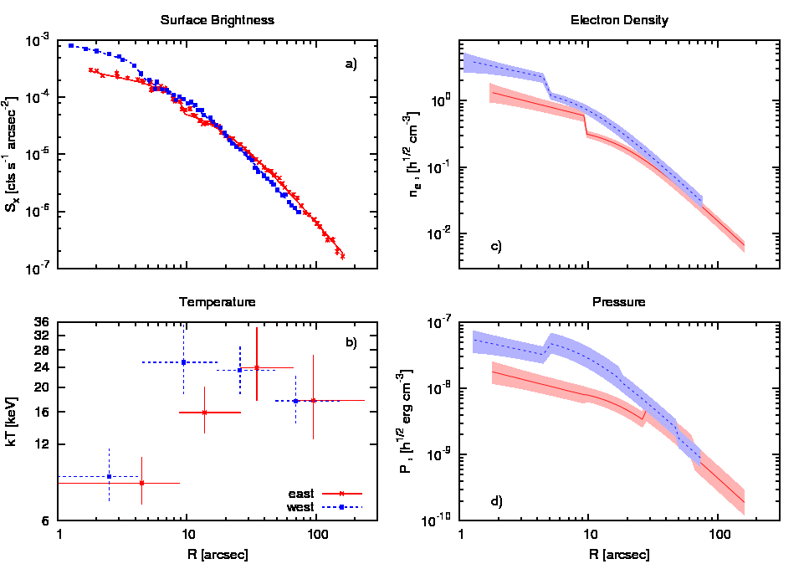
The Merger History of
RXJ1347.5-1145
Cold front identification

Slide 48
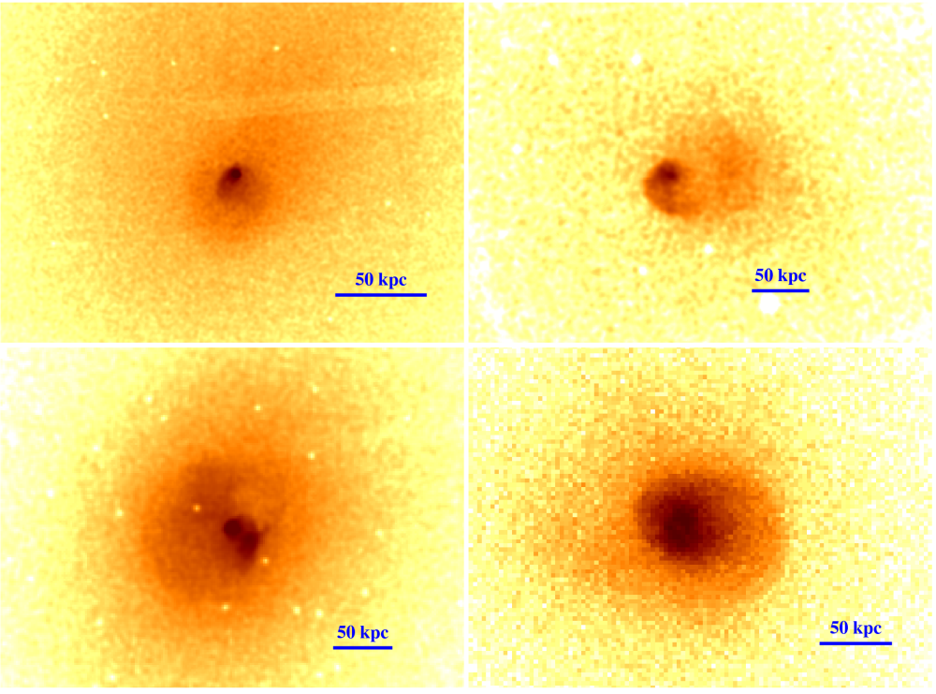
Gas Sloshing
Sloshing occurs when a cluster is gravitationally perturbed
Hydro simulations
Sharp edges in S_{X}
Cold fronts

Slide 49

Putting Things in Perspective
Scales in the Universe
Size: | Miles | Light years
Solar System | 2.5 x 10⁹ | 0.0004
Proxima Centauri | 2.6 x 10¹³ | 4.5
Local Bubble | 1.8 x 10¹⁵ | 300
Milky Way | 5.9 x 10¹⁸ | 10⁶
Local Group of Galaxies | 1.5 x 10¹⁹ | 2.5 x 10⁶
Local Super Cluster of Galaxies | 1.2 x 10²⁰ | 2 x 10⁷

Slide 50
RXJ1347.5-1145: Comparison with Simulations
Comparison of collisionless (dark) matter

Slide 51
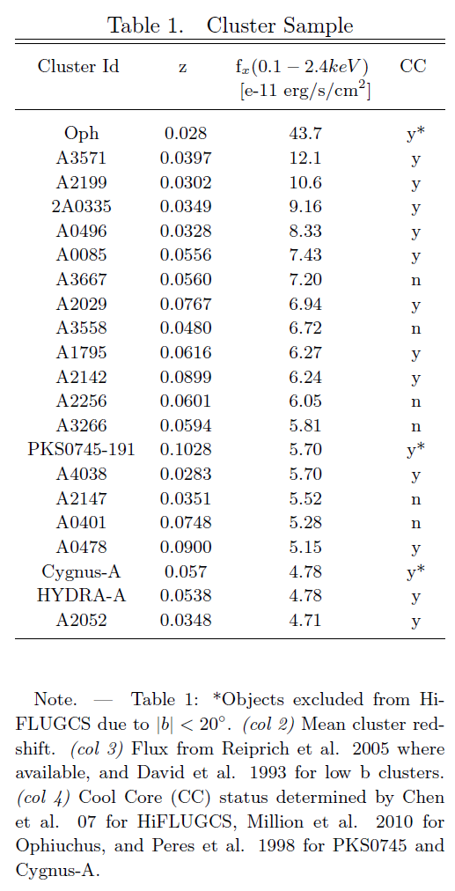
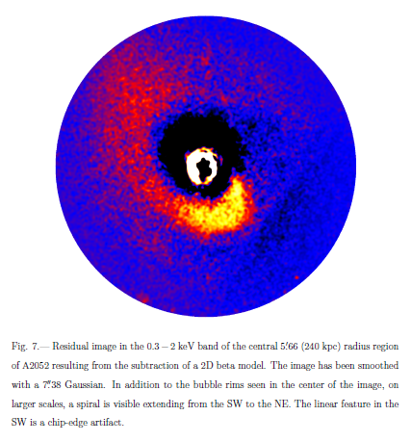
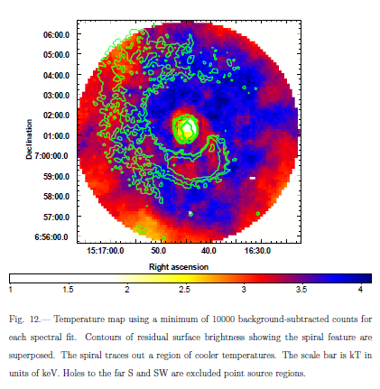
Flux Limited Sample
The remainder have CC but no sloshing
Abell 2052
  Blanton et al. 2011

Slide 52
Flux Limited Sample
The remainder have CC but no sloshing
Abell 2052
  Blanton et al. 2011

Slide 53
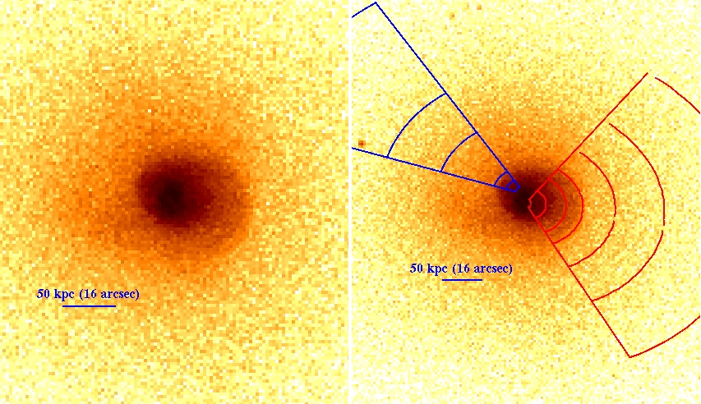
Characteristics of Sloshing
The sloshing cluster Abell 2204
  jump in radial T, drop in radial S_{x} (∝ρ²)

Slide 54
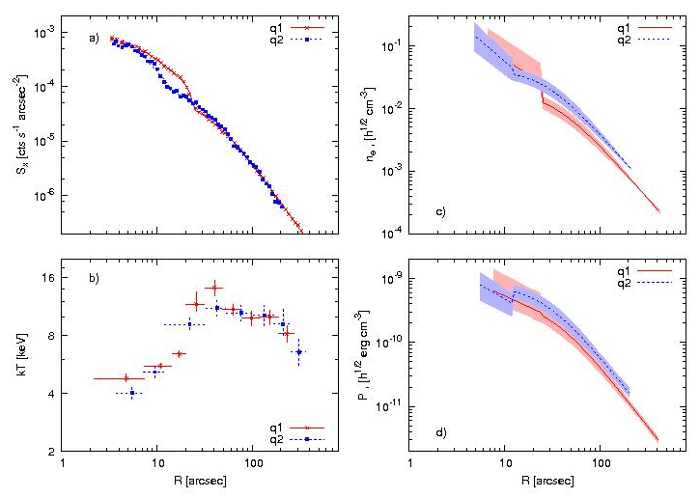
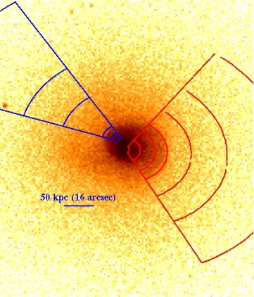
Radial Profiles

Slide 55

Hydrostatic Equilibrium
That we see this gas associated with nearly every galaxy cluster means they must be stable over time (Newton’s First Law)
Because we know that gravity attracts all matter, there must be an opposing force keeping the gas from collapsing → outward gas pressure

Slide 56
Galaxy Clusters
Optically resemble dense groupings of galaxies
Tens of galaxies in a group, hundreds to thousands of galaxies in a cluster
Spirals and ellipticals
Abell 1689

Slide 57
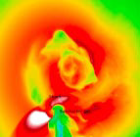
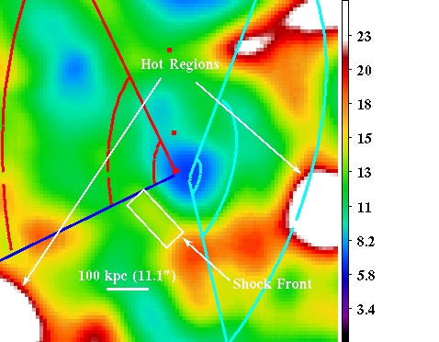
RXJ1347.5-1145
Temperature Comparison

Slide 58

Deviations from HE
Hydrostatic Equilibrium
Written another way, deviations from HE can be viewed as an acceleration term
Deviations from hydrostatic equilibrium imply motion (turbulent, bulk, magnetic)

Slide 59
Comparison With Simulations
1 kpc box size
initial conditions:
  Hernquist DM profile
  Gas profile from HE
  M = 2e15 M⨀
  A2029

Slide 60
Hot Gas In Clusters
Most luminous matter in galaxy clusters is in the ICM
Large scales → relaxed
High resolution images show cluster cores have edges in S_{x}
  caused by AGN outbursts, bulk motion induced by gravitational perturbation (“sloshing”)

Slide 61
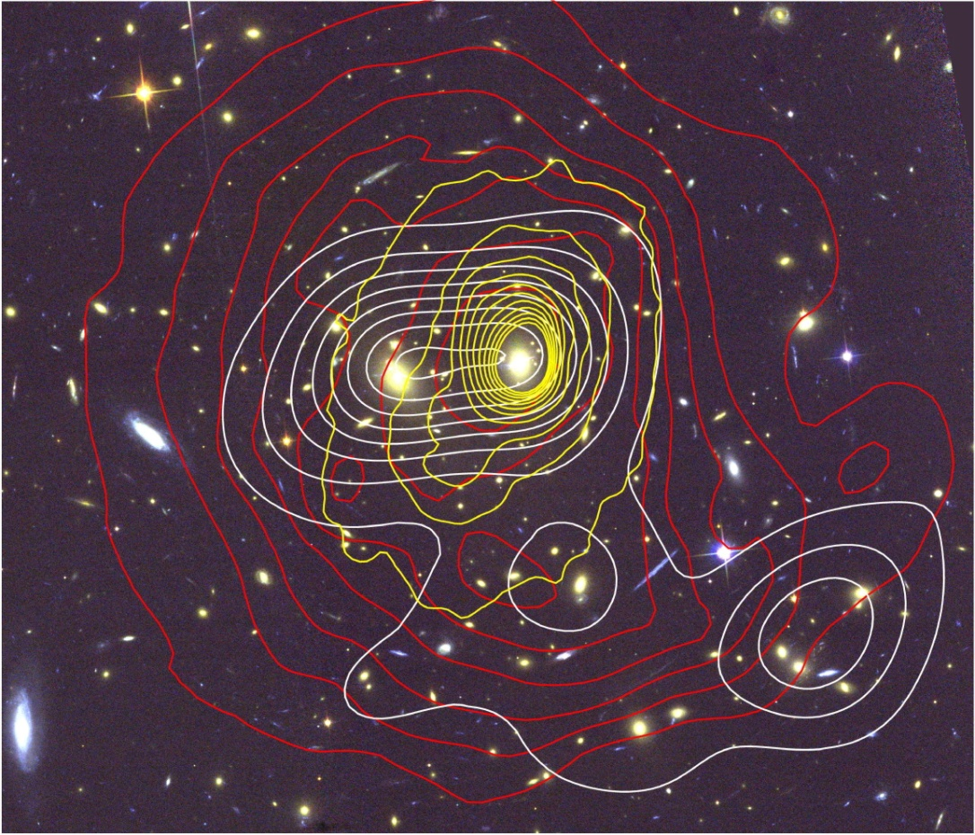
The Merger History of
RXJ1347.5-1145
Unique morphology, and extensive multiwavelength coverage

Slide 62
Cluster Gas in X-rays
So the ICM both rarefied and very hot
The low ICM is upwards of 70% of luminous (i.e. not dark) mass
Cool cores and the “cooling flow problem”
How do we know this?

Slide 63
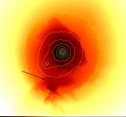
The Merger History of
RXJ1347.5-1145
Comparison with simulations

Slide 64
Flux Limited Sample
Of the CC clusters, we find 9 which possess sloshing type cold fronts

Slide 65
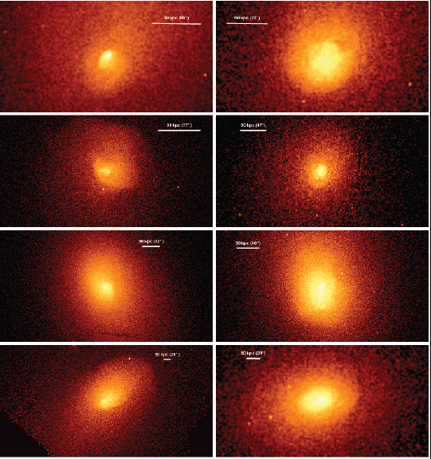
Flux limited Sample of Clusters
Using a complete sample, we find that the majority of clusters possess this sloshing gas
Requires high resolution instruments

Slide 66
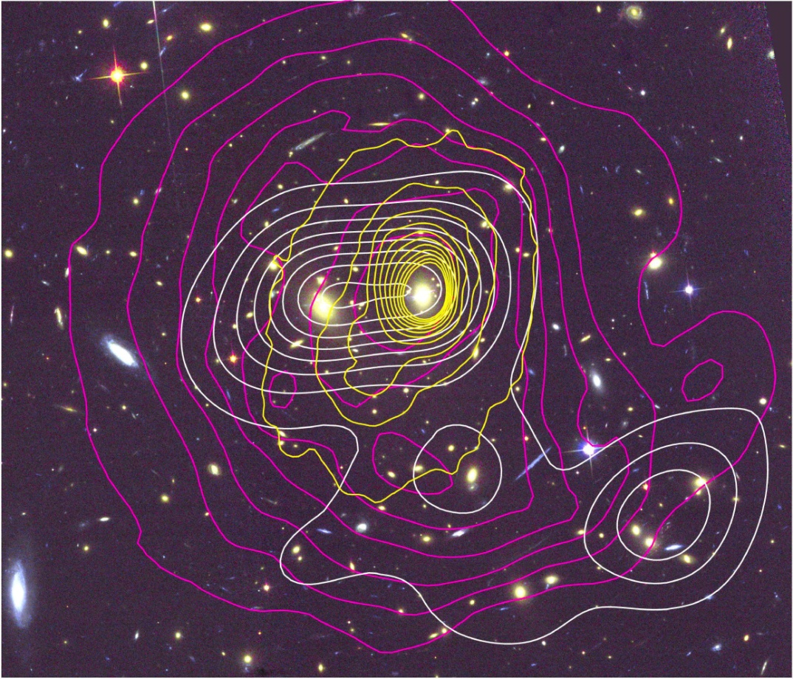
The Merger History of
RXJ1347.5-1145
Unique morphology, and extensive multiwavelength coverage

Slide 67
Gravity Produces Structure
Although the distributions look different, they both reflect the cluster’s gravitational potential
Abell 1689
X-ray (0.5-2.5 keV)
Optical Hubble Image

Slide 68
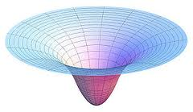
Gravity Produces Structure
In equilibrium, the gas distribution should reflect the shape of the potential well
Abell 1689

Slide 69
Gravity Produces Structure
From X-ray observations, we can probe the total matter distribution in clusters
Abell 1689

Slide 70
Cluster Gas in X-rays
Emission due to thermal bremsstrahlung radiation ( ∝² and ∝T^{1/2}) and line emission
Gas temperatures of 2-10 keV (~10⁷ K), with shock regions up to ~20 keV
Measuring the brightness of clusters in X-rays allows estimates of the gas density, which is very low (~0.001 cm⁻³)

