Slide 1
Simulating the Cooling Flow of Cool-Core Clusters
Yuan Li
Advisor: Greg Bryan
Department of Astronomy, Columbia University
July 2011

Slide 2
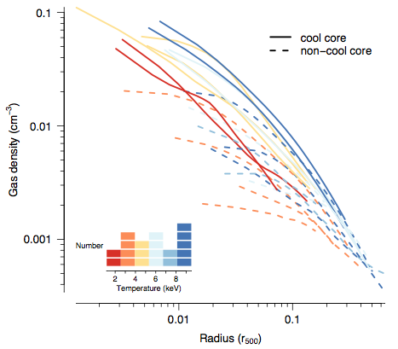
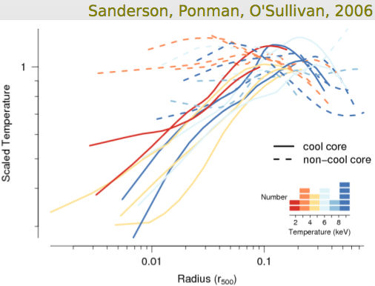
The Cooling Flow Problem
In Cool-Core Clusters: t_{cool} << Hubble Time
Steady state => Cooling flow
100s M_{sun} /yr >> SFR => Heating sources: AGN

Slide 3
Key Questions:
How cold gas cools out of the flow:
local or global?
The amount of cold gas produced
The rate of gas accretion on to a central SMBH
The lack of cool gas observed in X-rays
The impact of other processes (thermal conduction, Type Ia SN heating, etc) on the cooling instability
Will focus on heating in later work

Slide 4
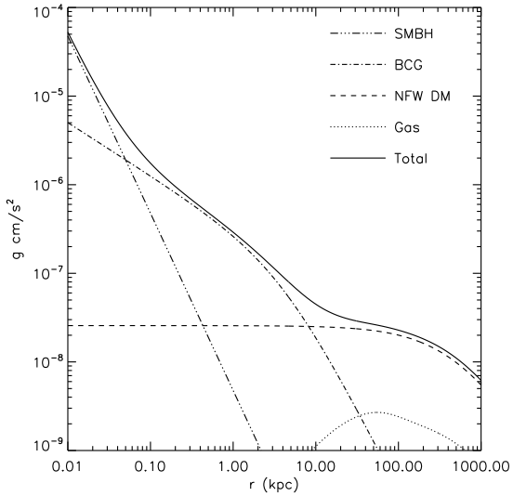
Simulation Setup
Enzo, an Adaptive Mesh Refinement (AMR) code: Mpc to pc scale (smallest cell: 2pc)
3D, spherical symmetric + rotation
An Isolated Cluster at z = 1
Comoving box size = 16 Mpc/h
NFW Dark Matter + BCG + SMBH + gas
Initial gas density and temperature: observations of Perseus Cluster
Initial pressure: HSE
Initial velocity: Gaussian random velocity + rotation
No feedback (yet)
Notes:
Gaussian random velocity with standard deviation ~ 200 km/s
Spin parameter: 0.05 = v/vc v~50 km/s
Refinement criterion: density, cooling time and Jeans length.
lmax=15, size=2pc
AMR we _can_ resolve the cooling gas for the first time, with resolution going from Mpc to pc scale

Slide 5
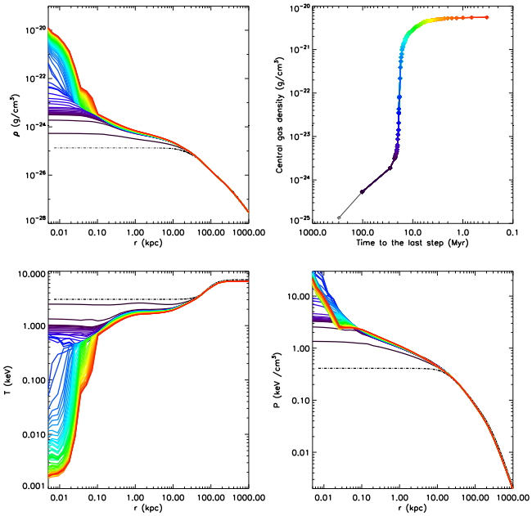
Results: Density Temperature and Pressure

Slide 6
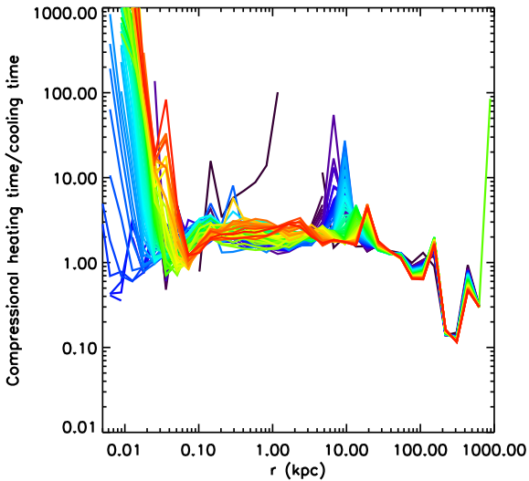
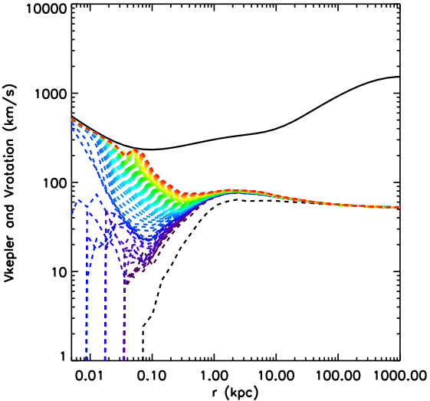
Compressional Heating / Cooling
Rotational Support

Slide 7
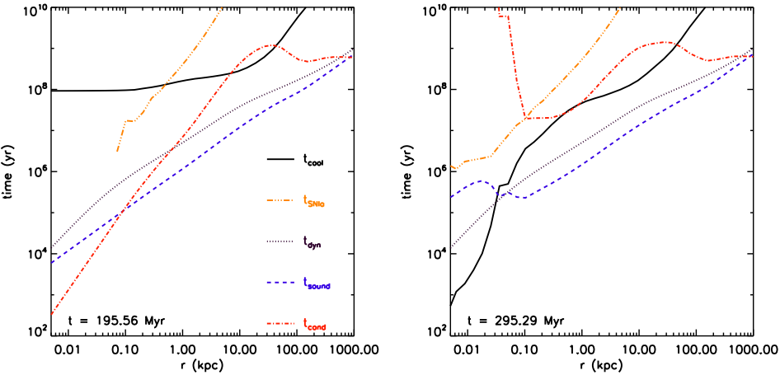
Results: Time-scales

Slide 8
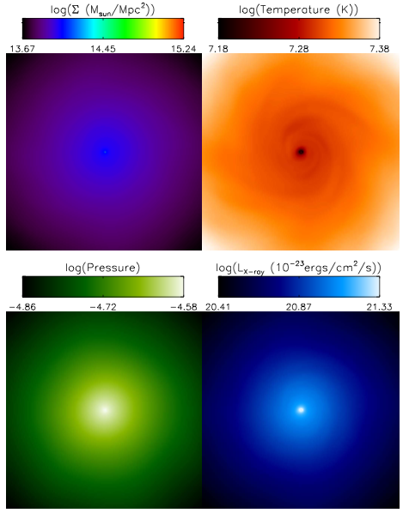
Projection-z
16.6 kpc
t=296 Myr
Notes:
296 Myr after the start
16 Myr after the instability

Slide 9
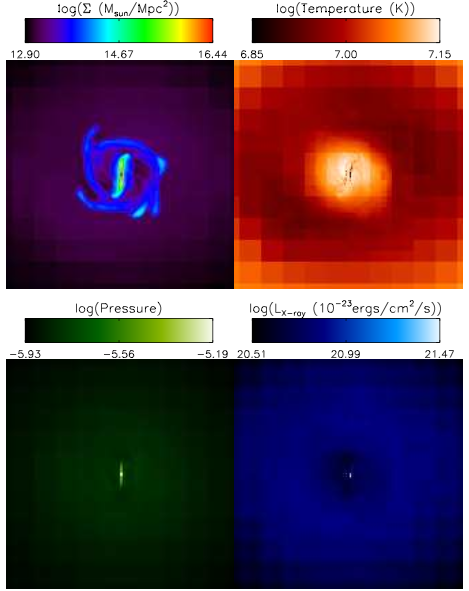
Projection-z
330 pc
t=296 Myr

Slide 10
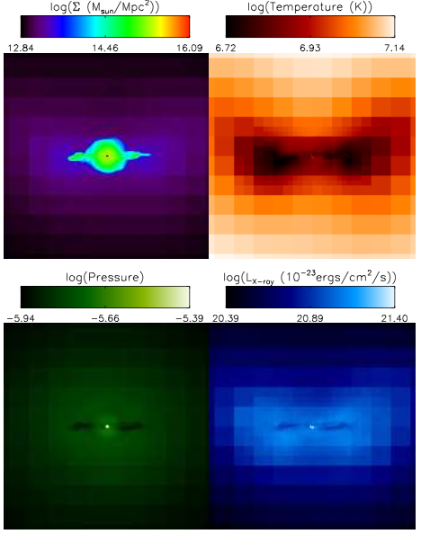
Projection-x
330 pc
t=296 Myr

Slide 11
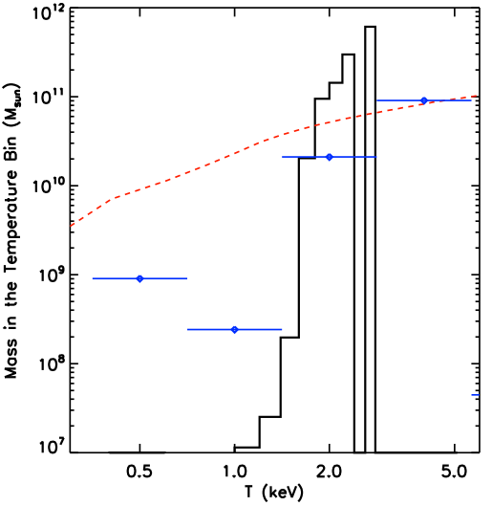
Results: The Amount of Cool Gas
Compared to Observations

Slide 12
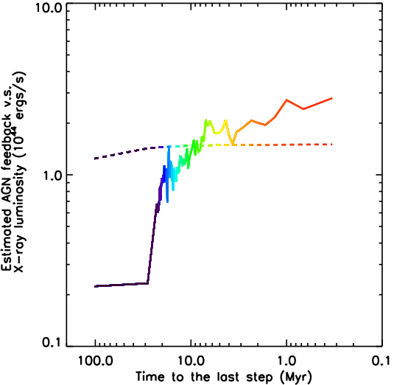
Results: Estimated AGN Feedback
Notes:
Classic cooling flow after a few hundred Myr

Slide 13
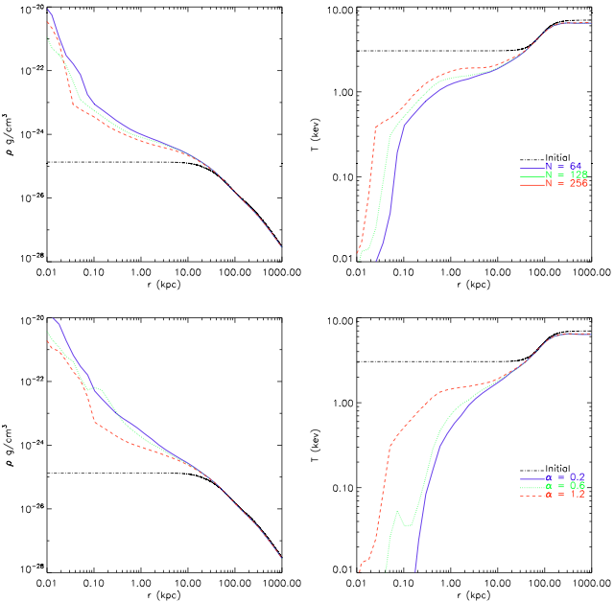
Results: Impact of Resolution

Slide 14
Conclusion
A global cooling catastrophe occurs first at a transition radius of about 50 pc from the SMBH
The temperature profile remains remarkably flat as the cluster core cools
There is a distinct lack of gas below a few keV
Local thermal instabilities do not grow outside the transition radius
Thermal conduction and Type Ia SN heating are not important
The final result is sensitive to the presence of the BCG and the resolution of the simulation
Next step: including feedback

Slide 16
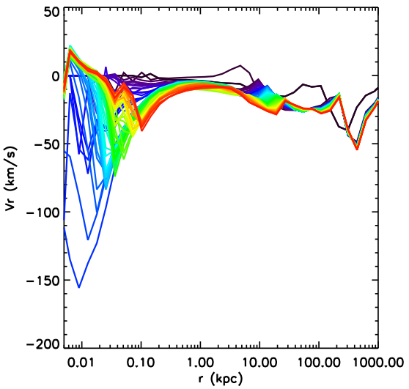
Results: Gas Inflow Velocity

Slide 17
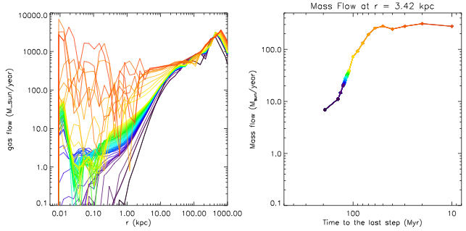
Classic Cooling Flow

