Slide 1
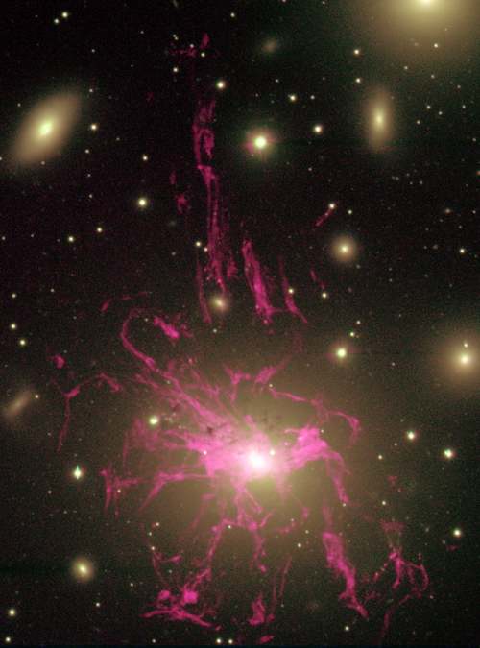
Velocity Field of the Optical Nebula at the Center of the Perseus Cluster
Hα (red) on optical continuum
Jeremy Lim (University of Hong Kong)
*Jeffrey Chan (University of Hong Kong)
Youichi Ohyama (ASIAA)
*I-Ting Ho (University of Hawaii)
*graduate students
30˝
(10.8 kpc)
NGC 1275
Conselice+01

Slide 2
Velocity Field of the Optical Nebula at the Center of the Perseus Cluster
Luminous optical nebulae preferentially found at centers of cool-core clusters. That associated with the central giant elliptical galaxy of the Perseus cluster, NGC 1275, particularly bright and extended.
Nature of Nebula: - composition? - excitation? - origin? - fate?
Hα (red) on optical continuum
30˝
(10.8 kpc)
NGC 1275
Conselice+01
Notes:
We know that this nebula is multiphase, containing molecular, atomic, and ionized gas that is so hot that it can be detected in X-rays.
What we don’t know so well is the mass composition, at this requires understanding how the nebula is excited.
My talk will focus on how this nebula is produced.
Although the role of this nebula in forming stars and possibly fueling the AGN in NGC 1275 also are interesting questions.

Slide 3
Velocity Field of the Optical Nebula at the Center of the Perseus Cluster
Luminous optical nebulae preferentially found at centers of cool-core clusters. That associated with the central giant elliptical galaxy of the Perseus cluster, NGC 1275, particularly bright and extended.
Nature of Nebula: - composition? - excitation? - origin? - fate?
Models have relied mainly on nebular morphology, together with velocity field for selected filaments only.
Hα (red) on optical continuum
30˝
(10.8 kpc)
NGC 1275
Conselice+01
Notes:
For far too long models for how this nebula is produced have relied mainly on its observed morphology, with limited information on its velocity field.

Slide 4
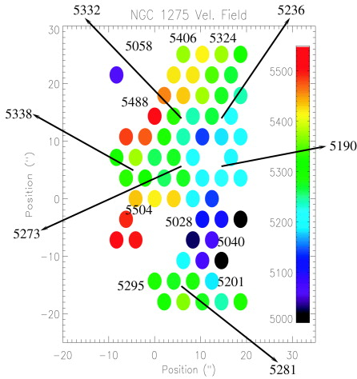
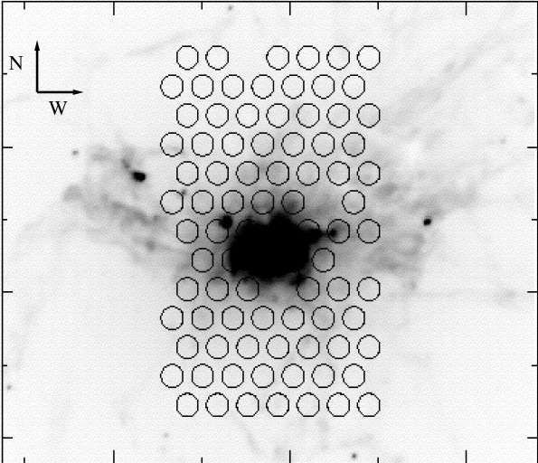
Velocity Field of Inner Nebula
Velocity field of inner nebula measured using DENSEPAK on WIYN 3.5-m.
Hα (red) on optical continuum
30˝
(10.8 kpc)
Conselice+01
Conselice+01
Notes:
The velocity of the inner region has been measured with sparse spatial coverage using an IFU.

Slide 5
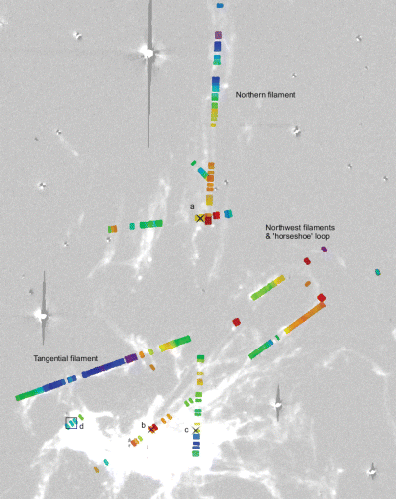
Filament Kinematics in Outer Nebula
Kinematics of selected filaments in outer nebula measured using slit spectroscopy.
Hα (red) on optical continuum
30˝
(10.8 kpc)
Hatch+06
Conselice+01
Notes:
The kinematics of selected filaments in the outer nebula have been measured using slit spectroscopy.

Slide 6
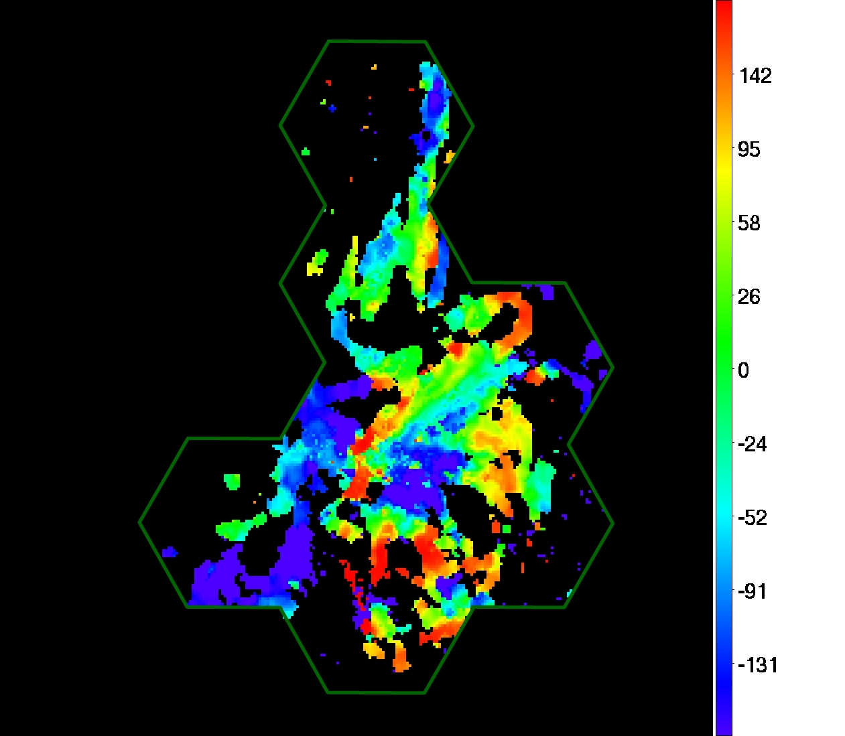
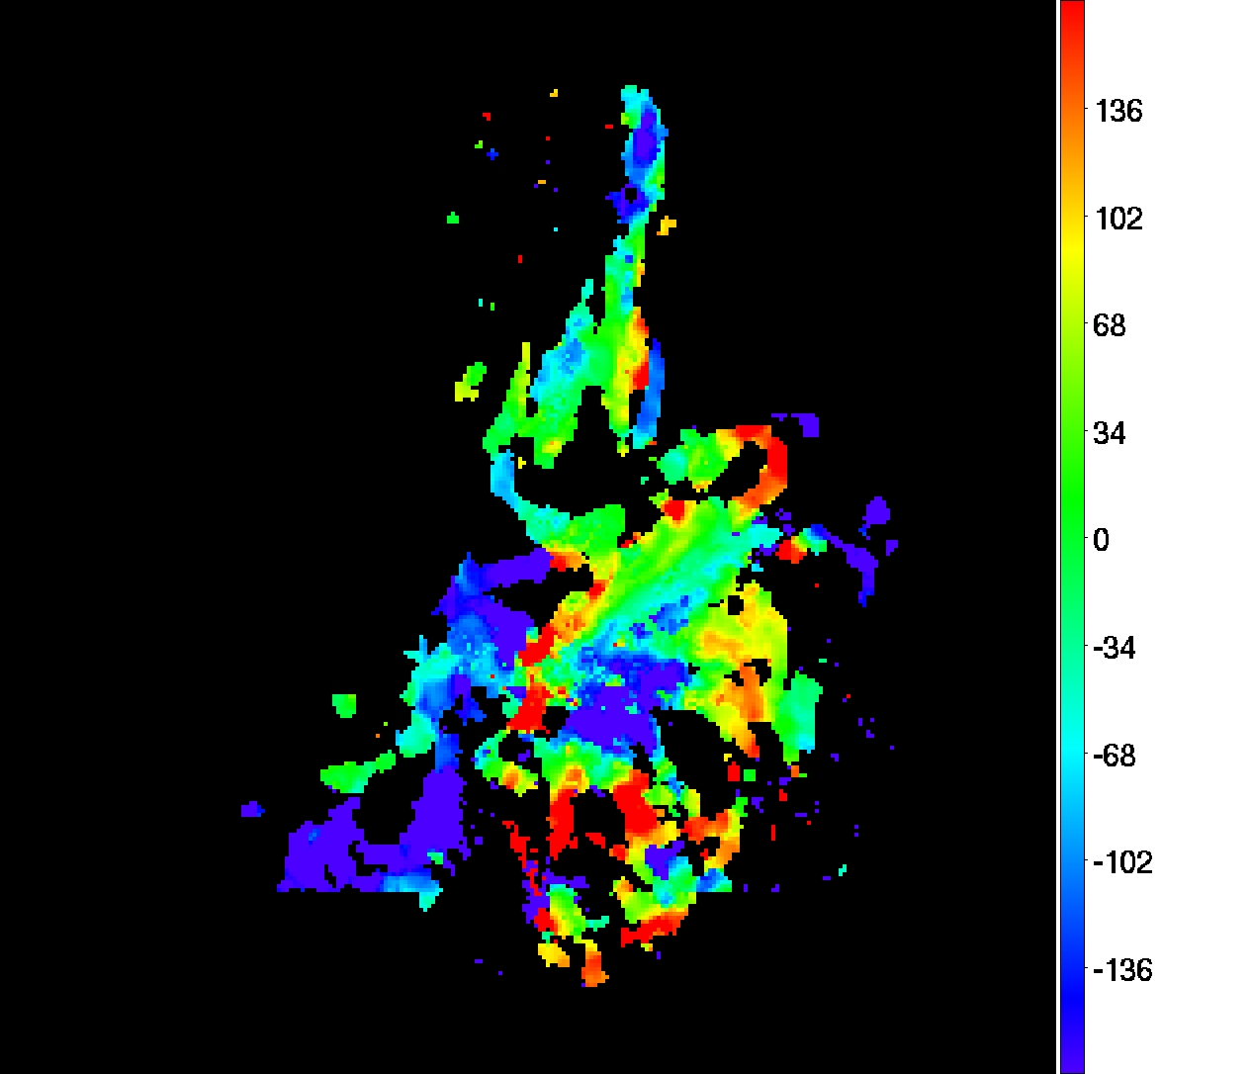
Velocity Field of Entire Nebula
Velocity field at 2.8″ and 125 km/s resolution using PPAK on Calar Alto 3.5-m.
Hα (red) on optical continuum
30˝
(10.8 kpc)
Relative Velocity (km/s)
Conselice+01
Notes:
Today, we present for the first time the velocity field of the entire nebula taken with an fiber-fed integrated field unit on the 3.5-m telescope at Calar Alto.
This IFU is able to cover a large patch of the sky at the time, although we still required 7 pointings to cover the region shown here as indicated by the hexagonal patches. The reduction is in the final stage, although there are a small things we have to clean up like these spots here and here. These are noise peaks caused by the uneven noise distribution in the map.
The color indicates the central velocity of the Halpha line, with green spanning the systemic velocity and yellow and red indicating redshifted velocities, whereas light to dark blue indicates blueshifted velocities.
The instrumental angular resolution is 2.8” and velocity resolution is 125 km/s. Because the Halpha line is very broad throughout the nebula, we can measure the line center to an order of magnitude better precision than the instrumental resolution.

Slide 7
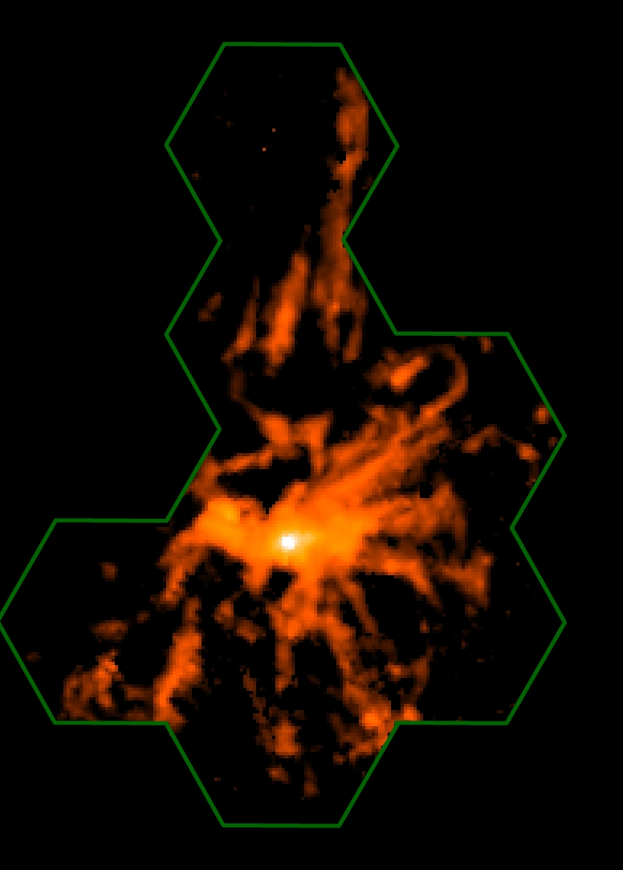
Velocity Field of Entire Nebula
Velocity field at 2.8″ and 125 km/s resolution using PPAK on Calar Alto 3.5-m.
Hα (red) on optical continuum
30˝
(10.8 kpc)
Relative Velocity (km/s)
Conselice+01
Notes:
And here is the integrated line intensity. As you can see, we covered nearly the entire nebula, and would like to cover the remaining few filaments not observed.

Slide 8
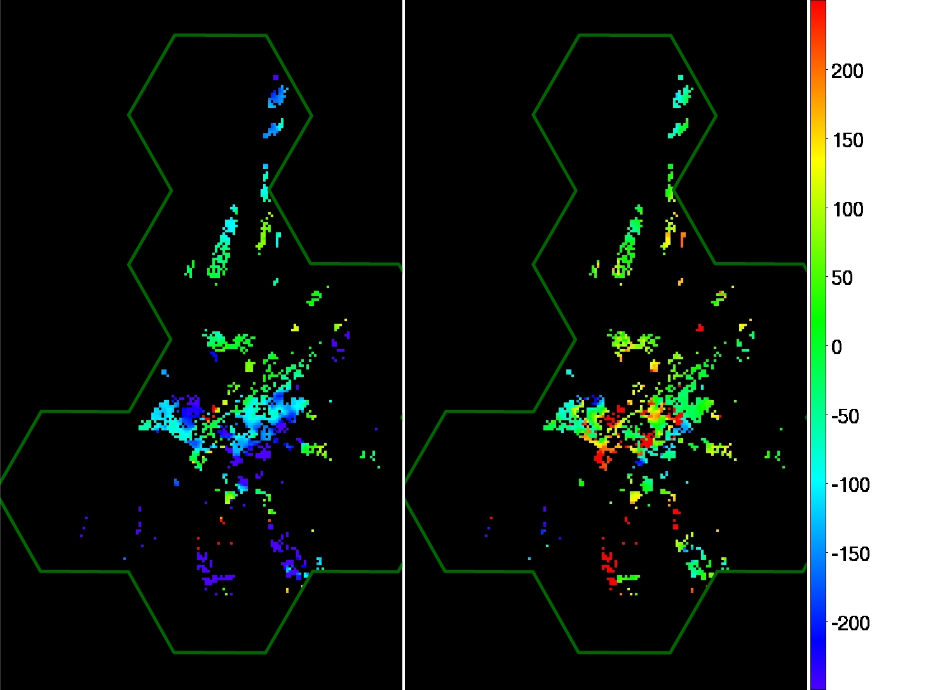
Velocity Field of Entire Nebula
Parts of nebula have multi-velocity components (multiple filaments in resolution element, multiple filaments along line-of-sight, broad+narrow components).
2-Component Fit to Velocity Field
Relative Velocity (km/s)
Notes:
Parts of the nebula have two or even three velocity components, due either to multiple filaments in a resolution element, filaments that overlap along the line or sight, or those having a markedly non-Gaussian velocity profile.
The velocity field I showed you before corresponds to the strongest of the multiple components.
Here I show you regions where there are at least two velocity components.
For example, parts of the northern filament have a broad and narrow component with comparable central velocities.
Large swaths of this large loop to the south have two distinct velocity components, one of which is blueshifted and the other redshifted.

Slide 9
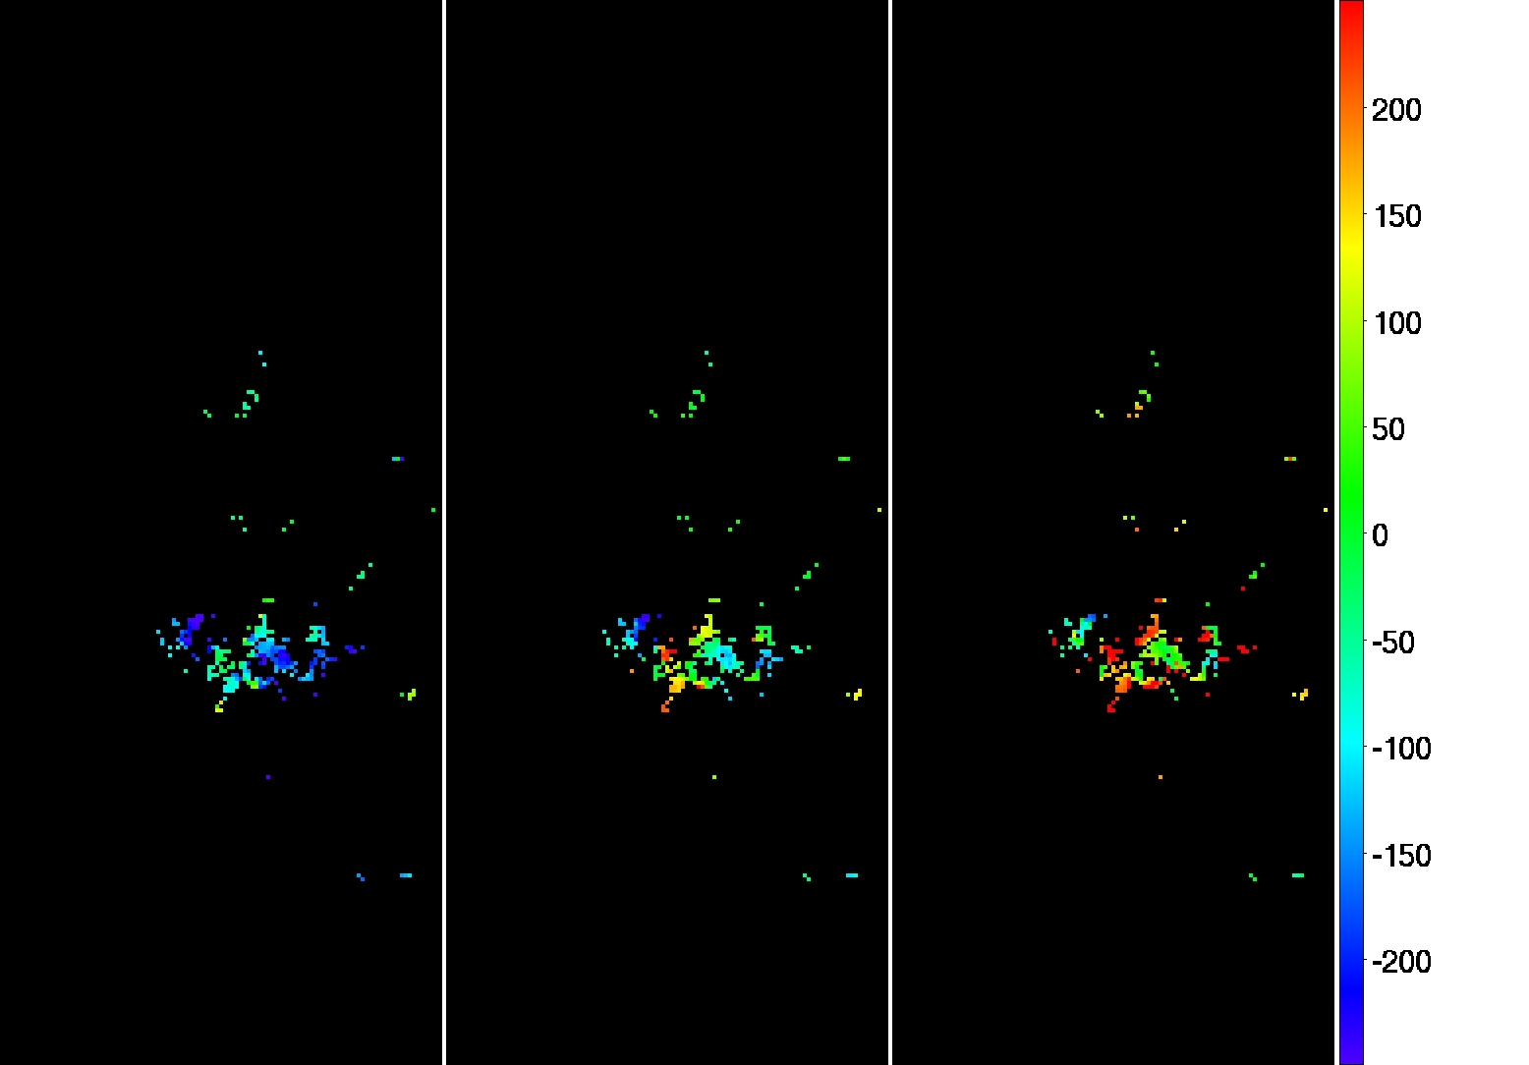
Velocity Field of Entire Nebula
Parts of nebula have multi-velocity components (multiple filaments in resolution element, multiple filaments along line-of-sight, broad+narrow components).
3-Component Fit to Velocity Field
Notes:
Parts of the inner region of the nebula require three velocity components.
This is due largely to overlapping filaments.
As you can see, none of these velocity components actually trace out a complete filament, indicating that we see multiple velocity components where the filaments happen to cross each other along the line of sight.

Slide 10
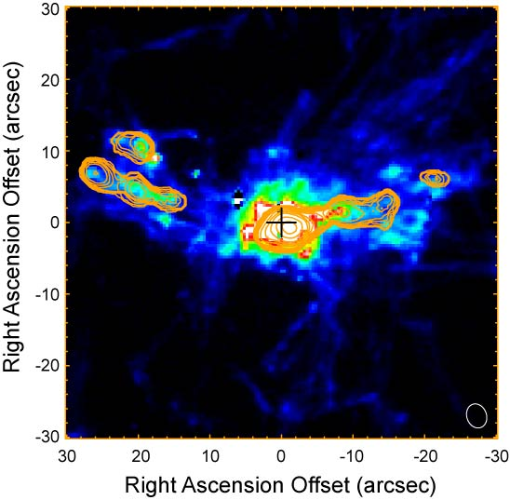
Filament Kinematics in Inner Nebula
SMA map of molecular gas in inner region of nebula as traced in CO.
Hα (red) on optical continuum
CO(2-1) intensity contours on Hα color
30˝
(10.8 kpc)
Ho+08
Conselice+01
Notes:
The kinematics of the brightest filaments in the inner region of the nebula have been well studied in cool molecular gas as traced in CO.

Slide 11
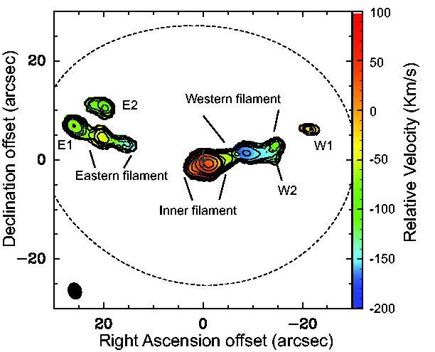
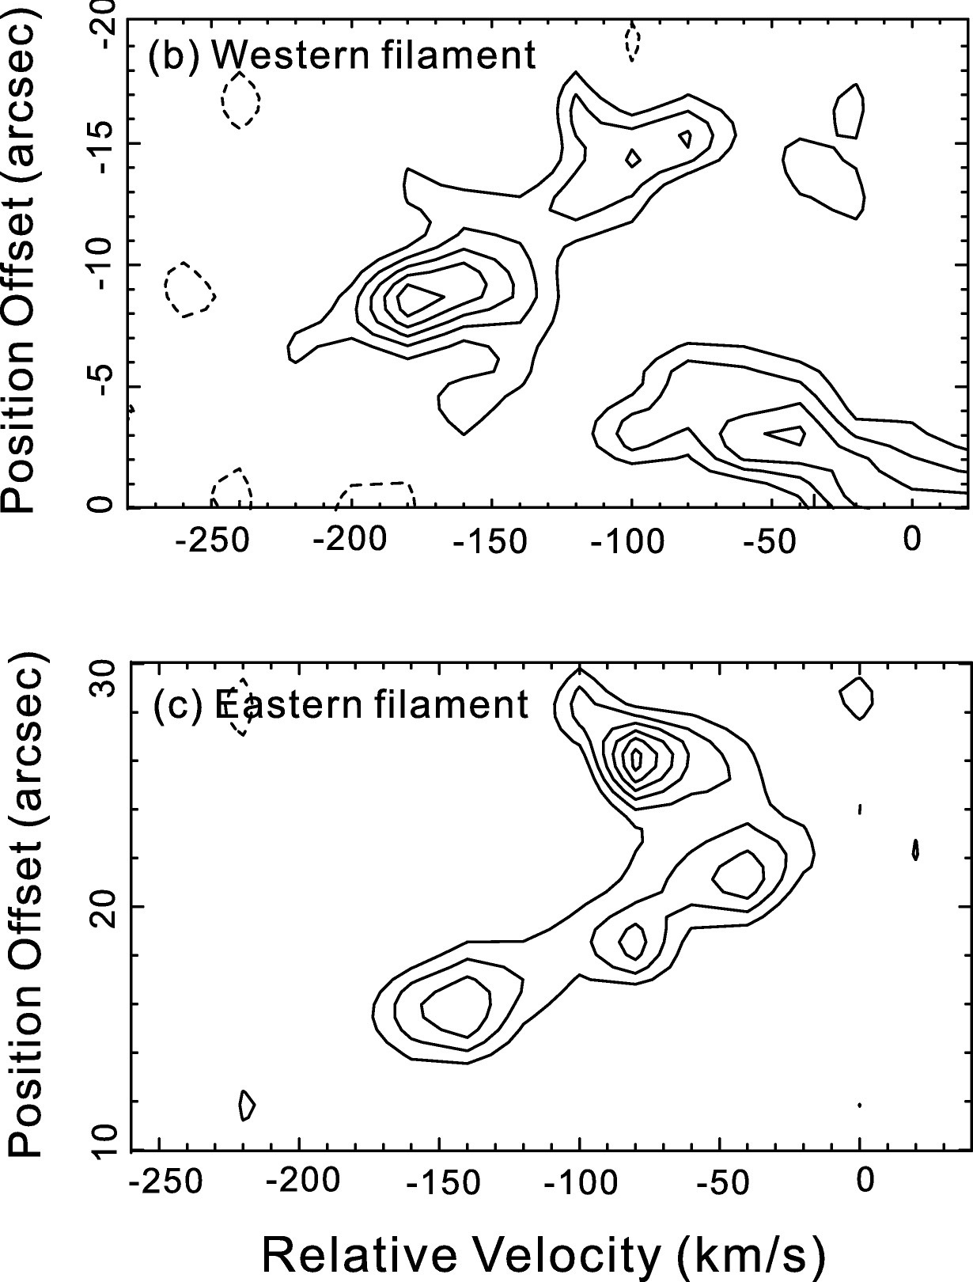
Filament Kinematics in Inner Nebula
Western and Eastern filaments exhibit linearly increasing blueshifted velocities with decreasing radius.
CO(2-1) intensity contours on velocity field
CO(2-1) Position-Velocity Diagrams
Inner filament
+
E1
1 kpc
Ho+09
Lim+08
Notes:
We found that the Eastern and Western filaments increase linearly in blueshifted velocities with decreasing radius.

Slide 12
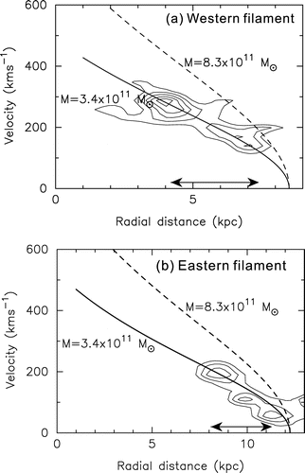
Filament Dynamics in Inner Nebula
Such a linear increase in blueshifted velocities with decreasing radius is characteristic of free-fall in the gravitational potential of an elliptical galaxy.
CO(2-1) Position-Velocity Diagrams
Inner filament
E1
Lim+08
Notes:
Such a linear increase in blueshifted velocities with decreasing radius is characteristic of free-fall in the gravitational potential of an elliptical galaxy.
For example, the solid and dashed lines in this panel indicates how the velocity of a test particle would change if dropped from a radius of just beyond 8 kpc from the center, and in this panel at a radius of just beyond 11 kpc from center, for two different galaxy masses. In both cases, just beyond the starting point, the velocity of the test particles increase linearly with decreasing radius.
Here, the PV-diagrams have been deprojected for an inclination of ~45 deg.

Slide 13
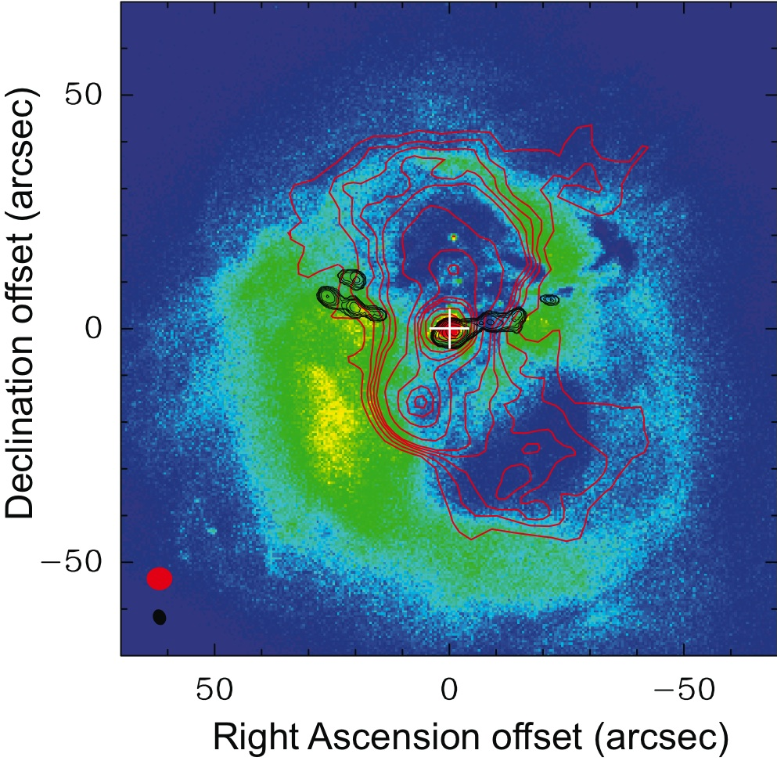
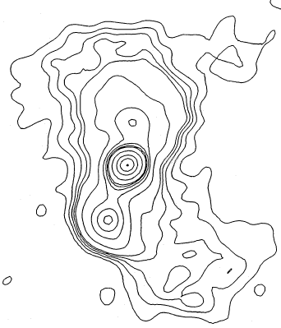
A Residual X-ray Cooling Flow?
Molecular filaments in inner nebula avoid radio jets, which together with their inferred dynamics suggest gas deposited by a residual X-ray cooling flow.
Hα (red) on optical continuum
30˝
(10.8 kpc)
X-ray in color
Radio jet
CO(2-1)
Heinz & Churazov 05
Conselice+01
Notes:
The molecular filaments in the inner nebula avoid the radio jets from the AGN in NGC 1275.
This, coupled with the fact that the filaments are in free fall, suggest that they have been produced by a residual X-ray cooling flow in the Perseus cluster.

Slide 14
Filament Kinematics in Outer Nebula
Kinematics of selected filaments in outer nebula measured using slit spectroscopy.
Hα (red) on optical continuum
30˝
(10.8 kpc)
Hatch+06
Conselice+01
Notes:
The filaments in the outer region of the nebula, however, may be produced in an entirely different manner.
Note that the longest filament, that towards the N, lies along the axis of the radio jet.
It has been proposed that many of the filaments in the outer nebula are dragged outwards by rising bubbles. Support for this idea has come from the kinematics of the N filament and the horseshoe loop measured using slit spectroscopy.

Slide 15
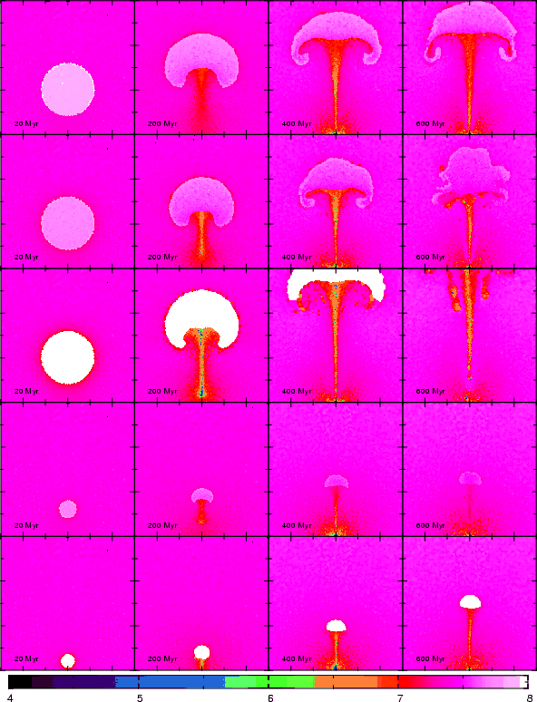
Outer Nebula Structured by Rising Bubbles?
Extended northern filament (bundle) dragged out by rising bubble?
Hα (red) on optical continuum
Revaz+08
30˝
(10.8 kpc)
Time
Conselice+01
Notes:
Here are the predictions of one such model, where the rising bubble is shown as a circle in the first column.
In this model, the N filament is the stem comprising material dragged outwards behind a rising bubble.

Slide 16
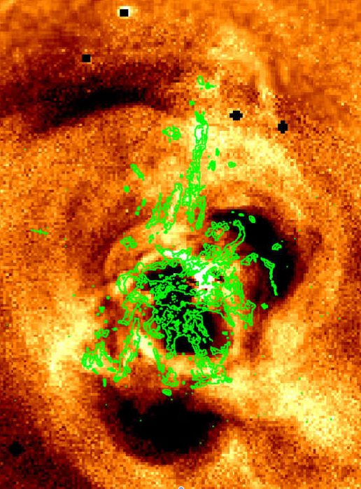
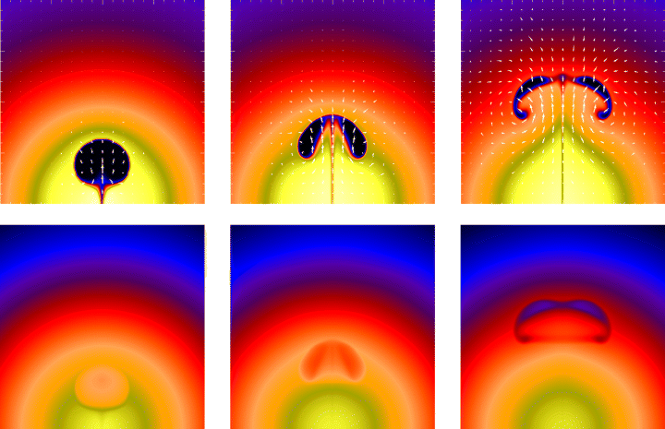
Outer Nebula Structured by Rising Bubbles?
Hα (green contours) on X-ray
Horseshoe loop comprises vortex behind rising bubble?
Flow pattern in viscous fluid containing rising bubble
Reynolds+05
Fabian+11
Notes:
The horseshoe loop is thought to be a vortex created by a rising bubble.
Indeed, the horseshoe loop lies just inwards of a huge bubble, and we can also see the other supposed vortex.

Slide 17
Outer Nebula Structured by Rising Bubbles?
Hα (green contours) on X-ray
Outer loops comprise vortices behind rising bubbles?
Flow pattern in viscous fluid containing rising bubble
Reynolds+05
Fabian+11

Slide 18
Outer Nebula Structured by Rising Bubbles?
Hα (green contours) on X-ray
Outer loops comprise vortices behind rising bubbles?
Flow pattern in viscous fluid containing rising bubble
Reynolds+05
Fabian+11
Notes:
The two loops towards the south also are located inwards of a large bubble, and may comprise vortices created by this bubble.

Slide 19
Kinematics of Northern Filament
Kinematics of Northern filament measured using slit spectroscopy.
Hα (red) on optical continuum
30˝
(10.8 kpc)
Hatch+06
Conselice+01
Notes:
Let us look more closely at the velocity field in these three regions, beginning with the N filament.

Slide 20
Velocity Field of Northern Filaments
Velocity field of Northern filaments measured using PPAK on the Calar Alto 3.5-m telescope.
Relative Velocity (km/s)
Hatch+06
Notes:
Here is a comparison of the velocity field measured using slit spectroscopy and that we measured.

Slide 21
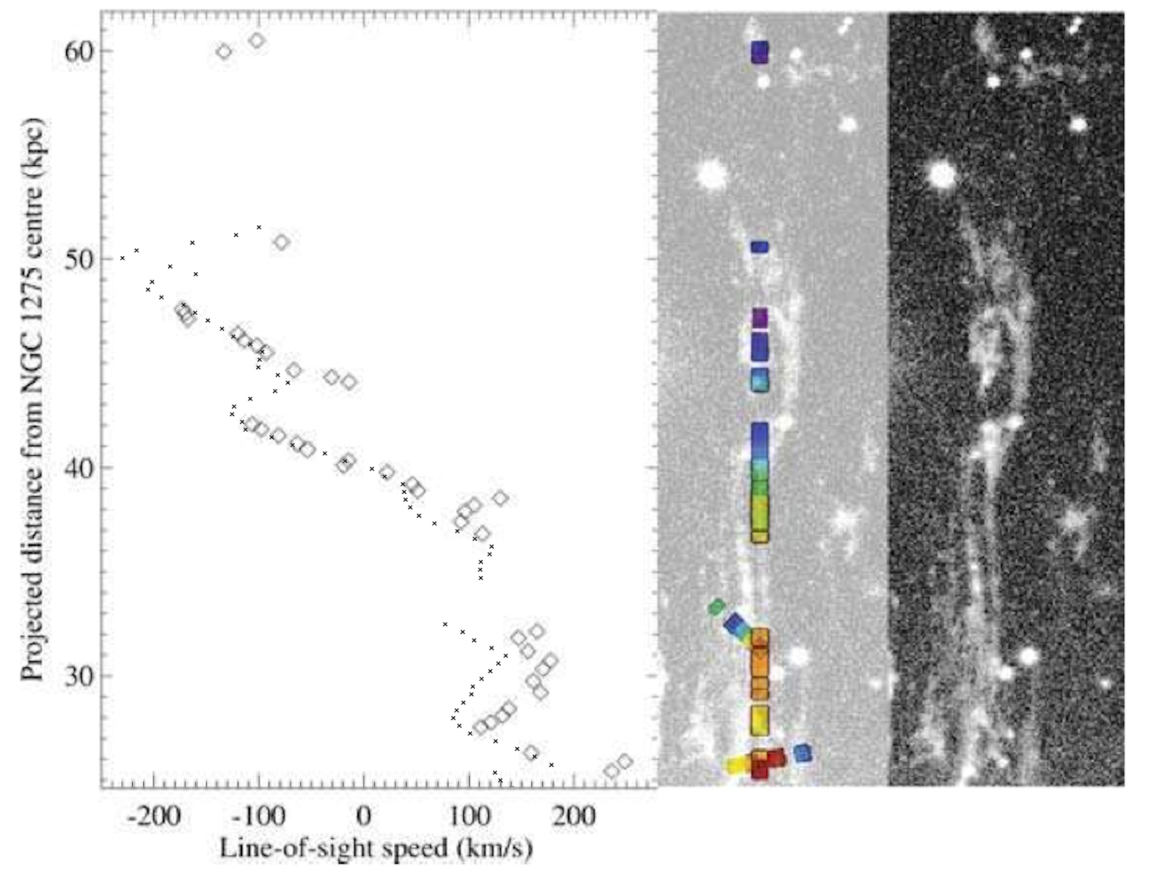
Kinematics of Northern Filament
Is Northern filament dragged outwards by a rising bubble?
30˝
(10.8 kpc)
Slit spectroscopy of northern filament
Hatch
Ours
Hatch+06
Conselice+01
Notes:
The diamonds here indicate the velocities at line center measured using slit spectroscopy, and the dots the velocities we measured for the same cut through the filament. As you can see, the two measurements are in excellent agreement, and also illustrate the high precision with which we can infer the line central velocity.
About halfway down this filament, the velocity flips from blueshifted to redshifted, consistent with the idea that the outer portion is being dragged outwards whereas the inner portion is falling back.
Notice that the slit passes through two different strands of the N filament.

Slide 22
Velocity Field of Northern Filaments
Are Northern filaments dragged outwards by a rising bubble?
30˝
(10.8 kpc)
Slit spectroscopy of northern filament
Hatch
Ours
Relative Velocity (km/s)
Hatch+06
Notes:
Here is the velocity field we measured for all the different strands of the N filament.
As you can see, the two strands differ in velocity by ~100 km/s along their lengths. This is very difficult to understand if the two strands are parts of the same overall filament.

Slide 23
Kinematics of Horseshoe Loop
Kinematics of selected filaments in outer nebula measured using slit spectroscopy.
Hα (red) on optical continuum
30˝
(10.8 kpc)
Hatch+06
Conselice+01
Notes:
Let us now turn to the kinematics of the horseshoe loop.

Slide 24
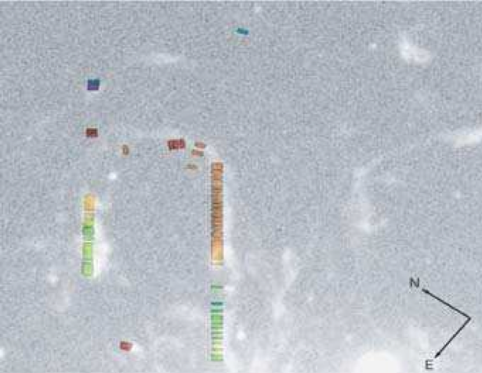
Kinematics of Horseshoe Loop
Hα (green contours) on X-ray
Is Horseshoe loop a vortex behind a rising bubble?
Kinematics of Horseshoe Filament
Hatch+06
Fabian+11
Notes:
Which you will recall is thought to be a vortex created by a rising bubble.

Slide 25
Kinematics of Horseshoe Loop
Is Horseshoe loop a vortex behind a rising bubble?
Flow pattern in viscous fluid containing rising bubble
Kinematics of Horseshoe Filament
Hatch+06
Reynolds+05
Notes:
The flow pattern is such that the highest velocities should occur on the inward side of the vortex, as is indeed seen.
You can see that the right part of the loop has higher redshifted velocities than the left.
Furthermore, the flow pattern in front of the bubble should be opposite to that behind the bubble, as is apparently the case as indicated by the blueshifted velocities here.

Slide 26
Velocity Field of Horseshoe Loops
Are Horseshoe loops vortices behind rising bubbles?
Flow pattern in viscous fluid containing rising bubble
Kinematics of Horseshoe Filament
Hatch+06
Reynolds+05
Relative Velocity (km/s)
Notes:
Here is our measured velocity field.
The velocity field we measured for the horseshoe loop is similar to that inferred from slit spectroscopy, where the right side reach higher redshifted velocities than the left side. Furthermore, we show clearly that the velocity field in front of the bubble is blueshifted.
On the other hand, the velocity field of the counterpart to the horseshoe loop is entirely different. Instead of increasing in redshifted velocities outwards, it increases in blueshifted velocities outwards, and reverses in velocity along its visible arm. If the horseshoe loop is a vortex, this makes it difficult to understand the velocity field of its counterpart in terms of a vortex.

Slide 27
Velocity Field of Southern Loops
Hα (green contours) on X-ray
Do Southern loops comprise vortices behind rising bubbles?
Velocity Field of Southern Loops
Reynolds+05
Relative Velocity (km/s)
Fabian+11
Notes:
Finally, we show for the first time the velocity field of the two southern loops.
These two loops have entirely different velocities. The loop on the left is blueshifted, whereas the loop on the right Is predominantly redshifted.

Slide 28
Velocity Field of Southern Loops
Do Southern loops comprise vortices behind rising bubbles?
2-Component Fit to Velocity Field
Relative Velocity (km/s)
Notes:
Actually, its even more complicated than that.
Large swaths of the loop to the right has two velocity components, one of which is blueshifted, and other redshifted. Usually the redshifted component has higher line intensity. In the figure I showed before, we plotted the stronger component.
It is probably going to be difficult to reconcile the southern loops with vortices created by a rising bubble.

Slide 29
Summary
Velocity field of NGC 1275 optical nebula promises a more complete test for models for how this nebula is produced, and will likely lead to significant revisions of current leading models.
Velocity field of inner nebula can, at places, be complicated by overlapping filaments, but the velocity field of most filaments can be untangled.
The two strands of the Northern filament reverse in velocity inwards, in qualitative agreement with models where the outer portion is dragged outwards whereas the inner portion is falling back. At the same radius from center, however, the two strands have entirely different velocities (by ~100 km/s)
Velocity field of Horseshoe loop in qualitative agreement with vortex behind rising bubble, but that of its counterpart difficult to reconcile with this model.
Velocity field of Southern loops difficult to reconcile with vortices behind a rising bubble.

Slide 31
Kinematics of Outer Nebula
Kinematics of selected filaments in outer nebula measured using slit spectroscopy.
Hα (red) on optical continuum
30˝
(10.8 kpc)
Hatch+06
Conselice+01

Slide 32
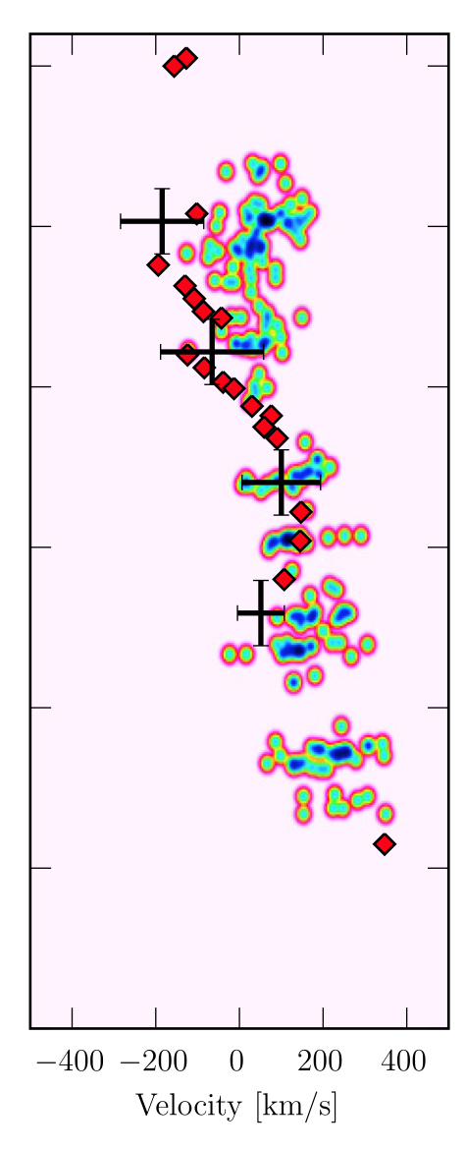
Origin of Nebula
Is northern filament being dragged outwards by a rising bubble?
30˝
(10.8 kpc)
Slit spectroscopy of northern filament
Hatch+06
Salomé+11
Conselice+01

Slide 33
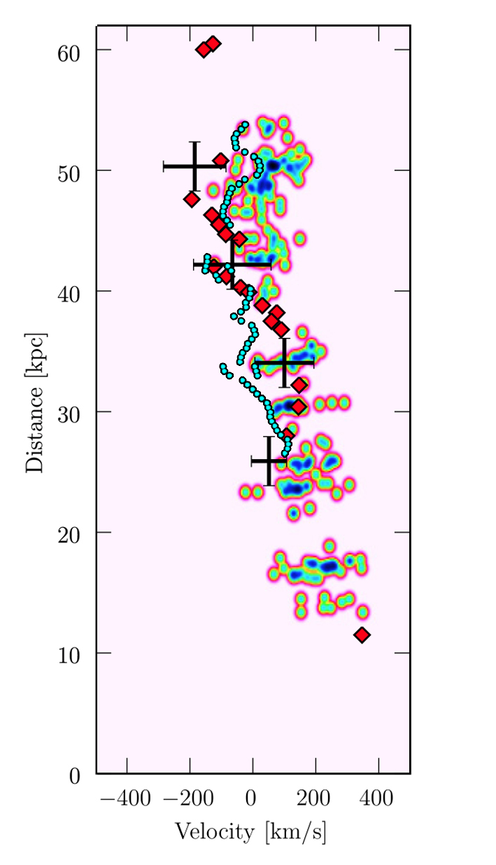
Origin of Nebula
Is northern filament being dragged outwards by a rising bubble?
30˝
(10.8 kpc)
Slit spectroscopy of northern filament
Hatch+06
Salomé+11
Conselice+01

Slide 34
Kinematics of Horseshoe Filament
Hα (green contours) on X-ray
Is Horseshoe filament a vortex behind a rising bubble?
Kinematics of Horseshoe Filament
Hatch+06
Relative Velocity (km/s)
Fabian+11

