Slide 1
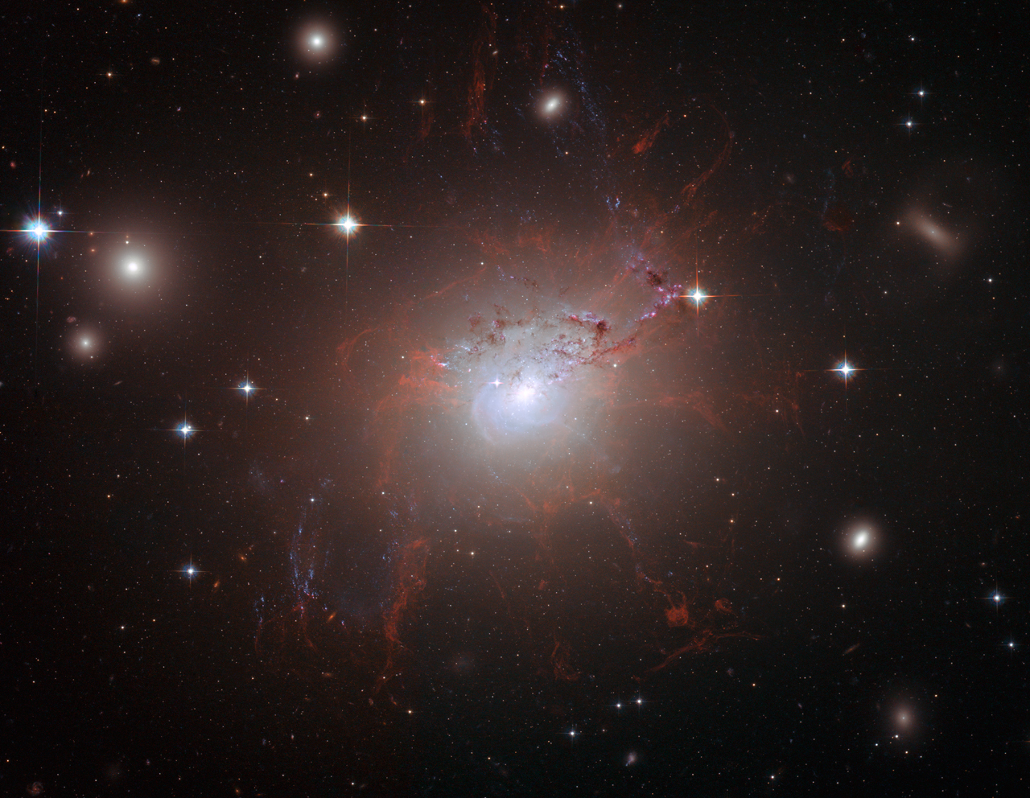
The Cold Gas in Cluster Cores – so much progress in the Chandra era
Alastair Edge
(Durham University)
and many collaborators

Slide 2
Cold?
This conference is primarily focused (rightly) on the X-ray regime so I should just define the parameters for this talk!
I regard “cold” as gas with a temperature of <10³K. So “warm” is 10³<T<10⁶K (see next talk!) and everything hotter can be accessed by Chandra.
This still leaves me with a very wide range of observations to review!

Slide 3
Cold, cooling and cooled
I will leave the semantic discussion of cool core/cooling flow for others and instead I’ll focus on the simple issue of the presence and properties of gas at <10³K in clusters and the links to the X-ray properties of the cluster.
We will learn only when we determine the properties of many clusters, not just a few extreme ones.

Slide 4
….talking of which…!
No review in this area is complete without acknowledging the “Monster” that is NGC1275…

Slide 5
NGC1275
NGC1275 the BCG of the Perseus cluster and has many peculiar properties for a giant elliptical galaxy:
Optical line filaments, Seyfert 1 nucleus and importantly cold molecular gas.
It has played an important role in the unfolding story of AGN feedback .

Slide 6
Feeding Feedback?
The realisation that AGN feedback has a dramatic effect on cluster cores is thanks largely to Chandra observations of cavities and temperature profiles on <100kpc scales.
However, the feedback loop requires some gas to cool in order fuel AGN activity.
Can we find this gas and use its properties to refine models?

Slide 7
CO is all you need!
Cold gas by its nature keeps a very low observational profile!
Molecular Hydrogen is only directly observable at T>~500K.
Fortunately nature has provided CO as a very versatile tracer of cold, molecular gas.

Slide 8
CO History
In the 1990s a number of groups searched for CO in BCGs with no success apart from NGC1275.
Why?
Receivers – narrow bandwidth
Telescopes – 10-12m dishes are not sensitive enough
Targets – very few BCGs as extreme as NGC1275 were observed.

Slide 9
Boxing Day 1998
Realising that there were objects more line luminous than NGC1275 in the RASS samples (e.g. A1835 and Zw3146) we requested JCMT time to search for CO(3-2) redshifted into the band of a newly upgraded receiver.

Slide 10
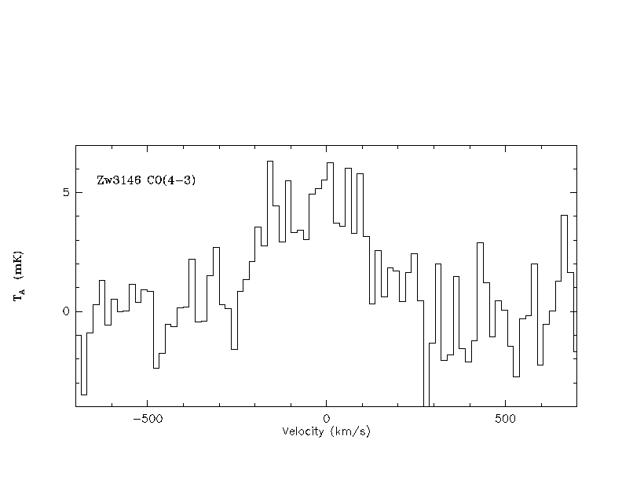

Slide 11
Like the T…?
You wait for ages for one event (a British bus or a Red Sox World Series win!) then more seem to follow immediately after.
Likewise with CO detections of BCGs. Within a year of the JCMT detection we had more than a dozen others!

Slide 12
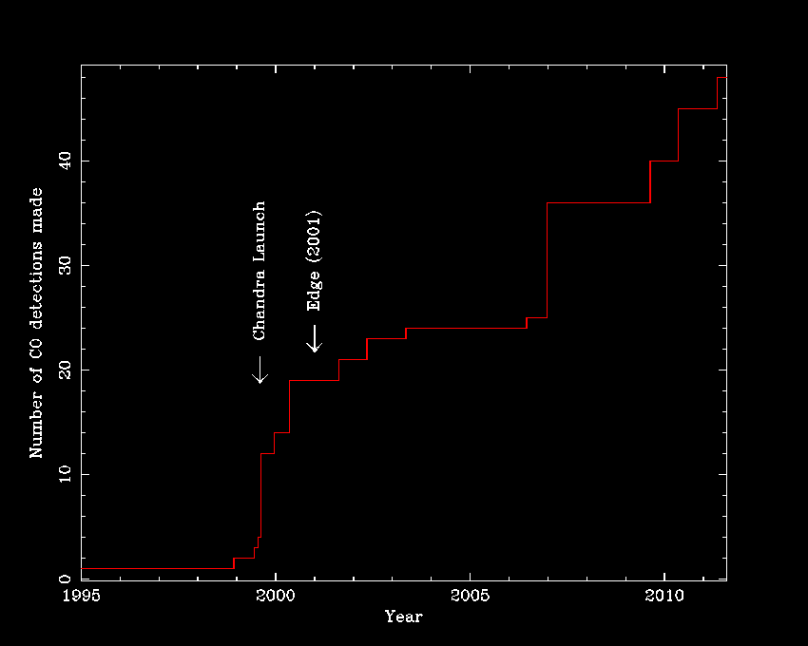

Slide 13
CO in the Chandra Era
In the 12 years of Chandra operations we have gone from one to >46 CO detections!
What can we learn from these detections?

Slide 14
Setting a baseline
Making any detection of CO tells us that there is at least some molecular gas present.
The fact it isn’t at the level expected for a “classic” cooling flow for 10¹⁰ years is an important mirror of the X-ray constraints on mass deposition rates.

Slide 15
CO dynamics
One of the factors that affects the likelihood of detecting a particular line is the line width. This can vary from 100 to 800 km s⁻¹!

Slide 16
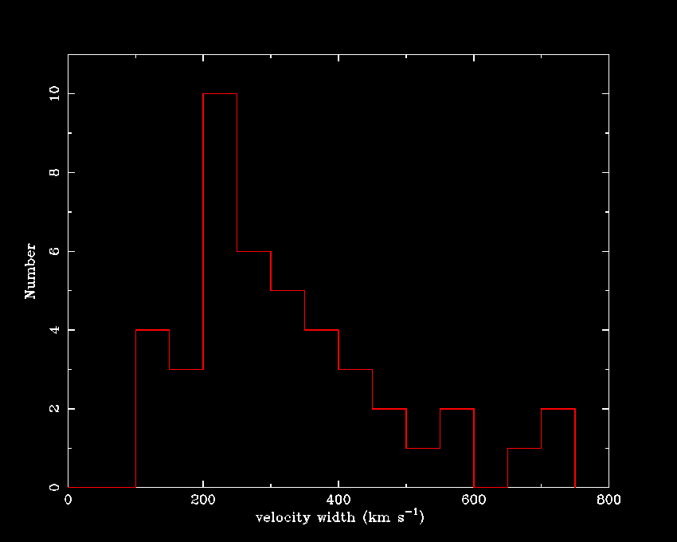

Slide 17
CO dynamics
One of the factors that affects the likelihood of detecting a particular line is the line width. This can vary from 100 to 800 km s⁻¹!
Also there are a number of systems that show clear double-peaked line profiles that are characteristic of gas disks.

Slide 18
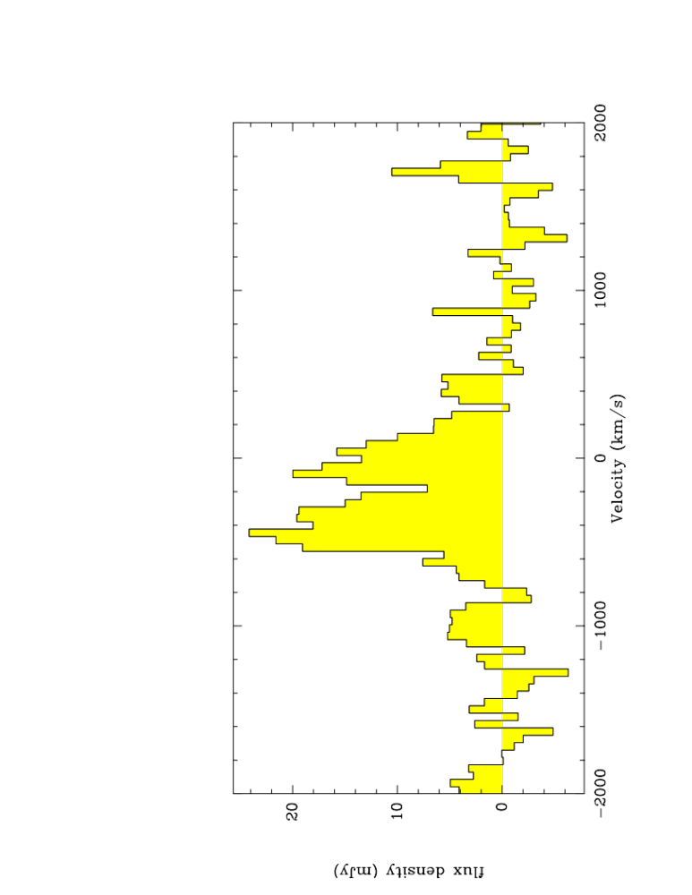
Hydra-A CO(2-1) IRAM 30m spectrum

Slide 19
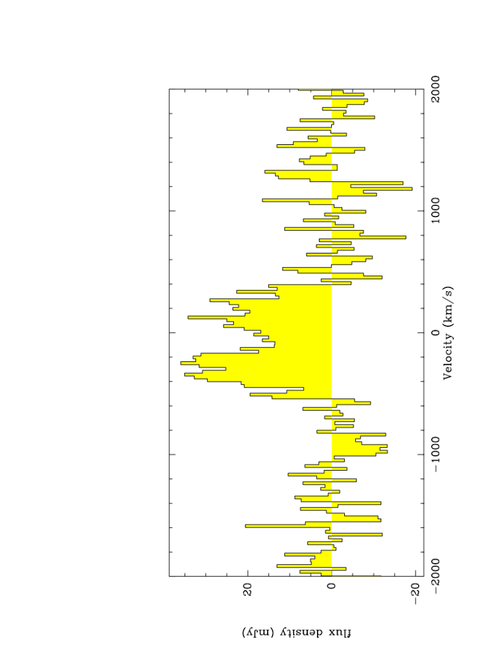
A1664 CO(2-1) IRAM 30m spectrum

Slide 20
CO dynamics
One of the factors that affects the likelihood of detecting a particular line is the line width. This can vary from 100 to 800 km s⁻¹!
Also there are a number of systems that show clear double-peaked line profiles that are characteristic of gas disks.
The variation in the line width is also reflected in the optical line dynamics.

Slide 21
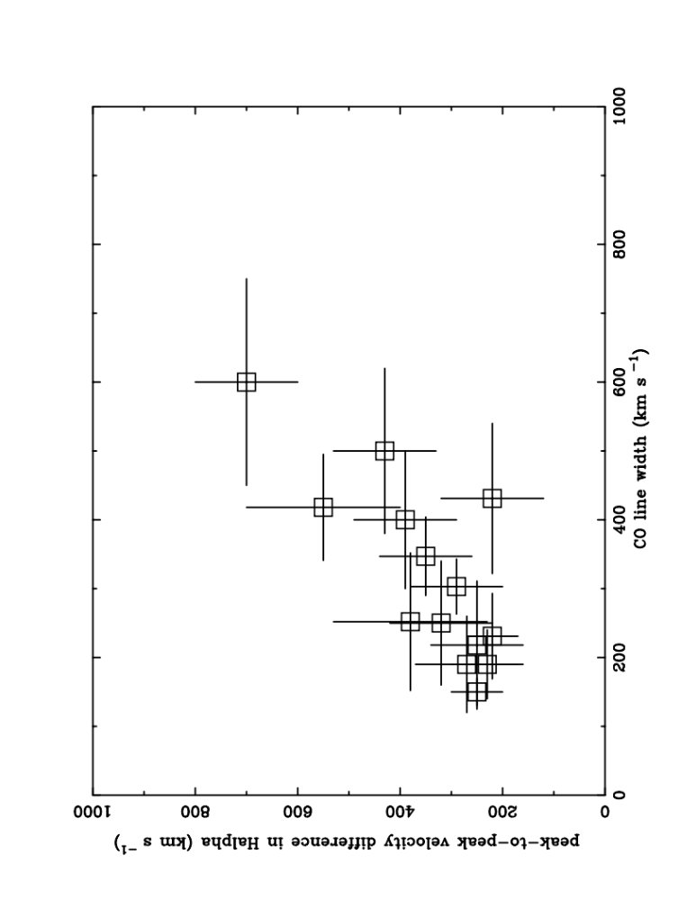

Slide 22
CO excitation
The majority of the brightest systems have detections at CO(2-1) and/or CO(3-2) so we can place limits on the excitation of the cold gas.
Indeed, it is frequently easier to detect the higher order lines in good conditions so searches for CO(2-1) or CO(3-2) in weaker systems can be more efficient than simply exposing longer on CO(1-0), particularly at z<0.05.

Slide 23
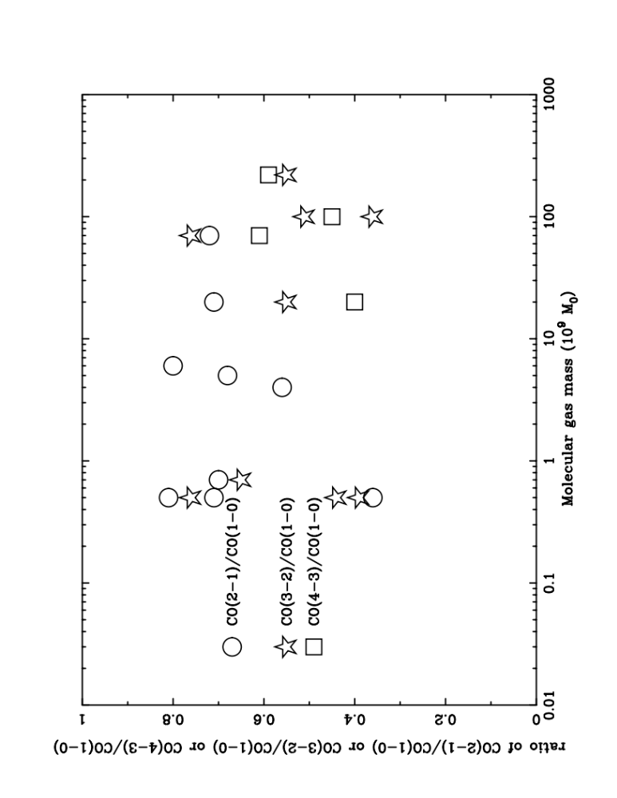
CO line ratios for best multiple line detections

Slide 24
CO correlations
The CO line strengths and the molecular gas mass derived from them can be compared to a number of other tracers of the cold gas phase.

Slide 25
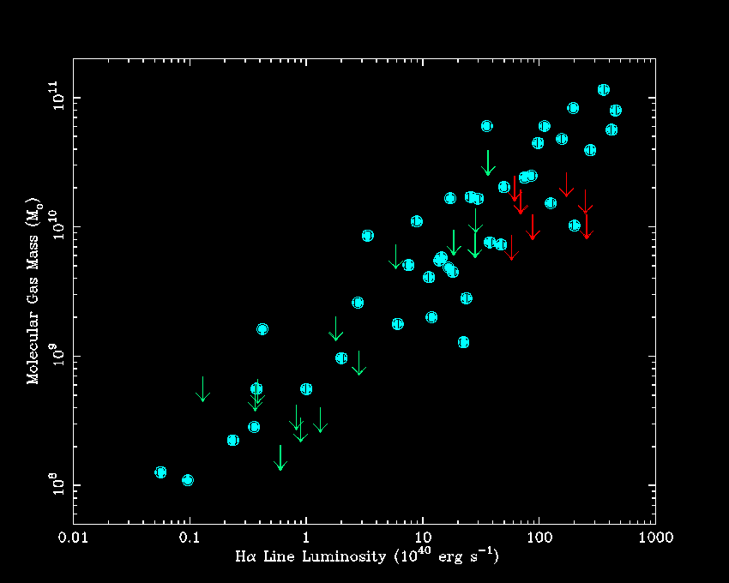
Edge (2001) updated – Hα line luminosity vs M_{H2}
NGC1275
AGN dominated
Cygnus-A

Slide 26
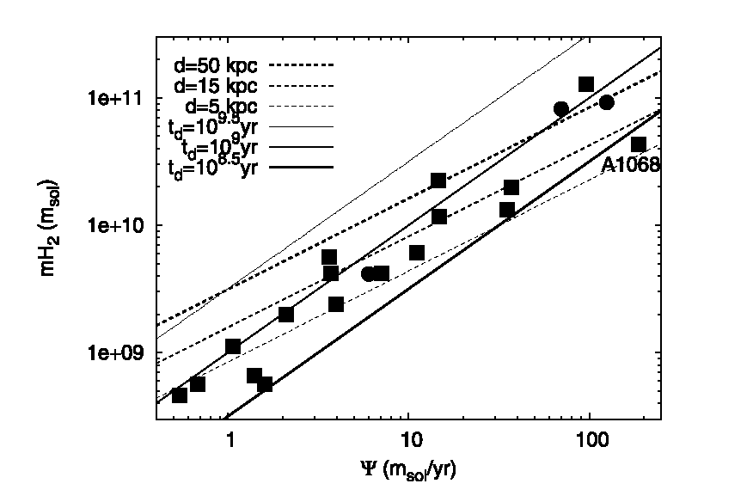
O’Dea et al (2008) – Spitzer MIR derived SFR vs M_{H2}

Slide 27
CO limitations
Observing CO is clearly a powerful technique if the source is sufficiently bright and the instrument used has a good bandwidth.
However, there is a limit to how faint single dish observations can reach.

Slide 28
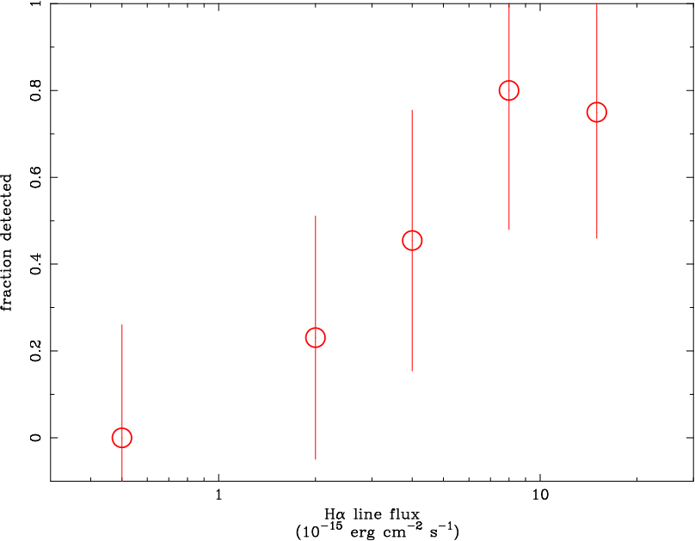

Slide 29
CO future
ALMA is clearly going to revolutionise our ability to study CO in BCGs in terms of spatial resolution and sensitivity.
CAMRA, SMA and PdBI in the north will be important.
Also there are many other lines that can be used to derive the properties of the cold phase (¹³CO, HCN, CN, HCO⁺) – see Bayet et al (2011).

Slide 30
Atomic Gas
Herschel offers the first realistic opportunity to detect emission from atomic lines CII, OI and others that are efficient cooling lines in the cool ISM.
I am PI of a Key Project to observe 11 BCGs.
There are several other OT1 programmes and one more round for proposals in September.

Slide 31
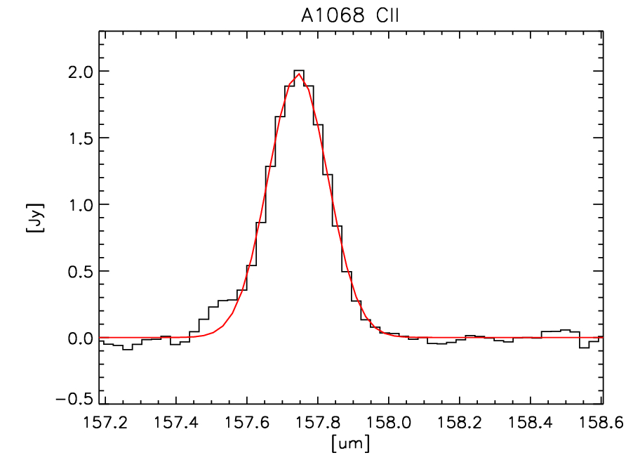
See Edge et al (2010)

Slide 32
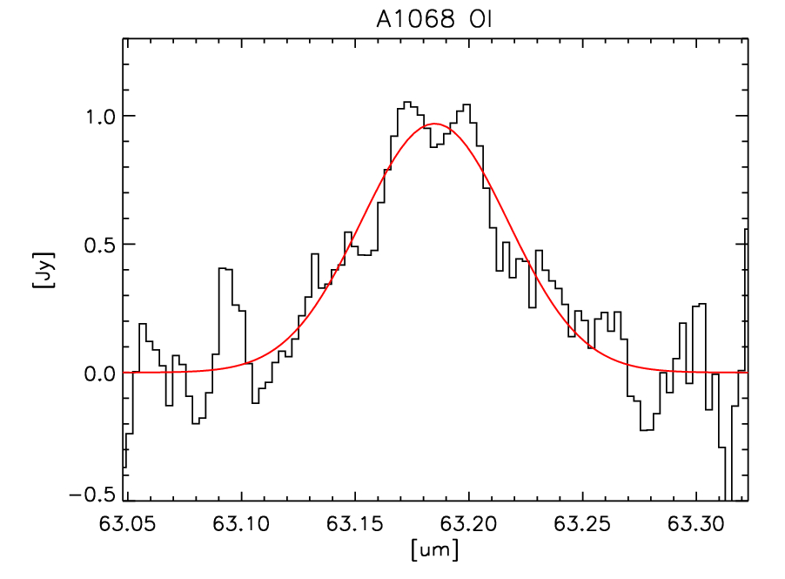
See Edge et al (2010)

Slide 33
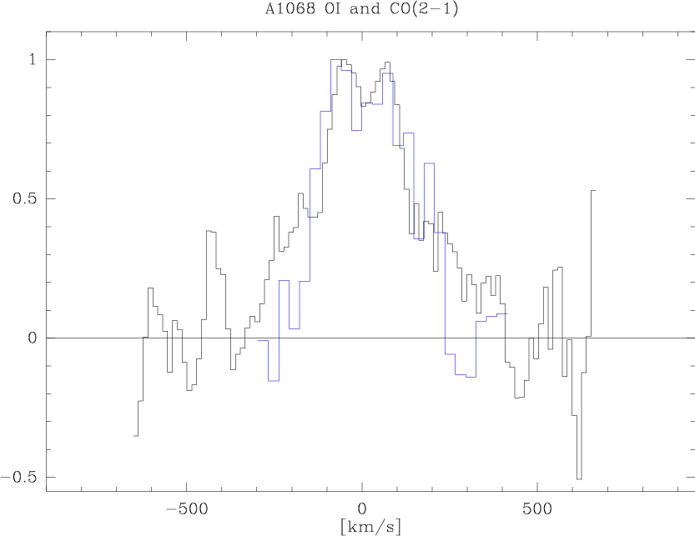

Slide 34
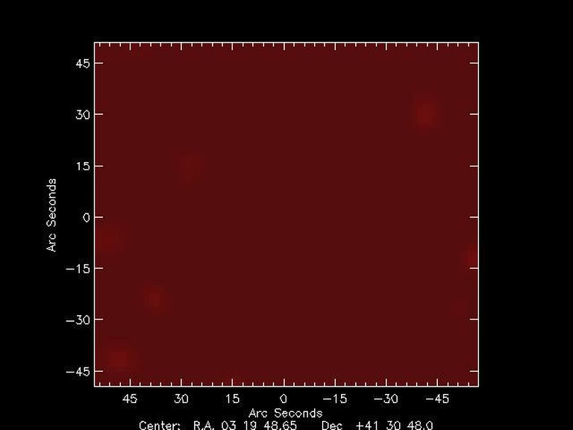
NGC1275 CII Herschel PACS channel map – Mittal in prep

Slide 35
Warm molecular H₂
While cold molecular H₂ is effectively invisible, when warmed it is visible in the NIR and MIR.
We have ~30 detections in the NIR of 1-0 S series lines with UKIRT and a similar number of 0-0 S series with Spitzer.
This emission correlates directly with CO and the optical lines.

Slide 36
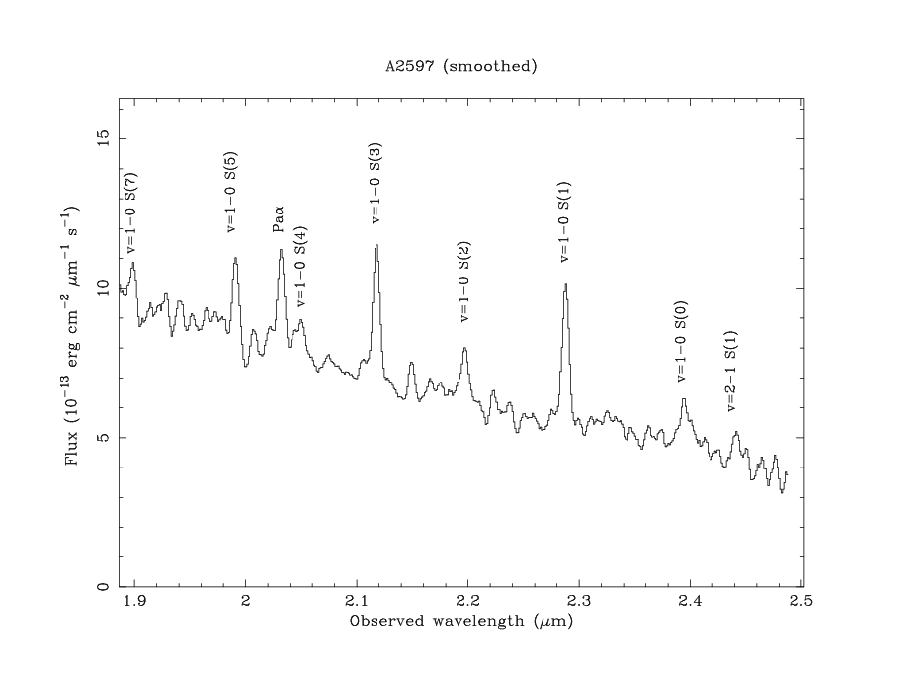
From Edge et al (2002) UKIRT CGS4 spectrum
1-0 S Series H₂ Lines

Slide 37
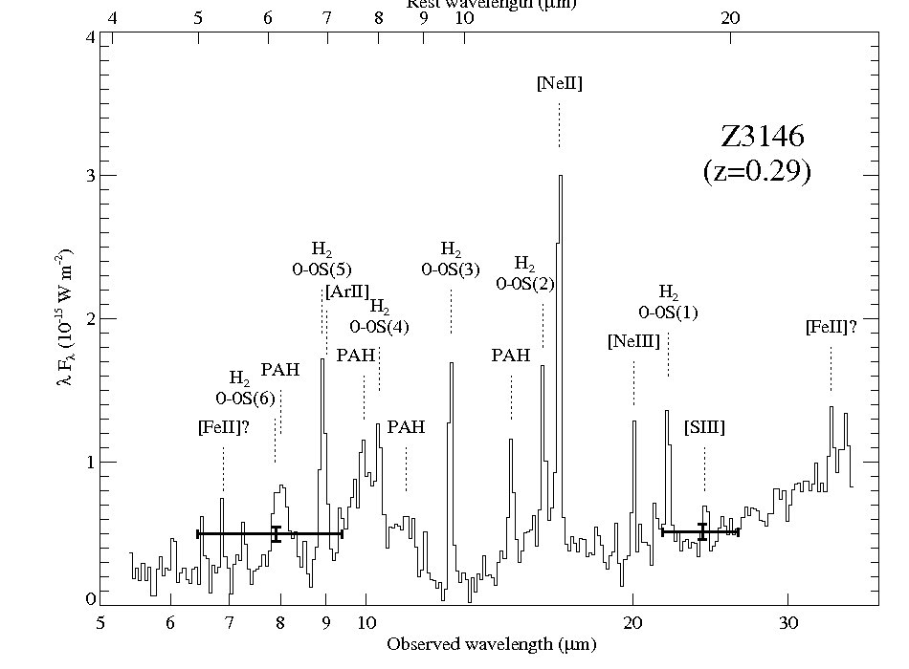
From Egami et al (2006)

Slide 38
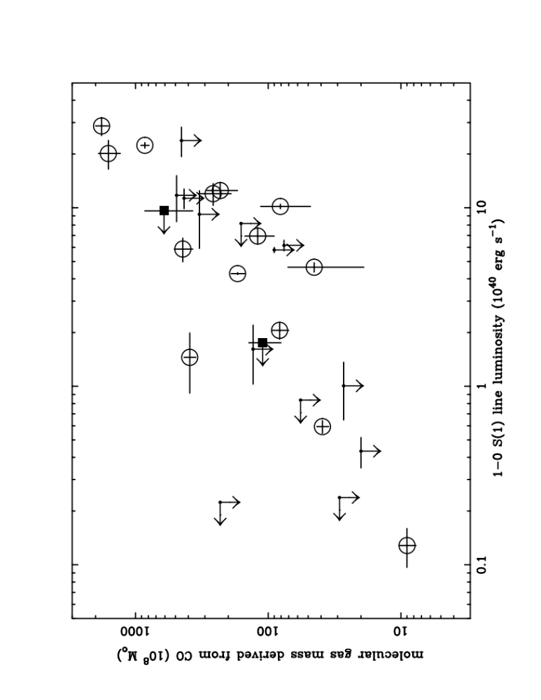
Edge et al (2002) – UKIRT 1-0 S Series H₂ vs M_{H2}

Slide 39
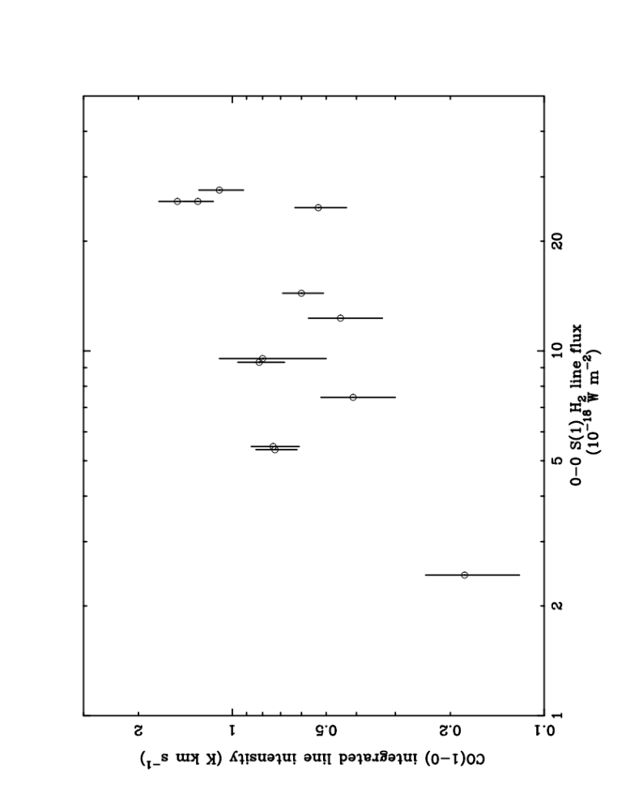
Egami in prep and Donahue et al (2011) 0-0 S(1) vs CO line fluxes

Slide 40
Dust
Cold molecular gas is infused with dust wherever it is found.
Can we use the FIR dust continuum to understand the cold gas?
SCUBA detections of two BCGs were published in July 1999 and now with Herschel this number is it is several dozen.
In the MIR, 24μm detections with Spitzer and WISE are nearing 100.

Slide 41
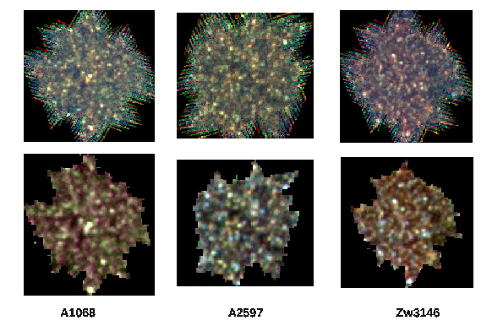
Herschel imaging of Edge et al (2010) clusters
PACS
SPIRE

Slide 42
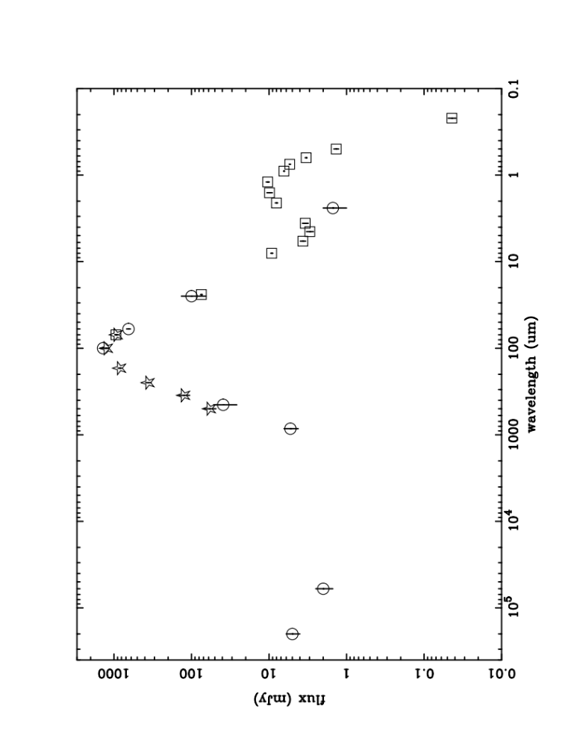
Abell 1068 radio-UV SED including Herschel PACS+Spire

Slide 43
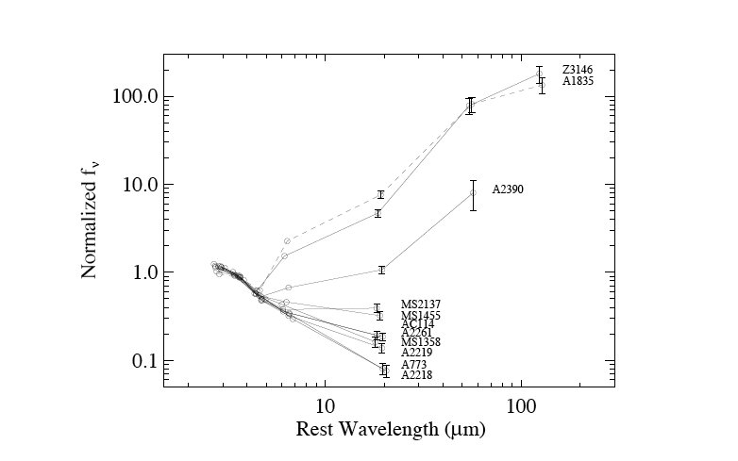
Egami et al (2006) Spitzer IRAC+MIPS photometry
Abell 1068 radio-UV SED including Herschel PACS+Spire
Dust
Stars

Slide 44
What does it all mean?
The connection between the X-ray properties of the core and the properties of the BCG has been tested a number of ways with Chandra.
Cavagnolo et al. – central entropy and lines/radio
Sanderson et al. – position of BCG wrt X-ray

Slide 45
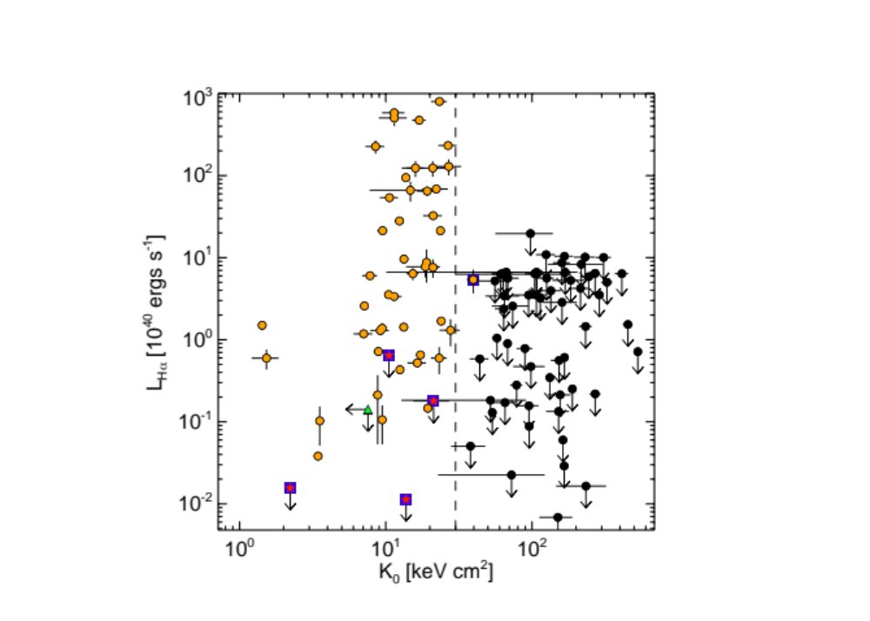
Cavagnolo et al (2008) Hα vs central entropy

Slide 46
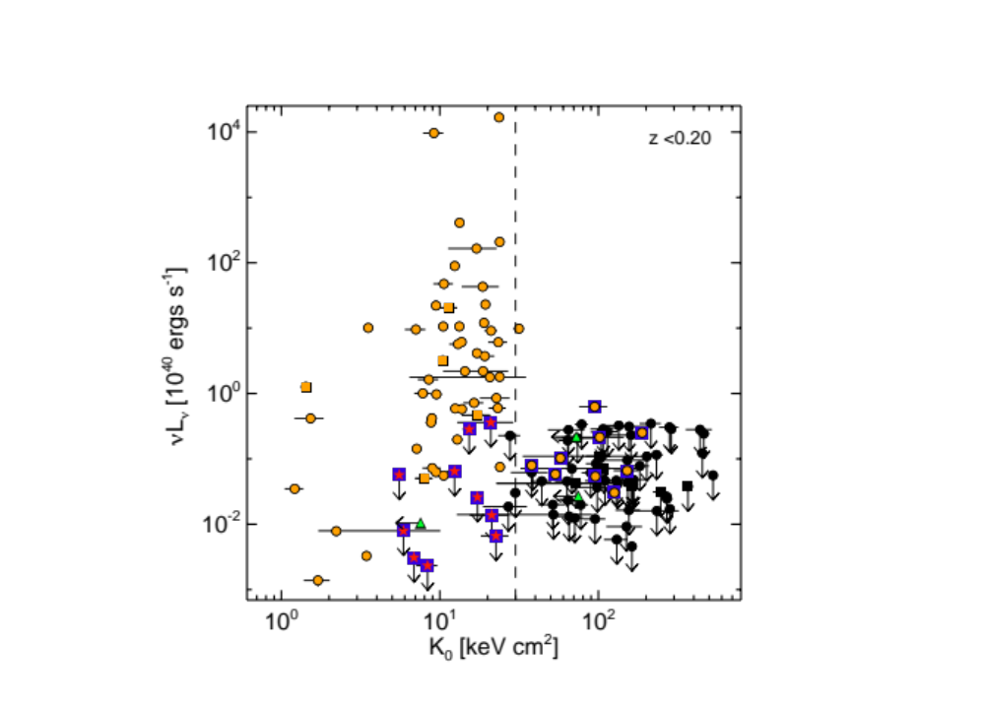
Cavagnolo et al (2008) Radio Power vs central entropy

Slide 47
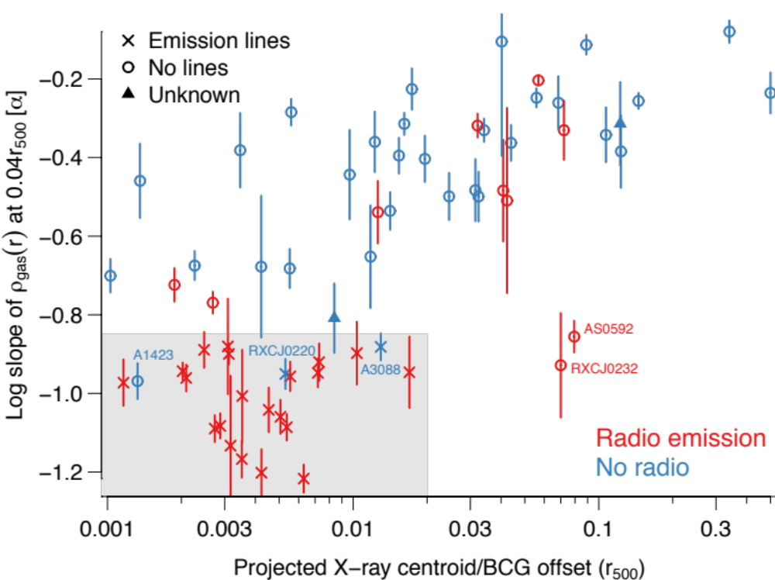
Sanderson et al (2009) Gas Density slope and BCG offset

Slide 48
What does it all mean? - II
The connection follows through to the cold gas tracers as they all correlate closely to the optical lines.
So X-ray cooling and the amount of cold gas are related.
The CO detection limit with current technology means we don’t detect every line emitting BCG.
Yet.

Slide 49
The Future
ALMA will allow CO detections of a factor of 10-50 fainter.
WISE, GALEX and PanSTARRS can be used to select “active” BCGs irrespective of the X-ray properties of the cluster so in principle many hundreds of systems can be studied.

Slide 50
The Role of Chandra
Chandra is vital to determine the <50kpc scale structure in cluster cores that appears to dictate the properties of the BCG.
My questions:
What can we learn from the systems where the Hα is offset from the BCG?
What is the AGN power?
What about more distant clusters? See 3C186!

Slide 51
July 2021
In 10 years time, what might I be reviewing?
The evolution of molecular gas mass with redshift
Connecting cold gas to local star formation
Mapping gas flow into the core of a BCG
Using the cold gas to determine BH masses
See you all then!

