Slide 1
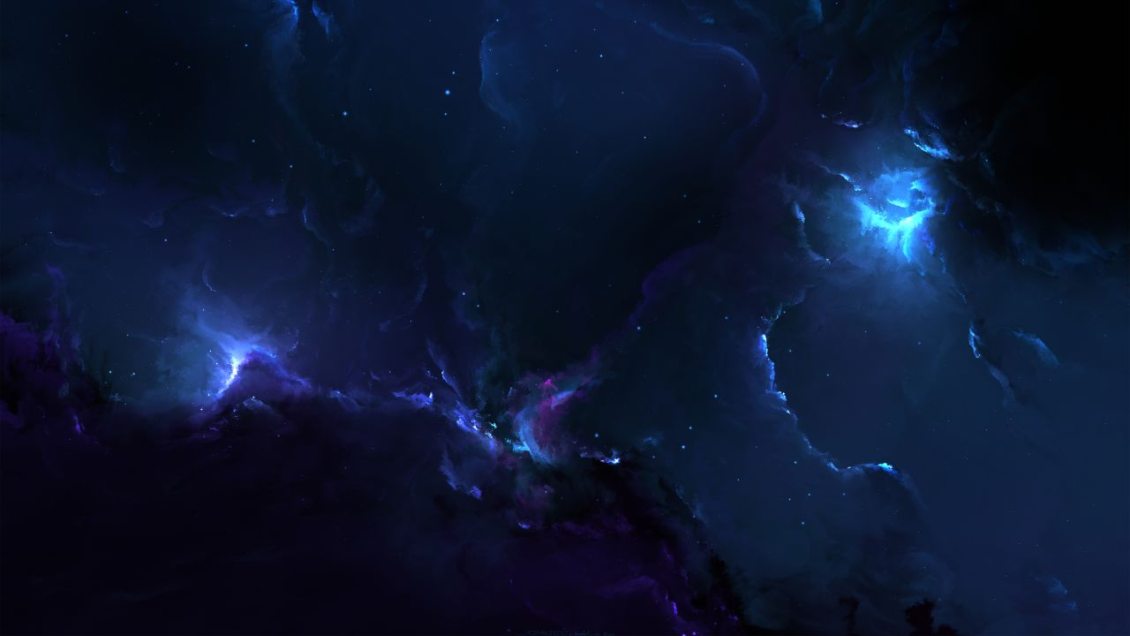
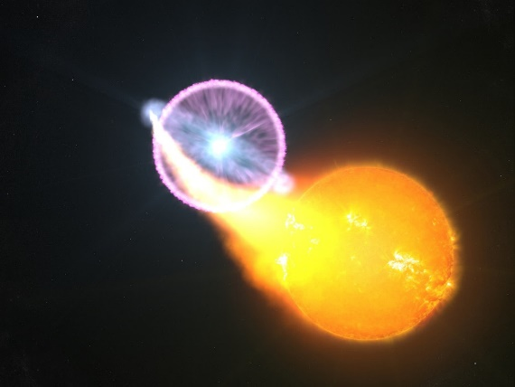



Exploring the formation and characteristics of shocks in novae
Elias Aydi
NASA NFHP Hubble Fellow
Michigan State University
L. Chomiuk, K. V. Sokolovsky, K. Mukai, B. Metzger, K. Shen, D. A. H. Buckley, J. Monier, G. Schaefer, M. Orio, J. Sokoloski, J. Linford, J. Mikolajewska, A. Kawash, E. Steinberg, K-L. Li, L. Izzo, E. Harvey, A. Stone, J. Strader, ASAS-SN collabs, BRITE collabs, and friends…
Hubble Symposium 2023
September 18 – 22, 2023

Slide 2

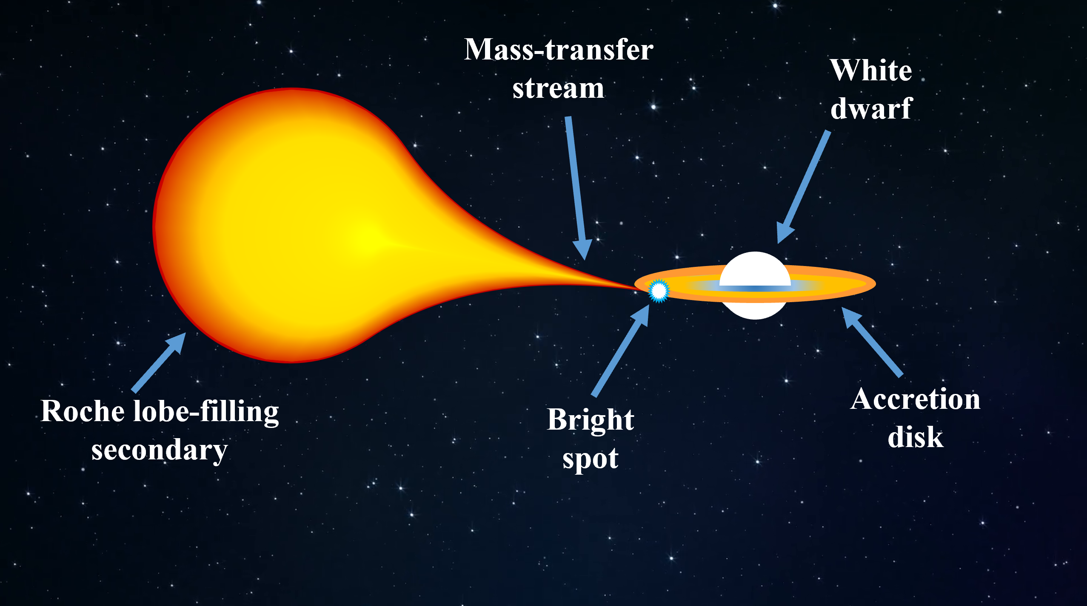
Novae – a brief summary
Porb ≈ hours
SALT - SAAO
SMARTS
E. Aydi 2018 ©
E. Aydi 2018 ©
E. Aydi - MSU

Slide 3
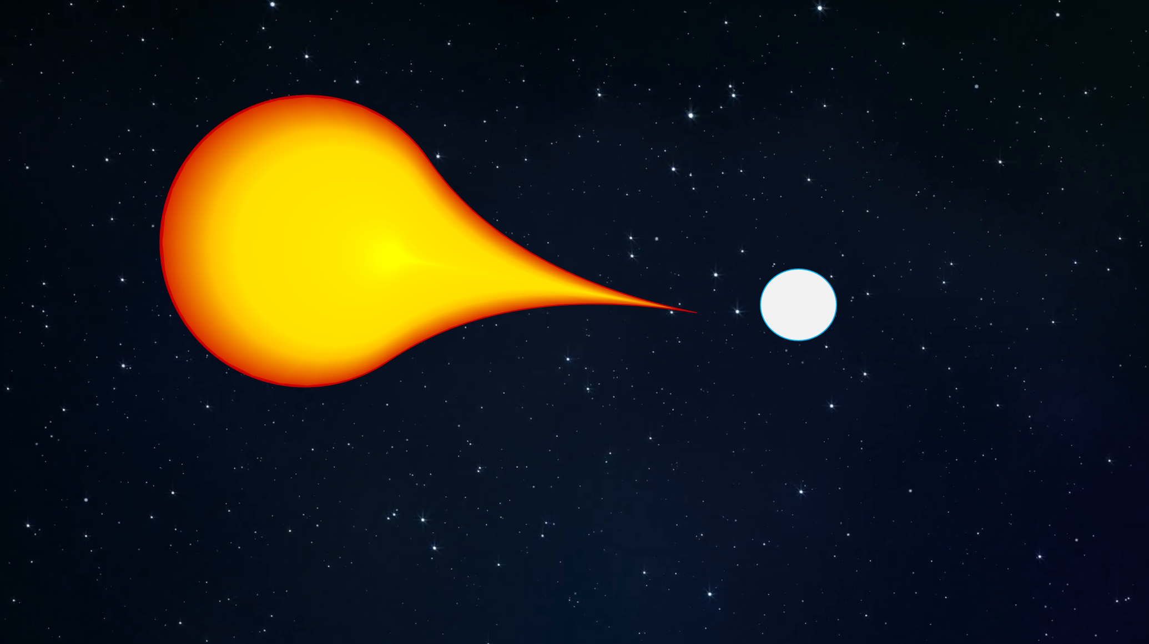
Novae – a brief summary
10⁻⁷-10⁻³ Mo ejected
SMARTS
500-5,000 km/s
E. Aydi 2018 ©
E. Aydi - MSU

Slide 4
Novae – a brief summary
Optical/UV
SMARTS
E. Aydi 2018 ©
E. Aydi - MSU

Slide 5
Novae – a brief summary
SMARTS
E. Aydi 2018 ©
E. Aydi - MSU

Slide 6
Novae – a brief summary
Supersoft X-ray source
~Ledd = 10^38 erg/s
SMARTS
E. Aydi 2018 ©
E. Aydi - MSU

Slide 7
Novae – a brief summary
Near Constant Bolometric Luminosity
Optical
UV
SuperSoft X-rays
Nuclear burning on the WD surface sustains near Eddington luminosity (~10³⁸ erg/s)
E. Aydi 2018 ©
E. Aydi - MSU

Slide 8
Novae – a brief summary
SALT - SAAO
SMARTS
E. Aydi 2018 ©
E. Aydi 2018 ©
E. Aydi - MSU

Slide 9

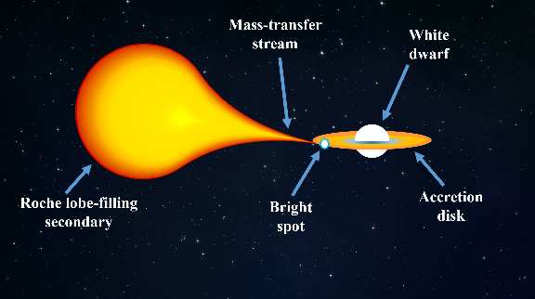

Novae in a nutshell
ACCRETE
ERUPT
SMARTS
E. Aydi 2018 ©
Around 10 novae are discovered in the Galaxy per year
E. Aydi - MSU

Slide 10
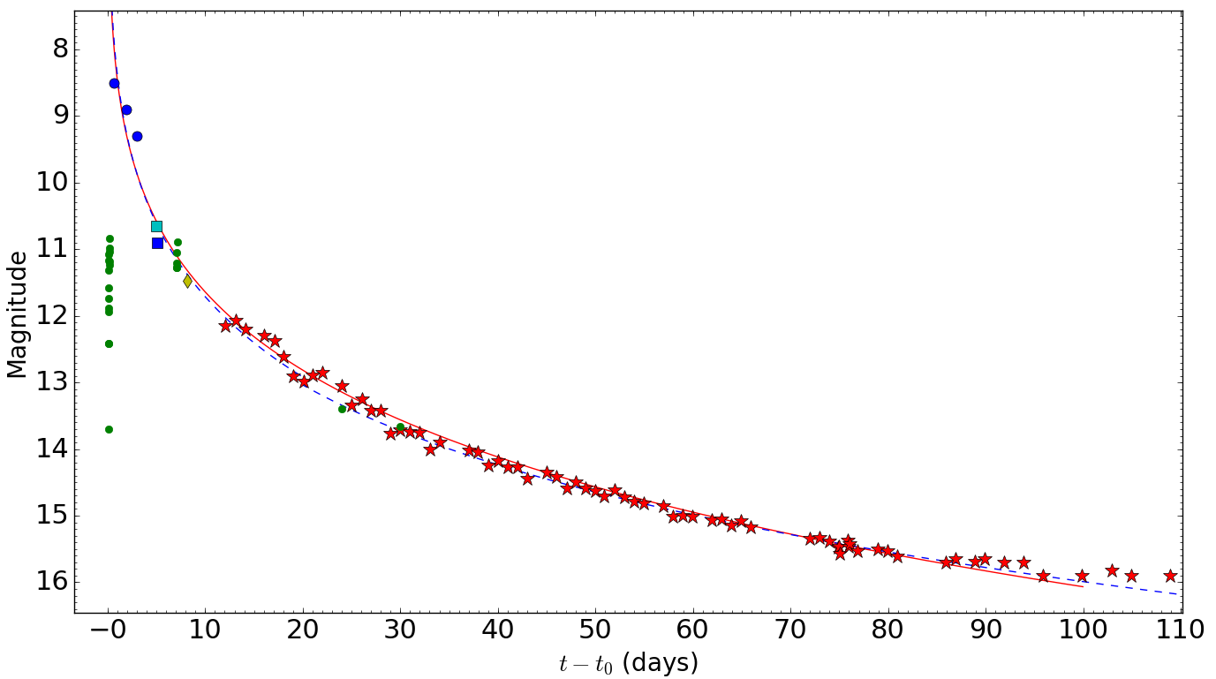
A typical visible light curve
Nova SMC 2016
Aydi et al. (2018a, MNRAS 474, 2679)
SMARTS
E. Aydi 2018 ©
E. Aydi - MSU

Slide 11
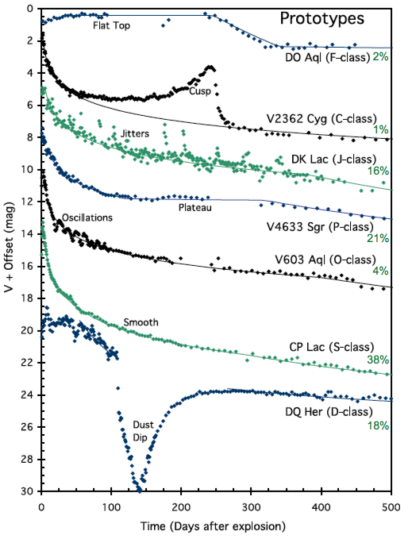
Not so typical
SMARTS
E. Aydi 2018 ©
E. Aydi - MSU
Strope et al. (2010)

Slide 12

Not so typical
SMARTS
E. Aydi 2018 ©
E. Aydi - MSU
Strope et al. (2010)

Slide 13

Novae as we know them – Standard paradigm
SMARTS
Luminosity powered by thermal emission from the hot WD
E. Aydi 2018 ©
E. Aydi - MSU

Slide 14
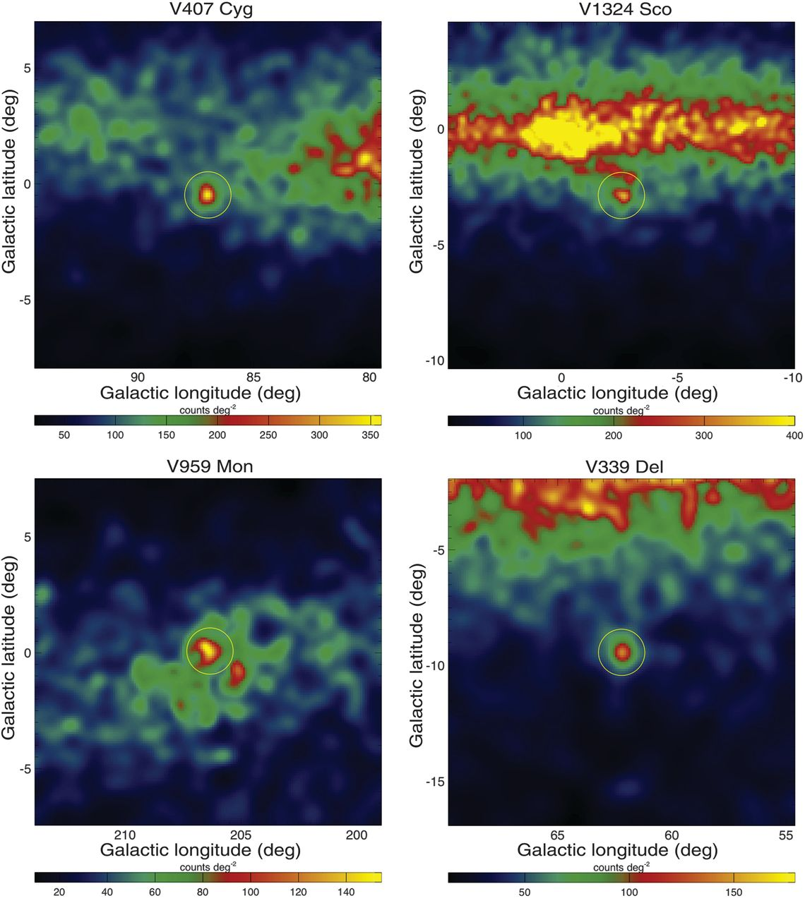
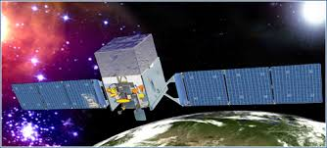
A shock!!
GeV gamma-ray emission from novae
Fermi-LAT
SMARTS
E. Aydi - MSU
Ackerman et al. (2014)

Slide 15

A shock!!
GeV gamma-ray emission from novae
Fermi-LAT
γ
SMARTS
Relativistic speeds?
Shocks
E. Aydi - MSU
Ackerman et al. (2014)

Slide 16
A shock!!
Based on our latest models, shocks are energetically important and could radiate a substantial fraction of the nova luminosity (source: trust me bro!)
Observed Lγ ~ 10³⁵ -10³⁶ erg/s
SMARTS
E. Aydi - MSU

Slide 17

A shock!!
Based on our latest models, shocks are energetically important and could radiate a substantial fraction of the nova luminosity (source: trust me bro!)
Observed Lγ ~ 10³⁵ -10³⁶ erg/s
SMARTS
E. Aydi - MSU

Slide 18
A shock!!
Based on our latest models, shocks are energetically important and could radiate a substantial fraction of the nova luminosity (source: trust me bro!)
Metzger et al. (2014, MNRAS, 442, 713), Metzger et al. (2015, MNRAS, 450, 2739), Li et al. (2017, Nat Ast, 1, 697), Steinberg et al. (2018, MNRAS 479, 687), Aydi et al. (2020, Nat Ast, 4, 776), and Steinberg et al. (2020, MNRAS 491, 4232).
SMARTS
E. Aydi - MSU

Slide 19
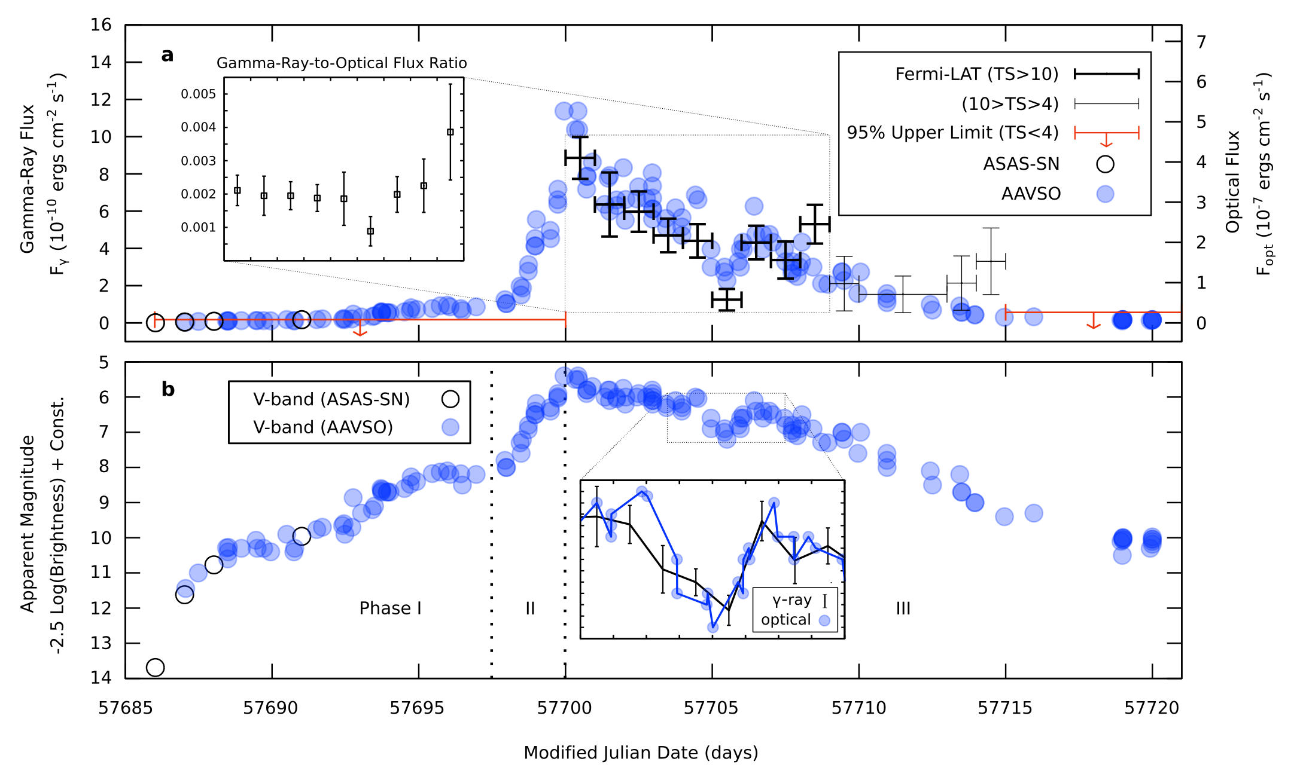
Nova V5856 Sgr providing some evidence
Li et al. (2017)
SMARTS
E. Aydi - MSU

Slide 20
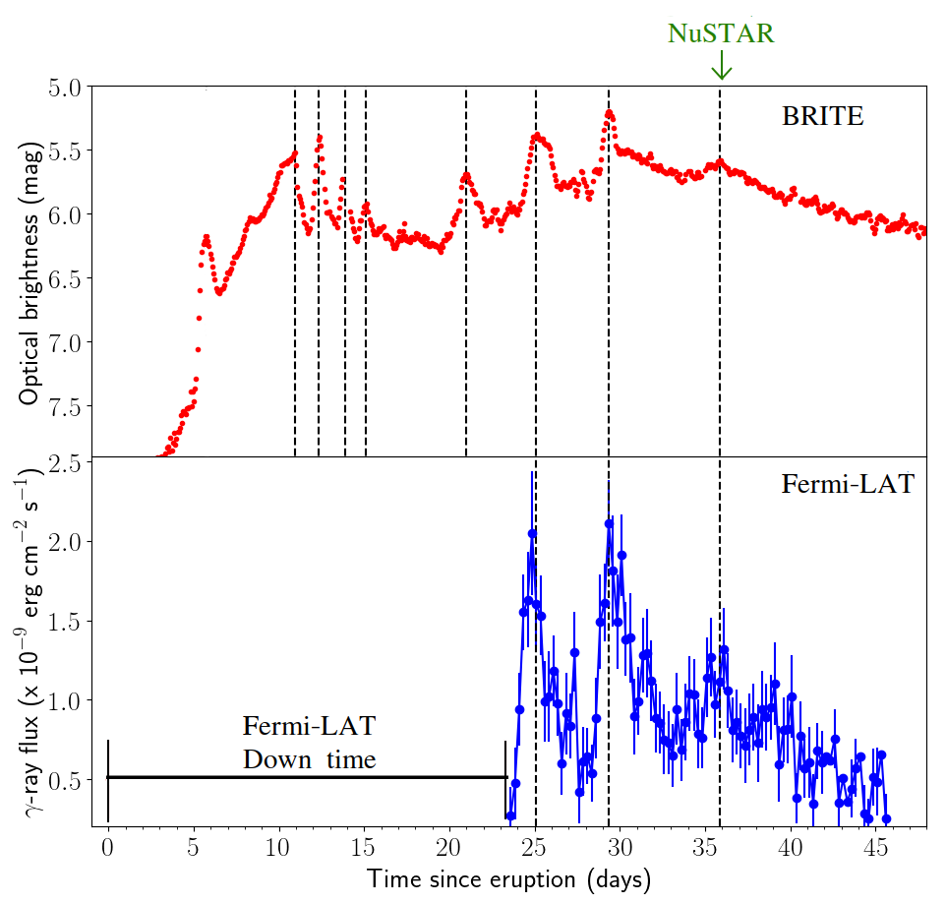
Nova V906 Car is lit
Aydi et al. 2020 (Nat Ast, 4, 776)
E. Aydi - MSU

Slide 21
Nova V906 Car is lit
Aydi et al. 2020 (Nat Ast, 4, 776)
Simultaneous flares → same origin (shocks)
E. Aydi - MSU

Slide 22
Nova V906 Car is lit
Aydi et al. 2020 (Nat Ast, 4, 776)
Simultaneous flares → same origin (shocks)
Luminosity doubled→ shocks radiate a large fraction of nova luminosity
E. Aydi - MSU

Slide 23
Some answers
SMARTS
E. Aydi 2018 ©
E. Aydi - MSU
Strope et al. (2010)

Slide 24

Some answers
SMARTS
E. Aydi 2018 ©
E. Aydi - MSU
Strope et al. (2010)

Slide 25
New insights into novae
GeV gamma-ray emission from novae
Fermi-LAT
SMARTS
E. Aydi - MSU
Ackerman et al. (2014)

Slide 26
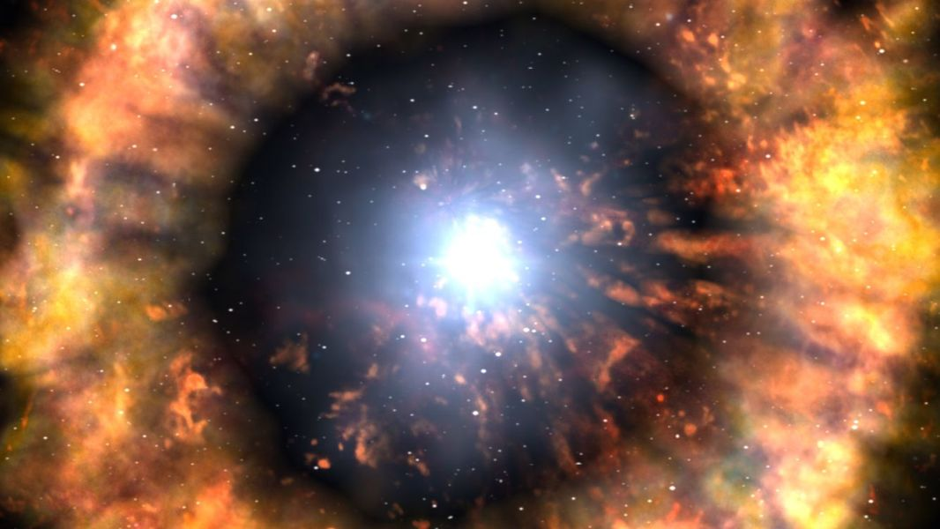
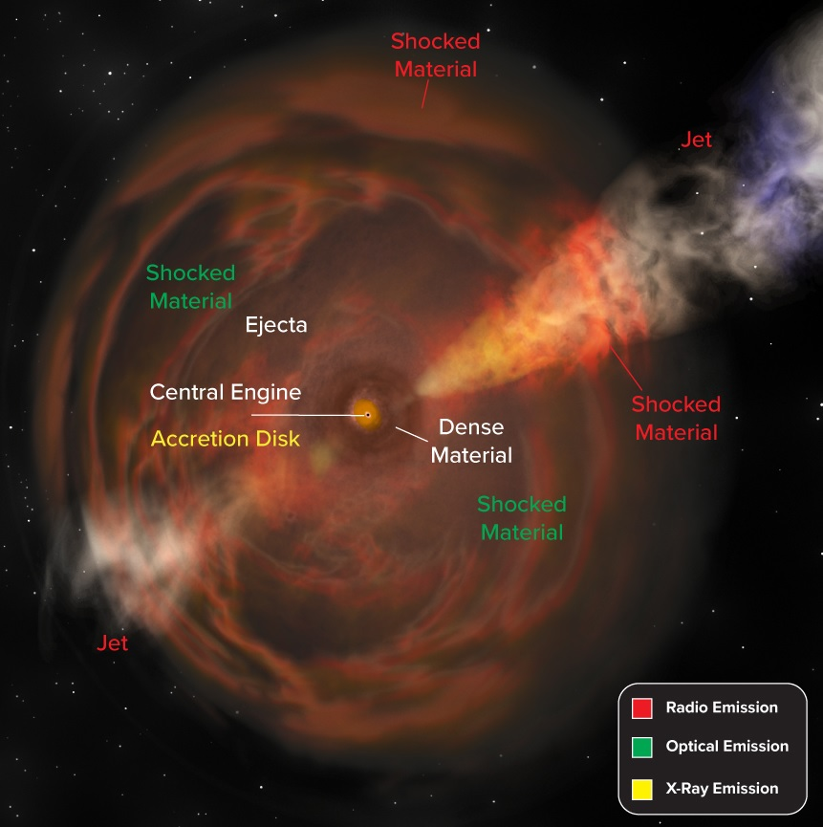
Nova shocks as laboratory
SLSNe/ Type IIn SNe
FBOTs
SALT - SAAO
Credit: NASA/Daana Berry/Skyworks Digital
Credit: Bill Saxton, NRAO/AUI/NSF
E. Aydi - MSU

Slide 27
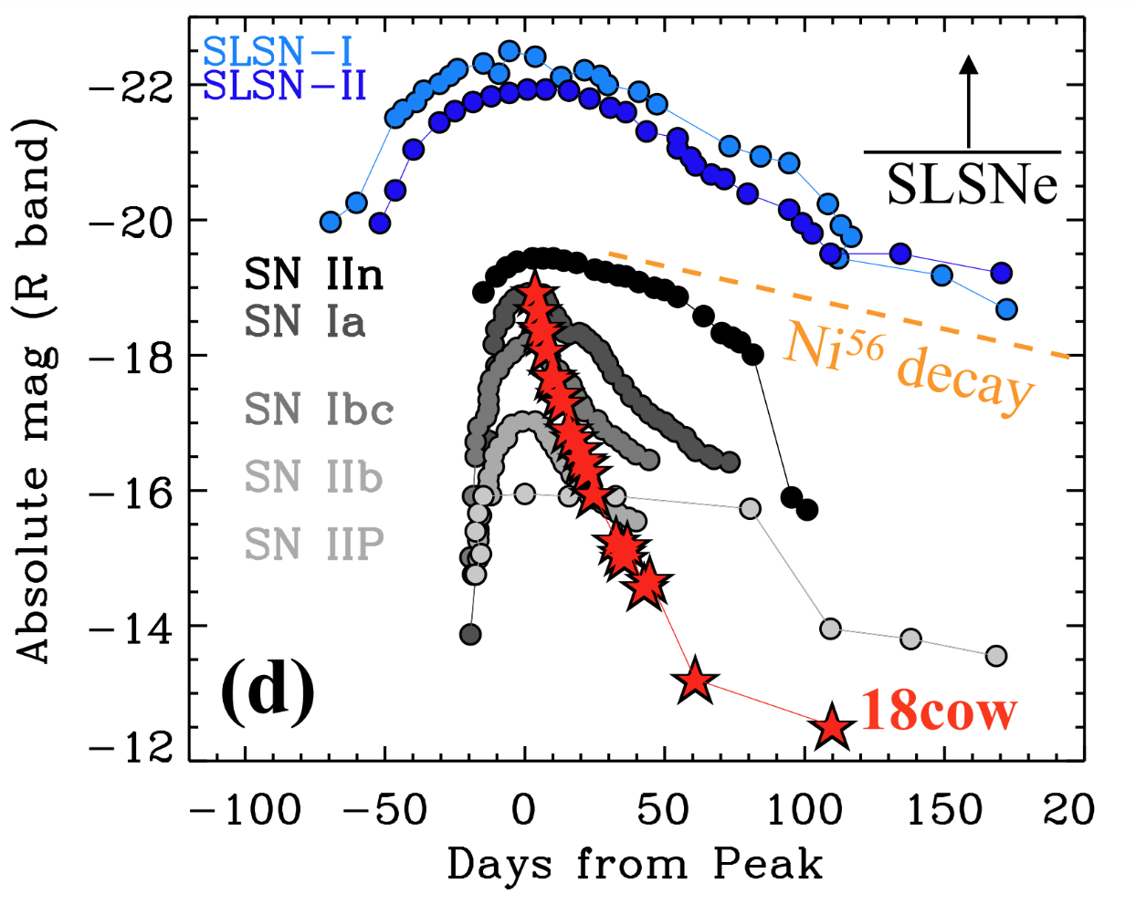
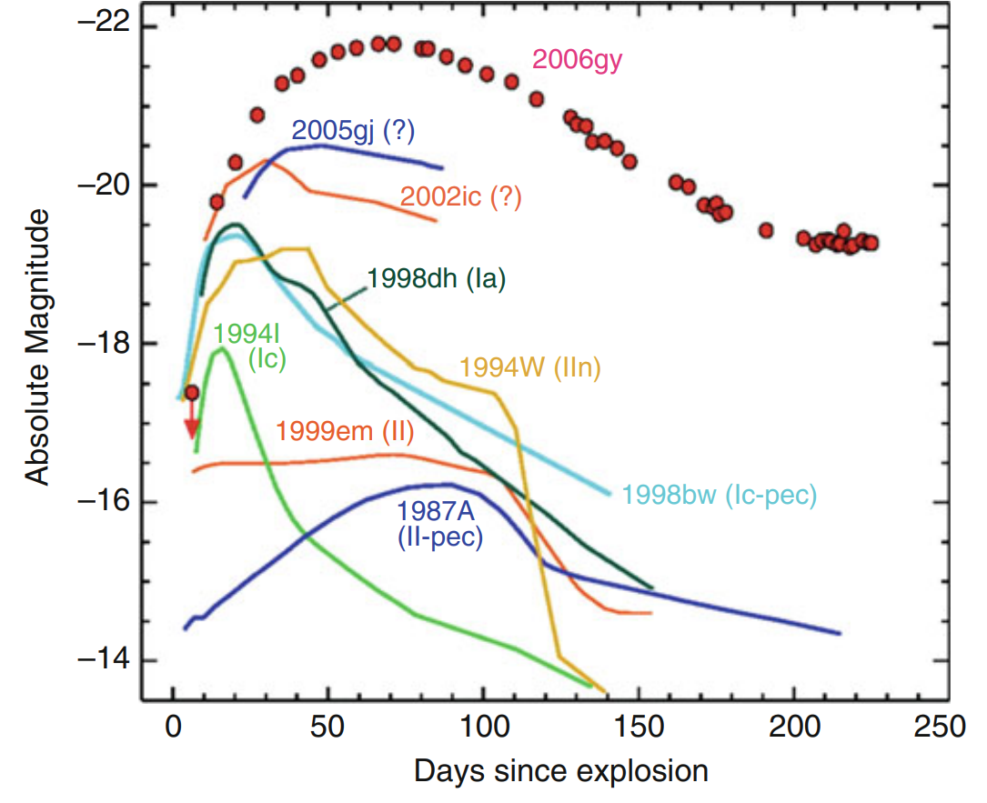
Nova shocks as laboratory
SALT - SAAO
SMARTS
Branch & Wheeler (2017)
Margutti et al. (2019)
E. Aydi - MSU

Slide 28
How does shock in novae form?
SMARTS
E. Aydi - MSU

Slide 29
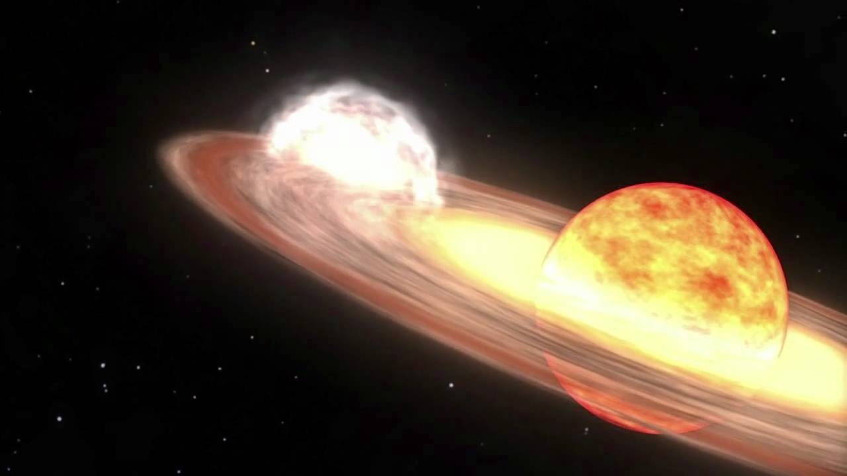
Where is the shock?
γ
Credits: http://svs.gsfc.nasa.gov/goto?10626
SMARTS
E. Aydi - MSU

Slide 30
Where is the shock?
γ
Giant evolved secondary
Credits: http://svs.gsfc.nasa.gov/goto?10626
SMARTS
E. Aydi - MSU

Slide 31
Where is the shock?
GeV gamma-ray emission from novae
Fermi-LAT
SMARTS
E. Aydi - MSU
Ackerman et al. (2014)

Slide 32
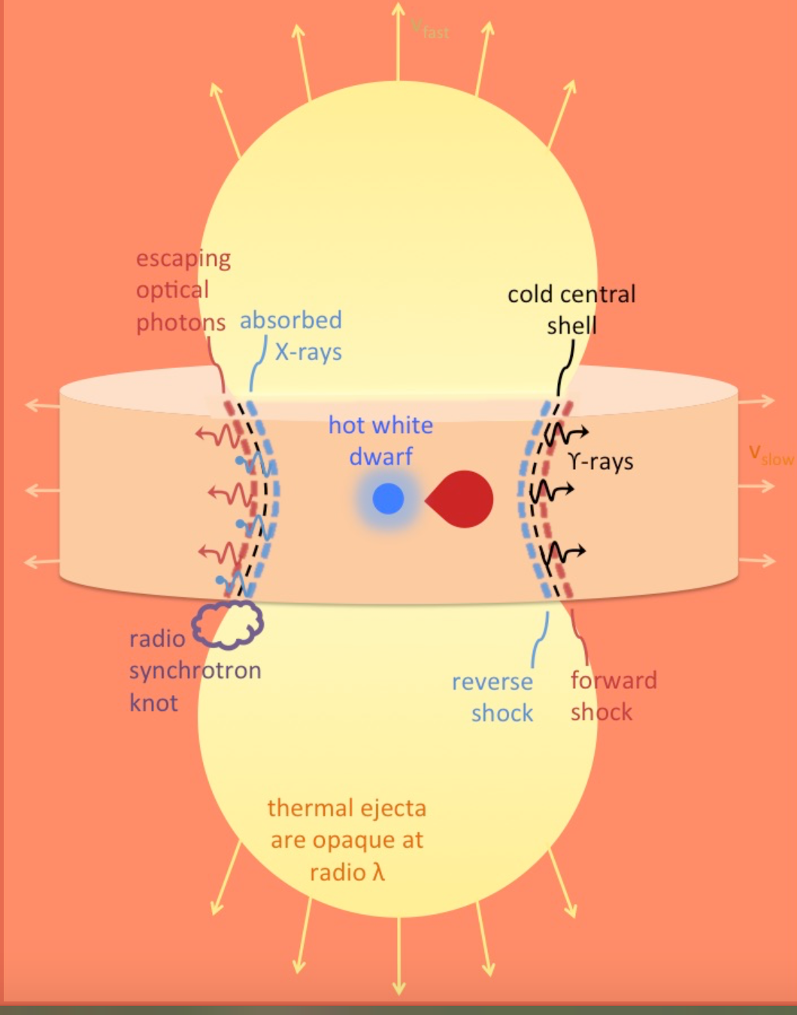

Shocks internal to the ejecta
Chomiuk et al. (2014)
Metzger et al. (2015)
SMARTS
E. Aydi - MSU

Slide 33
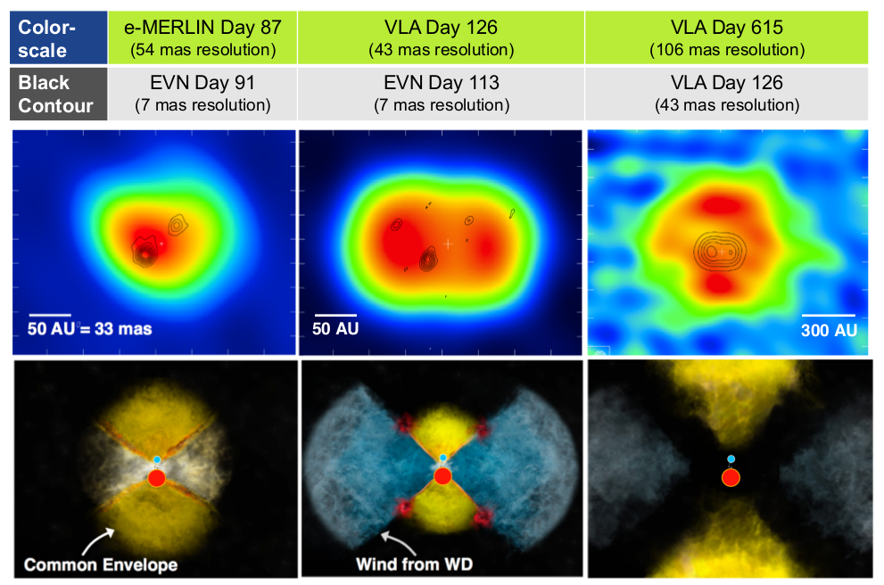
Radio imaging reveals two interacting outflows
Chomiuk et al. (2014)
V959 Mon
SMARTS
black: synchrotron from EVN
color: thermal from VLA
Symmetry axis “flips” by 90 degrees in 2 years following explosion.
E. Aydi - MSU

Slide 34
Radio imaging reveals two interacting outflows
Chomiuk et al. (2014)
V959 Mon
Bill Saxton / NRAO / AUI / NSF
SMARTS
E. Aydi - MSU

Slide 35
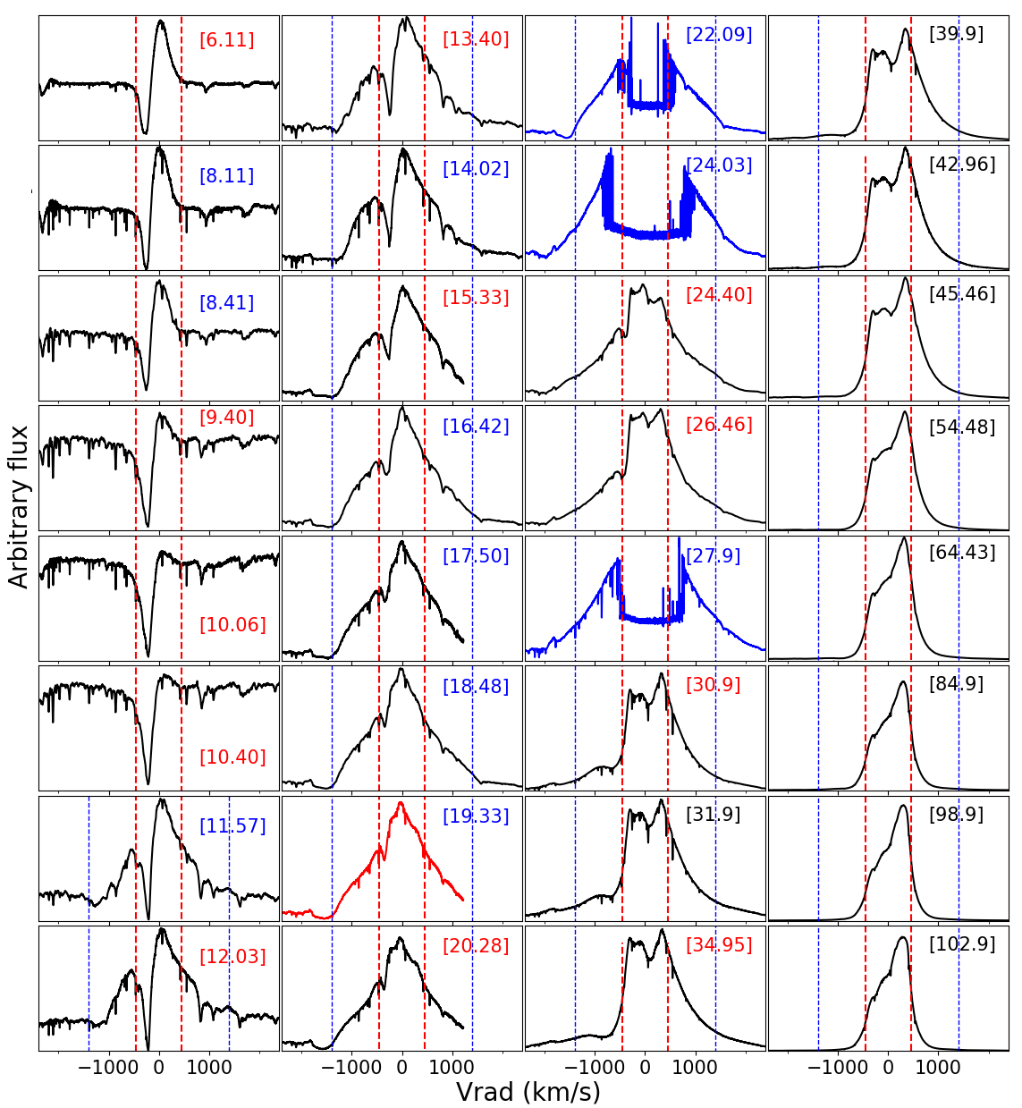
Spectra reveals two outflows
Halpha line profiles evolution
Aydi et al. 2020 (Nat Ast, 4, 776)
E. Aydi - MSU

Slide 36
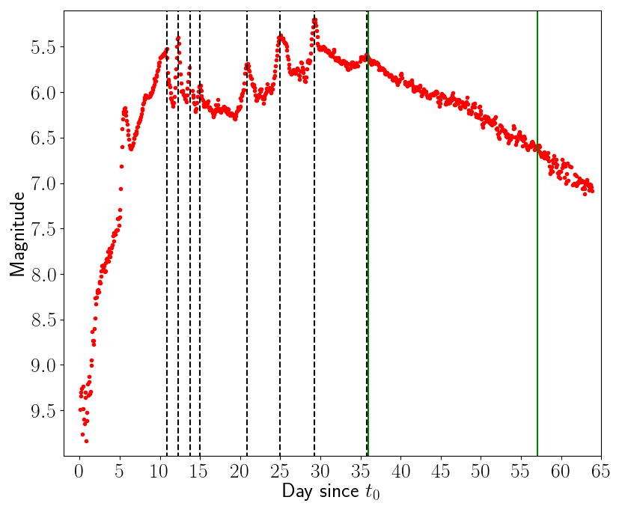
Spectra reveals two outflows
Halpha line profiles evolution
Aydi et al. 2020 (Nat Ast, 4, 776)
E. Aydi - MSU

Slide 37
Spectra reveals two outflows
Halpha line profiles evolution
Peak
Aydi et al. 2020 (Nat Ast, 4, 776)
E. Aydi - MSU

Slide 38
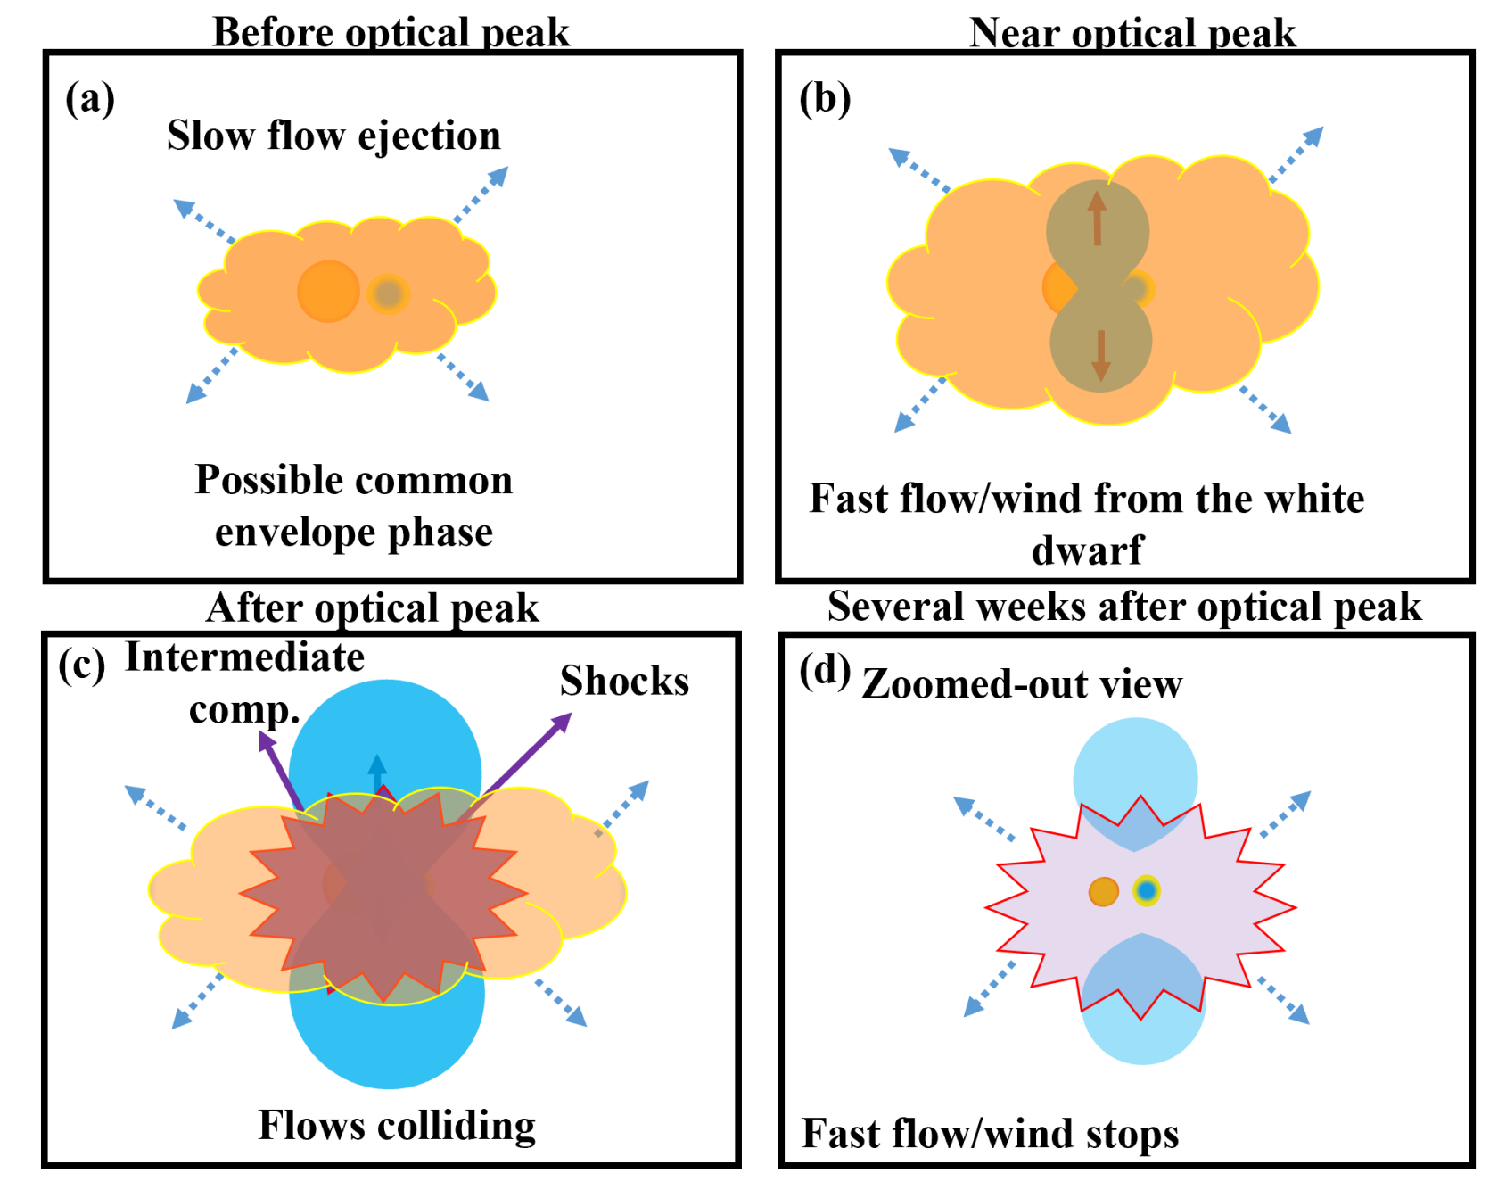
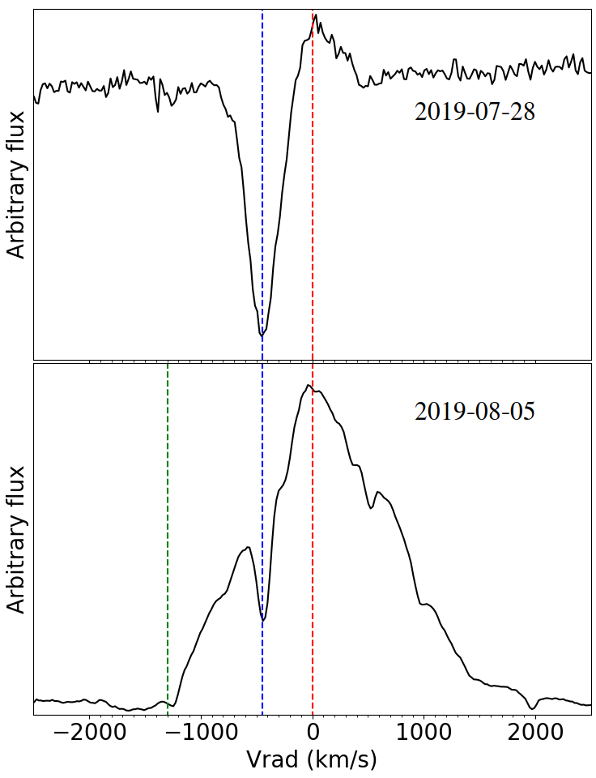
Spectra reveals two outflows
Nova LMC 2019
[-3]
SALT - SAAO
[+5]
SMARTS
E. Aydi - MSU
Aydi et al. 2020, ApJ, 905, 62

Slide 39
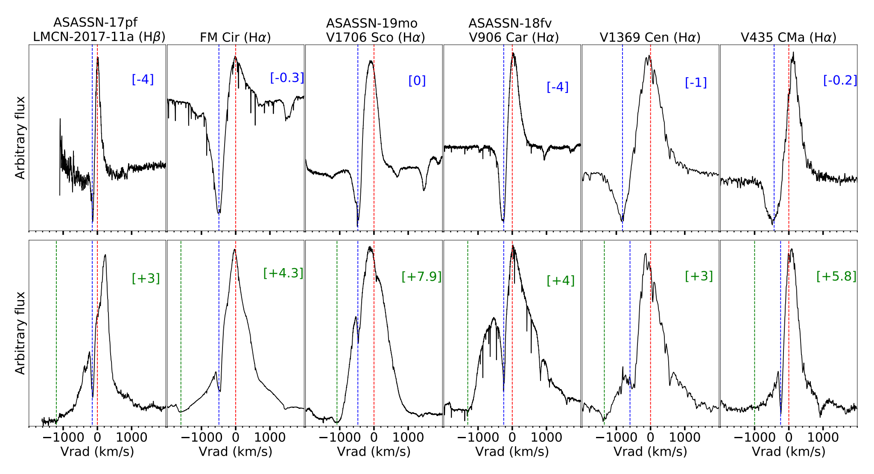
Spectra reveals two outflows
E. Aydi - MSU
Aydi et al. 2020, ApJ, 905, 62

Slide 40
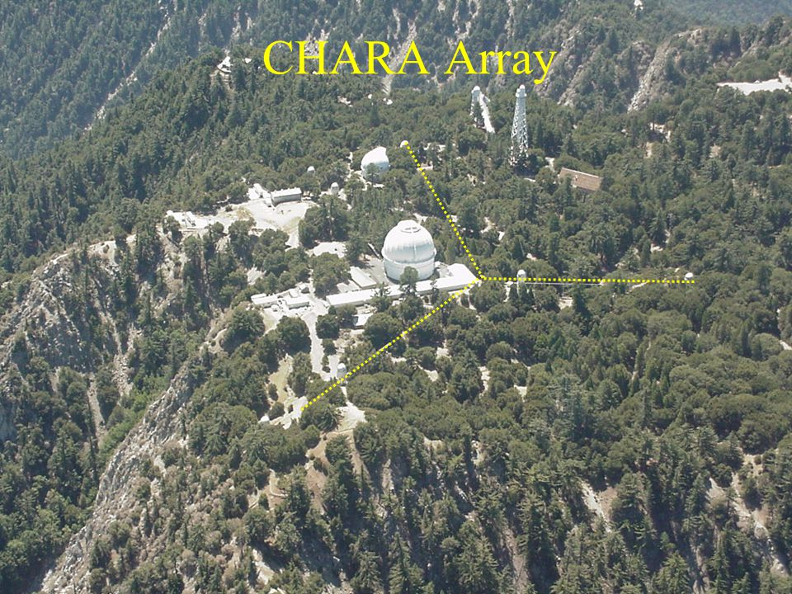
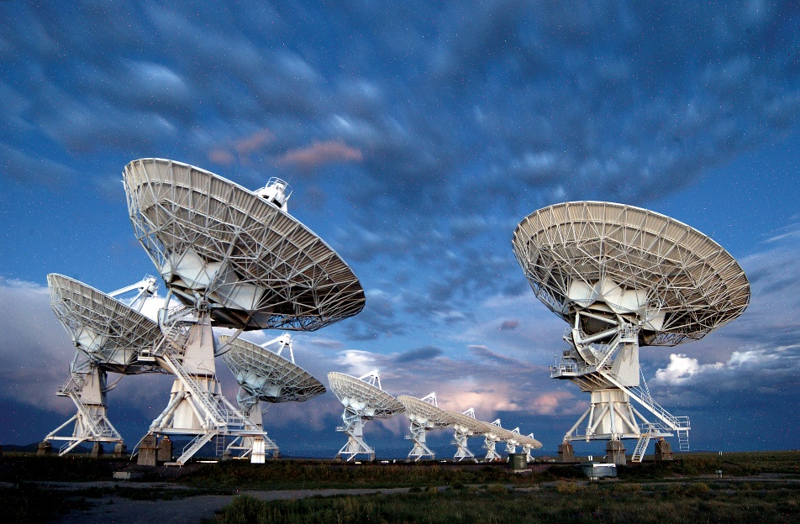
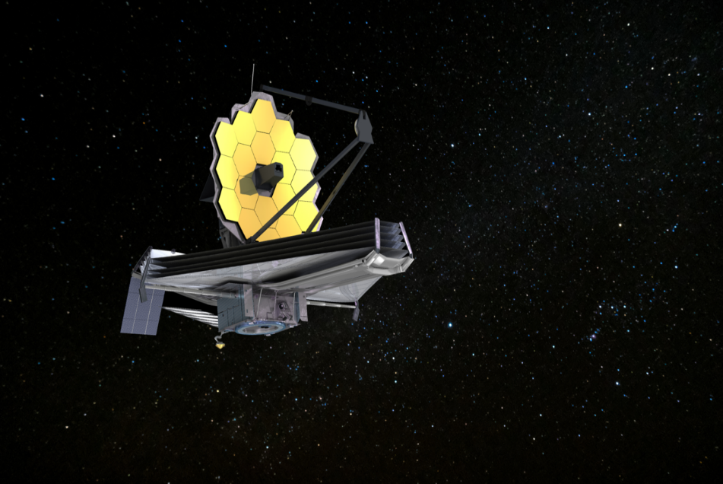
Imaging across an eruption
Early days/weeks
Months/year later
~ years later
VLA
JWST
SALT - SAAO
SMARTS
E. Aydi - MSU

Slide 41
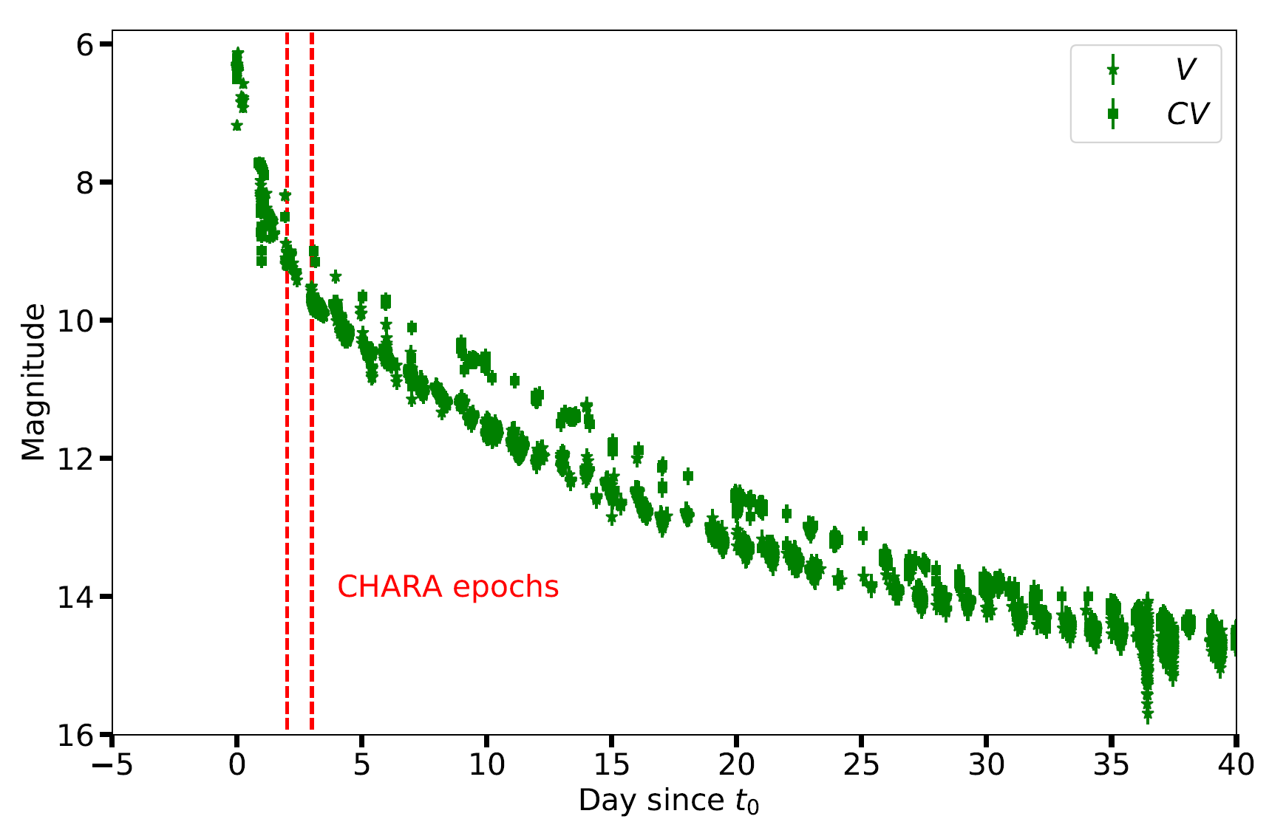
Imaging with CHARA
Nova V1674 Her - Discovered on June 12, 2021
Aydi et al. in perp.
SMARTS
E. Aydi - MSU

Slide 42
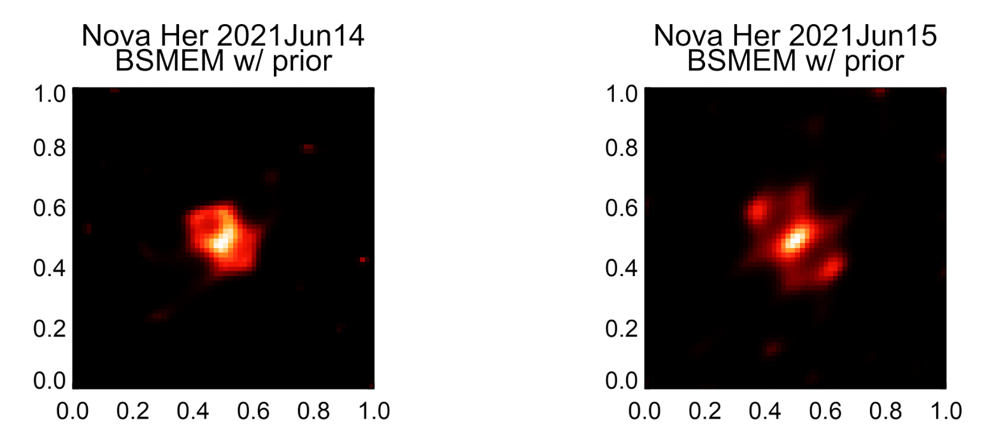
Imaging with CHARA
Day 2 (June 14, 2021)
Day 3 (June 15, 2021)
Aydi et al. in perp.
1 mas
SMARTS
+2 days
+3 days
(mas)
(mas)
Aydi et al. in perp.
E. Aydi - MSU
Preliminary results: Thanks to Gail Schaefer and John Monier

Slide 43
Imaging with CHARA
Day 2 (June 14, 2021)
Day 3 (June 15, 2021)
Aydi et al. in perp.
1 mas
SMARTS
+2 days
+3 days
(mas)
(mas)
Aydi et al. in perp.
E. Aydi - MSU
Preliminary results: Thanks to Gail Schaefer and John Monier

Slide 44
Imaging with CHARA
Day 2 (June 14, 2021)
Day 3 (June 15, 2021)
Aydi et al. in perp.
1 mas
SMARTS
+2 days
+3 days
(mas)
(mas)
Aydi et al. in perp.
E. Aydi - MSU
Preliminary results: Thanks to Gail Schaefer and John Monier

Slide 45
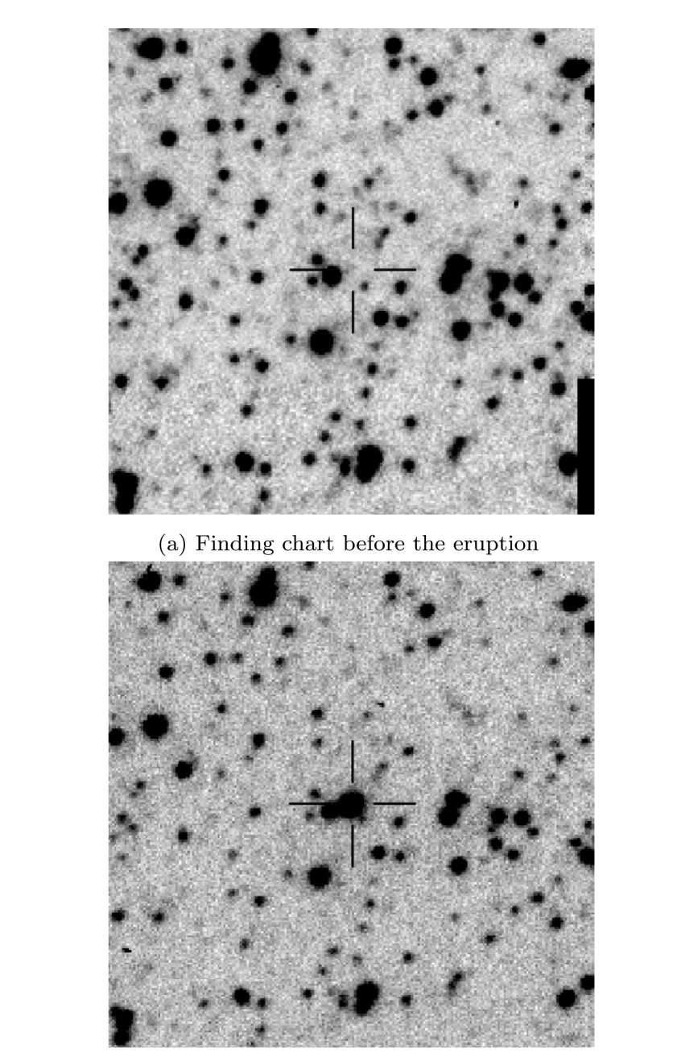
Imaging with CHARA
Nova V5852 Sgr Aydi et al. (2016)
E. Aydi - MSU

Slide 46
Imaging with CHARA
Day 2 (June 14, 2021)
Day 3 (June 15, 2021)
Aydi et al. in perp.
1 mas
SMARTS
+2 days
+3 days
(mas)
(mas)
Aydi et al. in perp.
E. Aydi - MSU
Preliminary results: Thanks to Gail Schaefer and John Monier

Slide 47
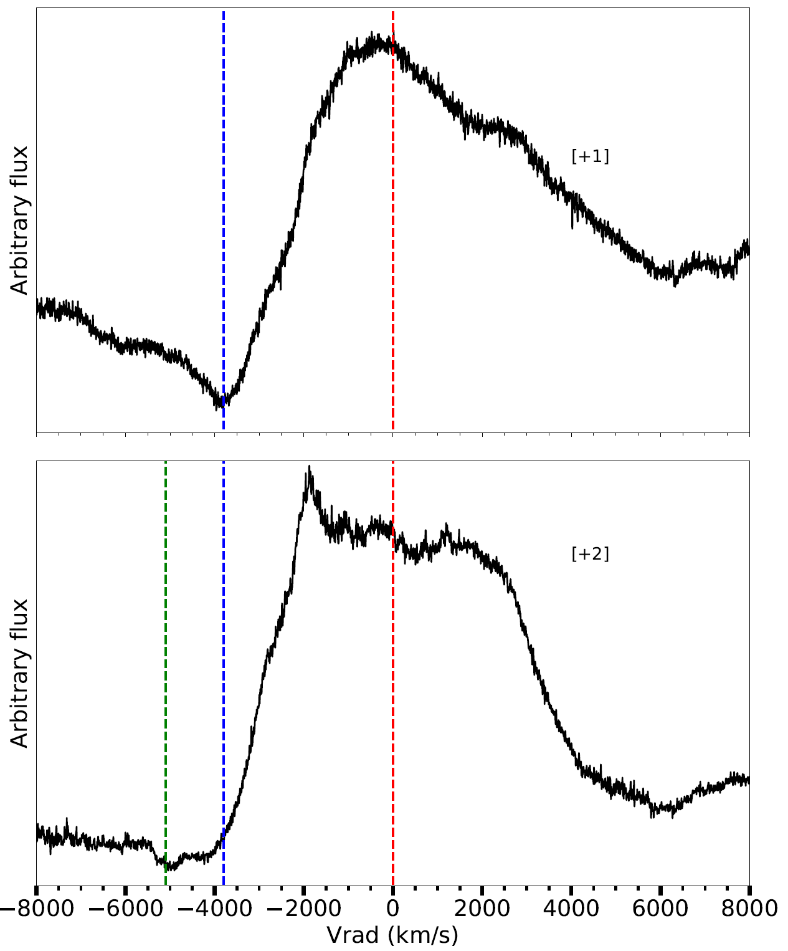
Imaging with CHARA
Aydi et al. in perp.
3800 km/s
+2 days
(mas)
5000 km/s
+3 days
(mas)
SMARTS
E. Aydi - MSU

Slide 48
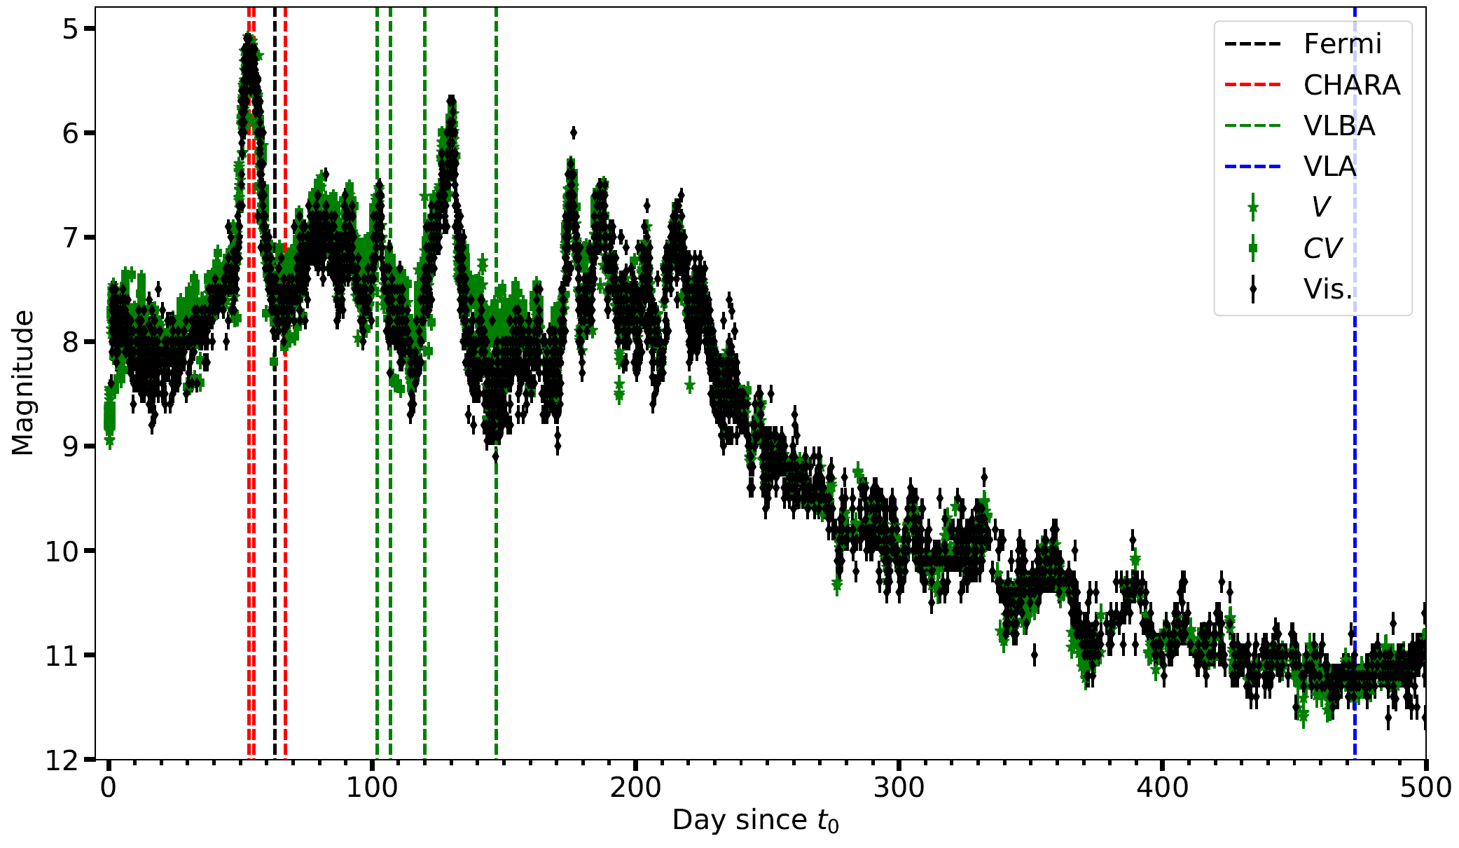
Imaging with CHARA
Nova V1405 Cas- Discovered on Marc 18, 2021
SMARTS
Aydi et al. in perp.
E. Aydi - MSU

Slide 49
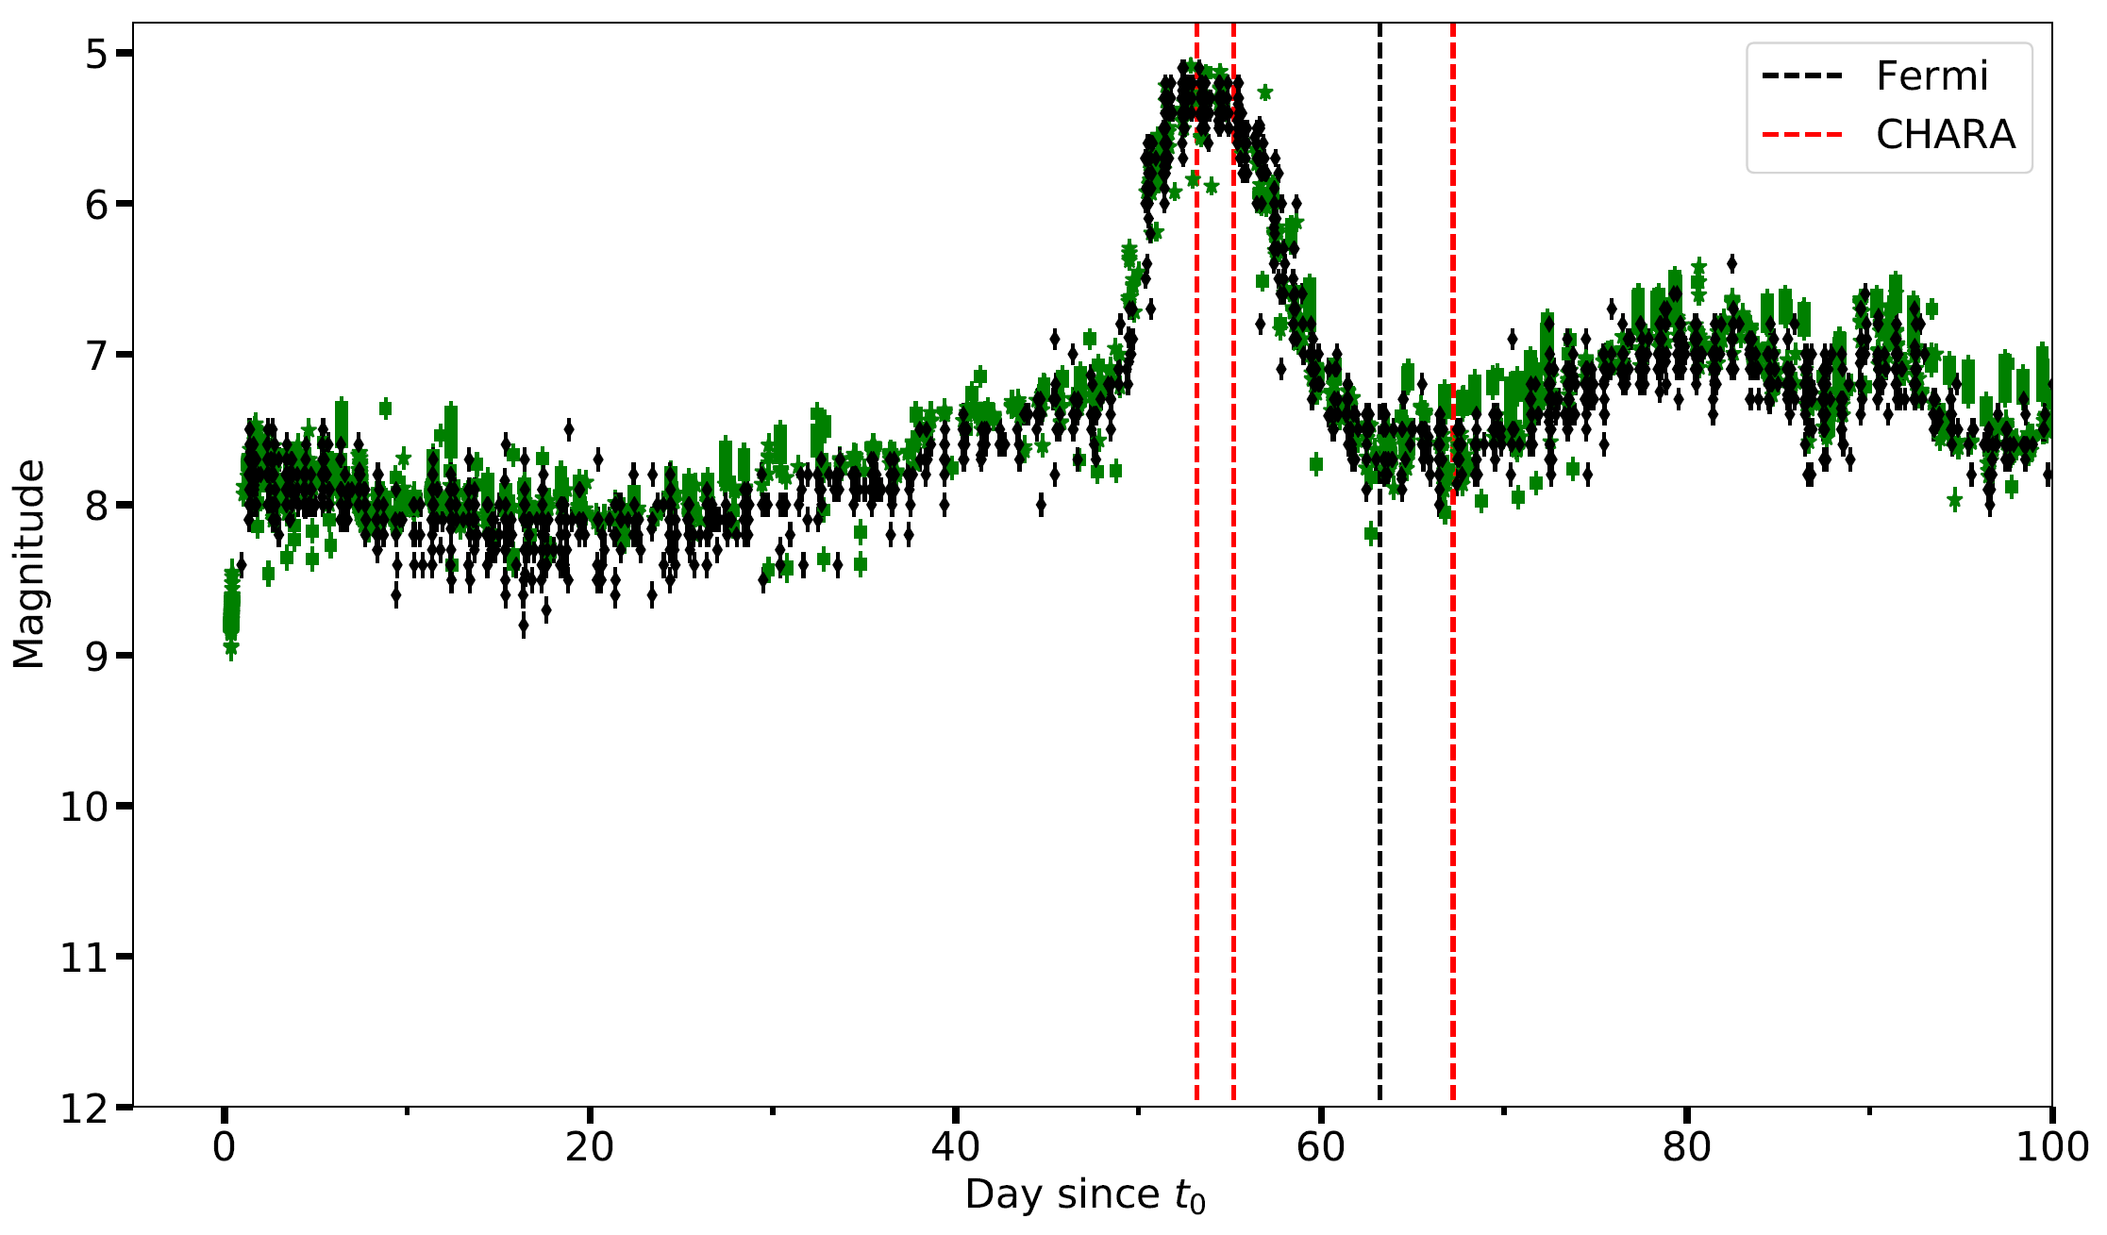
Imaging with CHARA
Nova V1405 Cas- Discovered on Marc 18, 2021
SMARTS
Aydi et al. in perp.
E. Aydi - MSU

Slide 50
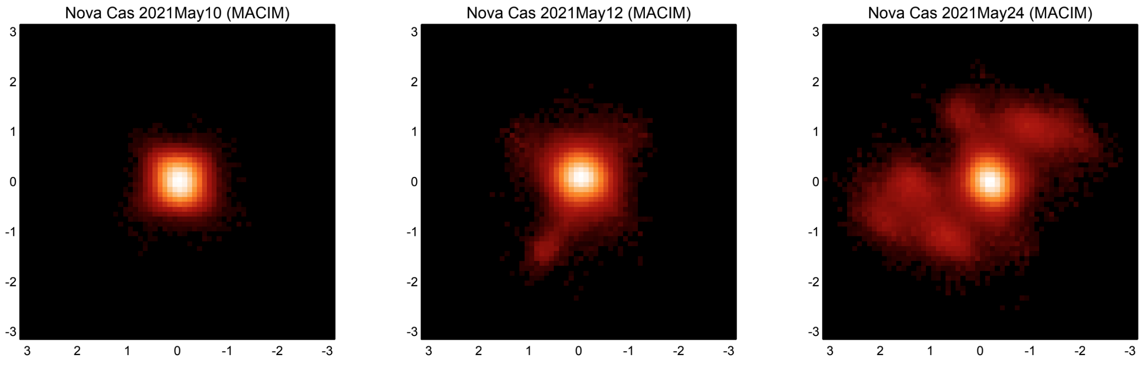
Imaging with CHARA
+53 days
+55 days
+67 days
SMARTS
(mas)
(mas)
(mas)
Aydi et al. in perp.
E. Aydi - MSU
Preliminary results: Thanks to Gail Schaefer and John Monier

Slide 51
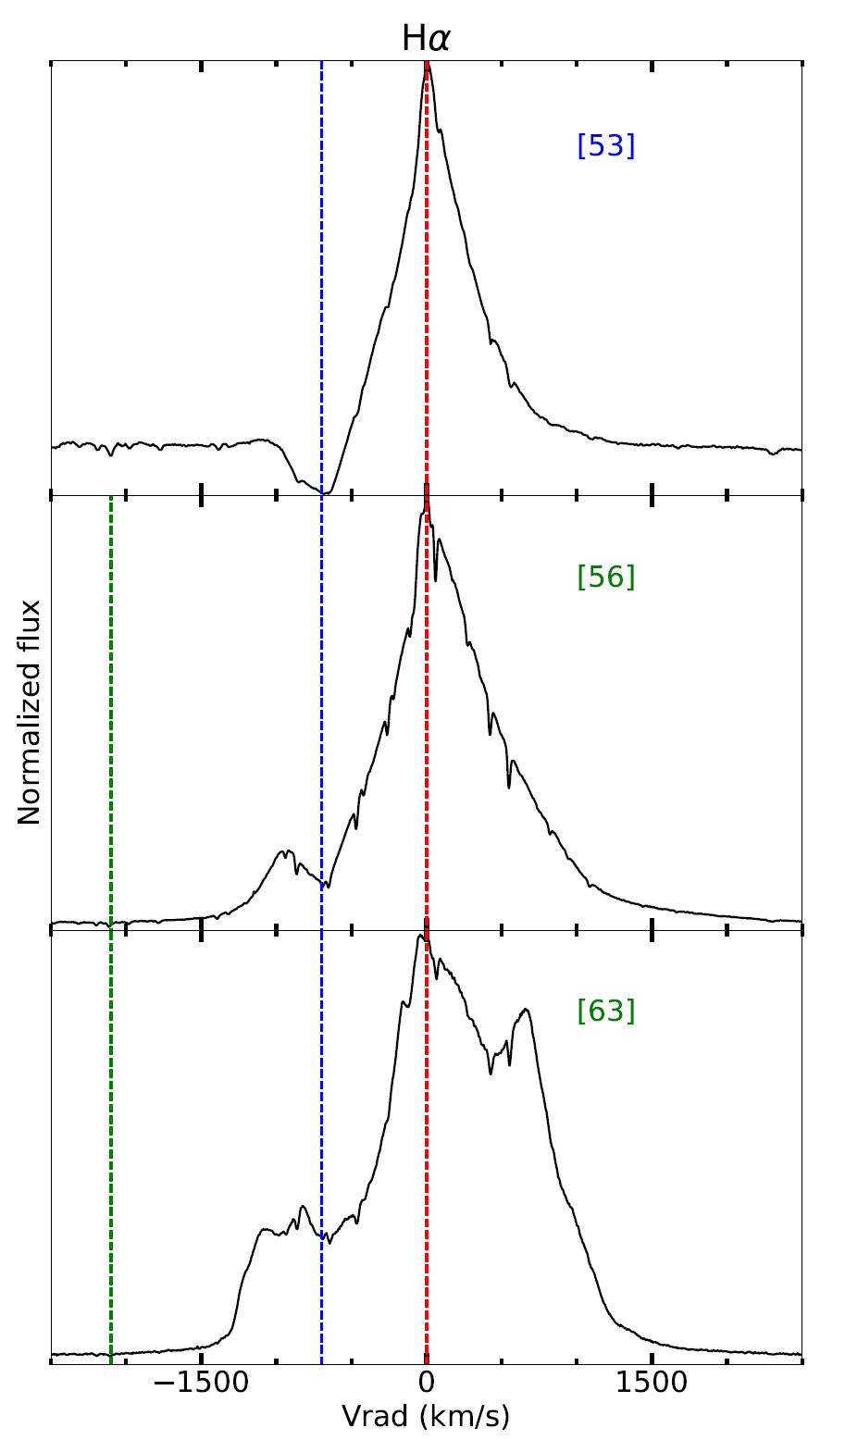

Imaging with CHARA
700 km/s
2100 km/s
SMARTS
Aydi et al. in perp.
E. Aydi - MSU

Slide 52

Imaging with CHARA
Nova V1405 Cas- Discovered on Marc 18, 2021
SMARTS
Aydi et al. in perp.
E. Aydi - MSU

Slide 53

More answers
SMARTS
E. Aydi 2018 ©
E. Aydi - MSU
Strope et al. (2010)

Slide 54
How do novae expel their envelopes?
If the binary motion helps expel the envelope, novae could be miniature common envelope systems evolving in real time!!
SALT - SAAO
SMARTS
E. Aydi - MSU
Aydi et al. (2020, ApJ, 905, 62)

Slide 55
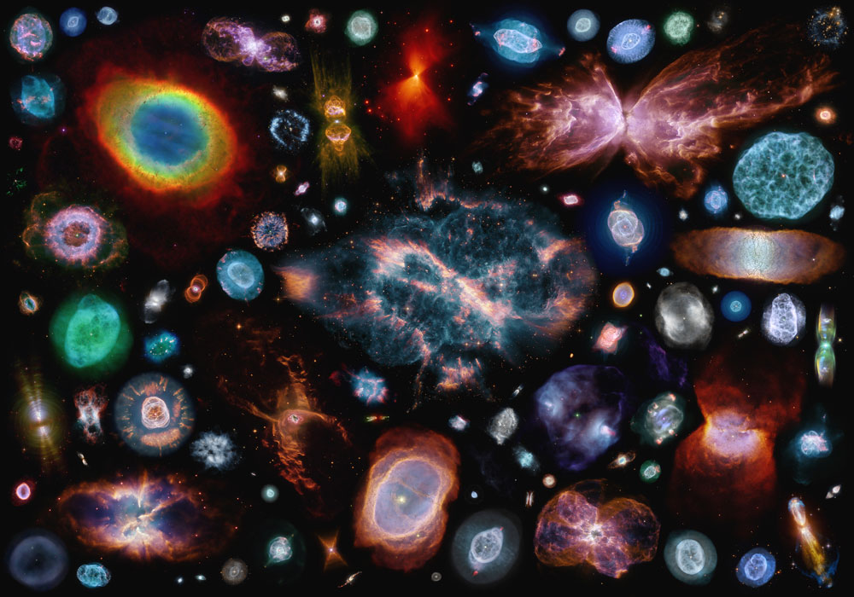
How do novae expel their envelopes?
E. Aydi - MSU

Slide 56
How novae expel their envelopes?
Early days
Months/year later
~year later
ng-VLA?
JWST
SALT - SAAO
Common envelope laboratory evolving on days/weeks timescale in our Galactic backyard
SMARTS
E. Aydi - MSU

Slide 57
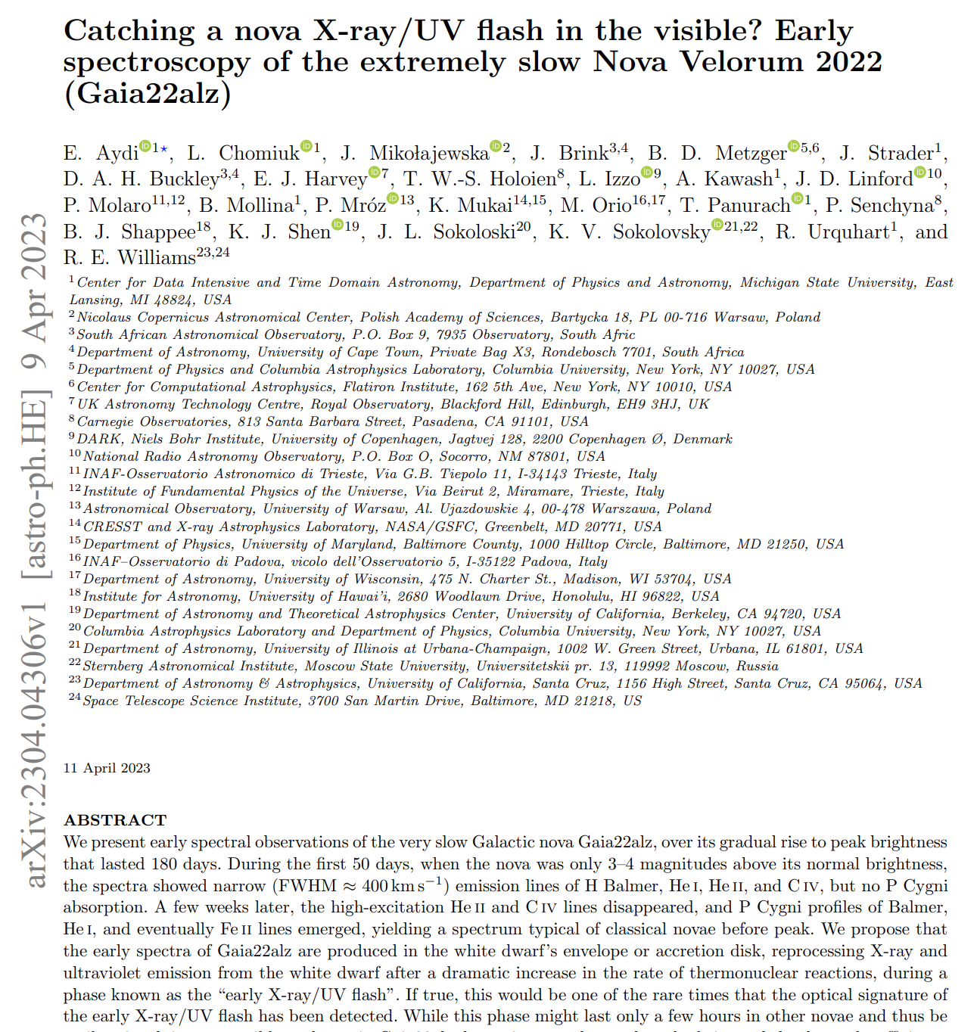
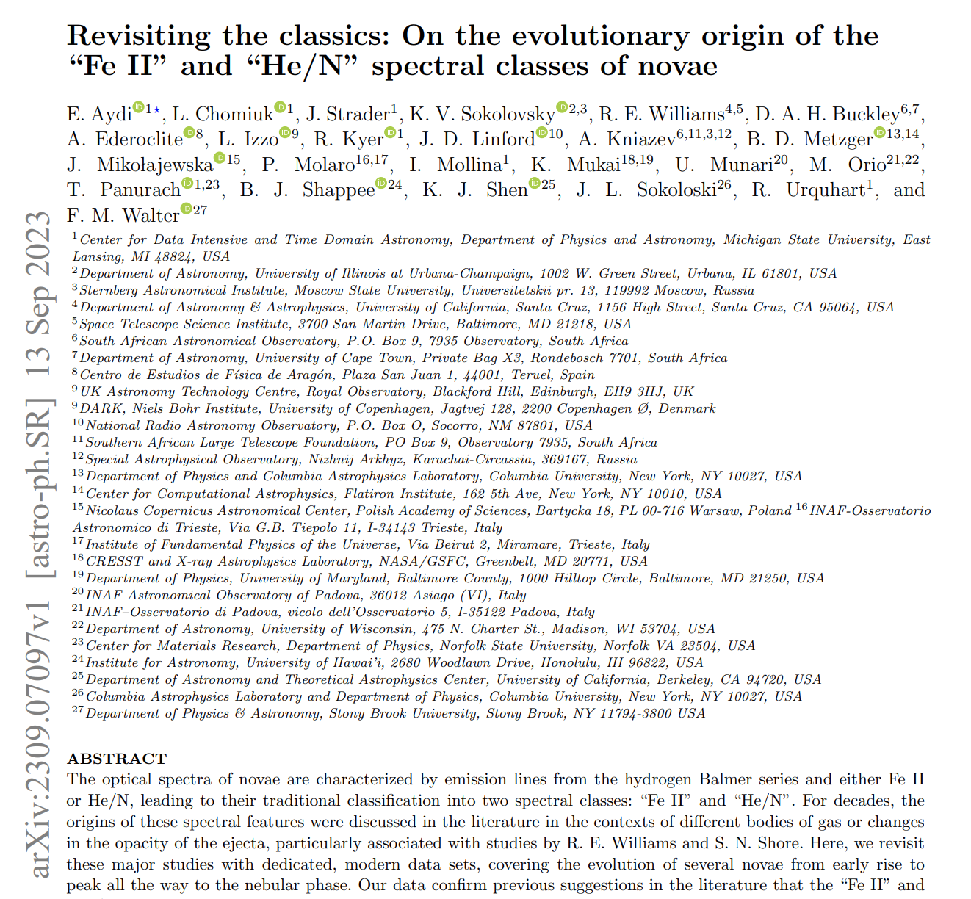
Check it out!
SALT - SAAO
SMARTS
Aydi et al. 2023, MNRAS, 524, 1946
Aydi et al. 2023, arXiv: 2309.070907
E. Aydi - MSU

Slide 58
Summary
Shocks play a major role in powering nova luminosities.
Novae can serve as very valuable laboratories in our Galactic backyard to understand particle acceleration and shock interaction in other shock-powered transients.
The nova shock model has the potential to tackle some key questsion in binary and high-energy astrophysics.
SALT - SAAO
SMARTS
E. Aydi - MSU

Slide 59
What determines the shock power in novae?
SALT - SAAO
E. Aydi - MSU

Slide 60
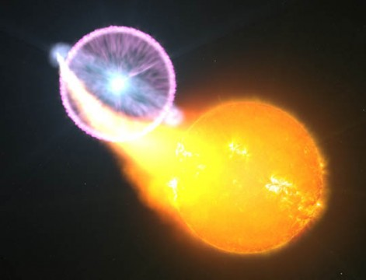
What determines the shock power in novae?
SALT - SAAO
2 to 3 novae are detected with Fermi each year
SMARTS
E. Aydi - MSU

Slide 61
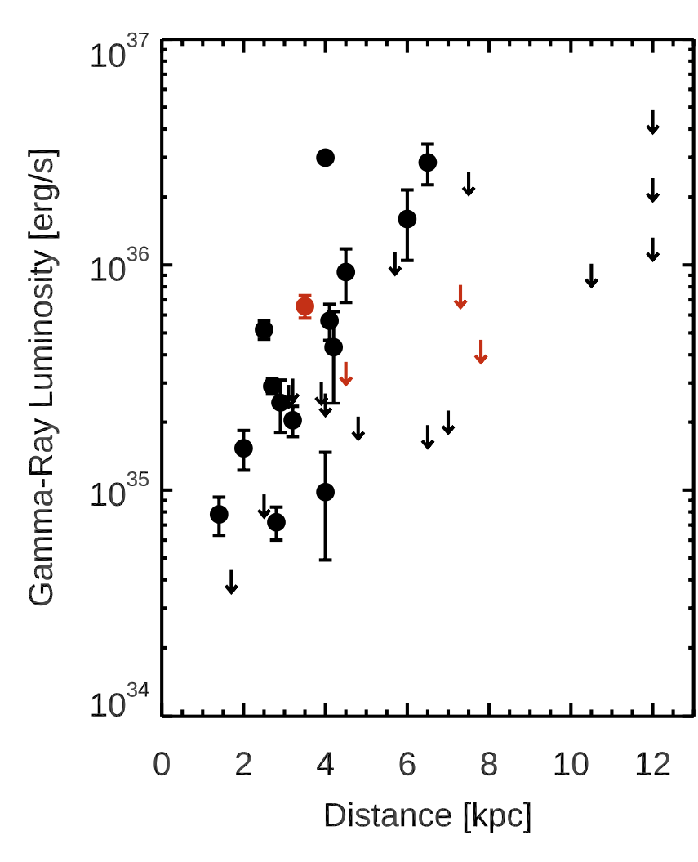
What determines the shock power in novae?
SALT - SAAO
SMARTS
Chomuik et al. (2021)
E. Aydi - MSU

Slide 62
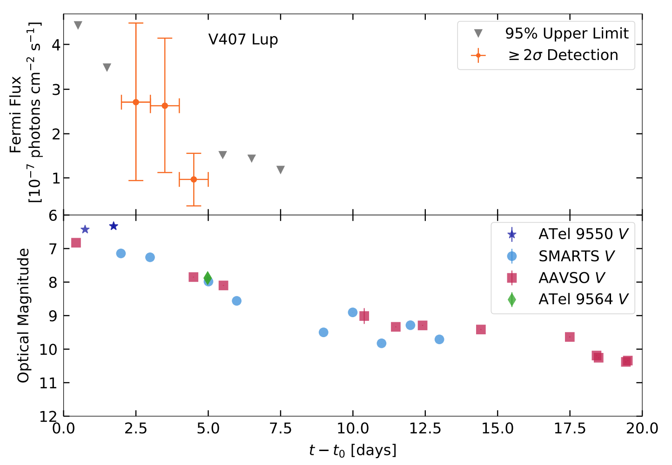
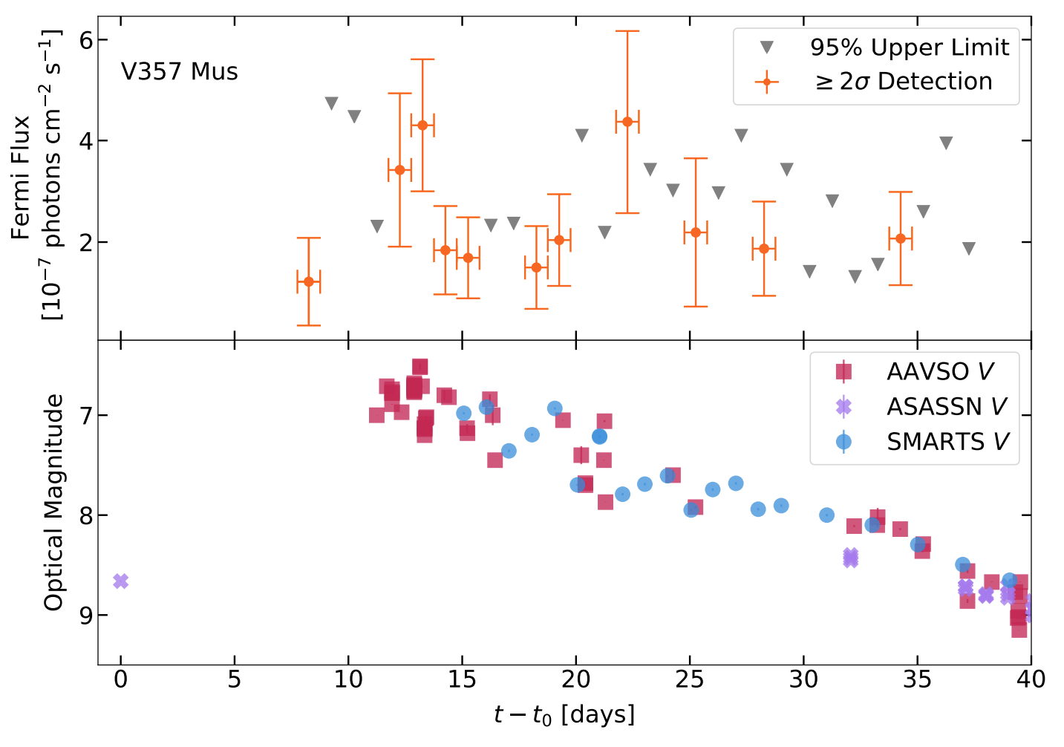
What determines the shock power in novae?
SALT - SAAO
SMARTS
Gordon et al. (2021)
E. Aydi - MSU

Slide 63

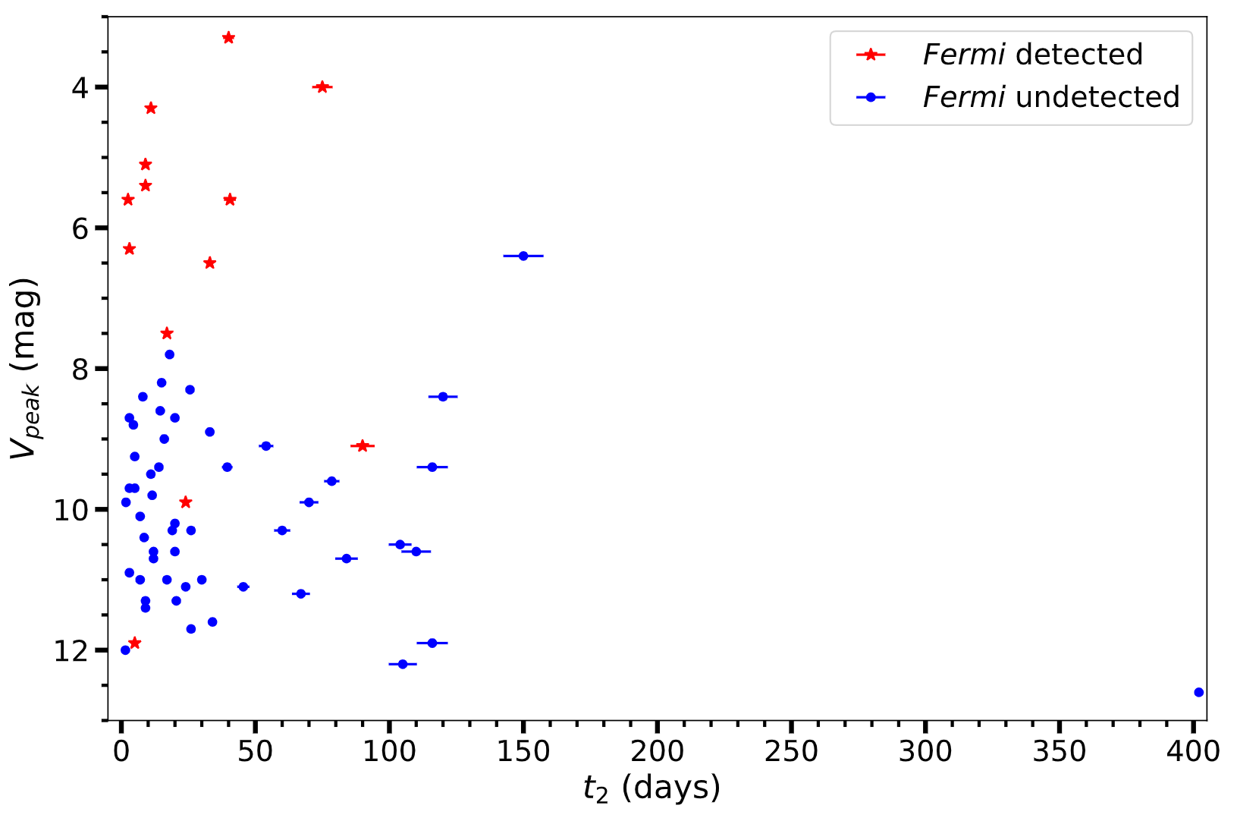
What determines the shock power in novae?
SALT - SAAO
Ashley Stone
SMARTS
Stone et al in prep.
E. Aydi - MSU

Slide 64
Luminosity of the shocks??
L_{sh} ρv²
∝
SMARTS
E. Aydi - MSU
Aydi et al. 2020, ApJ, 905, 62

Slide 65

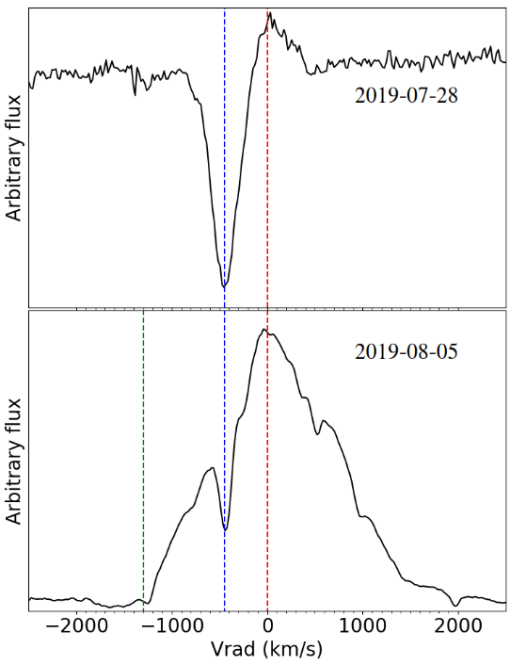
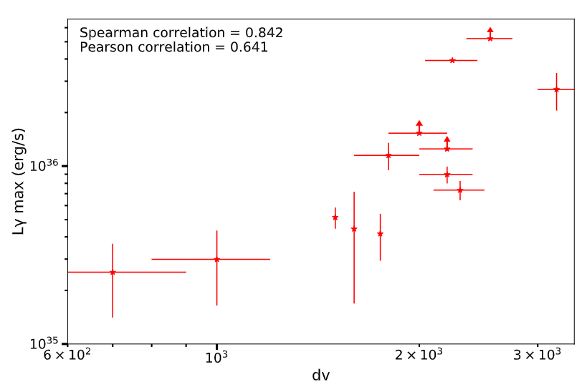
Parameter space to determine Lgamma
Stone et al in prep.
Ashley Stone
SALT - SAAO
SMARTS
E. Aydi - MSU

Slide 66
What determines the shock power in novae?
SALT - SAAO
Ashley Stone
SMARTS
Stone et al in prep.
E. Aydi - MSU

Slide 67
Parameter space to determine Lgamma
Stone et al in prep.
Ashley Stone
SALT - SAAO
SMARTS
E. Aydi - MSU

Slide 68
Check it out!
SALT - SAAO
SMARTS
Aydi et al. 2023, MNRAS, 524, 1946
Aydi et al. 2023, arXiv: 2309.070907
E. Aydi - MSU

Slide 69
Summary
Shocks play a major role in powering nova luminosities.
Novae can serve as very valuable laboratories in our Galactic backyard to understand particle acceleration and shock interaction in other shock-powered transients.
The nova shock model has the potential to tackle some key questsion in binary and high-energy astrophysics.
SALT - SAAO
SMARTS
E. Aydi - MSU

Slide 70
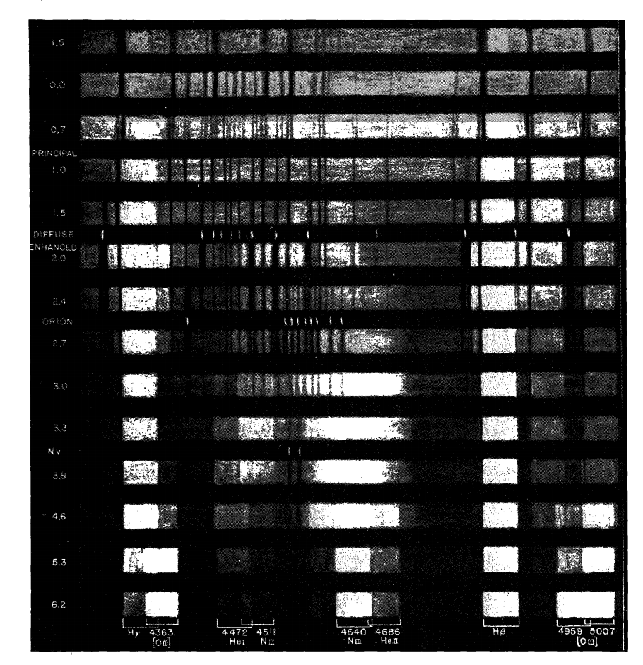
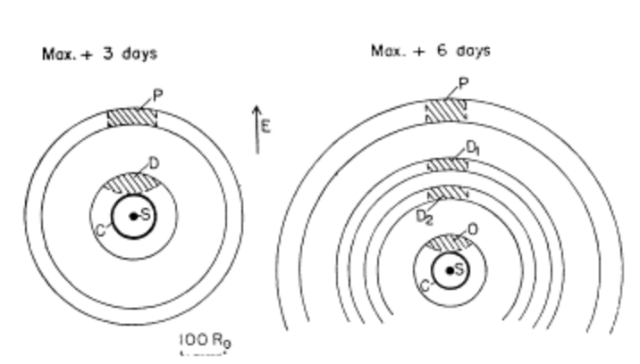
High-resolution spectroscopy is the key
McLaughlin (1944), Payne-Gaposchkin (1957)
SALT - SAAO
SMARTS
McLaughlin (1964)
E. Aydi - MSU

Slide 71
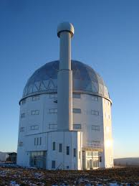
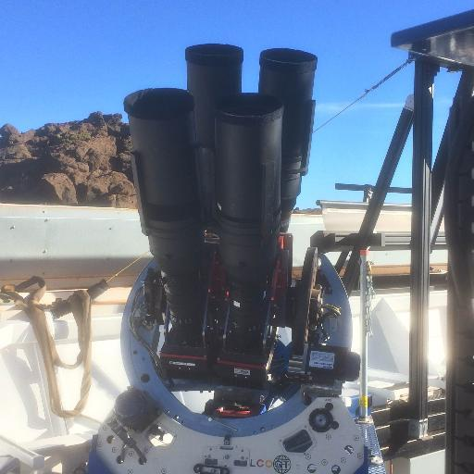
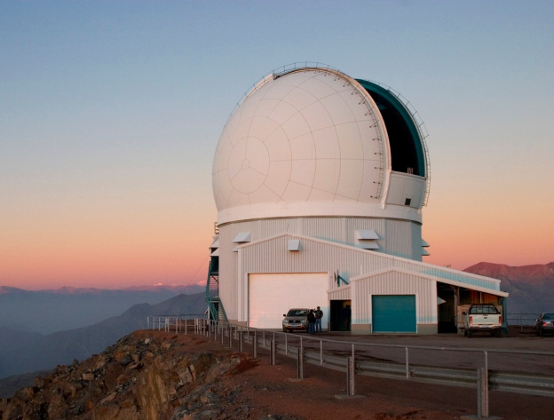

High-resolution spectroscopy is the key
SALT
SOAR
SALT - SAAO
Community of amateur astronomers
(AAVSO and ARAS)
SMARTS
E. Aydi - MSU

Slide 72
High-resolution spectroscopy is the key
E. Aydi - MSU
Aydi et al. 2020, ApJ, 905, 62

Slide 73
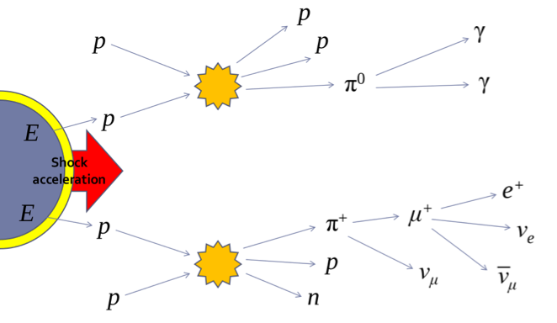

Novae as neutrino sources
Hadronic
Leptonic
SMARTS
E. Aydi - MSU

Slide 74

Novae as neutrino sources
IceCube
SMARTS
E. Aydi - MSU

Slide 75
Novae as neutrino sources
IceCube – upgraded
SMARTS
E. Aydi - MSU

Slide 76

Novae as TeV sources
Nova RS Oph (2021)
RS Oph is a Galactic recurrent nova with a recurrence period of 15-16 years.
SMARTS
E. Aydi - MSU

Slide 77


Novae as TeV sources
SMARTS
High Energy Stereoscopic System
(HESS)
Major Atmospheric Gamma-ray Imaging Cherenkov Telescope
(MAGIC)
E. Aydi - MSU

Slide 78

Novae as TeV sources
HESS Collab. (2022)
SMARTS
E. Aydi - MSU

Slide 79

Novae as TeV sources
E. Aydi
E. Aydi - MSU

Slide 80


Novae as TeV sources
VERITAS
IceCube
CTA
SMARTS
Particle accelerators in our Galactic backyard
E. Aydi - MSU

Slide 81
Shocks internal to the ejecta?
Chomiuk et al. (2014)
E. Aydi - MSU

Slide 82
Shocks internal to the ejecta?
Chomiuk et al. (2014)
Shocks could be radiative, but how much?
E. Aydi - MSU

Slide 83
Shocks internal to the ejecta?
Chomiuk et al. (2014)
Observed Lγ ~ 10³⁵ -10³⁶ erg/s
E. Aydi - MSU
Chomiuk et al. (2021)

Slide 84

Gamma-rays from novae
Li et al. (2017)
L_{γ} ~ 0.1 - 1% L_{Bol}
≈
(10³⁸ erg/s)
SMARTS
E. Aydi - MSU

Slide 85
Gamma-rays from novae
L_{γ} = L_{sh} ε γ εnth
Li et al. (2017)
Standard γ-gamma ray emission mechanism:
L_{γ} ~ 0.1 - 1% L_{Bol}
≈
(10³⁸ erg/s)
~5%
20%
SMARTS
L_{γ} ~ 1% L_{sh}
E. Aydi - MSU

Slide 86
Radiative shocks?
Chomiuk et al. (2014)
L_{sh} ≈ 10³⁸ erg/s
Rivaling the bolometric luminosity of the nova.
Shock energy is radiated rather than being dissipated into adiabatic expansion (and then reprocessed into visible emission)
Shocks as an additional source of emission
E. Aydi - MSU

Slide 87
Shock powered emission??
Chomiuk et al. (2014)
E. Aydi - MSU
Strope et al. (2010)

Slide 88

V906 Car (ASASSN-18fv)
Discovered by the All-Sky Automated Survey for SNe (ASAS-SN) on March 21, 2018
(Stanek et al. 2018, ATel 11454)
SMARTS
Photo credits: A. Muray &
J. Fabrega
E. Aydi 2018 ©
E. Aydi - MSU

Slide 89

V906 Car
SMARTS
E. Aydi 2018 ©
E. Aydi - MSU

Slide 90
V906 Car
Aydi et al. 2020 (Nat Ast, 2, 697)
SMARTS
E. Aydi 2018 ©
E. Aydi - MSU

Slide 91

V906 Car
Aydi et al. 2020 (Nat Ast, 2, 697)
Fermi-LAT
SMARTS
E. Aydi 2018 ©
E. Aydi - MSU

Slide 92
Gamma-rays from novae
Li et al. (2017)
L_{γ} ~ 0.1 - 1% L_{Bol}
≈
(10³⁸ erg/s)
SMARTS
E. Aydi - MSU

Slide 93
Gamma-rays from novae
Lγ = Lsh ε γ εnth
Li et al. (2017)
Diffusive shock acceleration mechanism
L_{γ} ~ 0.1 - 1% L_{Bol}
≈
(10³⁸ erg/s)
~5%
E. Aydi - MSU

Slide 94
Gamma-rays from novae
Lγ = Lsh ε γ εnth
Li et al. (2017)
Standard γ-gamma ray emission mechanism:
L_{γ} ~ 0.1 - 1% L_{Bol}
≈
(10³⁸ erg/s)
~5%
20%
SMARTS
E. Aydi - MSU

Slide 95
Gamma-rays from novae
L_{γ} = L_{sh} ε γ εnth
Li et al. (2017)
Standard γ-gamma ray emission mechanism:
L_{γ} ~ 0.1 - 1% L_{Bol}
≈
(10³⁸ erg/s)
~5%
20%
SMARTS
L_{γ} ~ 1% L_{sh}
E. Aydi - MSU

Slide 96
Gamma-rays from novae
Li et al. (2017)
L_{γ} ~ 0.1 - 1% L_{Bol}
L_{γ} ~ 1% L_{sh}
≈
(10³⁸ erg/s)
L_{sh} ≈ 10³⁸ erg/s
Rivaling the bolometric luminosity of the nova
SMARTS
E. Aydi - MSU

Slide 97
Radiative shocks?
Chomiuk et al. (2014)
L_{sh} ≈ 10³⁸ erg/s
Rivaling the bolometric luminosity of the nova.
Shock energy is radiated rather than being dissipated into adiabatic expansion (and then reprocessed into visible emission)
Shocks as an additional source of emission
E. Aydi - MSU

Slide 98



Shocks powering other stellar eruptions
Tidal
Disruption
Events
Type IIn SNe
Stellar mergers
SMARTS
E. Aydi - MSU

Slide 99
Observational support
V5856 Sgr (ASASSN-16ma)
Li et al. (2017)
SMARTS
E. Aydi - MSU

Slide 100

Two outflows scenario?
Credits: NASA Goddard/Fermi
E. Aydi - MSU

Slide 101
V906 Car
Aydi et al. 2020 (Nat Ast, 2, 697)
E. Aydi - MSU

Slide 102

V906 Car
Aydi et al. 2020 (Nat Ast, 2, 697)
E. Aydi - MSU

Slide 103

V906 Car
Image Credits:
Daniel Kasen
E. Aydi - MSU

Slide 104
V906 Car
Aydi et al. 2020 (Nat Ast, 2, 697)
E. Aydi - MSU

Slide 105
V906 Car
Aydi et al. 2020 (Nat Ast, 2, 697)
Peak
E. Aydi - MSU

Slide 106
High-resolution spectroscopy is the key
Nova LMC 2019
[-3]
SALT - SAAO
[+5]
SMARTS
E. Aydi - MSU
Aydi et al. 2020, ApJ, 905, 62

Slide 107
High-resolution spectroscopy is the key
E. Aydi - MSU
Aydi et al. 2020, ApJ, 905, 62

Slide 108
High-resolution spectroscopy is the key
Nova LMC 2019
[-3]
SALT - SAAO
[+5]
SMARTS
E. Aydi - MSU
Aydi et al. 2020, ApJ, 905, 62

Slide 109

V906 Car
Aydi et al. 2020 (Nat Ast, 2, 697)
NuSTAR
E. Aydi - MSU

Slide 110
V906 Car
Aydi et al. 2020 (Nat Ast, 2, 697)
X-ray coming
From deeply
Embedded shocks
L_{X} ~ 10^34 erg/s
X-rays are absorbed/suppressed
E. Aydi - MSU

Slide 111


Shocks internal to the ejecta
SMARTS
Chomiuk et al. (2014)
Steinberg & Metzger (2018)
E. Aydi - MSU

Slide 112
V906 Car
Aydi et al. 2020 (Nat Ast, 2, 697)
X-ray coming
From deeply
Embedded shocks
L_{X} ~ 10^34 erg/s
X-rays are absorbed/suppressed
E. Aydi - MSU

Slide 113

Early hard X-rays from shocks
(2001)
SALT - SAAO
SMARTS
E. Aydi - MSU

Slide 114



Surveying the X-ray Behavior of novae
Gordon et al. (2021, ApJ, 910, 134)
Alexa C. Gordon
SALT - SAAO
SMARTS
Swift Grant – PI: Aydi
E. Aydi - MSU

Slide 115

Surveying the X-ray Behavior of novae
Gordon et al. (2021, ApJ, 910, 134)
Alexa C. Gordon
SALT - SAAO
Recurrent novae
V3890 Sgr and RS Oph
SMARTS
E. Aydi - MSU

Slide 116
Gamma-rays from novae
External shocks
Internal shocks
Credits: http://svs.gsfc.nasa.gov/goto?10626
SMARTS
E. Aydi - MSU

Slide 117


How much do shocks contribute to the bolometric luminosity?
SALT - SAAO
NASA ADAP Grant
PI: Aydi/Chomiuk
SMARTS
E. Aydi - MSU

Slide 118
New insights into classical novae!!
What is the parameter space that determines the luminosity of shocks in stellar explosions?
How novae expel their envelopes?
Novae can be used as miniature common envelope events.
Are novae potential multi-messenger sources?
SALT - SAAO
SMARTS
E. Aydi - MSU

Slide 119


MORP Program at MSU Obs.
Film by Elias Aydi
E. Aydi - MSU

Slide 120


Outreach at MSU Obs.
Film by Elias Aydi
E. Aydi - MSU

Slide 121

Excitement!!
SALT - SAAO
SMARTS
E. Aydi - MSU

Slide 122


Two Minute Paper project
SALT - SAAO
SMARTS
E. Aydi - MSU

Slide 123
The future is BRITE
SMARTS
E. Aydi - MSU

Slide 124

The future with TESS
SMARTS
E. Aydi - MSU

Slide 125

TESS as a tool to study Novae
ASASSN-19qv (nova SMC 2019)
Aydi et al. in prep.
Discovered by ASAS-SN on July 04, 2019 in the SMC
SMARTS
E. Aydi - MSU

Slide 126

TESS as a tool to study Novae
ASASSN-19qv (nova SMC 2019)
Aydi et al. in prep.
Discovered by ASAS-SN on July 04, 2019 in the SMC
SMARTS
E. Aydi - MSU

Slide 127

TESS as a tool to study Novae
ASASSN-19qv (nova SMC 2019)
Aydi et al. in prep.
SMARTS
E. Aydi - MSU

Slide 128
TESS as a tool to study Novae
SMARTS
E. Aydi - MSU

Slide 129

Two Minute Paper project
SALT - SAAO
SMARTS
E. Aydi - MSU

Slide 130
Two Minute Paper project
SALT - SAAO
Suppport from NSF/AAS to establish this platform and turn it into an interdisciplinary project
SMARTS
E. Aydi - MSU

Slide 131

Imaging years into the eruption
Nova V906 Car ≈ 2 years after eruption with Zorro on Gemini
Preliminary results:
Thanks to Ricardo Salinas
And Eliott Horch
Halpha
832 nm
SMARTS
170 mas
90 mas
E. Aydi - MSU

Slide 132
Imaging years into the eruption
Nova V906 Car ≈ 2 years after eruption with Zorro on Gemini
Preliminary results:
Thanks to Ricardo Salinas
And Eliott Horch
Halpha
832 nm
SMARTS
170 mas
90 mas
E. Aydi - MSU

Slide 133
Novae in the radio
SMARTS
E. Aydi 2018 ©
E. Aydi - MSU

Slide 134

Typical radio light curve of novae
SMARTS
E. Aydi 2018 ©
E. Aydi - MSU

Slide 135
Typical radio light curve of novae
SMARTS
E. Aydi 2018 ©
E. Aydi - MSU

Slide 136
Typical radio light curve of novae
SMARTS
E. Aydi 2018 ©
E. Aydi - MSU

Slide 137

Novae in the radio
Chomiuk et al. 2021,
ApJ, 257, 49
E. Aydi - MSU

Slide 138

Novae in the radio
Chomiuk et al. 2021, ApJ, 257, 49
E. Aydi - MSU

Slide 139
Novae in the radio
Chomiuk et al. 2021,
ApJ, 257, 49
E. Aydi - MSU

Slide 140

Novae across the spectrum
SMARTS
E. Aydi - MSU

Slide 141

Gamma-rays from novae
Leptonic scenario
Strong magnetic fields are required near the shocks to confine and accelerate particles up to sufficiently high energies ∼10 − 100 GeV to generate the observed gamma-ray emission;
Embedded in the same magnetic field, however, relativistic electrons lose energy to lower-frequency synchrotron radiation faster than it can be emitted as gamma-rays, disfavoring the leptonic models
SMARTS
E. Aydi - MSU

Slide 142

Shock parameter space
Metzger et al. (2016)
SMARTS
E. Aydi - MSU

Slide 143

Novae as laboratory
SMARTS
E. Aydi - MSU

Slide 144
Novae as laboratory
Cosmic neutrino background?
SMARTS
E. Aydi - MSU

Slide 145

Novae as laboratory
Fang et al. (2021)
SMARTS
E. Aydi - MSU

Slide 146
Novae as laboratory
Fang et al. (2021)
Contribute a few % of the total IceCube background
SMARTS
E. Aydi - MSU

Slide 147

Laboratory to study shocks and dust formation
SALT - SAAO
Type IIn SNe
Stellar mergers
IR transients
SMARTS
E. Aydi - MSU

Slide 148


How and where dust forms?
Strope et al. (2010)
SMARTS Consortium (Walter 2012)
SMARTS
E. Aydi - MSU

Slide 149

How and where dust forms?
Derdzinski et al. (2017)
SALT - SAAO
SMARTS
E. Aydi - MSU

Slide 150

How and where dust forms?
SMARTS
E. Aydi - MSU

Slide 151
How and where dust forms?
SMARTS
E. Aydi - MSU

Slide 152
How and where dust forms?
SMARTS
E. Aydi - MSU

Slide 153
How and where dust forms?
SMARTS
E. Aydi - MSU

Slide 154

How and where dust forms?
GMOS N/S + GNIRS + FLAMINGOS 2
Strope et al. (2010)
SMARTS
E. Aydi - MSU

Slide 155
How and where dust forms?
GMOS N/S + GNIRS + FLAMINGOS 2
Strope et al. (2010)
JWST
SMARTS
E. Aydi - MSU

Slide 156
How and where dust forms?
Nova V906 Car ≈ 2 years after eruption with Zorro
Preliminary results:
Thanks to Ricardo Salinas
And Eliott Horch
Halpha
832 nm
SMARTS
170 mas
90 mas
E. Aydi - MSU

Slide 157
Shocks powering other stellar eruptions
Tidal
Disruption
Events
Type IIn SNe
Stellar mergers
Shock interaction is commonly invoked to power the light curves of SLSNe – between SN ejecta and CSM material
shocks can take place between fast matter ejected during the dynamical “plunge” phase at the end of the merger process and slower outflows from the earlier gradual inspiral
Shock-mediated collisions between the bound streams of the disrupted star in TDEs may power at least part of the optical emission in these events
SMARTS
E. Aydi - MSU

Slide 158
Gamma-rays from novae
Leptonic scenario
SMARTS
E. Aydi - MSU

Slide 159
Gamma-rays from novae
Hadronic scenario
(pion production)
SMARTS
E. Aydi - MSU

Slide 160


Gamma-rays from novae
Nova V906 Car
(ASASSN-18fv)
Aydi et al. (2020a)
Nova V5856 Sgr
(ASASSN-16ma)
Li et al. (2017)
SMARTS
E. Aydi - MSU

Slide 161

Particle acceleration in novae
Animation
by Andrey Vladimirov
Diffusive Shock Acceleration
A charged particle traveling through the shock wave (from upstream to downstream). If it encounters a moving change in the magnetic field, this can reflect it back through the shock (downstream to upstream) at increased velocity.
If a similar process occurs upstream, the particle will again gain energy.
SMARTS
E. Aydi - MSU

