Slide 1
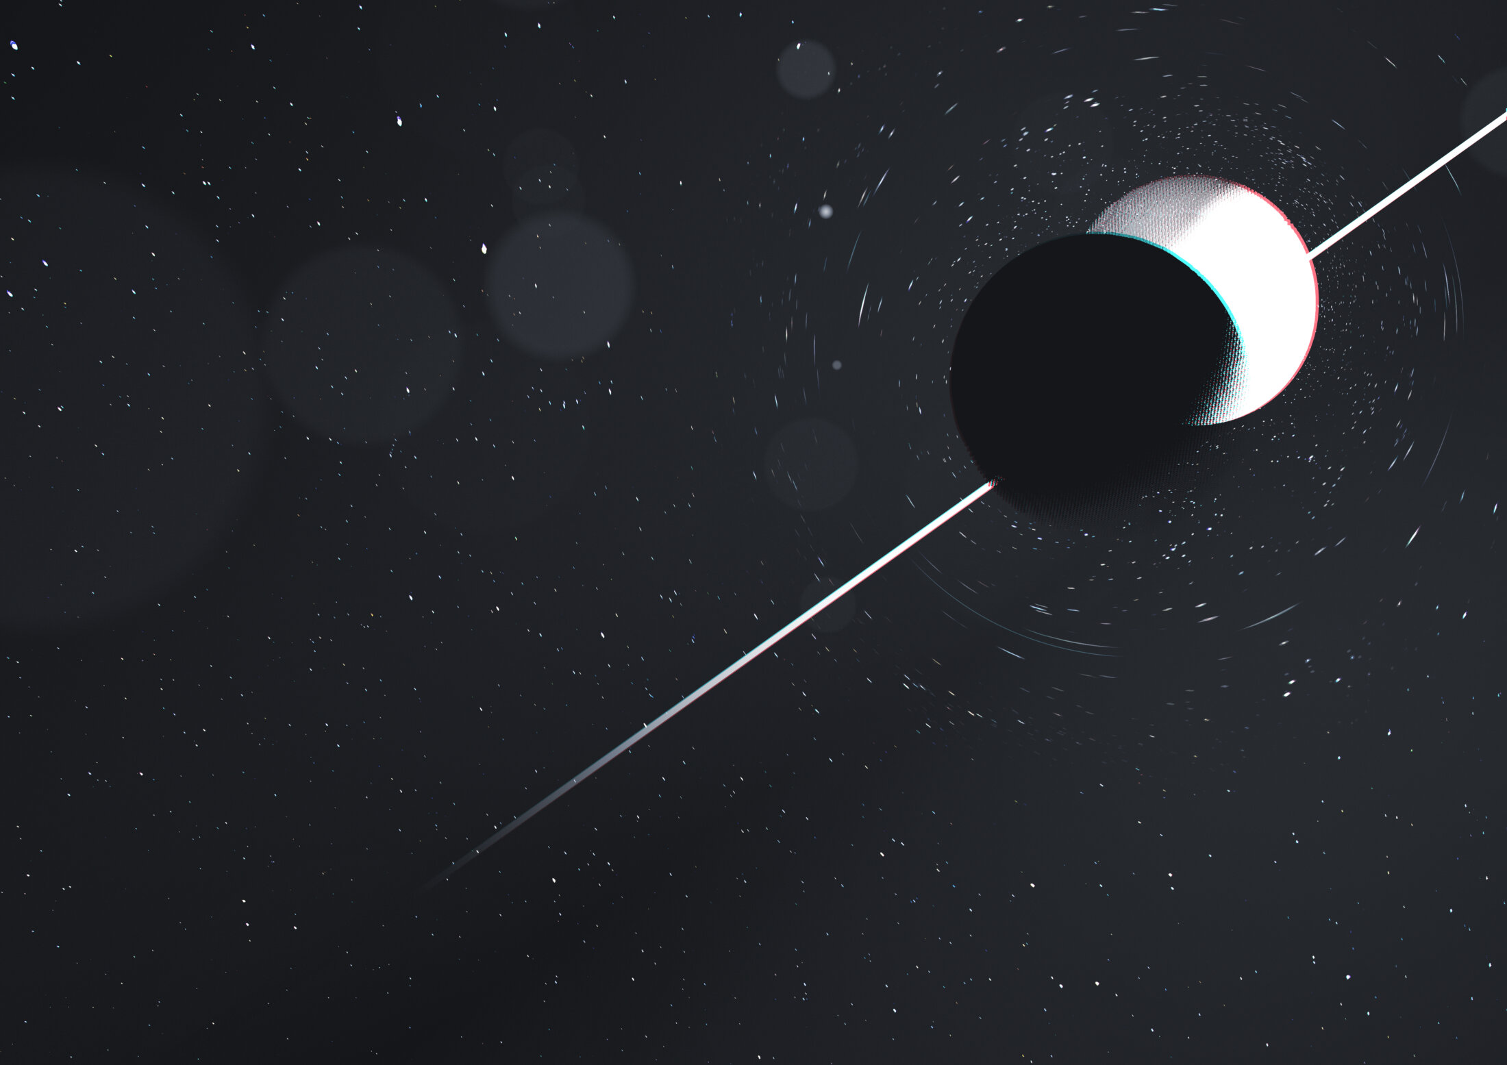
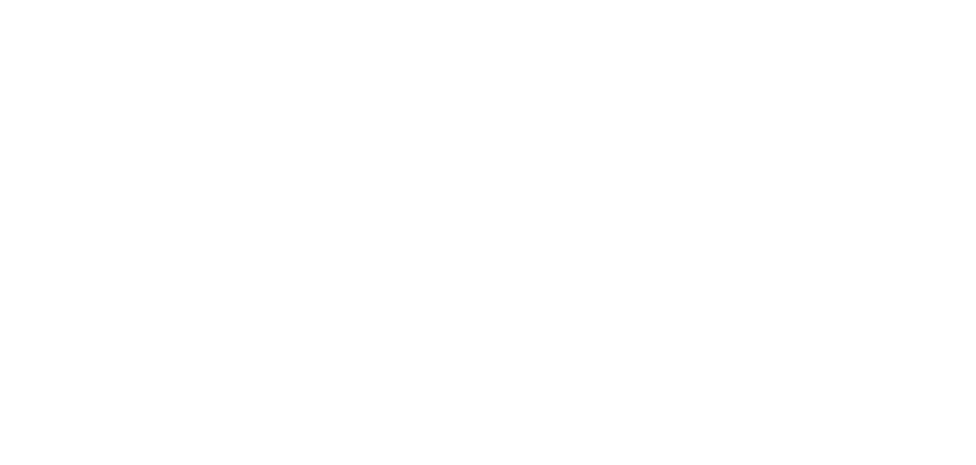


The gravitational-wave population of neutron star-black hole mergers
Image: Carl Knox, OzGrav/Swinburne
Sylvia Biscoveanu
With Philippe Landry, Salvatore Vitale, and Eric Burns
NHFP Symposium 2023
@sylvia_bisco sbisco@northwestern.edu

Slide 2
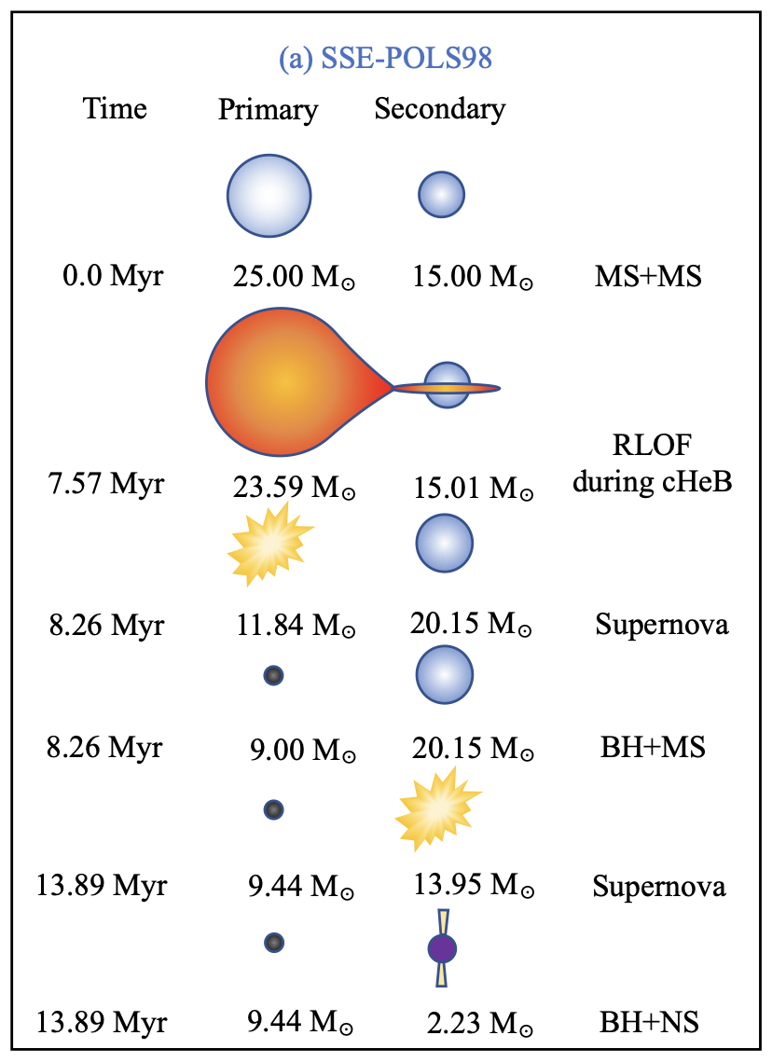
Neutron star-black hole mergers
Agrawal+ 2303.10187
Gravitational-wave observations of the merger of neutron star-black hole binaries offer a promising probe of:
  Compact binary formation channels
  Electromagnetic counterparts like kilonovae and gamma-ray bursts
  The unknown neutron star equation of state

Slide 3
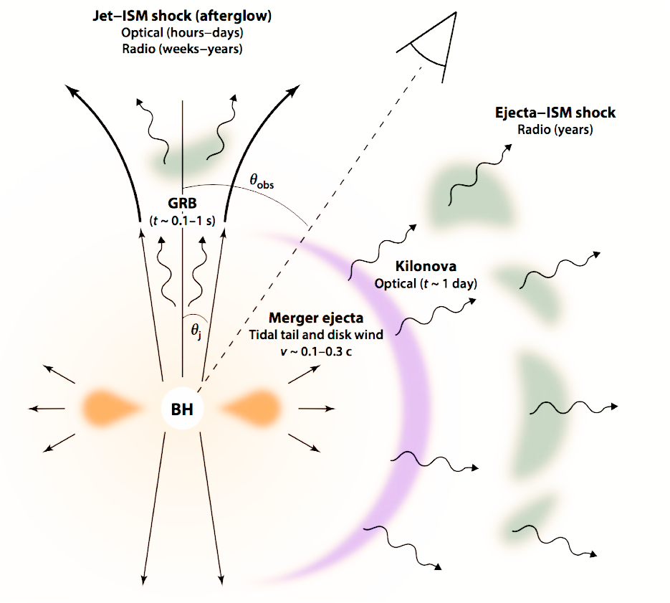
Neutron star-black hole mergers
Gravitational-wave observations of the merger of neutron star-black hole binaries offer a promising probe of:
  Compact binary formation channels
  Electromagnetic counterparts like kilonovae and gamma-ray bursts
  The unknown neutron star equation of state
Metzger 1910.01617

Slide 4
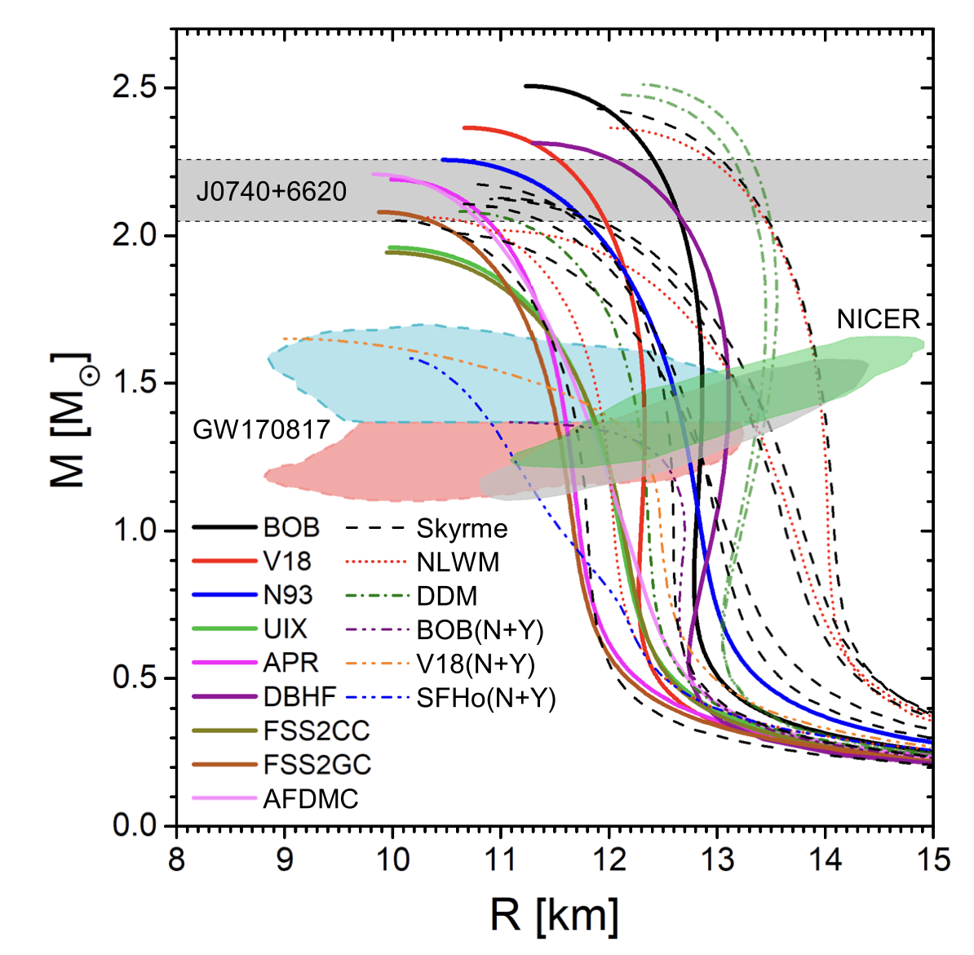
Neutron star-black hole mergers
Burgio+ 2105.03747
Gravitational-wave observations of the merger of neutron star-black hole binaries offer a promising probe of:
  Compact binary formation channels
  Electromagnetic counterparts like kilonovae and gamma-ray bursts
  The unknown neutron star equation of state

Slide 5






Neutron star-black hole mergers
Gravitational-wave observations of the merger of neutron star-black hole binaries offer a promising probe of:
  Compact binary formation channels
  Electromagnetic counterparts like kilonovae and gamma-ray bursts
  The unknown neutron star equation of state
$$\hat{L}$$
$$θ_{1}$$
$$θ_{2}$$
$$χ_{1}$$
$$χ_{2}$$
m₂, $Λ_{2}$
m₁

Slide 6
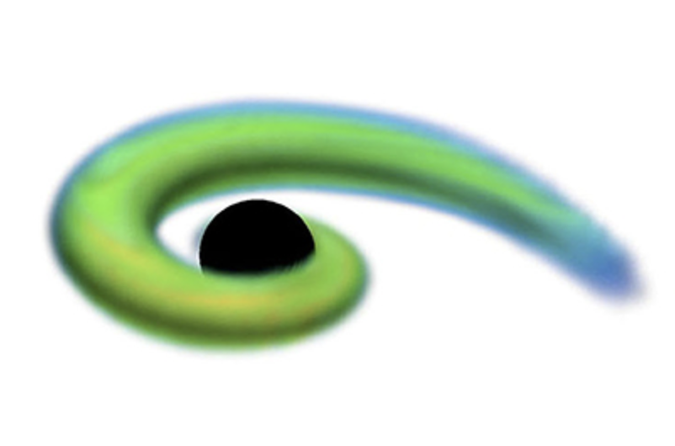



Merger outcomes
$$χ_{f}$$
Rigid neutron stars, unequal mass ratios, small black hole spins:
← Black hole swallows neutron star
$$θ_{JN}$$
m_{f}
$$χ_{f}$$
Deformable neutron stars, equal mass ratios, large prograde spins →
Neutron star tidally disrupted outside ISCO
Image: Foucart 2006.10570
m_{f}

Slide 7
Motivation
What are the mass and spin distributions of neutron star-black hole (NSBH) mergers?
  How do they compare to those of binary black holes?
What are the prospects for detecting electromagnetic counterparts for NSBHs given the observed population?
  Are their population properties conducive to tidal disruption?
What can we learn about the neutron star equation of state when we fold in multimessenger information (or lack thereof)?

Slide 8
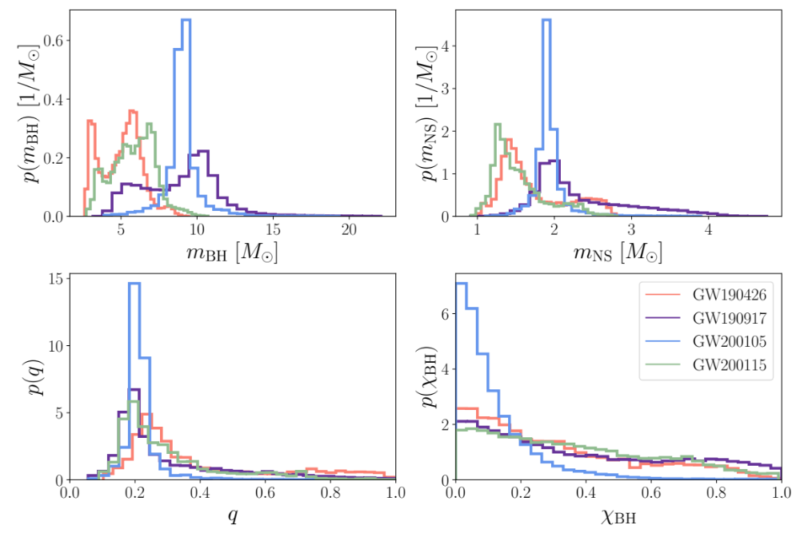
Candidate NSBH events
Four “significant” events detected up to the end of LIGO-Virgo’s third observing run
Infer the parameters governing their mass and spin population distributions using hierarchical Bayesian inference
Notes:
false alarm rate < 1/yr
GW190426_152155 – $9.12×{10}^{−1}$
GW190917_114630 – $6.56×{10}^{−1}$
GW200105_162426 –$2.04×{10}^{−1}$
GW200115_042309 – $<{10}^{−5}$

Slide 9
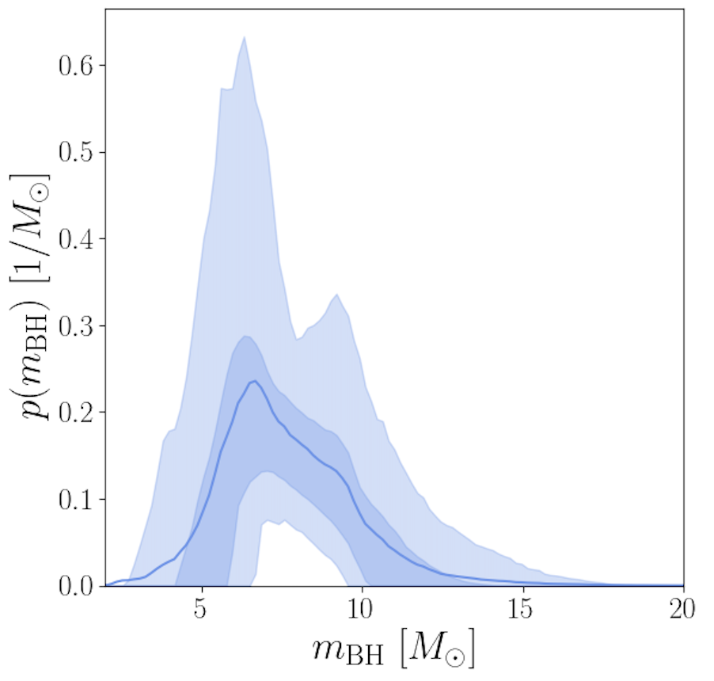
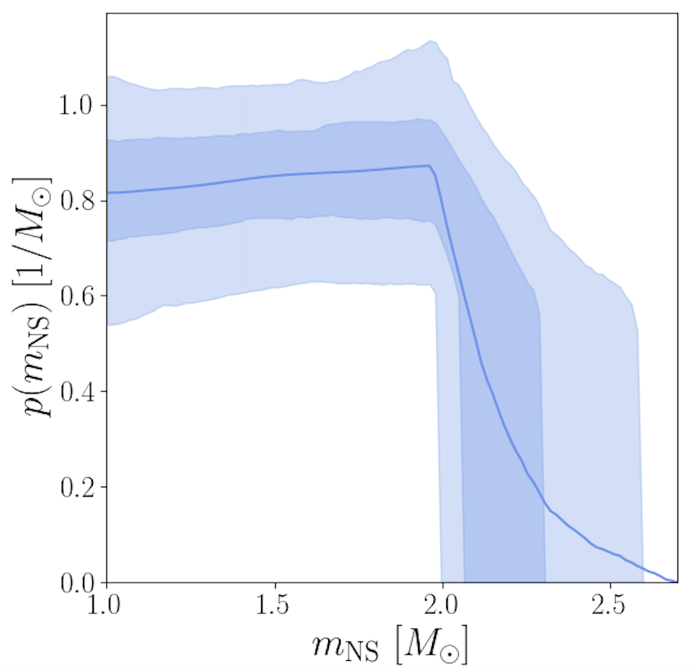
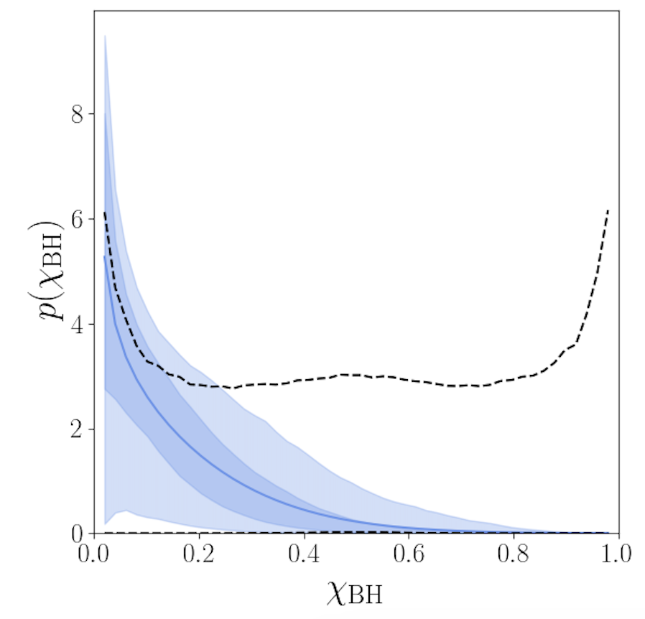
Population results
Black holes in NSBH are less massive and more slowly spinning than in binary black hole systems
Biscoveanu+ 2209.06978
Notes:
q_min = 1/m_BH, q_max = m_NS, max/m_BH
Prior on maximum NS mass goes from 1.97 to 2.7 Msun
Only weak constraints on the neutron star maximum mass, which also depends on the EoS

Slide 10
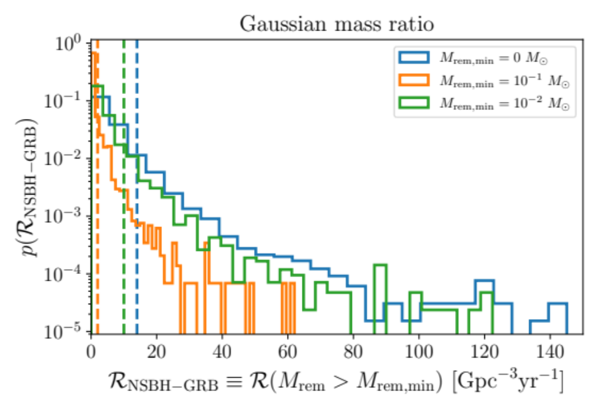
Electromagnetically-bright fraction
Calculate the probability of NS tidal disruption (Foucart+ 1807.00011) given the observed mass and spin distributions and equation of state uncertainty
At most 14% of NSBH sources experience tidal disruption of the neutron star
  Might have an associated electromagnetic counterpart
Upper limit of 20 Gpc⁻³ yr⁻¹ GRBs from NSBH mergers at 90% credibility (underlying beaming-corrected rate)
Biscoveanu+ 2306.14974
Notes:
NSBHs contribute at most $1.03 M_{⊙}{Gpc}^{−3}{yr}^{−1}$ total r-process ejecta, ~40% of the total including binary neutron star contributions
Merger rate of 1.24 − 62.3 Gpc−3yr−1

Slide 11
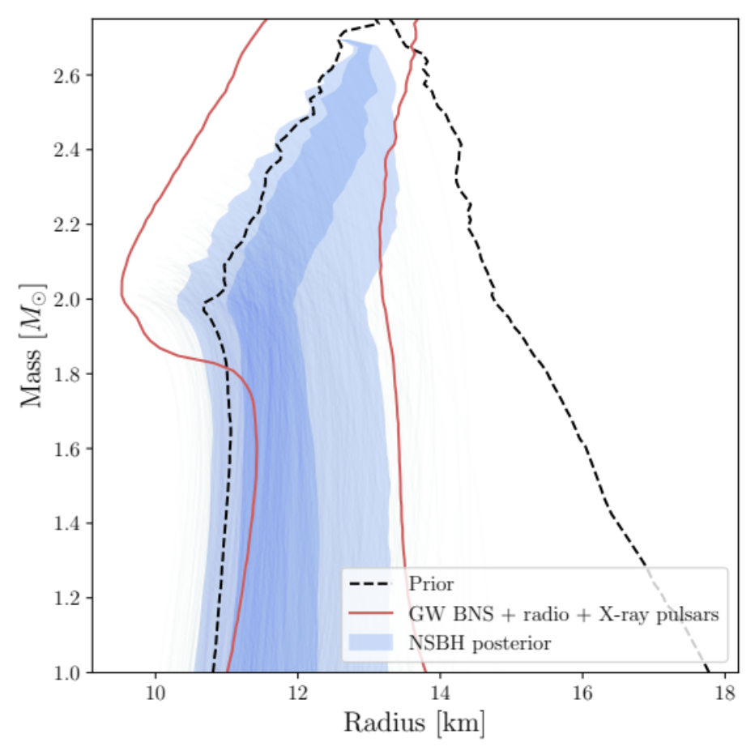
Equation of state constraints
Biscoveanu+ 2209.06978
Comparing to Legred+ 2106.05313
Didn’t detect electromagnetic counterparts for any of the four GW NSBH systems detected so far
Assume this is because no tidal disruption occurred (best case scenario)
Rule out stiff equations of state, because otherwise the NS would be tidally disrupted

Slide 12
Conclusions
Black holes in NSBHs are less massive and more slowly spinning than those in black hole binaries
At most 14% of detected NSBHs may have an electromagnetic counterpart
  Only a small fraction of all GRBs may have NSBH progenitors
Multimessenger analyses including only nondetections of NSBH counterparts provide an independent measurement of the neutron star equation of state
Notes:
Total sGRB rate is order 100-1000 Gpc⁻³ yr⁻¹

Slide 13
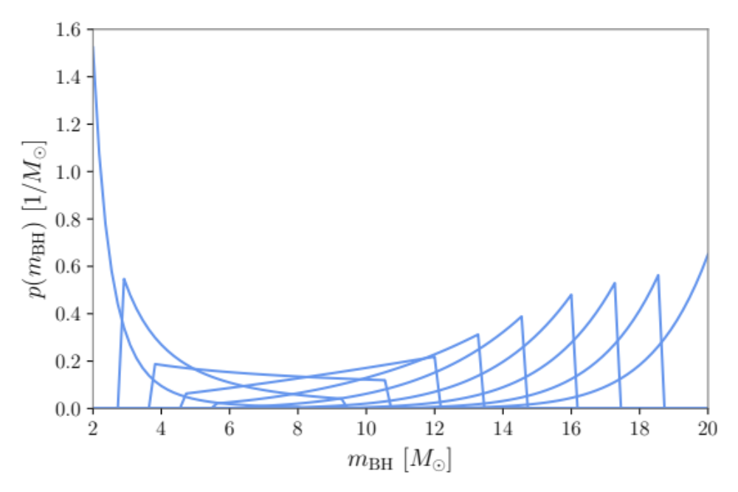
Population analysis
Population model
  Black hole mass – power law
  Black hole spin magnitude – Beta distribution
  Mass ratio – truncated Gaussian OR power-law
    Maximum neutron star mass free parameter
  Neutron star spin magnitude – uniform up to $χ_{NS}<0.7$ (breakup spin)
Notes:
Breakup spin is the limit where the star spins so fast it overcomes its own gravity and begins to shed mass

Slide 14
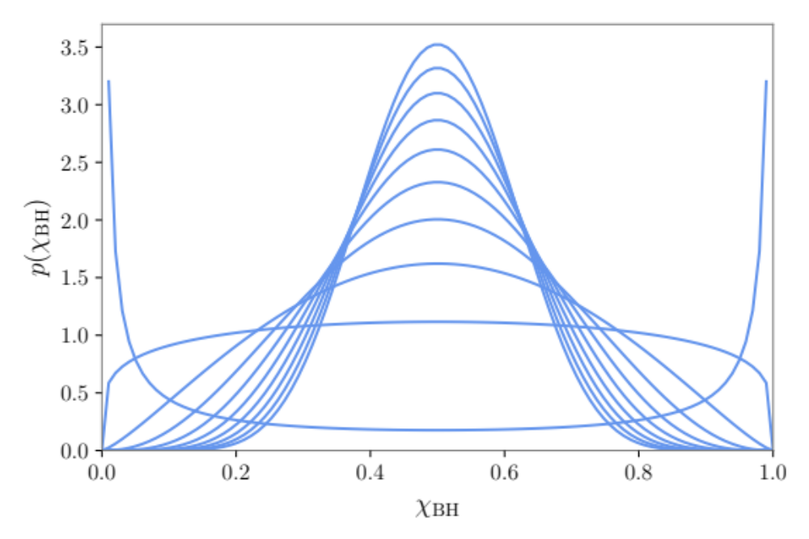
Population analysis
Population model
  Black hole mass – power law
  Black hole spin magnitude – Beta distribution
  Mass ratio – truncated Gaussian OR power-law
    Maximum neutron star mass free parameter
  Neutron star spin magnitude – uniform up to $χ_{NS}<0.7$ (breakup spin)
Notes:
Breakup spin is the limit where the star spins so fast it overcomes its own gravity and begins to shed mass

Slide 15
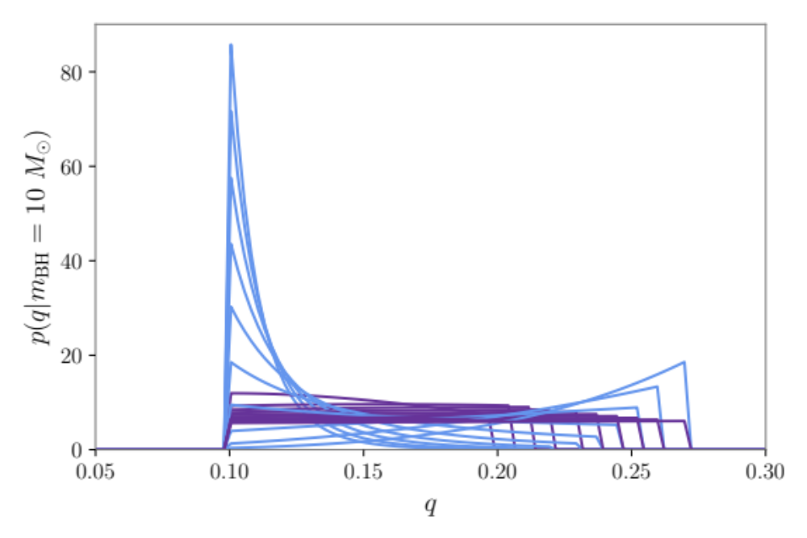
Population analysis
Population model
  Black hole mass – power law
  Black hole spin magnitude – Beta distribution
  Mass ratio – truncated Gaussian OR power-law
    Maximum neutron star mass free parameter
  Neutron star spin magnitude – uniform up to $χ_{NS}<0.7$ (breakup spin)
Notes:
Breakup spin is the limit where the star spins so fast it overcomes its own gravity and begins to shed mass

Slide 16
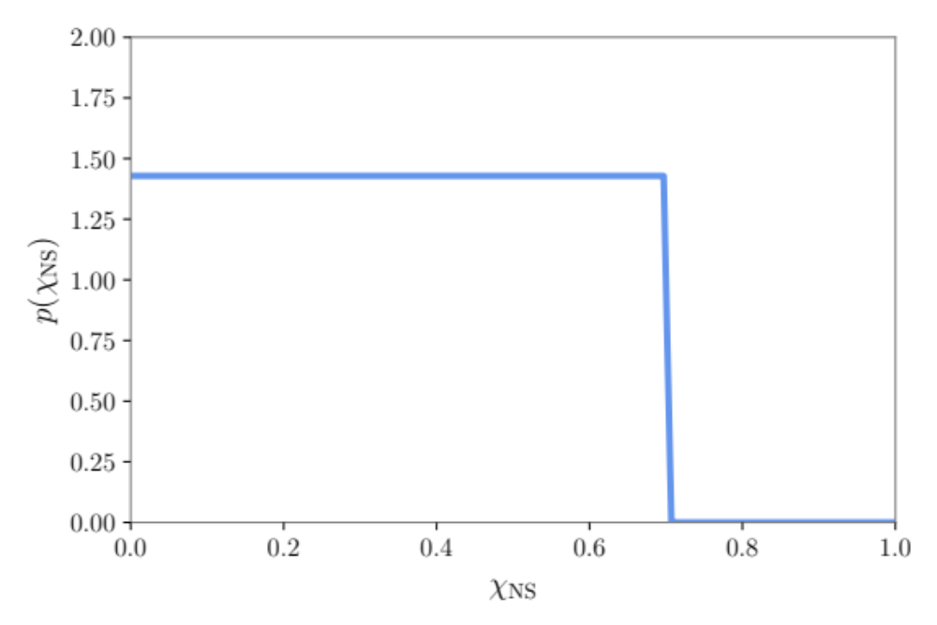
Population analysis
Population model
  Black hole mass – power law
  Black hole spin magnitude – Beta distribution
  Mass ratio – truncated Gaussian OR power-law
    Maximum neutron star mass free parameter
  Neutron star spin magnitude – uniform up to $χ_{NS}<0.7$ (breakup spin)
Notes:
Breakup spin is the limit where the star spins so fast it overcomes its own gravity and begins to shed mass

Slide 17
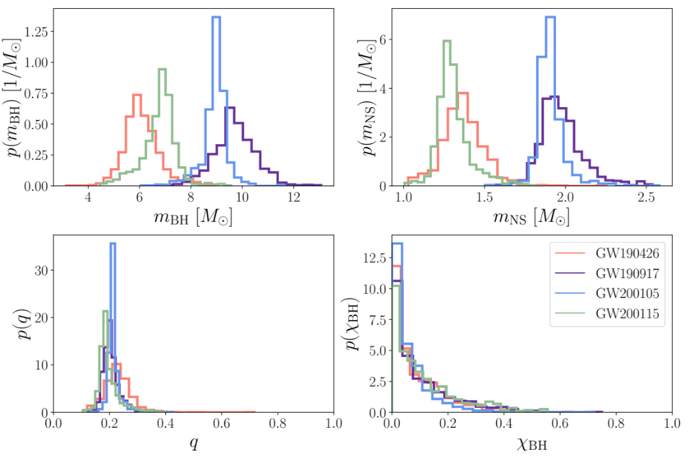
Reweighted population

Slide 18
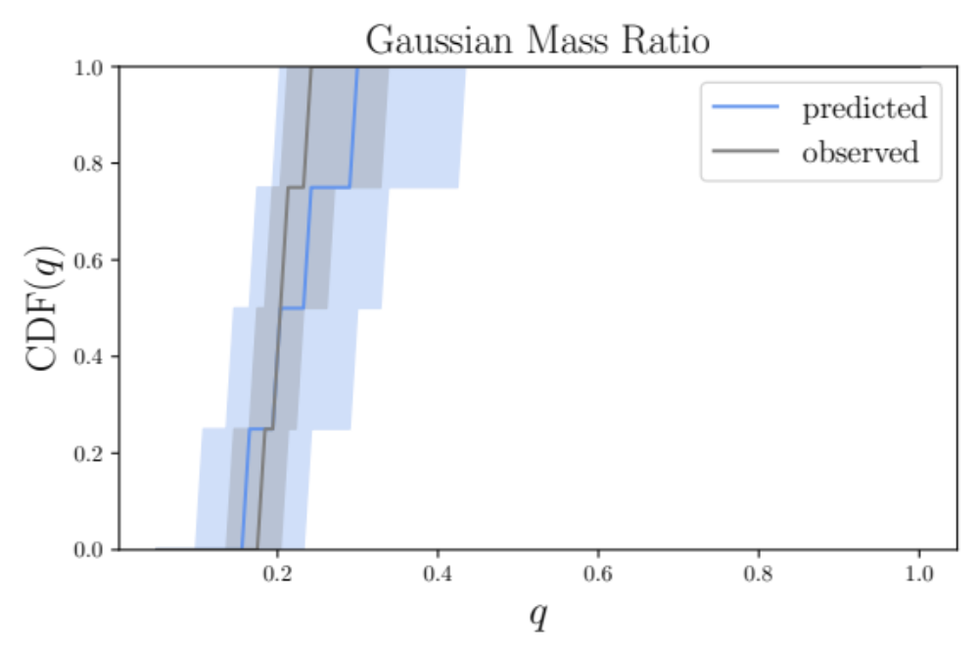
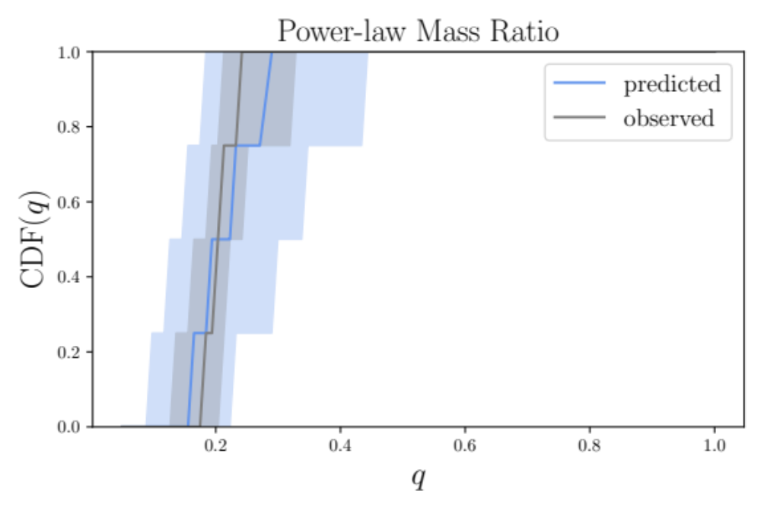
Mass ratio model comparison

Slide 19
Electromagnetically-bright fraction
Previous works have estimated the fraction of NSBH systems that may launch an electromagnetic counterpart using population synthesis predictions (Román-Garza+ 2012.02274, Broekgaarden+ 2103.02608, Fragione 2110.09604)
Instead, we take a data-driven approach to this calculation, accounting for the uncertainty in our inferred population and in the neutron star equation of state
neutron star compactness
ISCO radius (black hole spin aligned to orbital angular momentum)
neutron star baryonic mass
symmetric mass ratio
Foucart+ 1807.00011
Notes:
*More equal mass ratio, higher black hole aligned spin, and stiffer EoS means more distruption and remnant mass*
Remnant baryon mass outside the black hole (not separated into disk mass vs wind mass)
The baryonic mass of the neutron star is the sum of its binding energy and gravitational mass
The gravitational mass of a spinning neutron star is higher than the gravitational mass of the NS with the same central density at rest, and its equatorial radius is also larger
Compactness is the same to within a few percent
Map from the gravitational mass of the spinning NS to its rest mass, calculate compactness

Slide 20
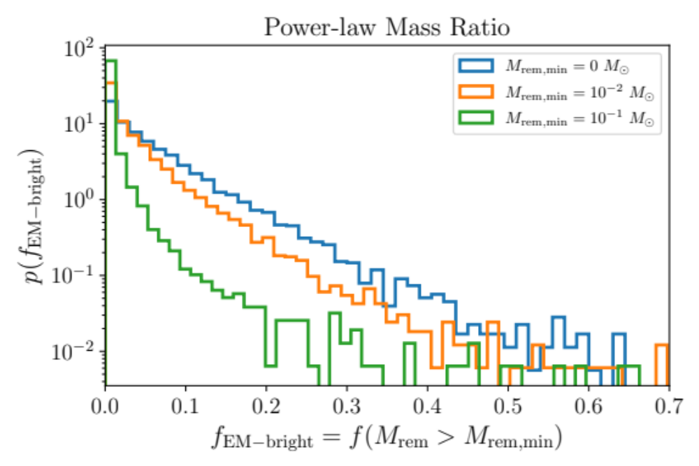
Electromagnetically-bright fraction
At most 14% of NSBH sources may have an associated electromagnetic counterpart
99% probability that none of the four NSBH candidates we consider were electromagnetically bright
Use this constraint to inform the population properties and measure the neutron star equation of state
Impose that no counterparts were detected for any of the candidate events because there was exactly zero remnant mass produced for each merger
Notes:
NSBHs contribute at most $1.03 M_{⊙}{Gpc}^{−3}{yr}^{−1}$ total r-process ejecta, ~40% of the total including binary neutron star contributions

Slide 21
Electromagnetically-bright fraction
At most 14% of NSBH sources may have an associated electromagnetic counterpart
99% probability that none of the four NSBH candidates we consider were electromagnetically bright
Use this constraint to inform the population properties and measure the neutron star equation of state
equation of state piecewise polytrope parameters
observed remnant mass = 0
remnant mass predicted by fitting formula
Notes:
NSBHs contribute at most $1.03 M_{⊙}{Gpc}^{−3}{yr}^{−1}$ total r-process ejecta, ~40% of the total including binary neutron star contributions

Slide 22
GRB rate
At most 14% of NSBH sources detectable in gravitational waves may have an associated electromagnetic counterpart
Using joint inference on the NSBH merger rate, determine the rate of NSBHs that have nonzero remnant mass → might launch GRBs
Upper limit of 20 Gpc⁻³ yr⁻¹ GRBs from NSBH mergers at 90% credibility (underlying beaming-corrected rate)
Notes:
NSBHs contribute at most $1.03 M_{⊙}{Gpc}^{−3}{yr}^{−1}$ total r-process ejecta, ~40% of the total including binary neutron star contributions
Small fraction of the total rate of short GRBs (probably of order 100-1000 Gpc⁻³ yr⁻¹)

Slide 23
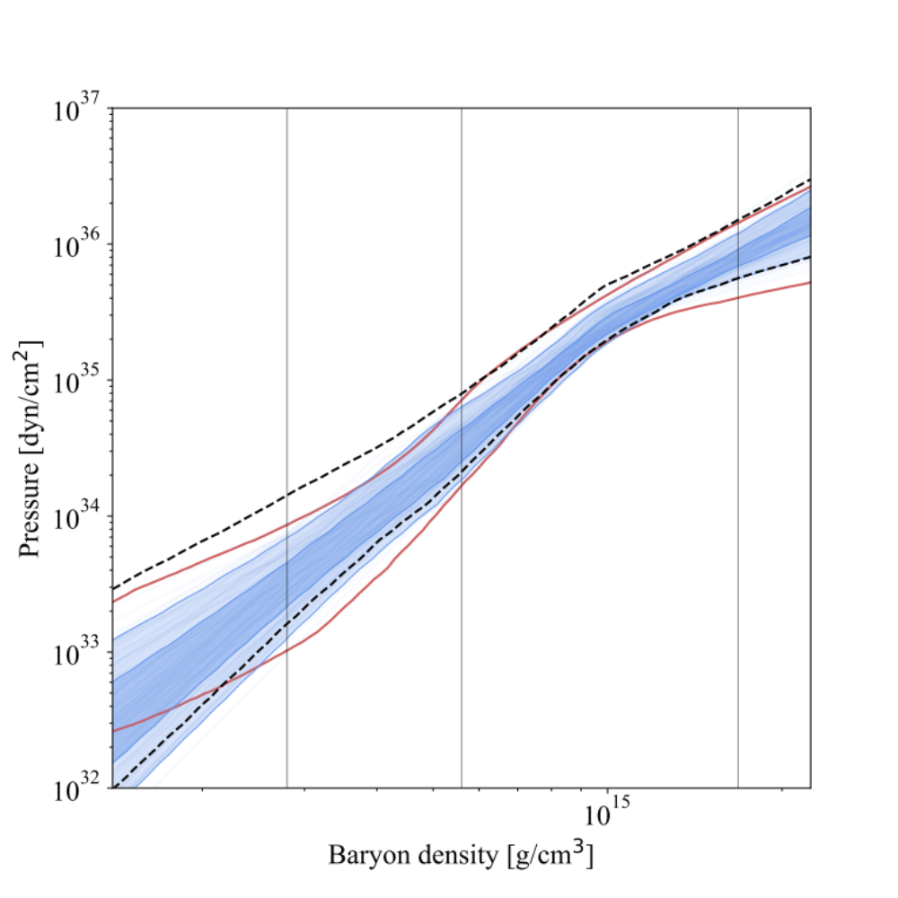
Equation of state inference
Comparing to Legred+ 2106.05313
The results obtained with this maximally optimistic assumption are comparable to those obtained with observations of individual BNS and pulsars
Notes:
Relatively constant constraint across wide range of densities, unlike the constraint from individual tidal measurements, which are focused at one specific density

Slide 24
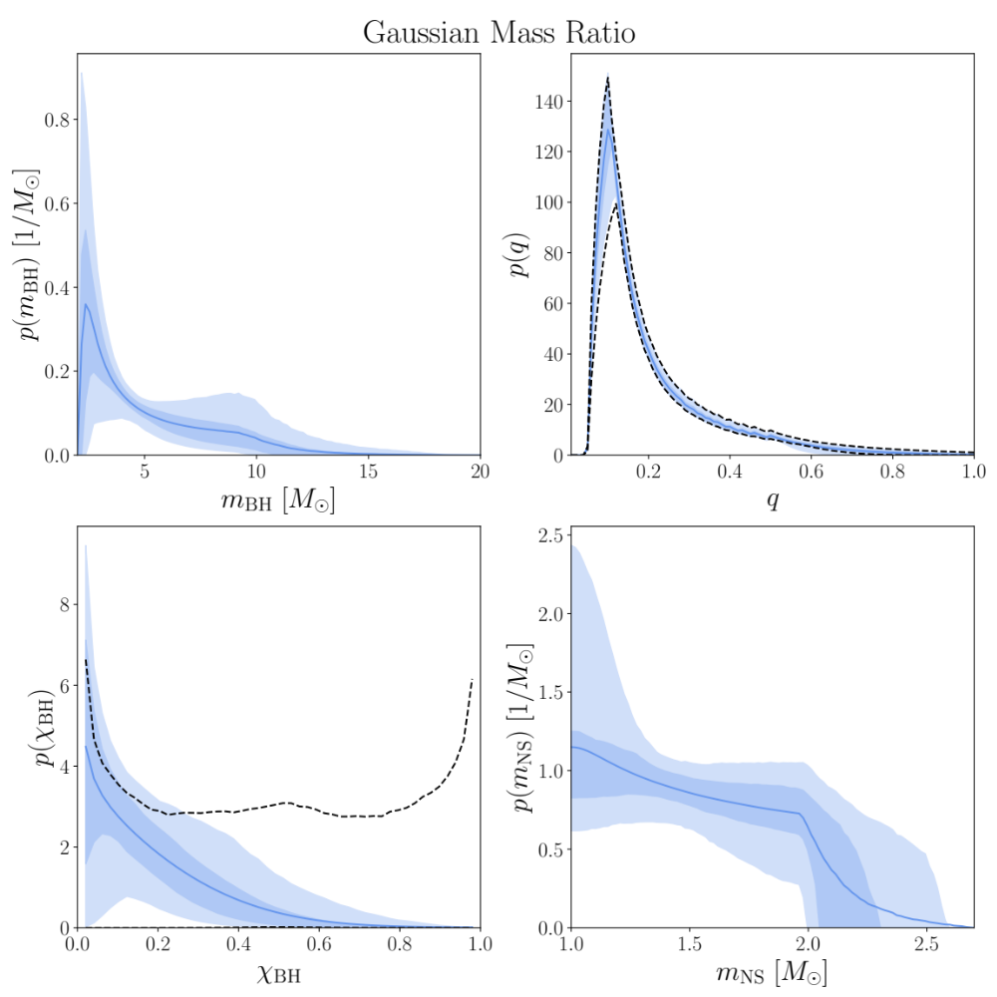
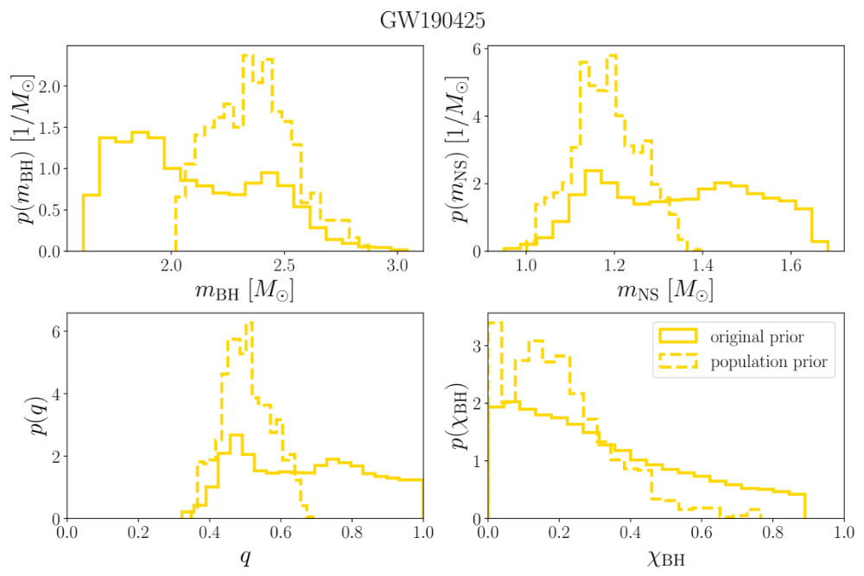
Including GW190425

Slide 25
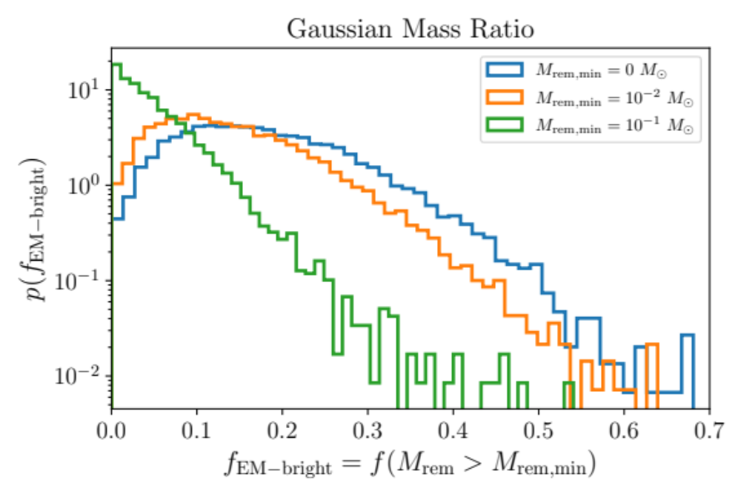
Including GW190425

