Slide 1
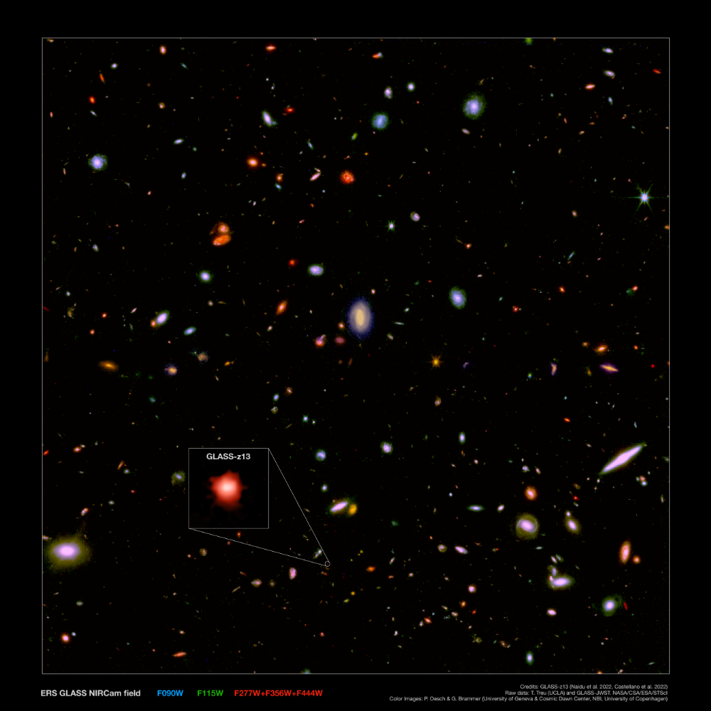
Into the First Billion Years with JWST
Rohan Naidu, MIT
Jorryt Matthee, Pascal Oesch, Irene Shivaei, Charlie Conroy, Sandro Tacchella, Ben Johnson, Sirio Belli, Rychard Bouwens, Gabe Brammer, Pratika Dayal, Yoshi Fudamoto Garth Illingworth, Erica Nelson, David Setton, Rob Simcoe, Wren Suess, Pieter van Dokkum, John Weaver, Kate Whitaker, et al.

Slide 2



Thank you NHFP!

Slide 3
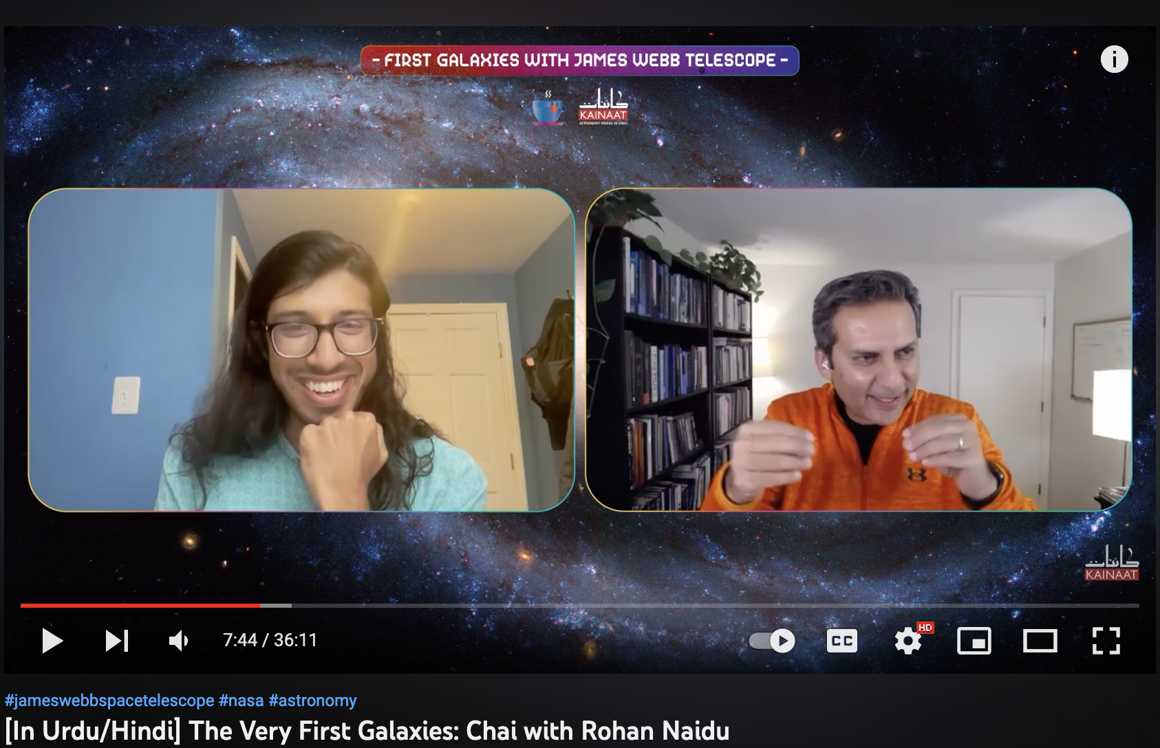
Thank you NHFP!
Salman Hameed (Hampshire College), Kainaath Chai YouTube show

Slide 4
A brief history of the Universe
z~1100
400, 000 yrs
z~6
1bn yrs
z~???
Loeb+06
Big
Bang
Dark
Ages
Cosmic Dawn
Reionization
Present
Day

Slide 5
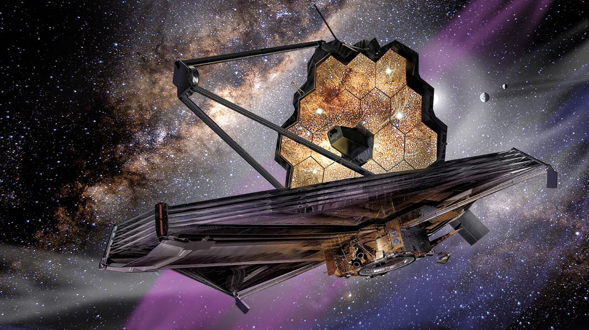
New classes of objects at the cosmic frontier
z~1100
400, 000 yrs
z~6
1bn yrs
z~???
Loeb+06
Remarkably Bright Galaxies at z>10
Little Red Dots aka Baby AGN
Metal-Poor (Metal-Free? Pop 3?) Stars
Big
Bang
Dark
Ages
Cosmic Dawn
Reionization
Present
Day

Slide 6
New classes of objects at the cosmic frontier
z~1100
400, 000 yrs
z~6
1bn yrs
z~???
Loeb+06
Remarkably Bright Galaxies at z>10
Little Red Dots aka Baby AGN
Metal-Poor (Metal-Free? Pop 3?) Stars
Big
Bang
Dark
Ages
Cosmic Dawn
Reionization
Present
Day

Slide 7
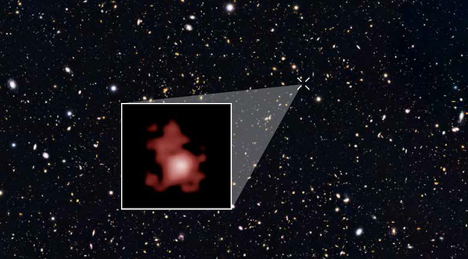
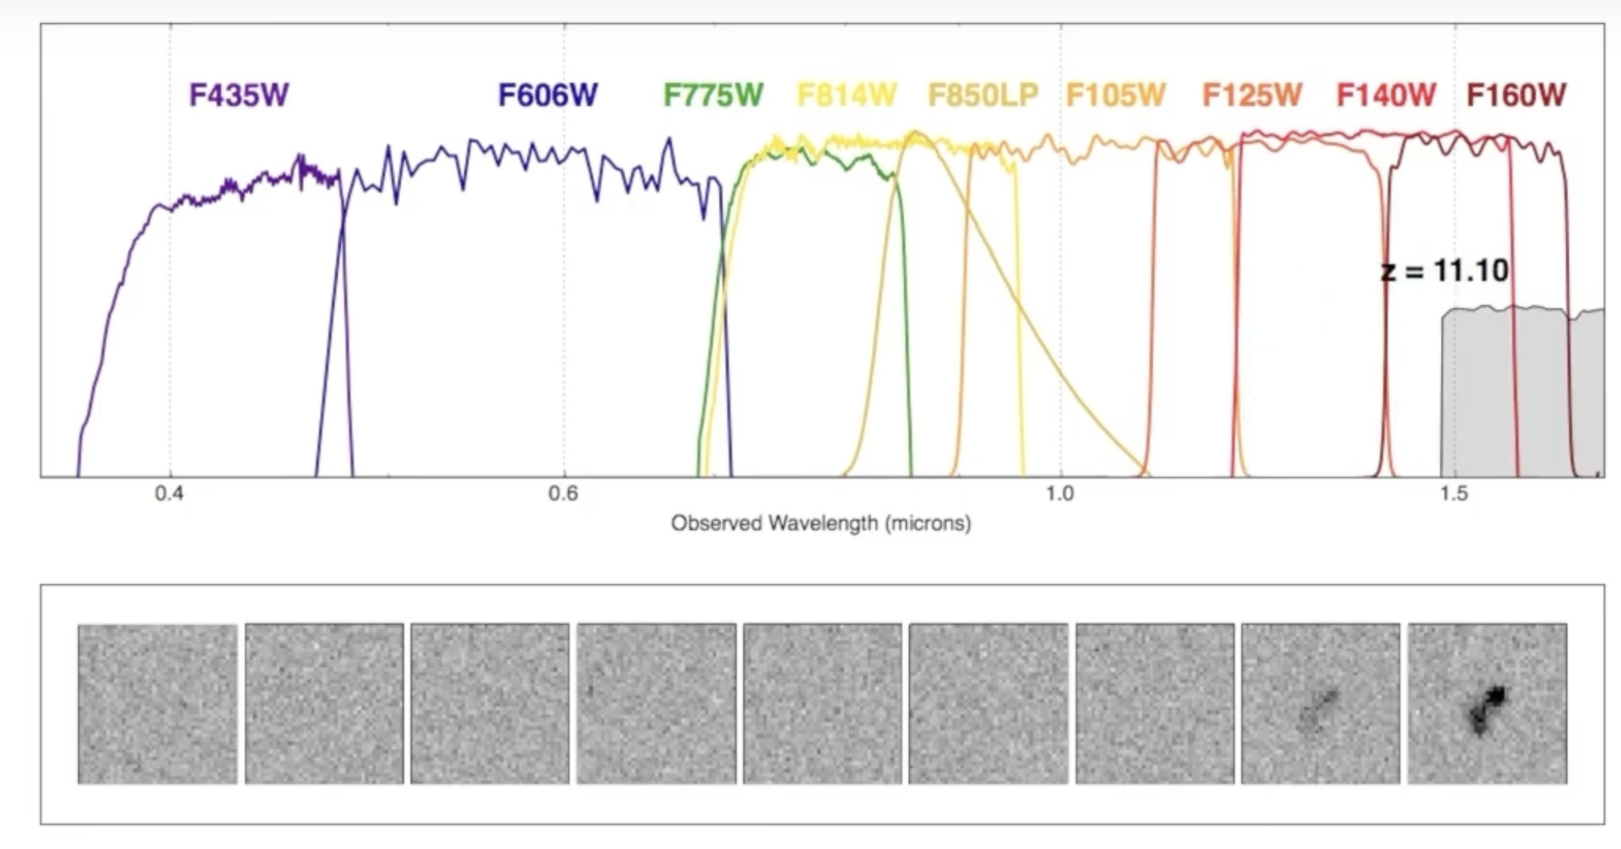
The search for the first galaxies
HST record-holder: z=11.1 (~400 mn years after the Big Bang, ~billion solar masses, Oesch+16)
GNz11 discovered with the Hubble Space Telescope

Slide 8
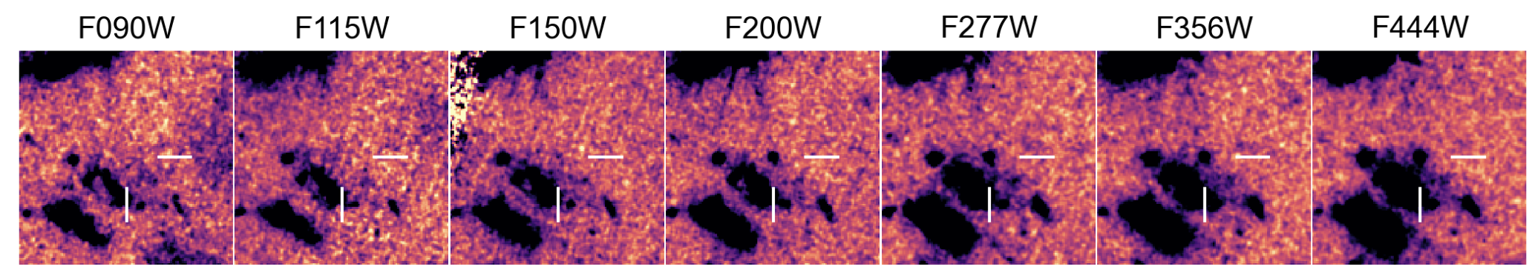
Enter JWST…
z~12 galaxy
Completely invisible to HST
Naidu+22

Slide 9
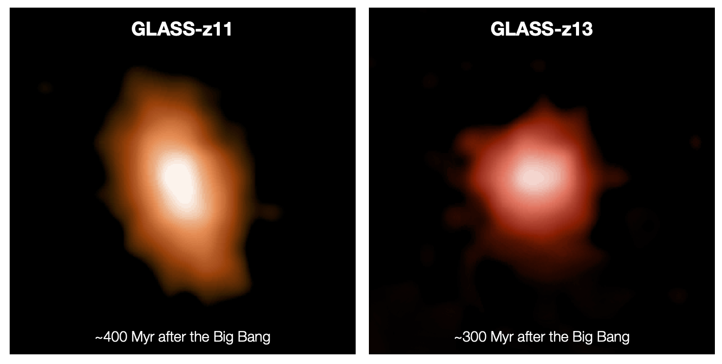
Two Remarkably Luminous, Billion Solar Mass Galaxies at z>10?
Naidu+22a, Castellano+22

Slide 10
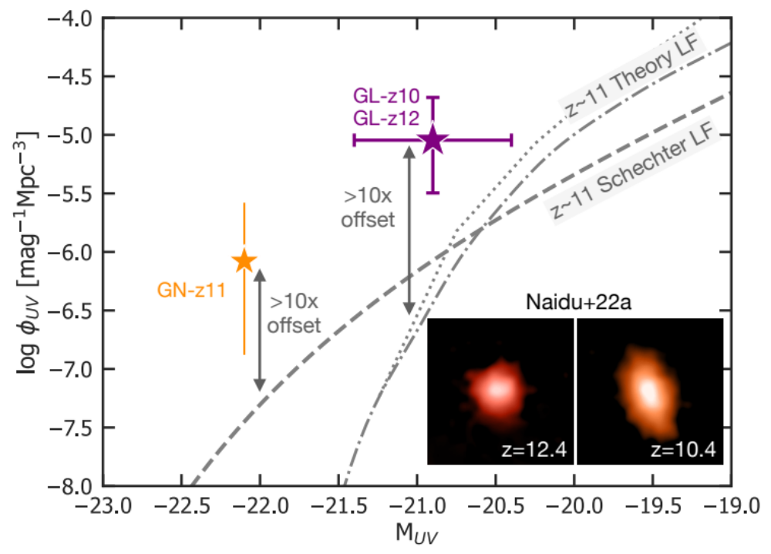
Too many bright galaxies at very early times?
Predicted N=0 at z>10 Mason+15, Williams+18, Tacchella+18
Found N>10! (“robust”/ “solid” candidates) Naidu+22a,b; Bouwens+23; Fujimoto+23
An “end of year one” goal requiring >10x larger survey areas achieved in the first week?

Slide 11
Solutions for “too bright/big to be”
e.g.,
Riaz+22
Ziparo+22
Ferrara+22
Steinhardt+22
Boylan-Kolchin 22
Lovell+22
Mirocha+22
Mason+23
Pacucci+23
Menci+23
Boyuan & Bromm 23
…
Class 1: Tweak cosmology/dark matter
  Buy more time by z~10 with early dark energy
  Primordial black holes as DM candidate
  …
Class 2: Boost brightness with baryons (i.e., bright but not “too big”)
  Ultra-luminous first stars
  Early black holes
  Higher star-formation efficiency Sultan’s talk
  …

Slide 12
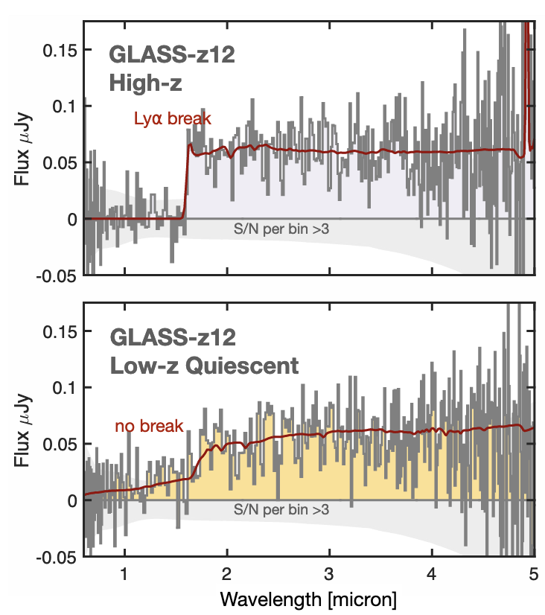
Solving “too bright/big to be”: JWST spectroscopy
These really bright sources have not been followed up yet!
Coming next month! (GO: 3703, Zavala+; 3073, Castellano+)
Simulated NIRSpec spectrum

Slide 13
New classes of objects at the cosmic frontier
z~1100
400, 000 yrs
z~6
1bn yrs
z~???
Loeb+06
Remarkably Bright Galaxies at z>10
Little Red Dots aka Baby AGN
Metal-Poor (Metal-Free? Pop 3?) Stars
Big
Bang
Dark
Ages
Cosmic Dawn
Reionization
Present
Day

Slide 14
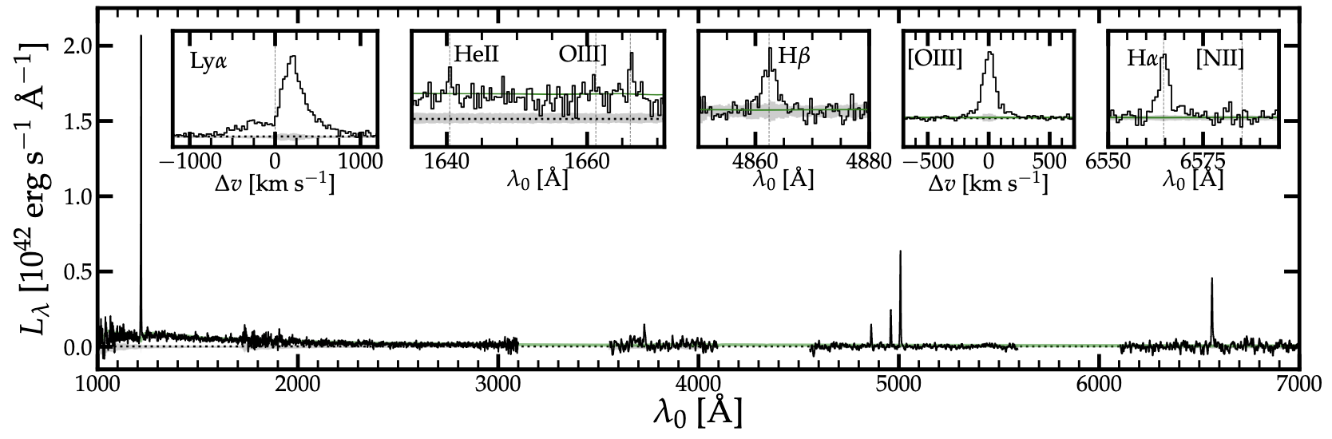
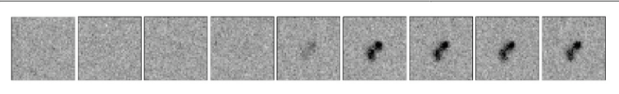
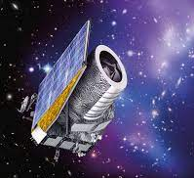
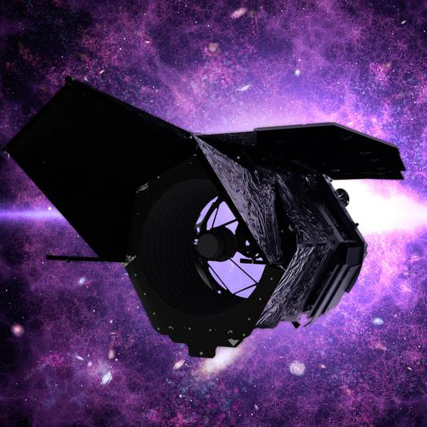
<1% of galaxies at z>6 have spectra
<1% of photometrically selected galaxies at z>6 had spectra
A golden era for early universe science
Beyond ground-based telescopes at z>3
z~6
Euclid (2023)
Roman (2027)
Rest-UV spectroscopy at z>6 – e.g., LyA (reionization), HeII (Pop III), CIV (AGN)
Lyman-α
[OIII]+Hb
Ha+
[NII]
Most fundamental quantities like stellar masses uncertain
Stack from XLSz2 Survey
Naidu+22c

Slide 15
From zero rest-optical spectra to ~3000 at z>6
Cosmic Dawn Survey (PI: Naidu)
  Grism spectroscopy of most distant overdensity at z~9
COLA1 (PI: Naidu & Matthee)
  Grism pectroscopy of a bubble during reionization
FRESCO (PI: Oesch)
  Spatially resolved spectra of ~3000 sources at z~0-9
EIGER (PI: Lilly)
  Environments of z~6-7 luminous quasars
Blue Jay (PI: Belli)
  Ultra-deep spectroscopy + imaging for z>6-10 searches
z~7
Faint
AGN?

Slide 16
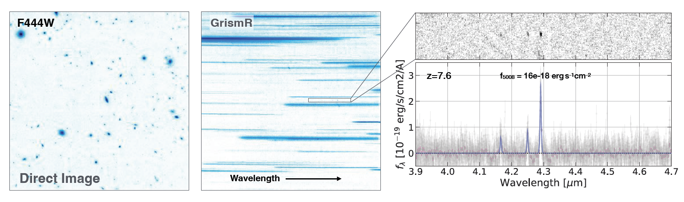
The power of NIRCam/grism spectroscopy: zero rest-optical spectra to ~3000 at z>6!
z~7
Faint
AGN?
  Grism programs represent <10% of Cycle 1 spectroscopic time, but have produced >70% of z>6 spectroscopic redshifts!

Slide 17
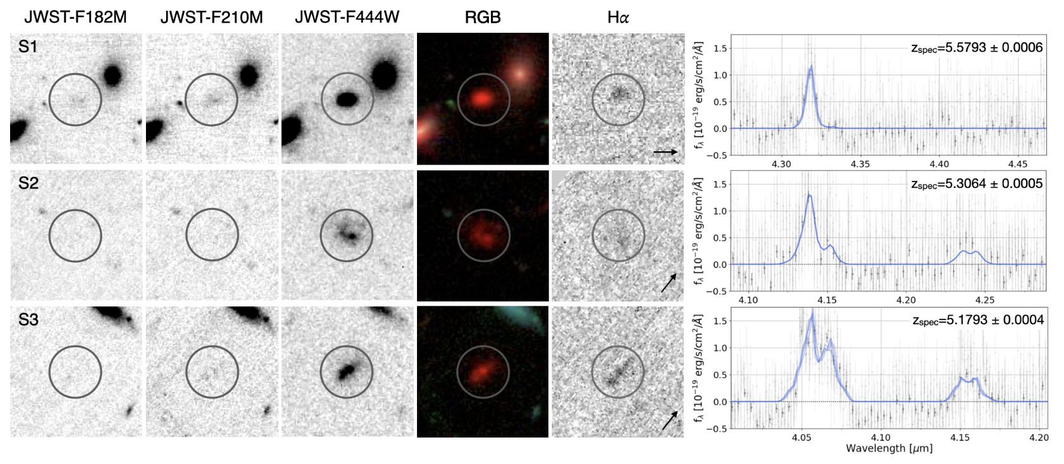
Descendants of remarkably bright objects at z>10?
FRESCO grism survey: Milky Way-mass(!!!) galaxies at z~5-6
Xiao, …Naidu+23
Spectroscopic confirmation of ultra-massive galaxies at z~5-6:

Slide 18
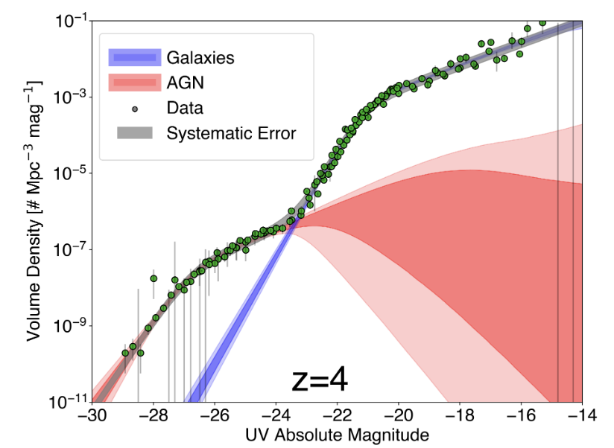
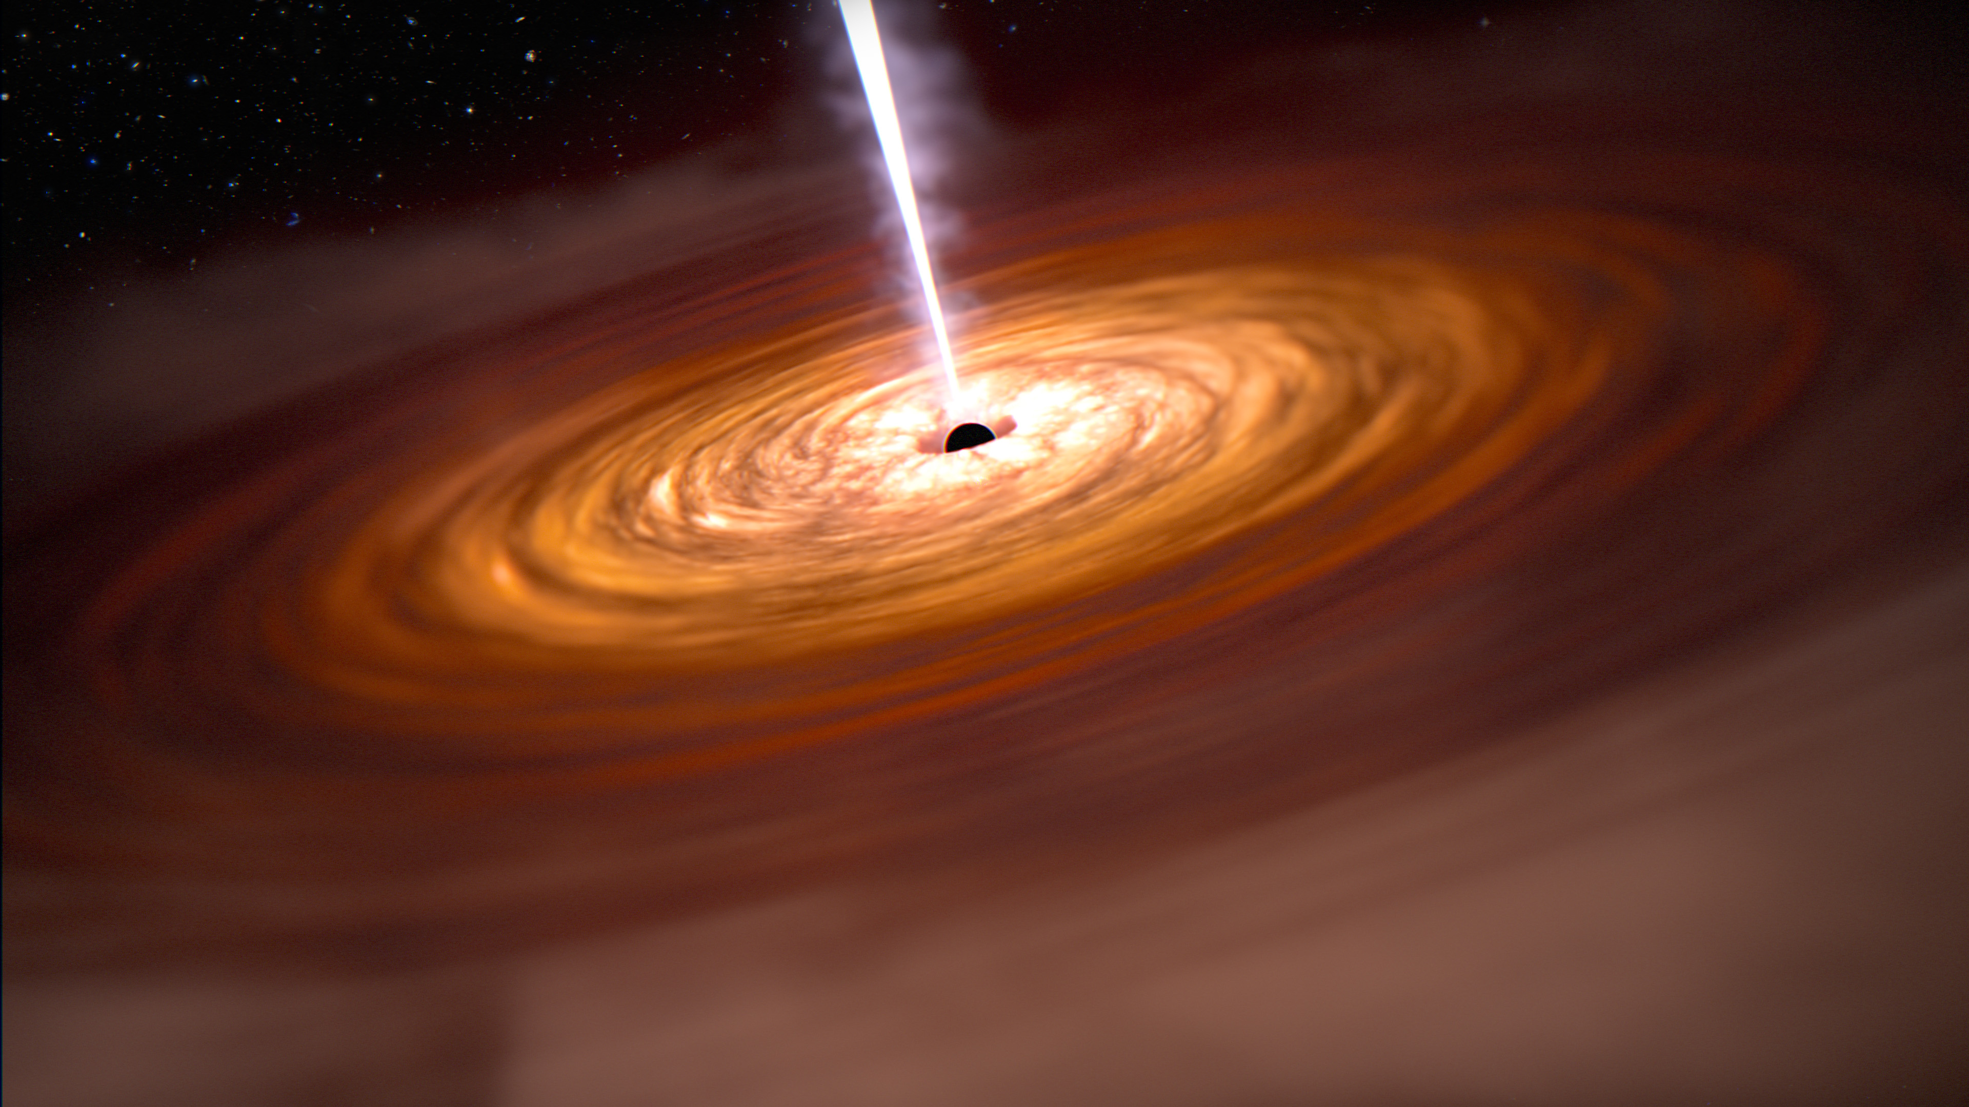
Low-mass black holes/faint AGN
Finkelstein & Bagley 22
Where are the low-mass (<10⁸ M☉) black holes at z>6? Onoue+22, Ono+22, Kocevski+23
z~9
???

Slide 19
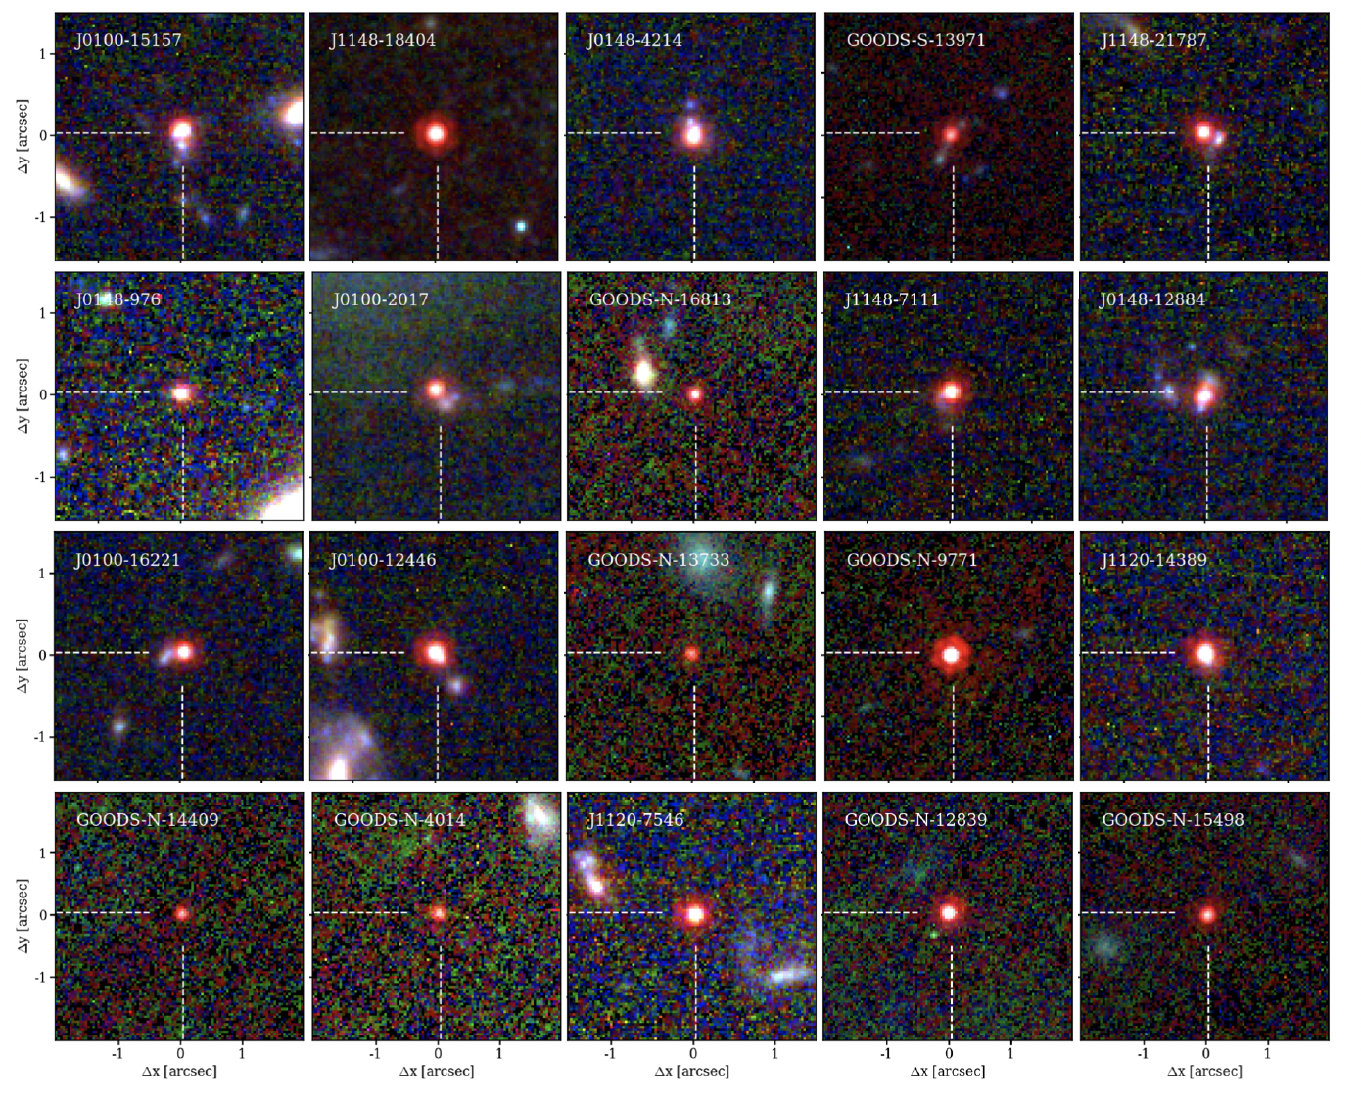
Little Red Dots are everywhere!
z~9
Matthee, Naidu+23

Slide 20
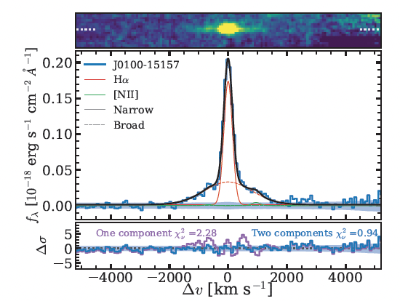
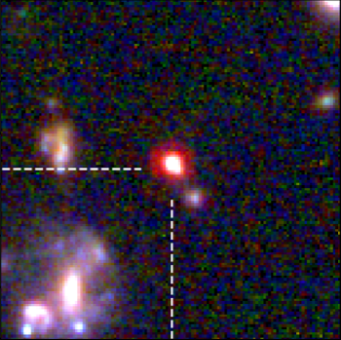
Little Red Dots are Broad-Line AGN!
Where are the low-mass (<10⁸ M☉) black holes at z>3? Onoue+22, Ono+22, Endsley+22, Kocevski+23
Sample of broad-line emitters (>1500 km/s) with red, AGN-like SEDs at z~3-7.
z~9
Matthee, Naidu+23

Slide 21
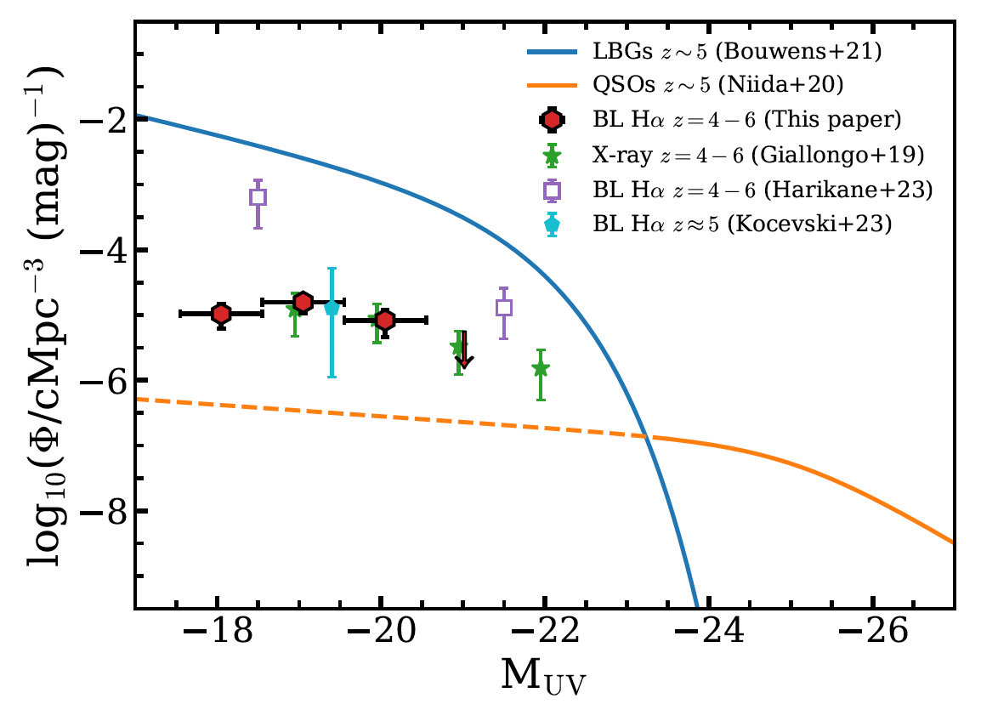
Little Red Dots aka Faint AGN
Much more abundant than typical expectations!
Could explain “too bright to be”
Now found out to z~8.5 Fujimoto+23, Furtak+23a,b, Larson+23, Maiolino+23, Kocevski+23, Harikane+23
z~9
JWST
Finkelstein & Bagley 22
Matthee, Naidu+23

Slide 22
New classes of objects at the cosmic frontier
z~1100
400, 000 yrs
z~6
1bn yrs
z~???
Loeb+06
Remarkably Bright Galaxies at z>10
Little Red Dots aka Baby AGN
Metal-Poor (Metal-Free? Pop 3?) Stars
Big
Bang
Dark
Ages
Cosmic Dawn
Reionization
Present
Day

Slide 23
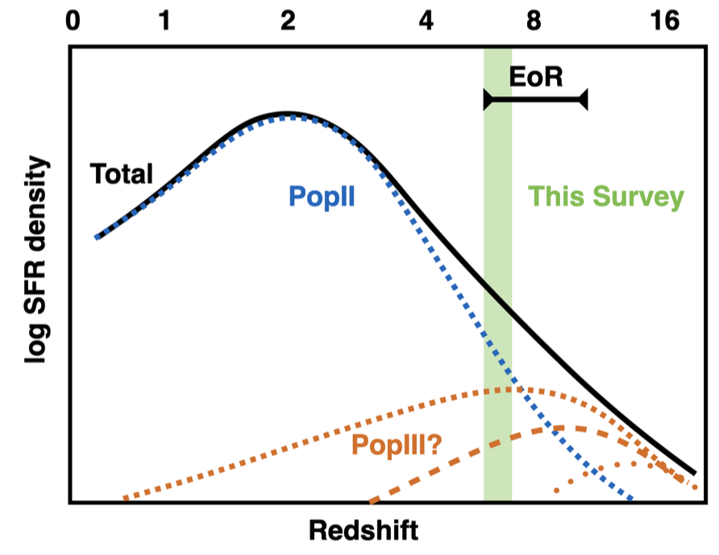
Metal-poor (perhaps metal-free?) stars
Very first Pop-III stars at z>15 need 100m telescope on the moon (mag~40) e.g., Schauer+20
But…late Pop-III star-formation possible out to z~6-7 e.g., Venditti+23
Based on Venditti+23

Slide 24
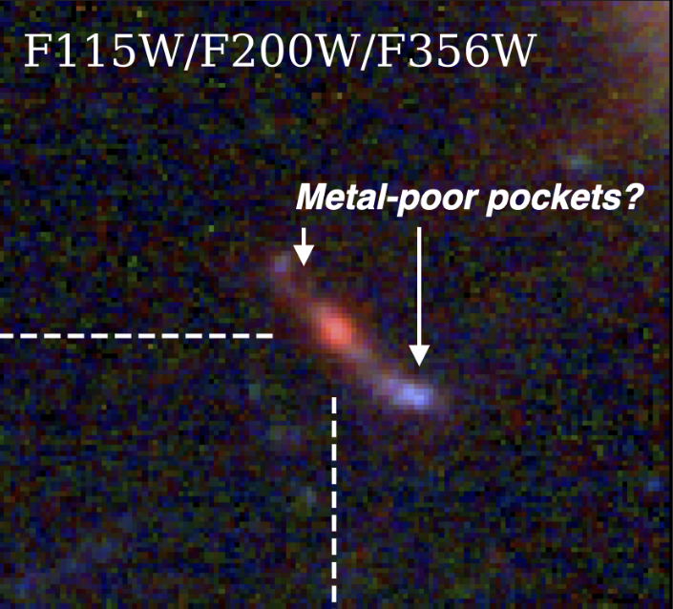
Metal-poor (perhaps metal-free?) stars
Metal-poor pockets, some with very low O3/Hb<2 observed.
EIGER
Survey

Slide 25
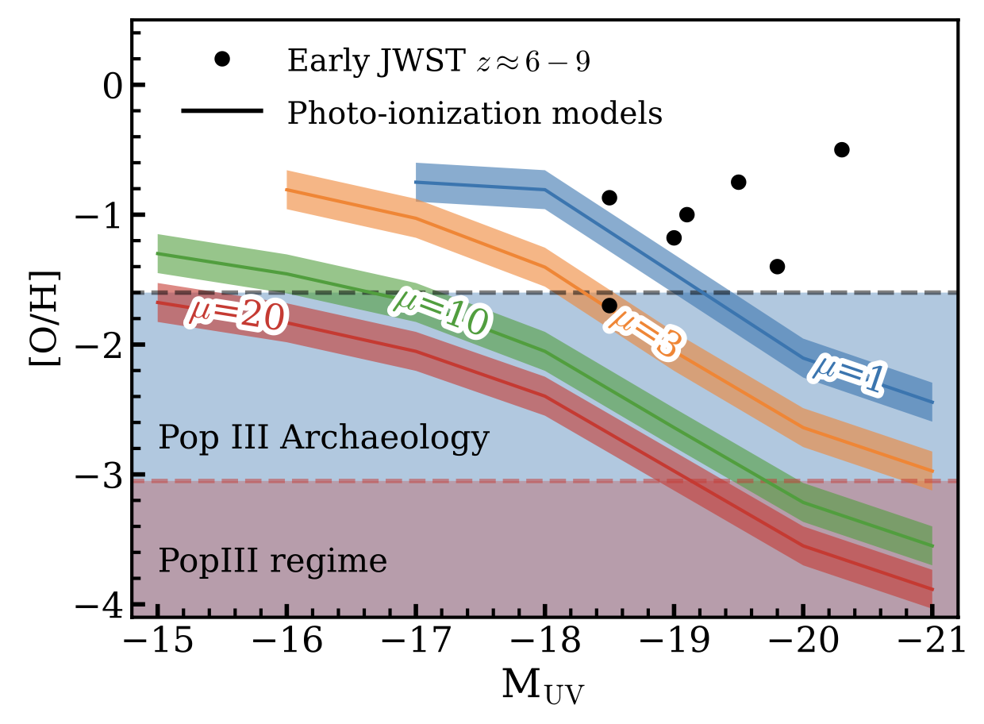
Metal-poor (perhaps metal-free?) stars
Metal-poor pockets, some with very low O3/Hb<2 observed.
If not Pop III, direct descendants of Pop III within reach!
Based on
Nakajima &
Maiolino 22
EIGER
Survey

Slide 26
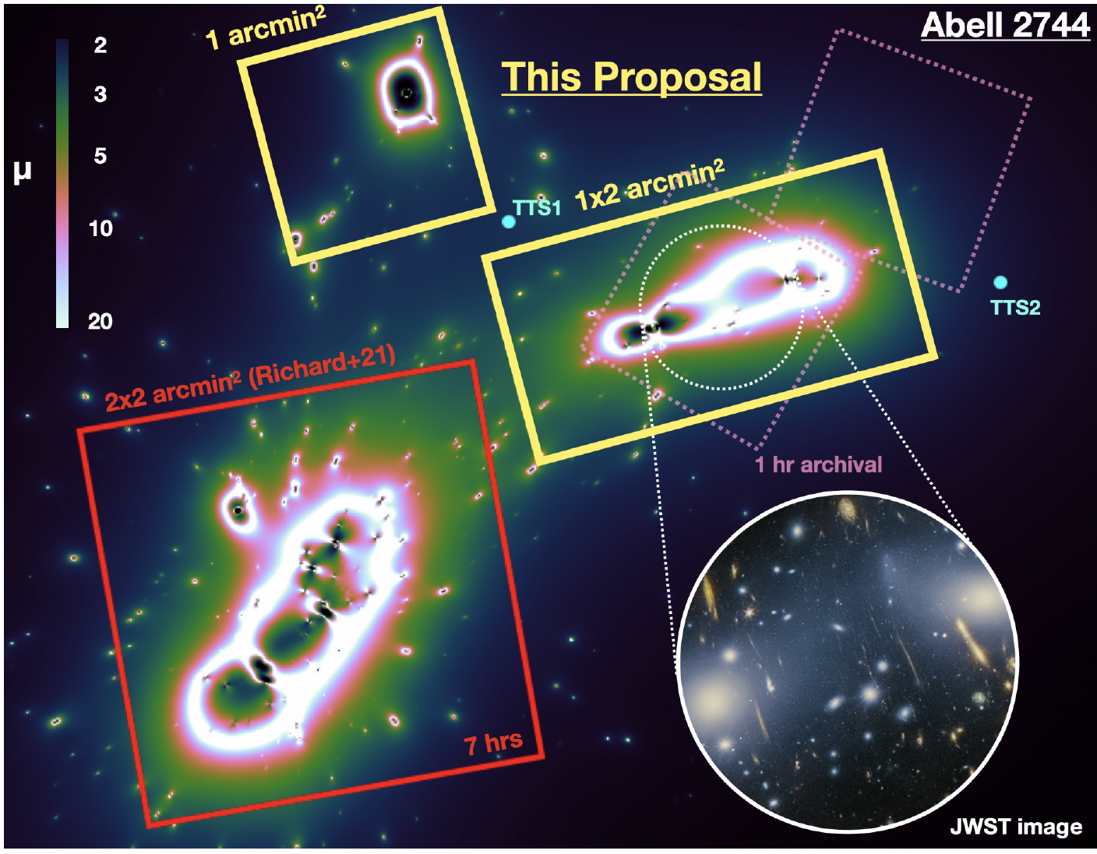
Metal-poor (perhaps metal-free?) stars
JWST Cycle 2 Program (47 hours) to search for metal-poor systems PIs: Matthee & Naidu
Use gravitational lensing in the A2744 cluster with spatially resolved spectroscopy.

Slide 27
Summary
JWST is revealing epochs of the Universe we’ve never seen before.
Surprising new classes of galaxies at the highest redshifts
  Remarkably bright galaxies!
  Little red dots!
  Metal-poor (perhaps metal-free?!) stars!

Slide 30
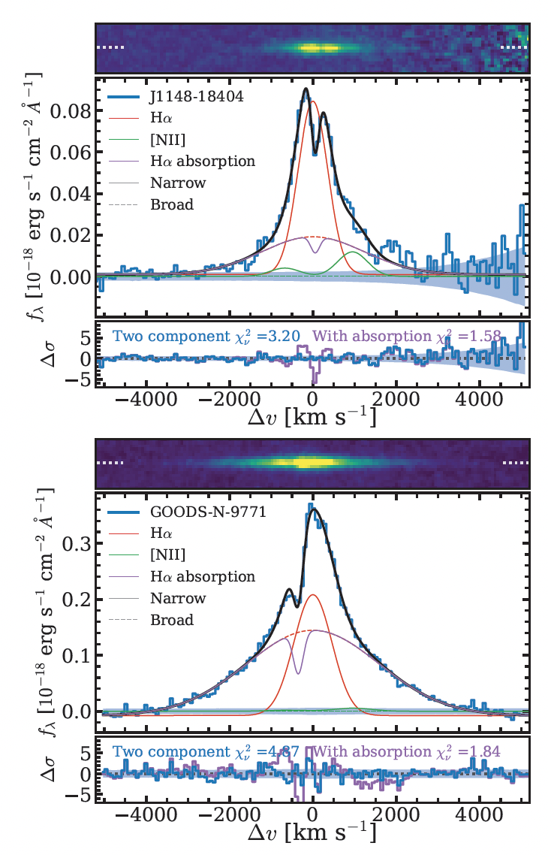
Little Red Dots aka Faint AGN
Much more abundant than typical expectations!
Implications for seed models? High clustering/merging fraction
z~9
Matthee, Naidu+23

Slide 31
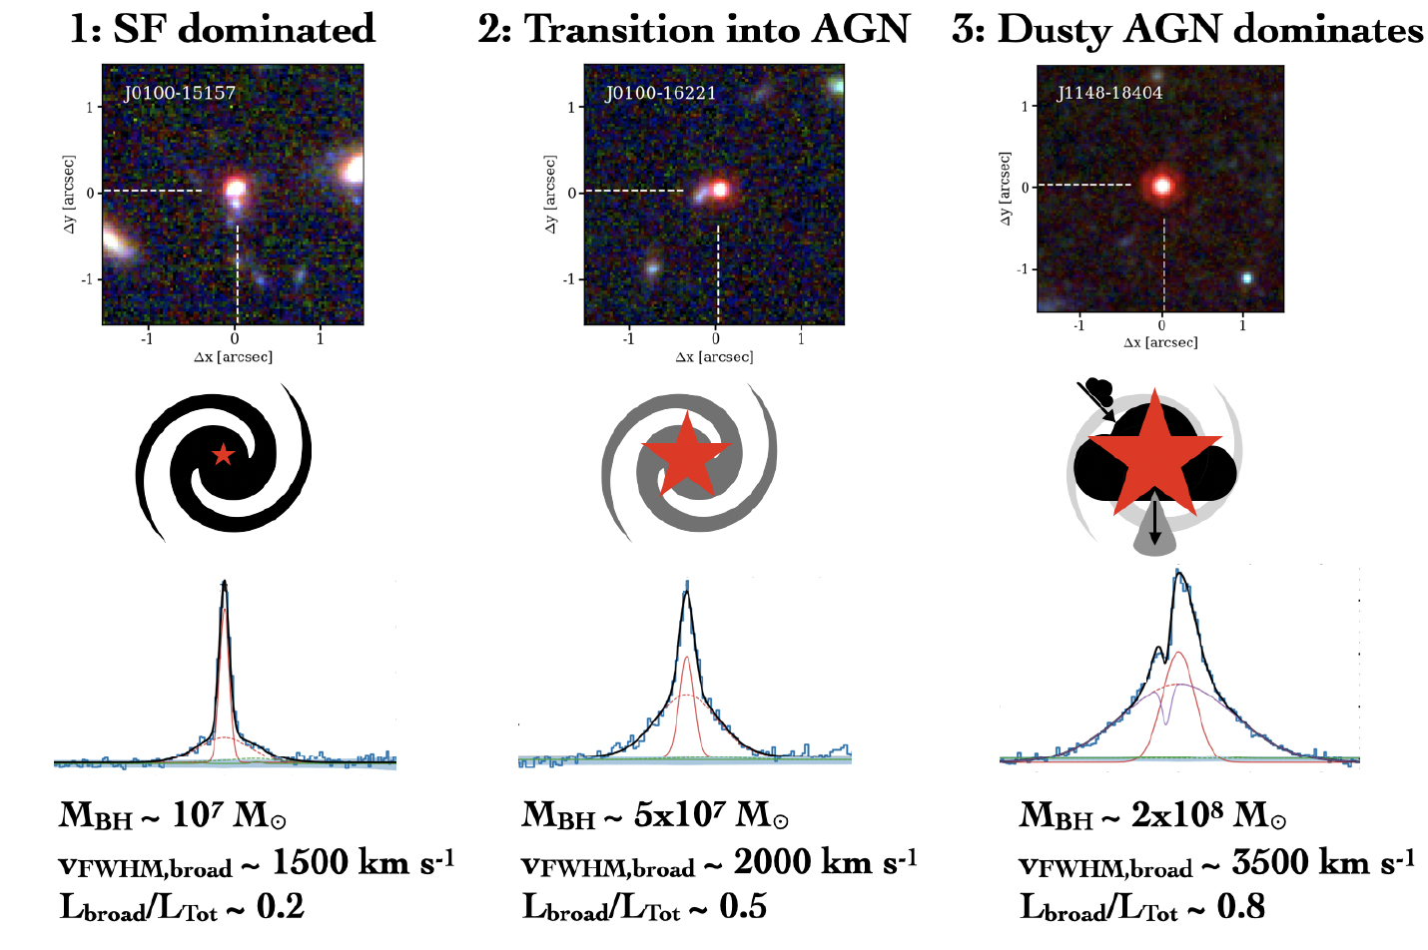
An evolutionary sequence for AGN growth
Matthee, Naidu+23

Slide 34
z~1100
400, 000 yrs
z~6
1bn yrs
z~???
Loeb+06
When and how did the first galaxies form?
A Spectroscopic View of the First Billion Years
Big
Bang
Dark
Ages
Cosmic Dawn
Reionization
Present
Day

Slide 35
Metal-poor (perhaps metal-free?) stars
Very first Pop-III stars at z>15 need 100m telescope on the moon (mag~40) e.g., Schauer+20
But…late Pop-III star-formation possible out to z~6-7 e.g., Venditti+23
Based on Venditti+23

Slide 36
Metal-poor (perhaps metal-free?) stars
Metal-poor pockets, some with very low O3/Hb<2 observed.
EIGER
Survey

Slide 37
Metal-poor (perhaps metal-free?) stars
Metal-poor pockets, some with very low O3/Hb<2 observed.
If not Pop III, direct descendants of Pop III within reach!
Approved JWST Cycle 2 Program to Search for these systems– PIs: Naidu & Matthee
Based on
Nakajima &
Maiolino 22
EIGER
Survey

Slide 38
z~1100
400, 000 yrs
z~6
1bn yrs
z~???
Loeb+06
When and how did the first galaxies form?
A Spectroscopic View of the First Billion Years
How did the first galaxies reionize the universe?
Big
Bang
Dark
Ages
Cosmic Dawn
Reionization
Present
Day

Slide 39
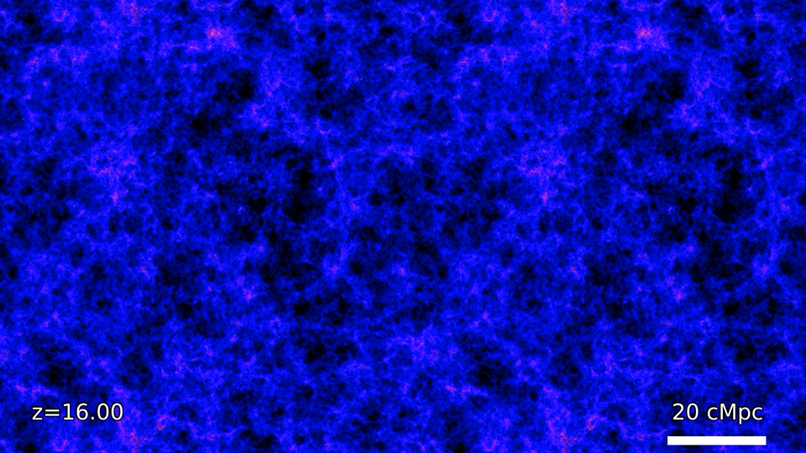

Slide 40
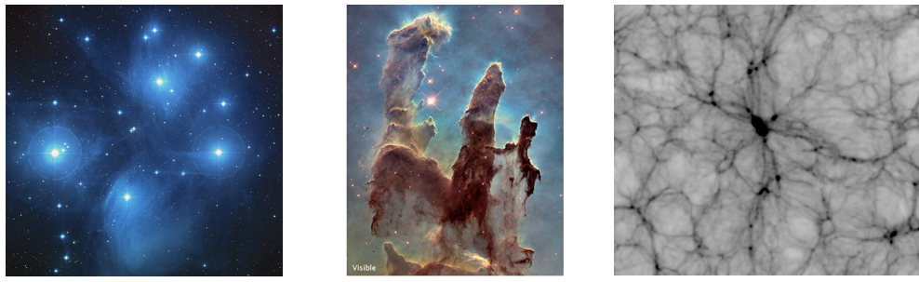
Reionization: a focal point for all early universe physics
Production of ionizing photons (metal-poor stars, binaries, accretion disks)
Journey through interstellar medium (dust, gas, feedback)
Contact with intergalactic medium (large-scale structure, gas physics)

Slide 41
Reionization: where did the photons come from?
Numerous, tiny, faint galaxies? “Democratic Reionization” Wise+14, Finkelstein+19, Chisholm+22
Rare, bright, massive galaxies? “Reionization by the Oligarchs” Naidu+20, Naidu & Matthee+22, Matthee & Naidu+22

Slide 42
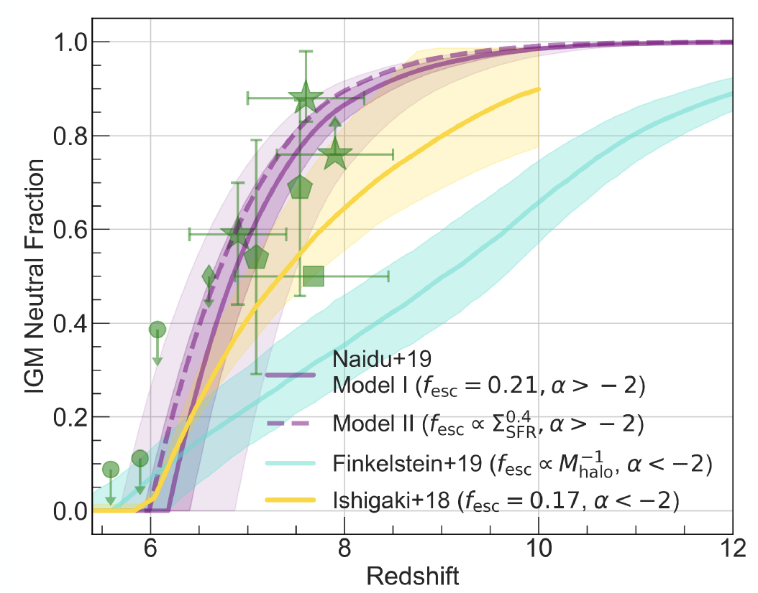
Reionization: where did the photons come from?
Bright galaxies
“Oligarchs”
Timeline
Faint galaxies
“Democratic”
Naidu+20, Tacchella+18
Radically different pictures of reionization.

Slide 43
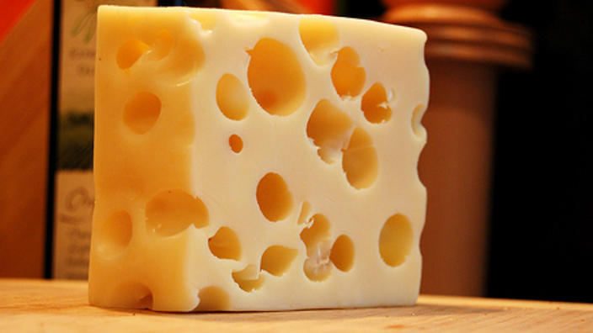

Reionization: where did the photons come from?
Bright galaxies
“Oligarchs”
Timeline
Topology
Faint galaxies
“Democratic”
Naidu+20, Tacchella+18
Radically different pictures of reionization.
Set the course of galaxy evolution across cosmic time (e.g., Milky Way satellite counts)

Slide 44

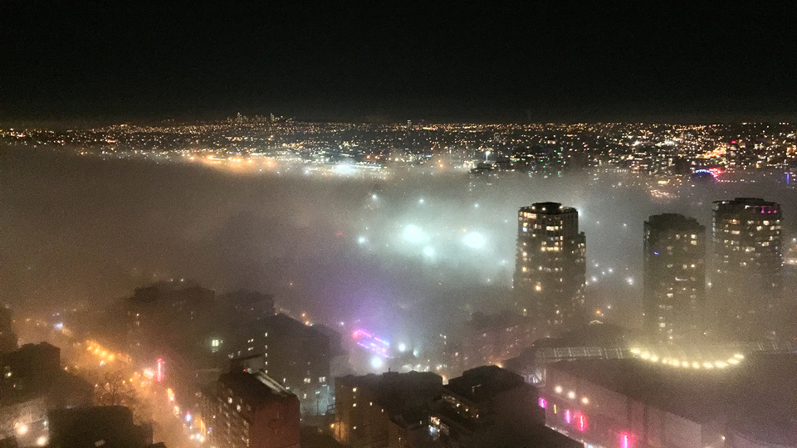
State of the (reionization) Union
Fundamental impasse: can’t tell which galaxies are leaking ionizing photons
Beyond z~4, the intervening IGM soaks up all photons
Fog (IGM) → can’t tell how bright the city is (how ionizing a galaxy is)

Slide 45
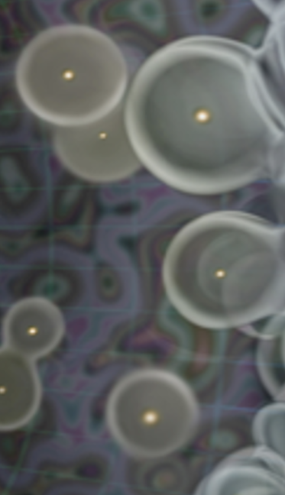
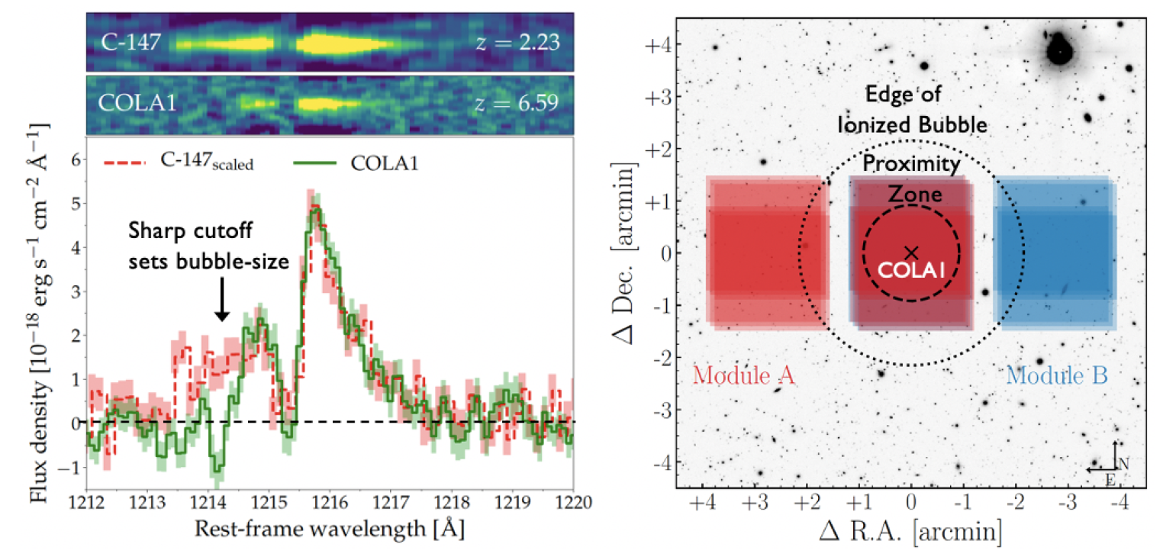
Which galaxies reionized the Universe?
JWST bubble program PI: Naidu & Matthee
LyA spectra
1215 A
Lyman-α
Only z~7 bubble with strongly constrained size Matthee+18, Mason & Gronke 2020

Slide 46
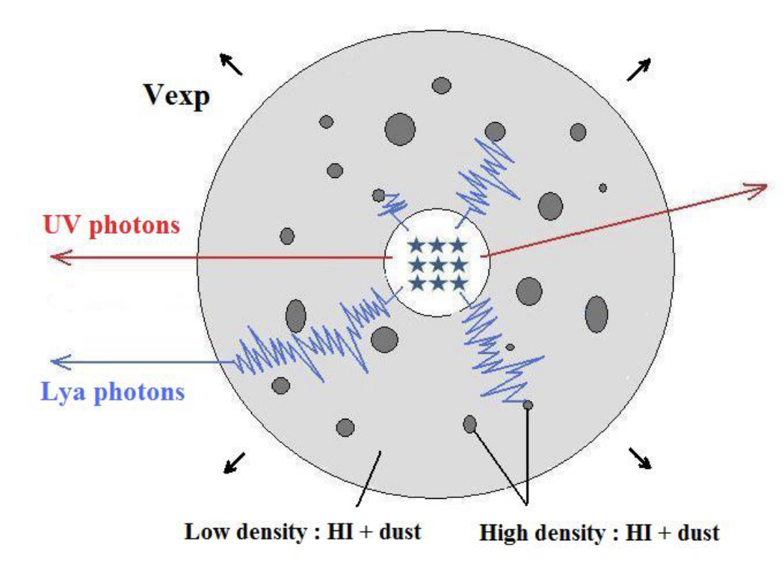
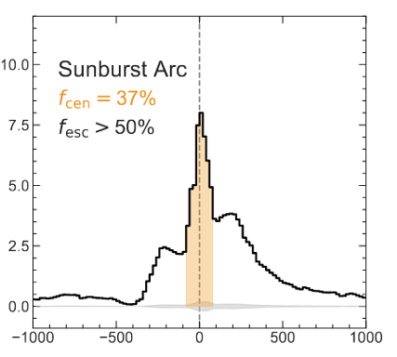
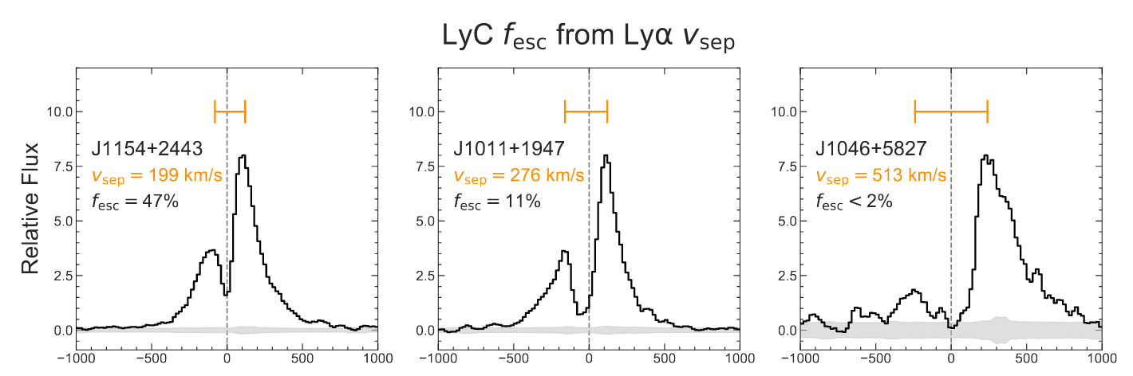
High-resolution Lyman-α holds the key
Naidu & Matthee+22
Matthee & Naidu+22
High-Redshift
Galaxy
Highly
Ionizing
Difficult to perform a simple test at significant redshift: what are the properties of high fesc vs. low fesc galaxies?
What is the connection between results at lower redshifts and the Epoch of Reionization?
Poorly
Ionizing
Duval+14

Slide 47
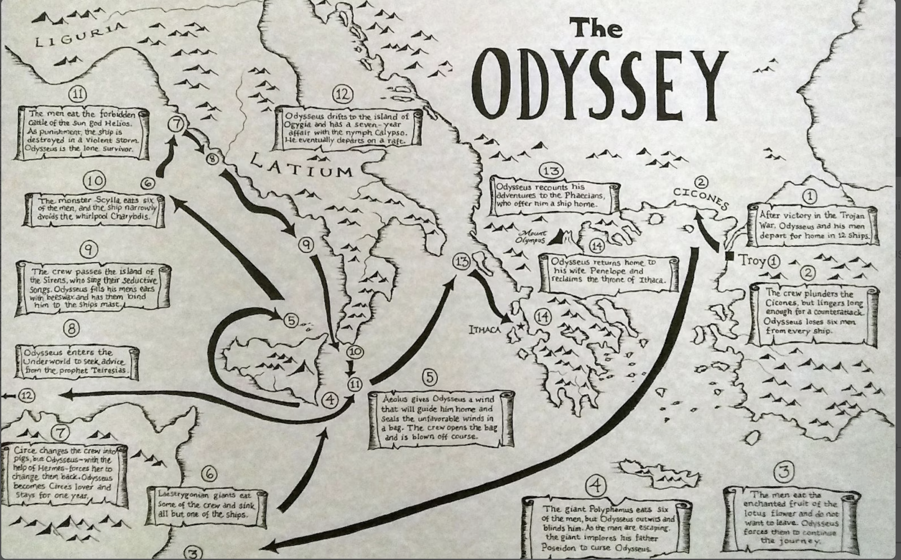
High-resolution Lyman-α holds the key
Naidu & Matthee+22
Matthee & Naidu+22
High-Redshift
Galaxy
Highly
Ionizing
Difficult to perform a simple test at significant redshift: what are the properties of high fesc vs. low fesc galaxies?
What is the connection between results at lower redshifts and the Epoch of Reionization?
Poorly
Ionizing
Duval+14

Slide 48
Which galaxies reionized the Universe?
JWST bubble program PI: Naidu & Matthee
LyA spectra
Only z~7 bubble with strongly constrained size Matthee+18, Mason & Gronke 2020

Slide 49
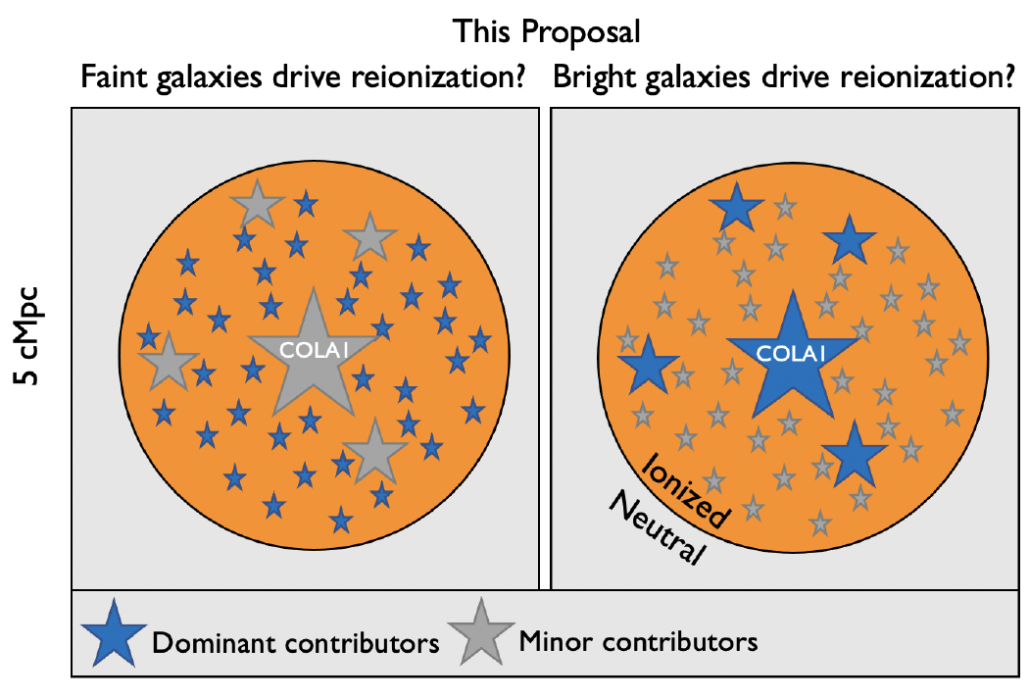
Which galaxies reionized the Universe?
JWST bubble program PI: Naidu & Matthee
Total ionizing photon budget known (since size is known ~ Stromgren sphere)
JWST survey: can bright galaxies do it all?
Only z~7 bubble with strongly constrained size Matthee+18, Mason & Gronke 2020

Slide 50
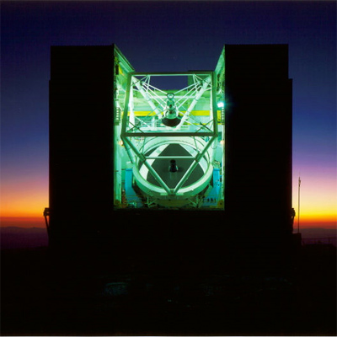
High-resolution Lyman-α Experiments
100+ hrs on VLT in 2023/24
i) first direct constraints on ultra-faint galaxies in lensed fields
ii) survey within z~6-7 quasar bubbles
MMT/Binospec is the perfect instrument -- combination of resolution + throughput + field of view
Highly
Ionizing
Poorly
Ionizing

Slide 51
A golden era for early universe science
JWST

Slide 52
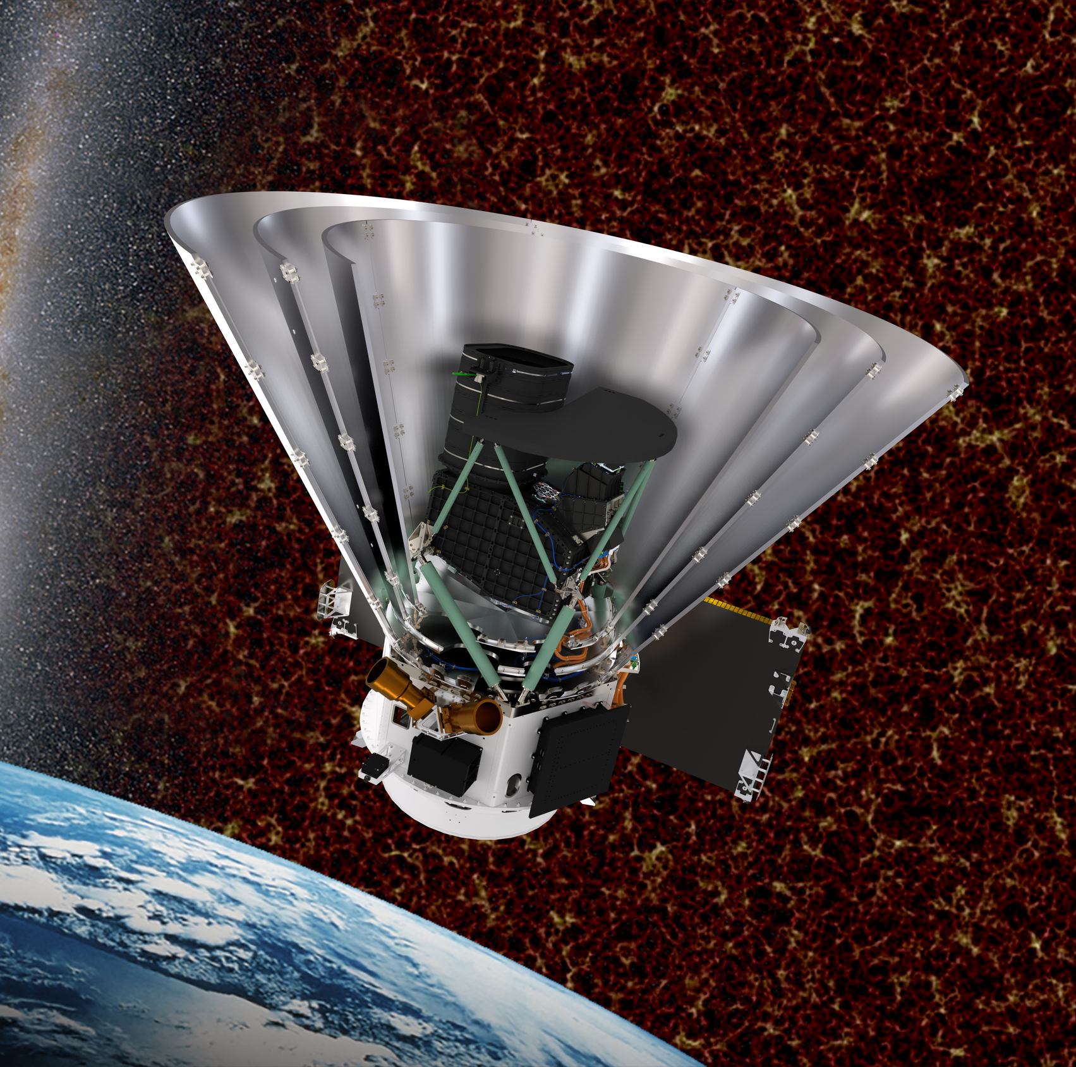
A golden era for early universe science
Euclid (2023)
SPHEREx (2025)
Roman (2027)
All-sky surveys will find >1000 luminous z>10 galaxies, rare overdensities
JWST

Slide 53
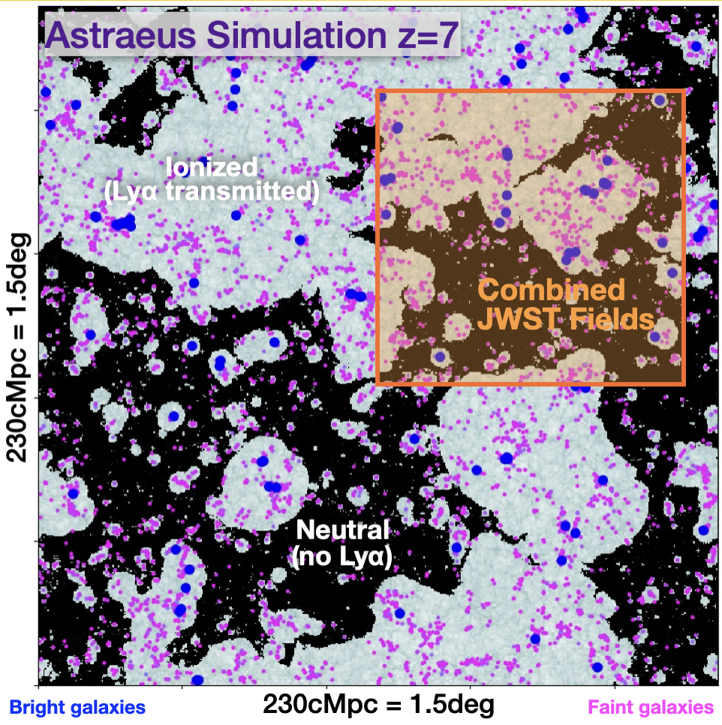
A golden era for early universe science
Euclid (2023)
SPHEREx (2025)
Roman (2027)
All-sky surveys will find >1000 luminous z>10 galaxies, rare overdensities
JWST
e.g., Hutter+20

Slide 54
A golden era for early universe science
Euclid Deep Survey (40 deg²)
Euclid (2023)
SPHEREx (2025)
Roman (2027)
All-sky surveys will find >1000 luminous z>10 galaxies, rare overdensities
JWST
e.g., Hutter+20

Slide 55
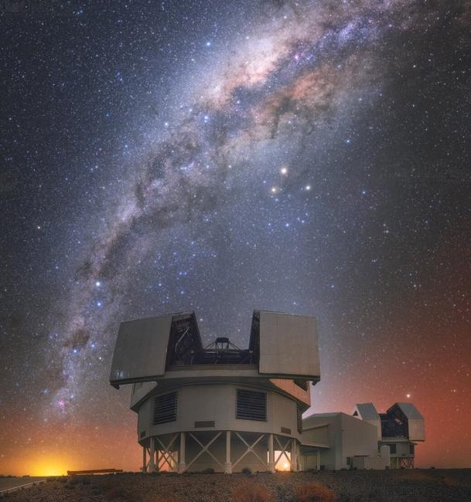
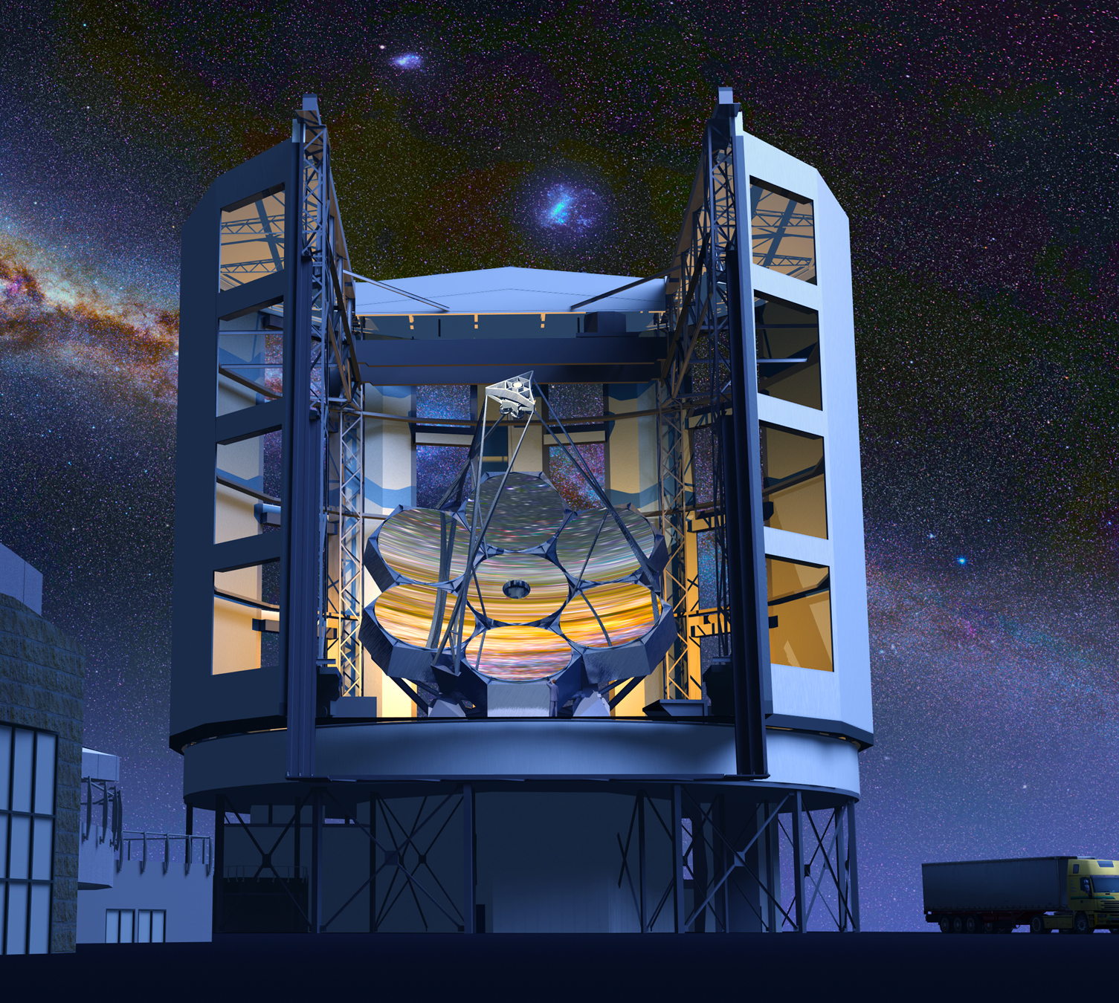
A golden era for early universe science
Euclid (2023)
SPHEREx (2025)
Roman (2027)
Rest-UV spectroscopy at z>6 – e.g., LyA (reionization), HeII (Pop III), CIV (AGN)
All-sky surveys will find >1000 luminous z>10 galaxies, rare overdensities
Magellan
GMT
MMT
JWST

Slide 56
A golden era for early universe science
Magellan (MIRMOS, FIRE)
MMT (Binospec)
GMT (GMACS)
JWST
Euclid (2023)
SPHEREx (2025)
Roman (2027)
Rest-UV spectroscopy at z>6 – e.g., LyA (reionization), HeII (Pop III), CIV (AGN)
Lyman-α
[OIII]+Hb
Ha+
[NII]
All-sky surveys will find >1000 luminous z>10 galaxies, rare overdensities
Magellan
GMT
MMT
JWST

Slide 57
A golden era for early universe science
Euclid (2023)
SPHEREx (2025)
Roman (2027)
Rest-UV spectroscopy at z>6 – e.g., LyA (reionization), HeII (Pop III), CIV (AGN)
All-sky surveys will find >1000 luminous z>10 galaxies, rare overdensities
Magellan
GMT
MMT
JWST

Slide 58
1920: do other galaxies exist?
2020s: a final expansion of the cosmic frontier to the brink of the Big Bang
Loeb+06
Big
Bang
Dark
Ages
Cosmic Dawn
Reionization
Present
Day

Slide 59
Summary
The first generations of stars and galaxies are finally within reach thanks to JWST.
The early universe has already shown us several surprises – e.g., luminous z>10 galaxies, abundant AGN.
The elusive protagonists of cosmic reionization will be revealed through high-resolution LyA and bubble experiments.
Upcoming space and ground-based missions promise to complete our census of cosmic history in the next few years.

Slide 62
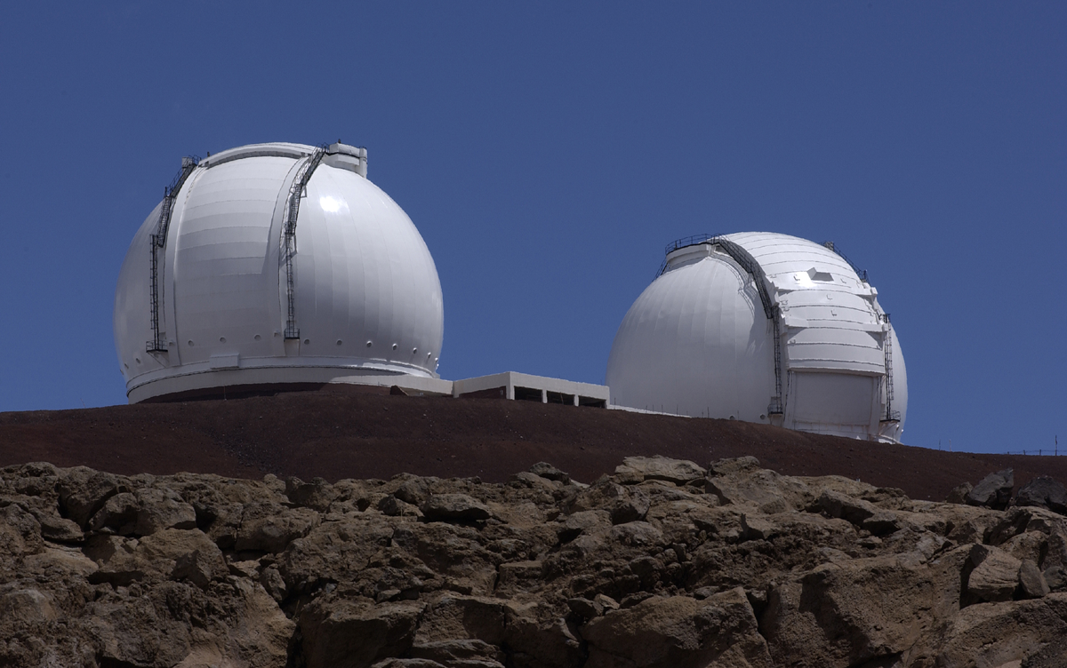
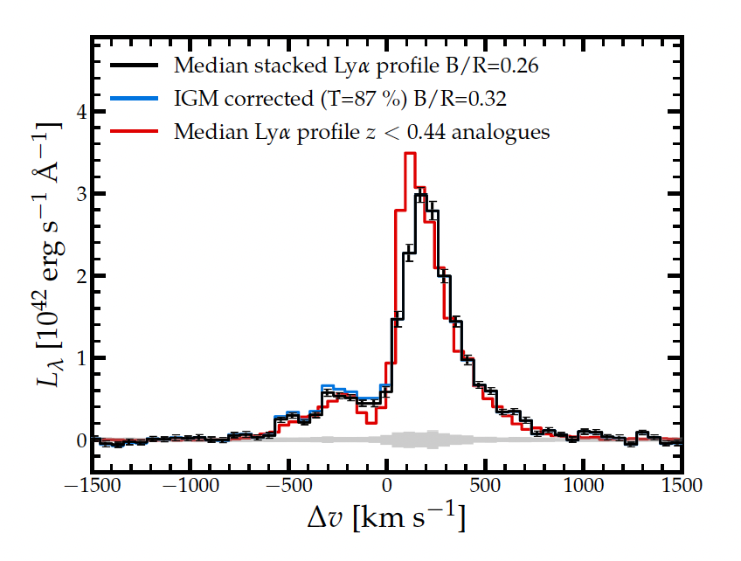
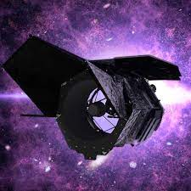
Solving Reionization with Lyman-alpha
Keck
JWST
Roman Space Telescope

Slide 63
Summary
JWST is revealing epochs of the Universe we’ve never seen before.
  Surprising new classes of galaxies at the highest redshifts (e.g., remarkably bright galaxies)
  Unraveling reionization with “bubble experiments”
The Milky Way is home to some of the first galaxies
  Key to understanding the geography of dark matter
  Allow detailed access to the chemistry of the early Universe

Slide 66
Cosmic Reionization: ionizing photon budget
Reionization Budget = Number of galaxies
x Ionizing photons/galaxy
x Fraction that evade dust+HI
= ⍴_{SFR} ξ_{ion} f_{esc}
Loeb+06
Clear path to ⍴_{SFR} and ξ_{ion}(?) with JWST.
Direct measurements of escape fractions (f_{esc}) impossible at z>4 due to IGM opacity.

Slide 67
Cosmic Reionization: everything hinges on LyC f_{esc}
Bright galaxies
have high fesc
Timeline
Faint galaxies
have high fesc
Naidu+20, Tacchella+18
Radically different pictures of reionization depending on fesc distribution.

Slide 68
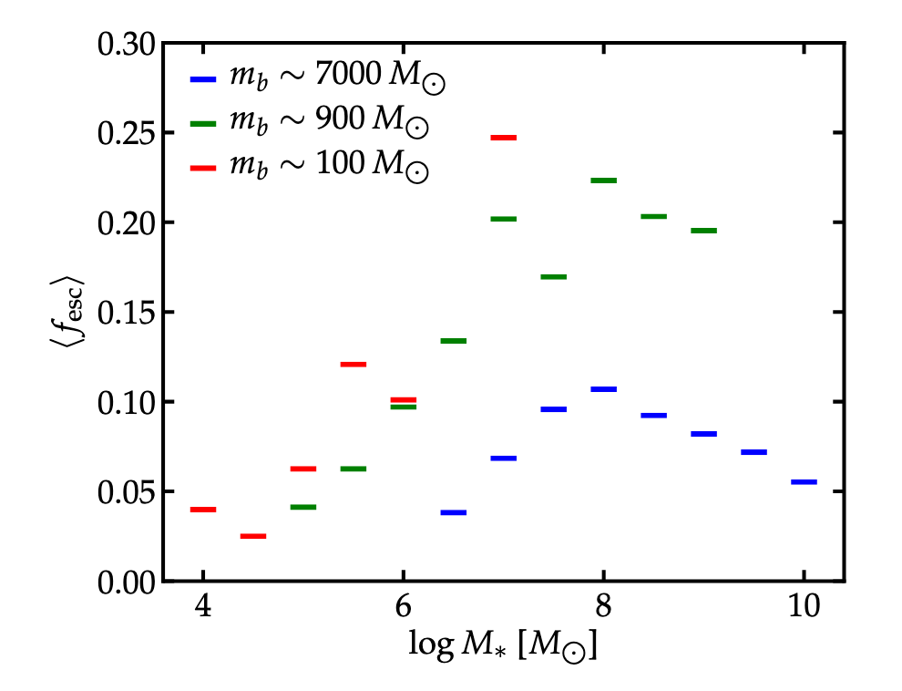
Cosmic Reionization: everything hinges on LyC f_{esc}
Bright galaxies
have high fesc
Timeline
Faint galaxies
have high fesc
Hi-Res
Low-Res
Inefficient SF
Dust
Ma+20, FIRE-2 Simulations
See also Ma+15,16
Naidu+20, Tacchella+18
Radically different pictures of reionization depending on fesc distribution.

Slide 69
Cosmic Reionization: everything hinges on LyC f_{esc}
Bright galaxies
have high fesc
Timeline
Topology
Faint galaxies
have high fesc
Naidu+20, Tacchella+18
Radically different pictures of reionization depending on fesc distribution.

Slide 70
State of the (LyC fesc) Union
Difficult to perform a simple test at significant redshift: what are the properties of high fesc vs. low fesc galaxies?
Fog (IGM/viewing angle effects) = can’t tell how bright the city (fesc) is

Slide 71
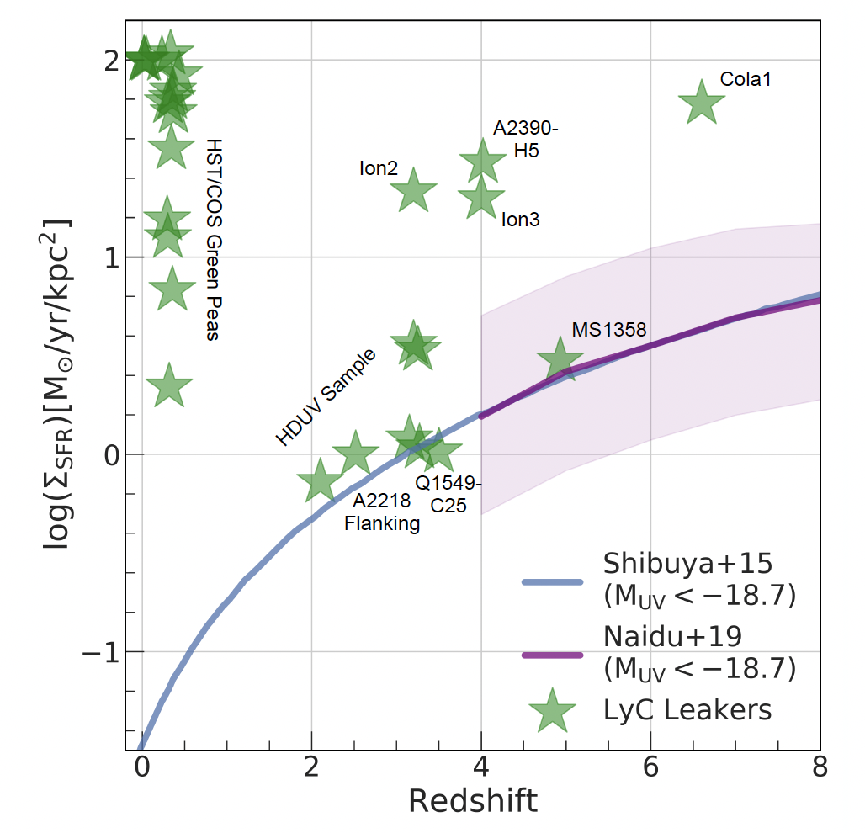
State of the (LyC fesc) Union
Difficult to perform a simple test at significant redshift: what are the properties of high fesc vs. low fesc galaxies?
What is the connection between results at lower redshifts and the Epoch of Reionization?
Naidu+20

Slide 72
State of the (LyC fesc) Union
Difficult to perform a simple test at significant redshift: what are the properties of high fesc vs. low fesc galaxies?
What is the connection between results at lower redshifts and the Epoch of Reionization?
Resolved Lyman-α
is the panacea
Duval+14

Slide 73
State of the (LyC fesc) Union
(LyA)
Difficult to perform a simple test at significant redshift: what are the properties of high fesc vs. low fesc galaxies?
What is the connection between results at lower redshifts and the Epoch of Reionization?
Resolved Lyman-α
is the panacea
Duval+14

Slide 74
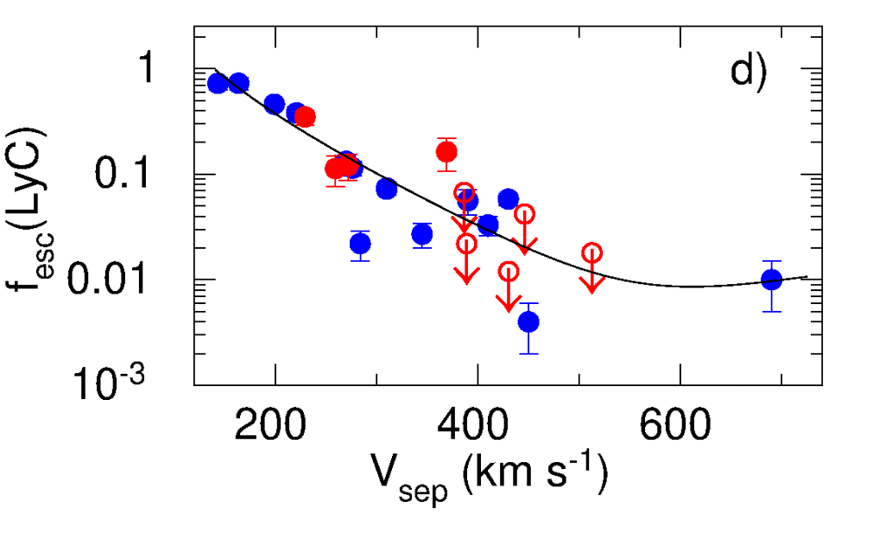
Lyα profiles are excellent tracers of LyC fesc: peak separation (Vsep)
z~0.3
Low Vsep = High fesc
Izotov+21

Slide 75


Lyα profiles are excellent tracers of LyC fesc: central Lyα fraction (fcen)
High fcen= High fesc
Systemic Lyα traces ionized channels
Vanzella+18

Slide 76

XLSz2:
X-SHOOTER
Lyα Survey at z~2
R>4000 Lyα profiles, <10 km/s systemic zs
N=35, well-defined, flux-limited sample (Lyα L>0.2 Lyα L*)
Coverage from Lyα to Hα
Matthee+21, MNRAS, 1292M

Slide 77

Stacks comparable log(M*)~9, Muv~-20, β~-2, 12 + log(O/H)~8
Naidu & Matthee
2022

Slide 78

High Escape occurs in an extreme ionization state ISM
High Escape (>20%)
Low Escape (<5%)
O32=8.4
O32=2.7
O32 = [OIII]5007A/[OII]3727A.
Extreme [OIII] emission (EW >800 A) can be used to select agents of reionization.

Slide 79

Evolutionary sequence for LyA and LyC

Slide 80
Evolutionary sequence for LyA and LyC

Slide 81

UV Luminosity Functions are the classical standard for reionization calculations
Total photons = Number of galaxies
x Ionizing photons/galaxy
x Fraction that evade dust+HI
= ⍴_{SFR} ξ_{ion} f_{esc}
Bouwens+21

Slide 82

LyA luminosity functions are a more intuitive choice
If there is no LyA escape, there is no ionizing photon escape
UV luminosity functions sum photons from all galaxies
LyA luminosity functions focus on “productive” galaxies
Madau+99, Robertson+13
Matthee & Naidu+21
Duval+14

Slide 83

The Ionizing background at z~2-8 is due to bright Lyman-alpha emitters
Excellent match to the shape of the emissivity

Slide 84

The Ionizing background at z~2-8 is due to bright Lyman-alpha emitters
Excellent match to the shape of the emissivity
The falling star-formation density is balanced by the rising LAE fraction

Slide 85

Rapid Reionization by bright Lyman-alpha Emitters
Only free parameter is the fraction of galaxies that are Lyman-alpha emitters.

Slide 86

But LAEs disappear at z>6?
Map LyA fraction to extreme [OIII] emitter fraction
Integrate Hb luminosity function
Boyett+21
de Barros+19
Stefanon+22

Slide 87

FRESCO: First Reionization Epoch Survey that is COmplete PI: Pascal Oesch
JWST/NIRCam F444W grism survey.
Spectra for every galaxy in the field of view: 60 arcmin² each in GOODS-S (covering HUDF) and GOODS-N.
First complete line luminosity functions out to z~9

Slide 88

Which galaxies reionized the Universe?
JWST bubble program PI: Matthee & Naidu
LyA spectra
Only z~7 bubble with strongly constrained size Matthee+18, Mason & Gronke 2020

Slide 89
Which galaxies reionized the Universe?
JWST bubble program PI: Matthee & Naidu
Total ionizing photon budget known (since size is known ~ Stromgren sphere)
Grism spectroscopy: can bright galaxies do it all?
Only z~7 bubble with strongly constrained size Matthee+18, Mason & Gronke 2020

