Slide 1
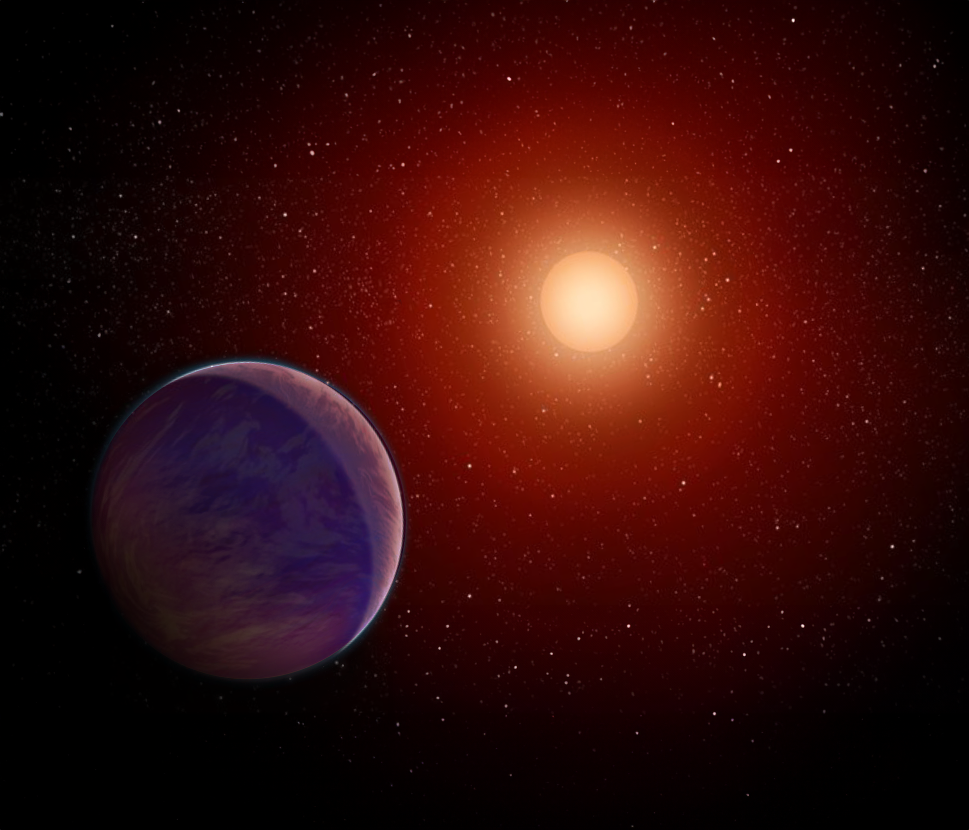

A close-in Neptune Orbiting An Ultracool Star
Guðmundur Stefánsson
NHFP Sagan Fellow -> University of Amsterdam
Princeton University
NHFP Symposium
September 19, 2023

Slide 2
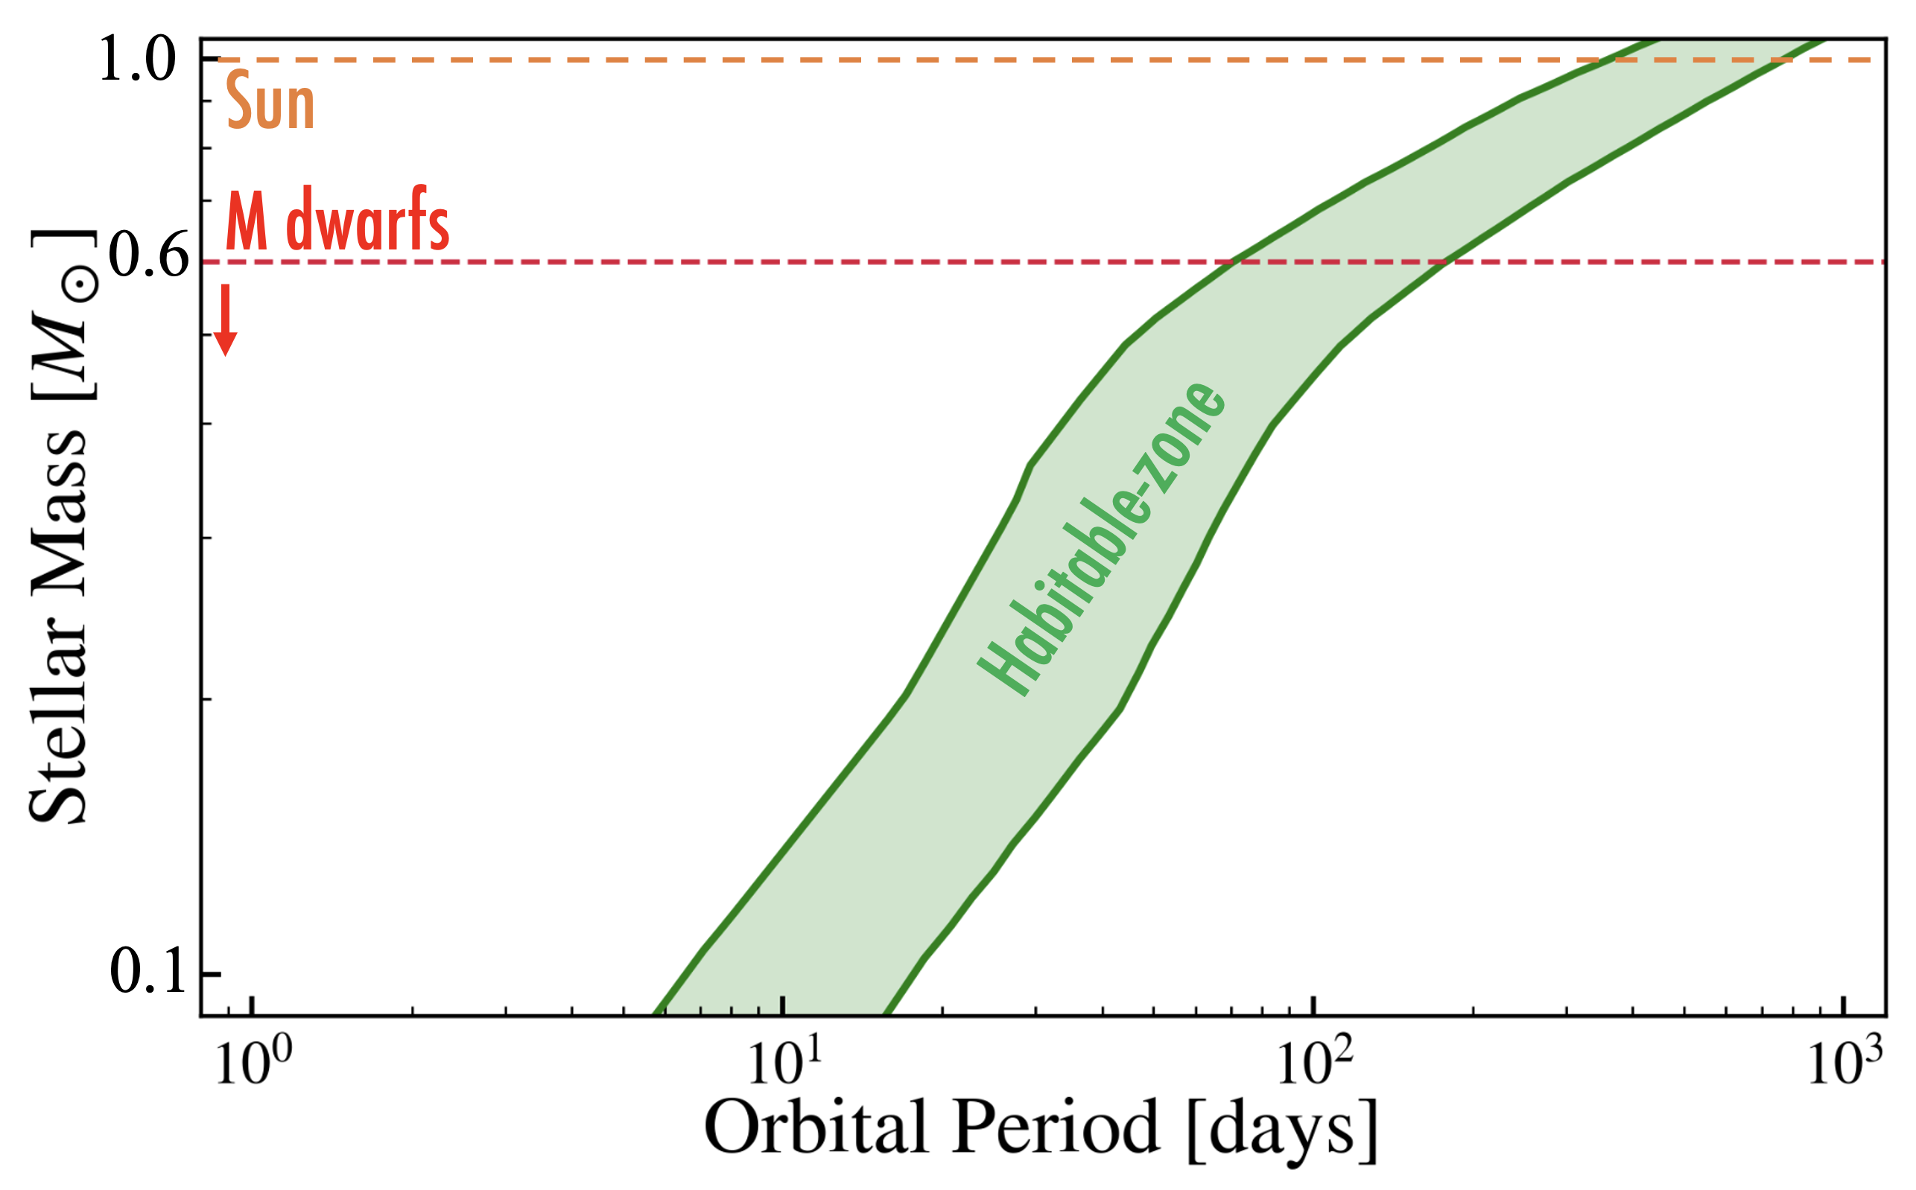
The M dwarf opportunity: #1 The low mass and small size of M stars increases sensitivity to small planets and planets in the habitable-zone

Slide 3
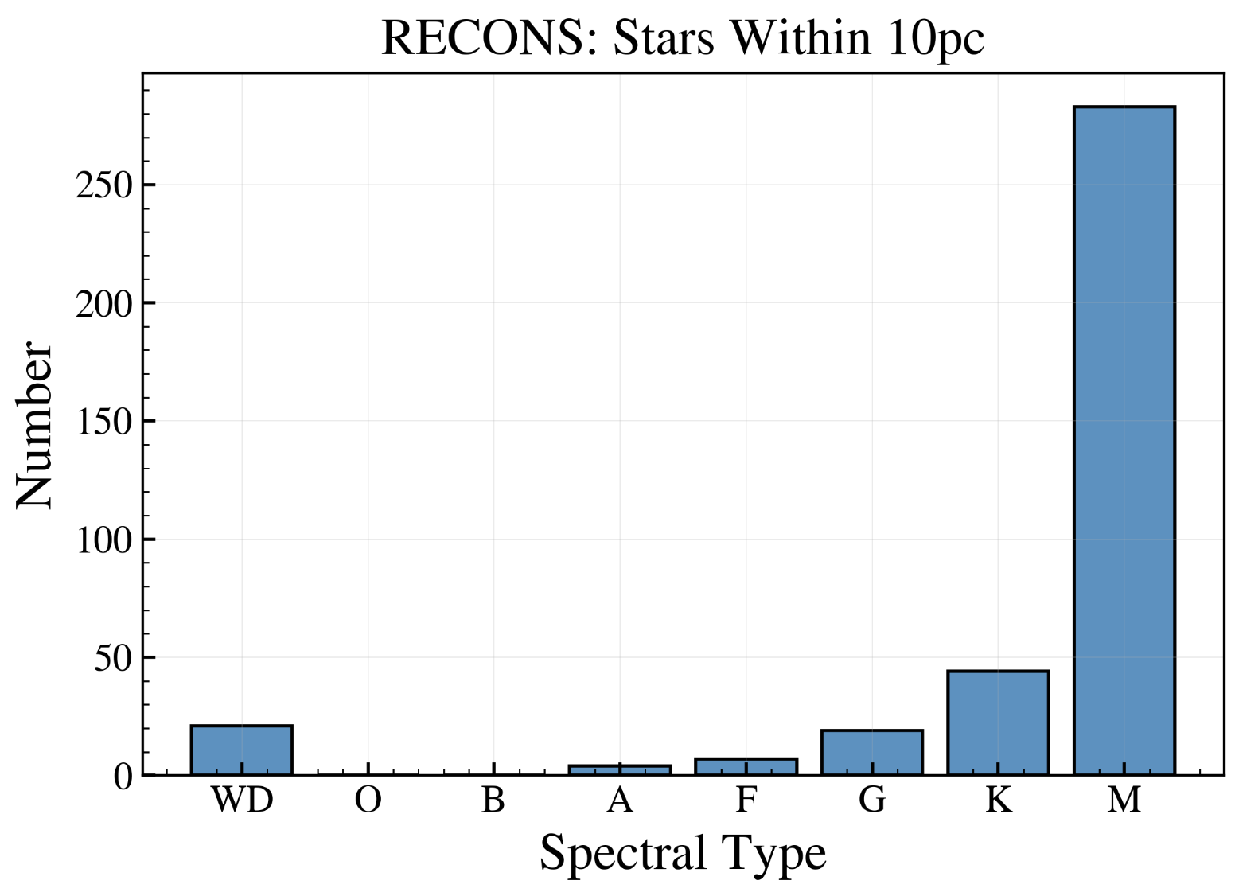
The M dwarf opportunity: #2 M dwarfs are the most numerous types of stars in the galaxy, and are also our nearest neighbors
Total number of stars: 378
RECONS

Slide 4
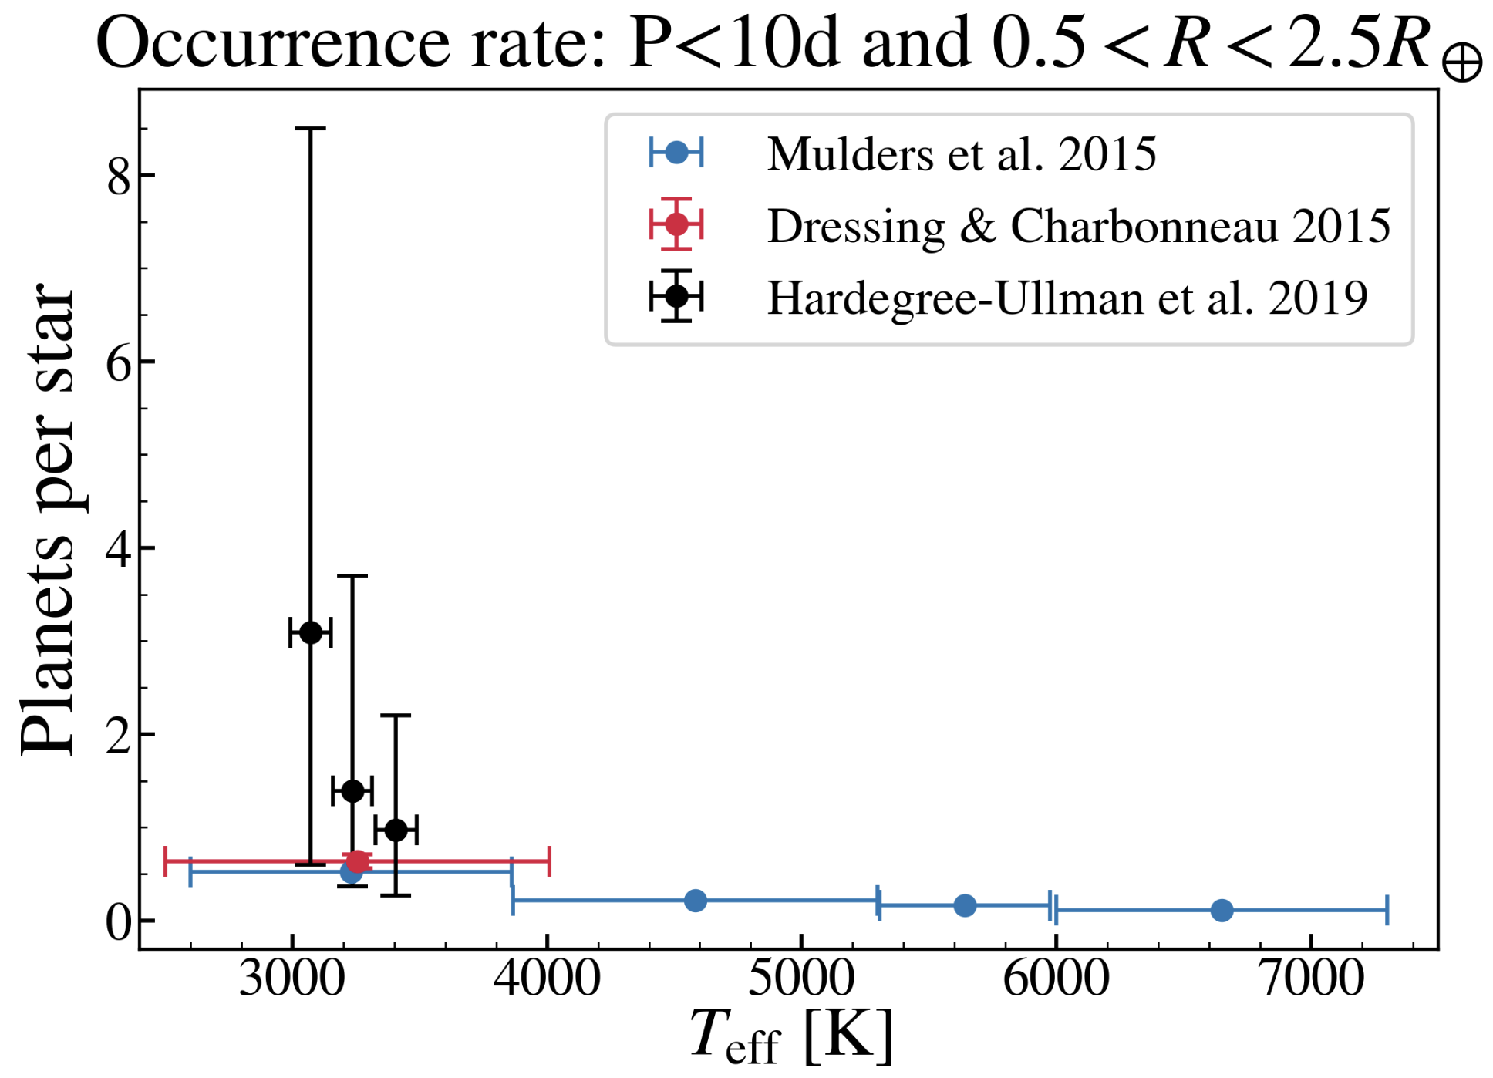
The M dwarf opportunity: #3 M dwarfs are known to host numerous close-in planets
However, due to their faintness, mid-to-late M stars have remained relatively poorly studied

Slide 5
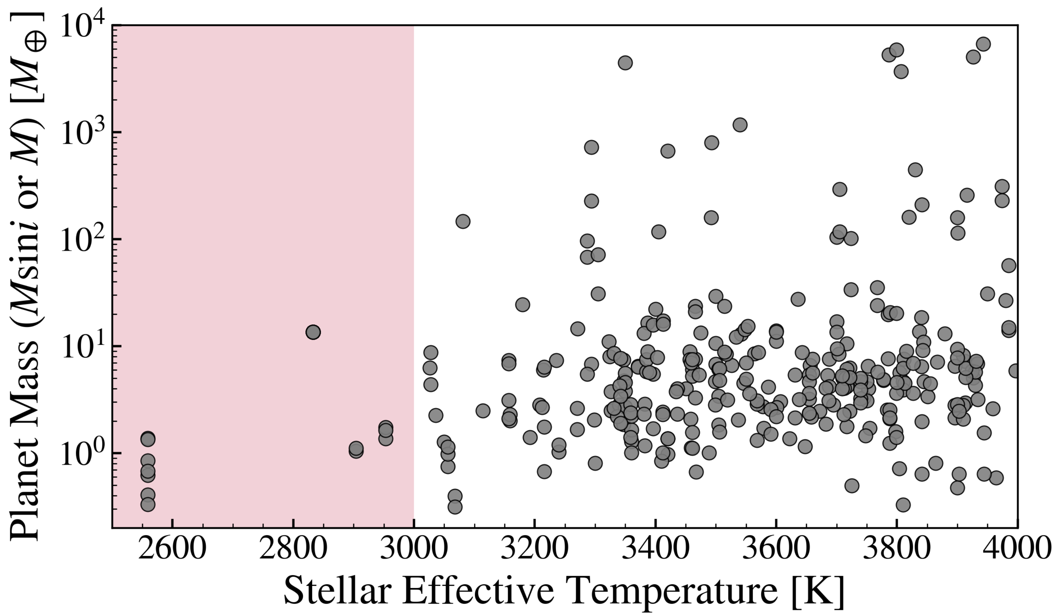

Currently only 3 systems of ultra-cool M stars have mass constraints. All host compact rocky planets.
Very low mass stars
HPF Survey
TRAPPIST-1
GJ 1061
Teegarden’s star
How do the properties of planets orbiting mid-to-late M stars differ from hotter stars?

Slide 6
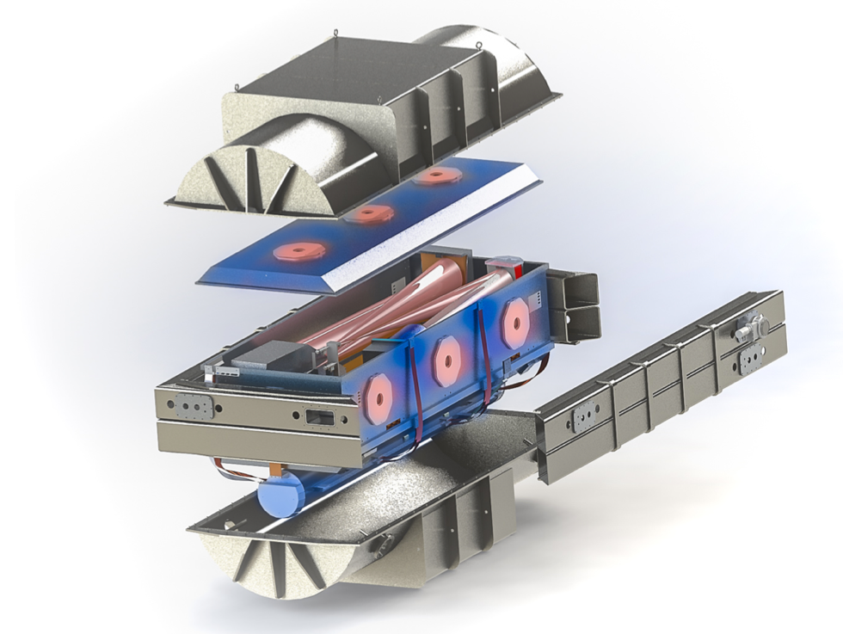

The Habitable-zone Planet Finder (HPF) is a fiber-fed stabilized NIR spectrograph on the 10m Hobby-Eberly Telescope
10m HET
RV precision: ~1m/s
Wavelength range: 810-1280nm
Resolution: 55,000

Slide 7
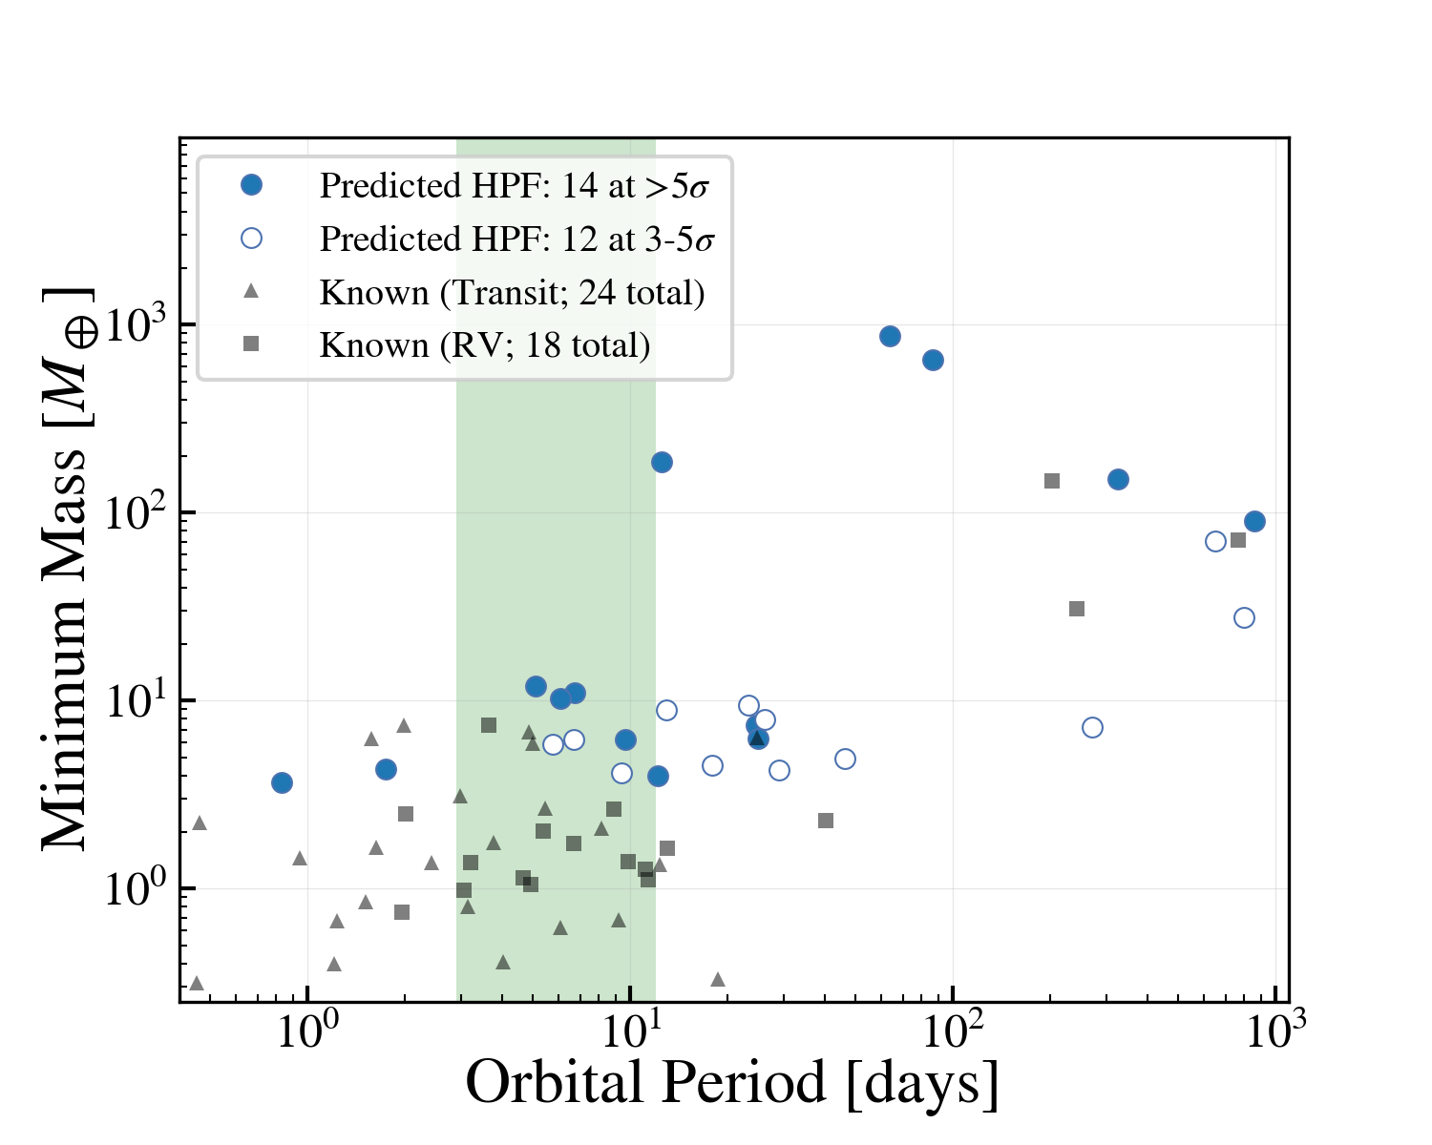
The HPF Survey focuses on surveying 30-40 nearby mid-to-late M-dwarf stars within 25pc for terrestrial planets in the habitable-zone
HZ

Slide 8
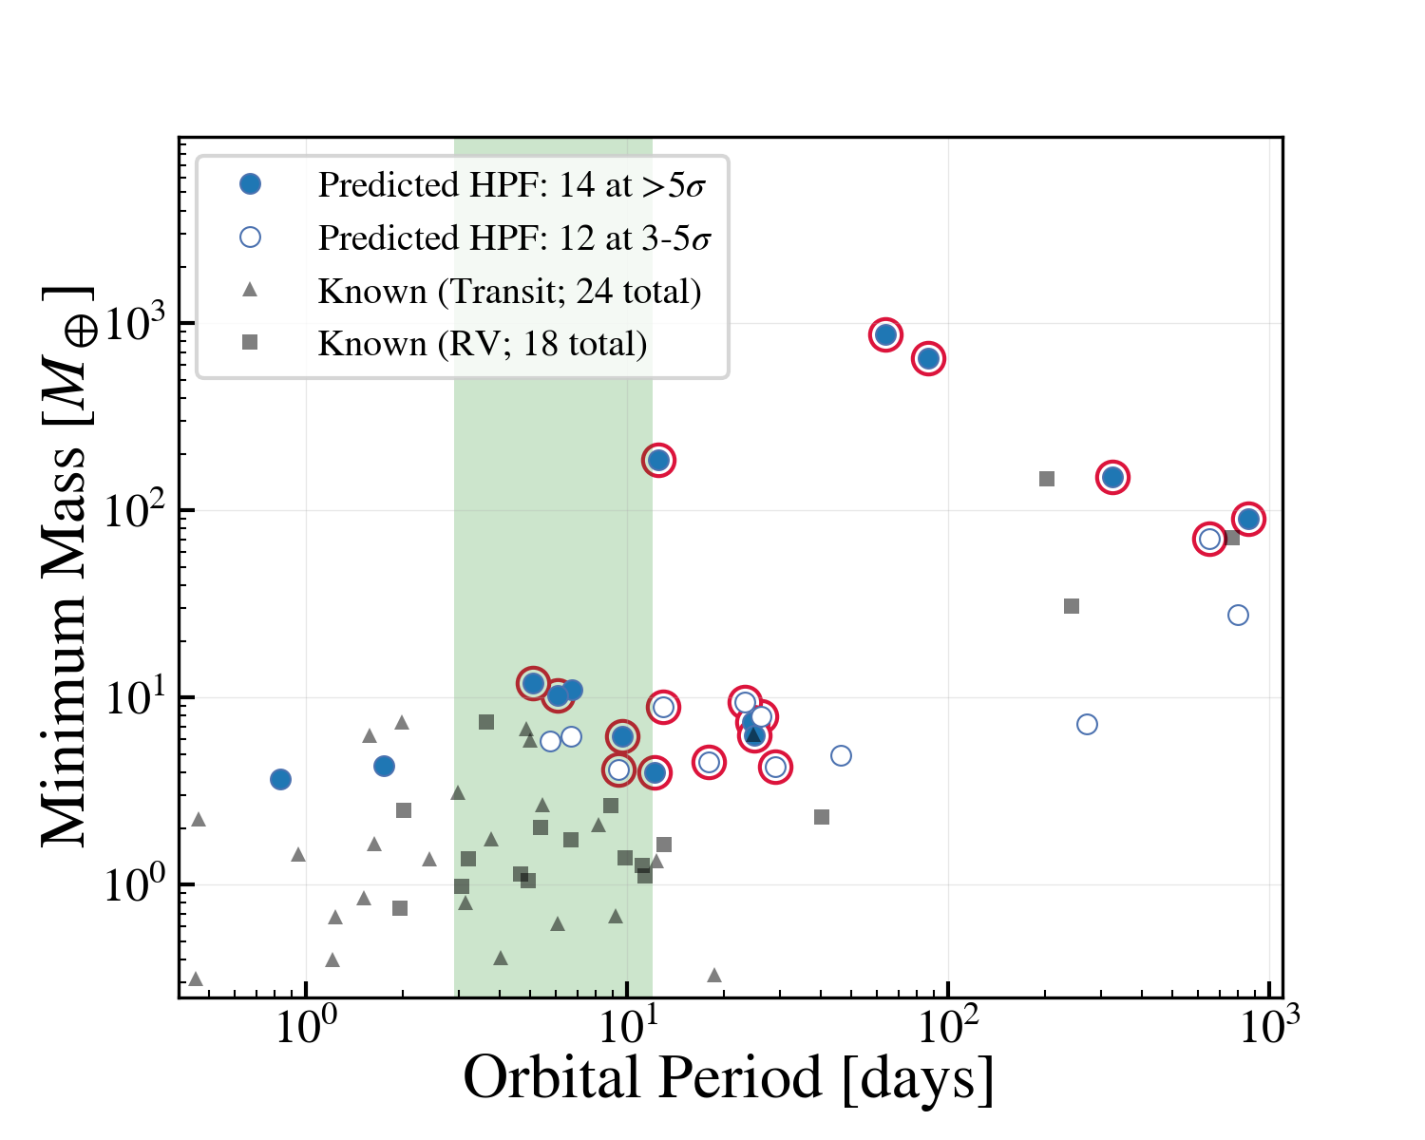
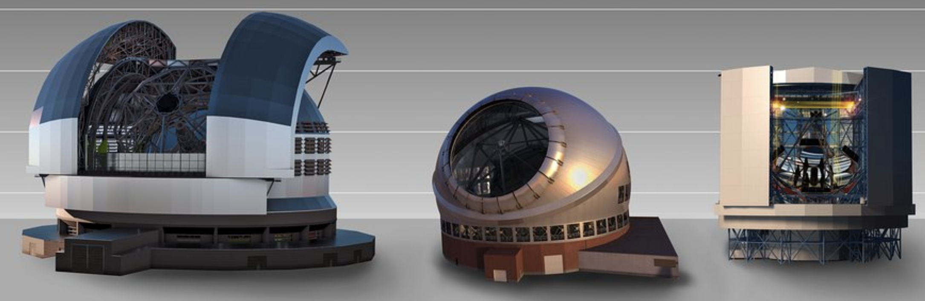
The HPF Survey focuses on surveying 30-40 nearby mid-to-late M-dwarf stars within 25pc for terrestrial planets in the habitable-zone
HZ
TMT
ELT
These will be some of the best targets for direct imaging in the future

Slide 9

The HPF survey is starting to provide exciting planet candidates
HZ
LHS 3154b

Slide 10
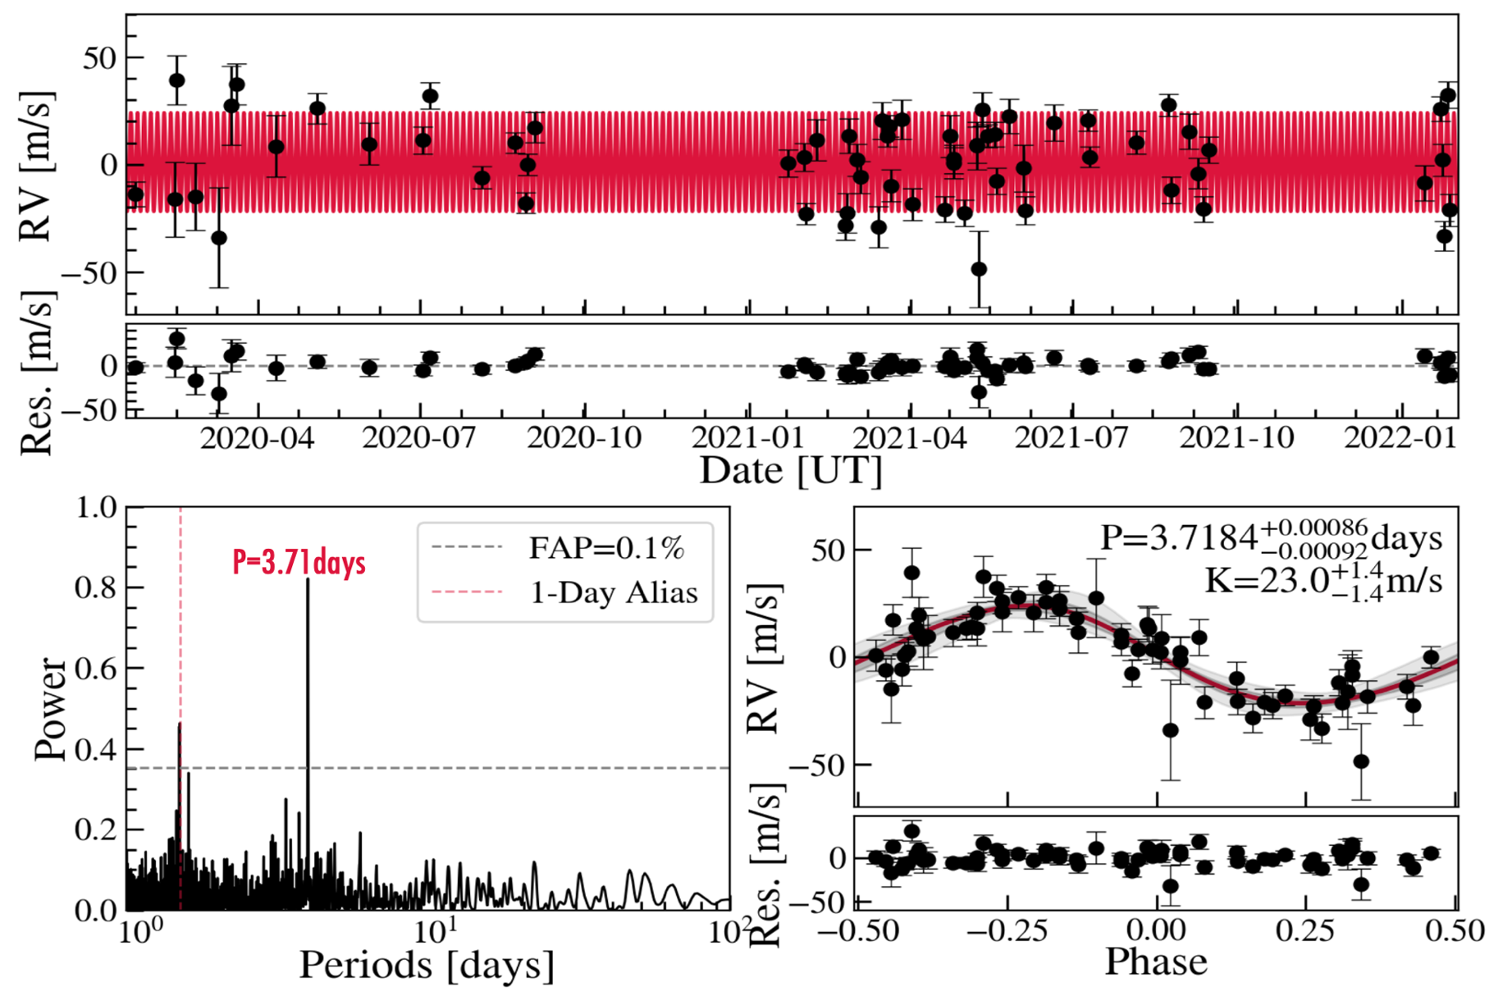
LHS 3154 b is a Neptune-mass planet orbiting an inactive very-low mass star (0.11 MSun) at 16pc
Stefánsson et al. 2023 (in review, arXiv: 2303.13321)

Slide 11
Very low mass stars
LHS 3154b
TRAPPIST-1
GJ 1061
Teegarden’s star
Stefánsson et al. 2023 (in review, arXiv: 2303.13321)

Slide 12
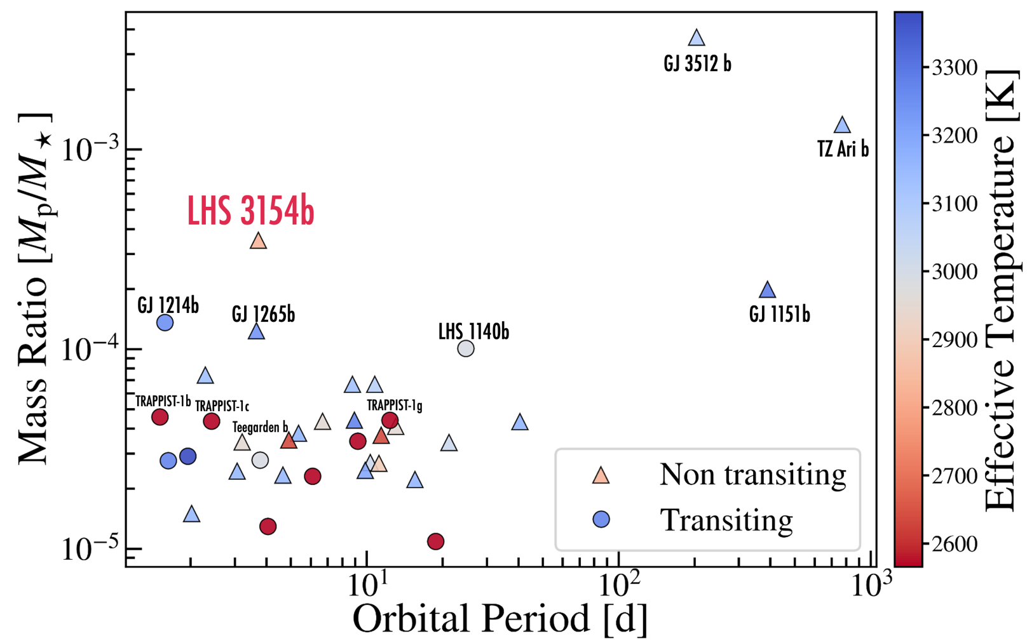


LHS 3154b high mass ratio challenges current theories of planet formation
Stefánsson et al. 2023 (in review, arXiv: 2303.13321)

Slide 13
How did LHS 3154b form?
Core Accretion
Gravitational Instability
Gas
Gas
Dust
Dust
Outcomes around 0.1 MSun stars:
Outcomes around 0.1 MSun stars:
<5 MEarth planets
Massive distant planets

Slide 14

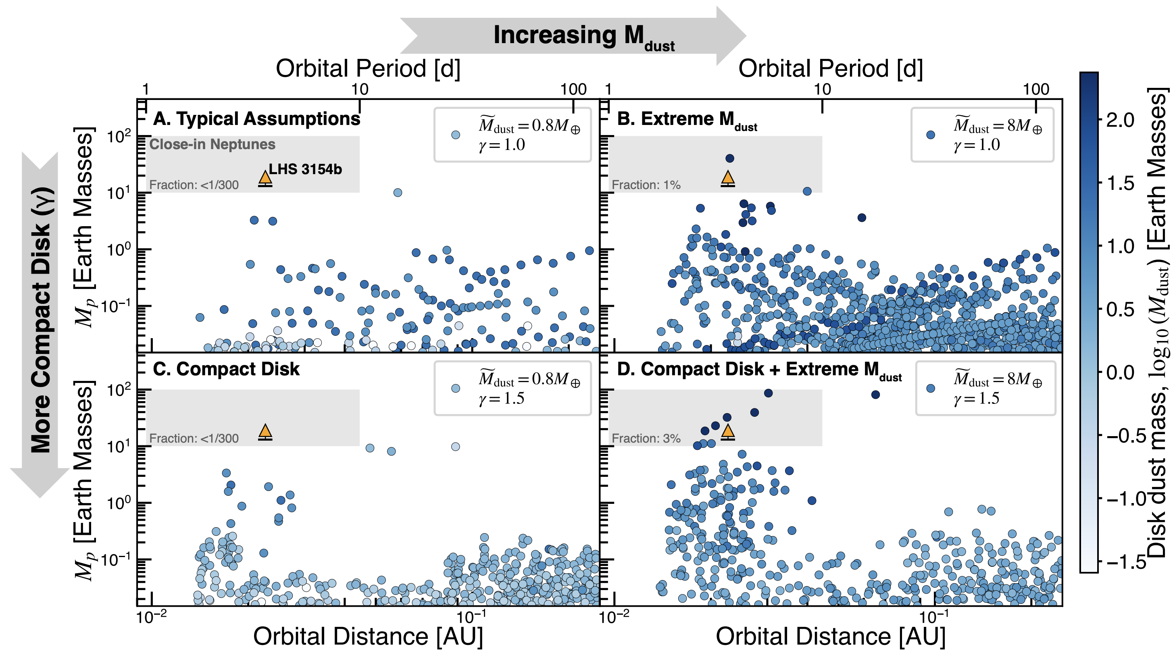





To form LHS 3154b via core-accretion requires massive protoplanetary disk dust masses
Nominal M_{dust}
Nominal M_{dust}
Close-in Neptunes
LHS 3154b
Stefánsson et al. 2023 (in review, arXiv: 2303.13321)

Slide 15
To form LHS 3154b via core-accretion requires massive protoplanetary disk dust masses
Nominal M_{dust} x 10
Close-in Neptunes
LHS 3154b
Simulated frequency (~3%) agrees with occurrence rate of $5_{−3}^{+8}\%$ from HPF survey
Stefánsson et al. 2023 (in review, arXiv: 2303.13321)

Slide 16
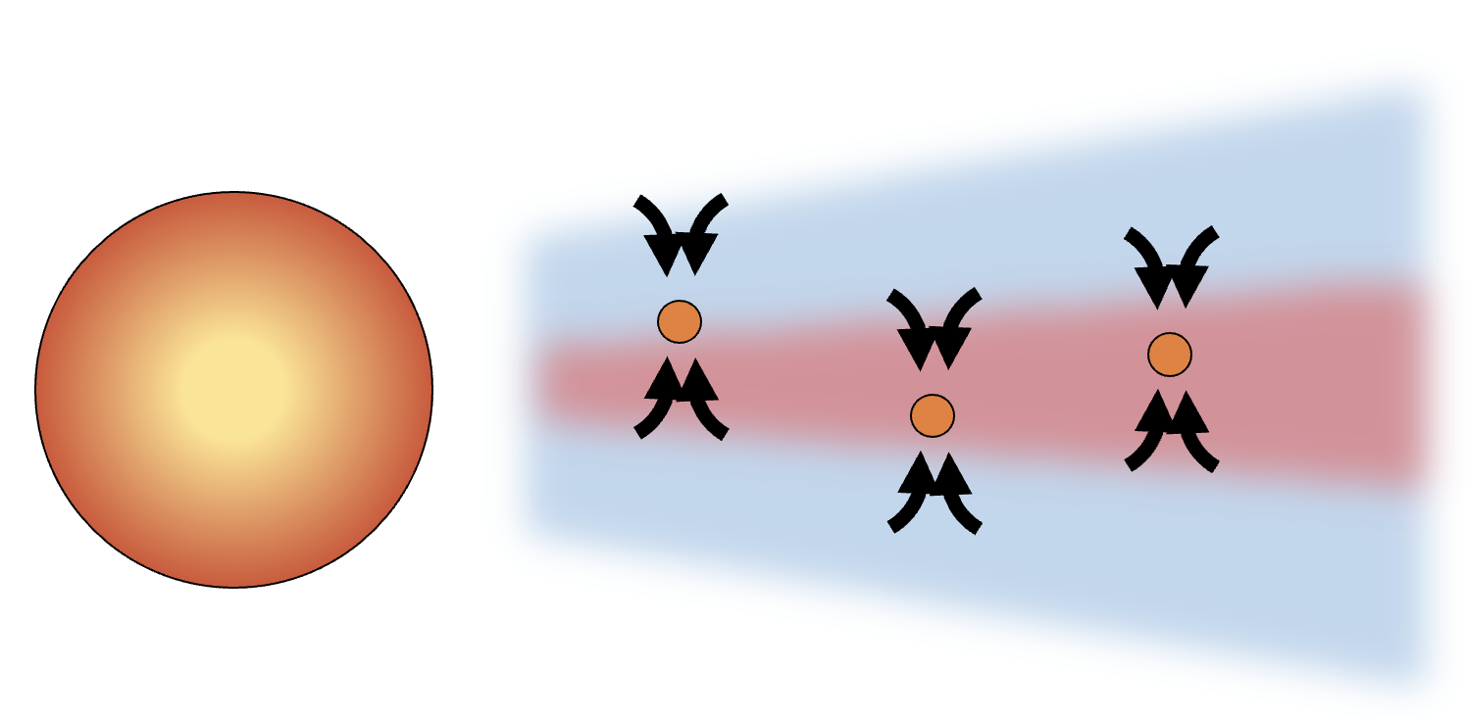
Summary
LHS 3154b is the only close-in Neptune known to orbit an ultracool star
To form LHS 3154b via core-accretion requires massive protoplanetary disk dust masses
The HPF Survey is ongoing—stay tuned for other exciting detections !
Thank you!

