Slide 1
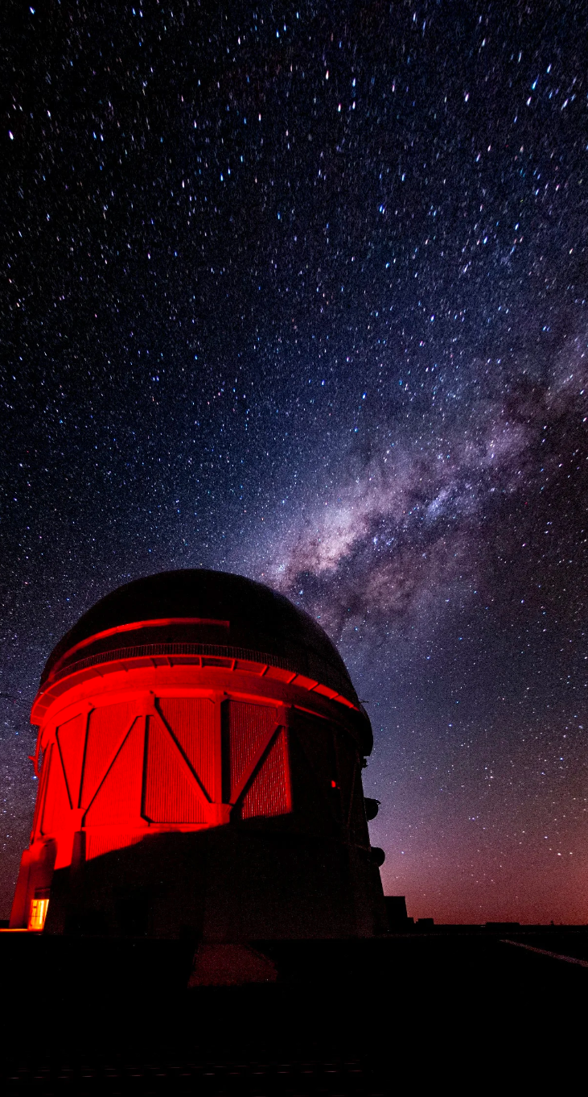
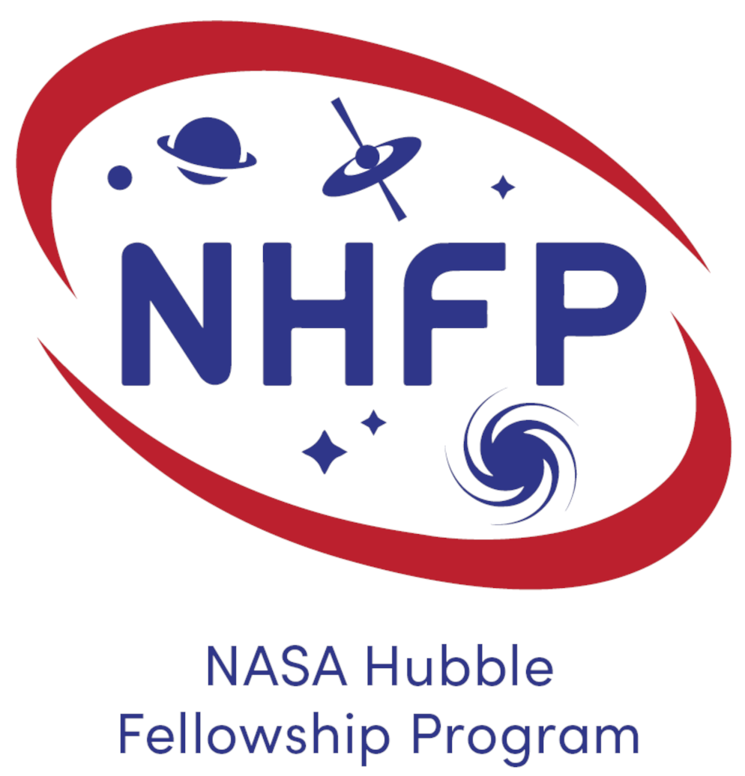
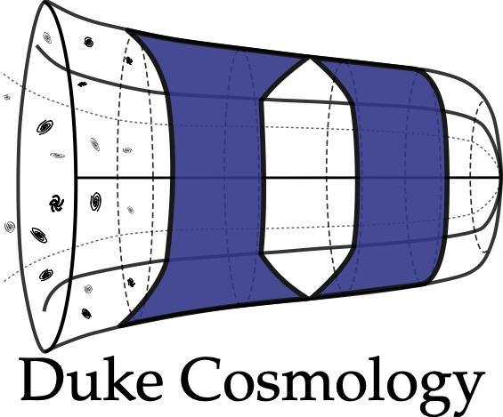


Type Ia Supernovae Cosmology:
challenges and results from the
Dark Energy Survey
Maria Vincenzi
2023 NASA Einstein Fellow @ Duke University
NHFP Symposium - September 21st, 2023 - Boston

Slide 2
The expansion history of our Universe
Cosmic
Microwave
Background
(CMB)
5 billion years ago:
expansion started accelerating..
~13.7 billion years ago
Big Bang
Today
Notes:
Since I’m kicking off the second cosmology session, I thought it would have been good to spend two minutes reminding you all of what we know about the evolution of our Universe, and what are the biggest open in modern cosmology.
This is kind of a schematic timeline, from the Big bang and recombination, til accelerated expansion we measure today.

Slide 3
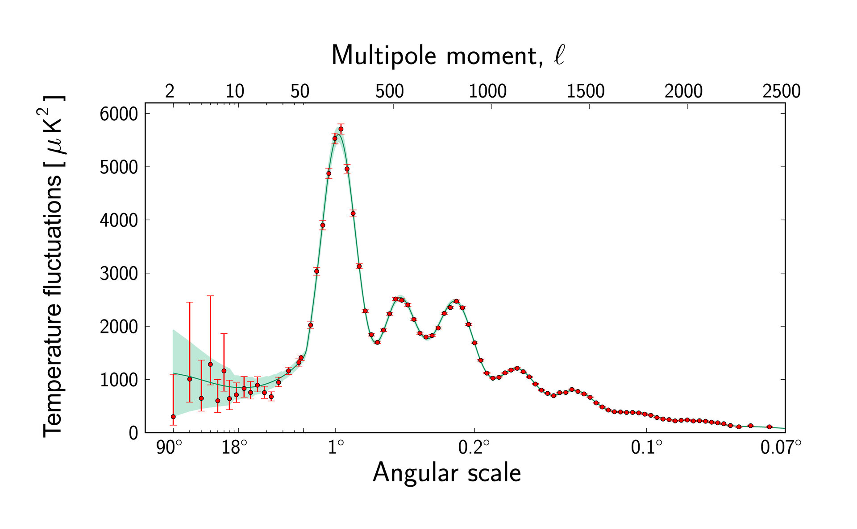

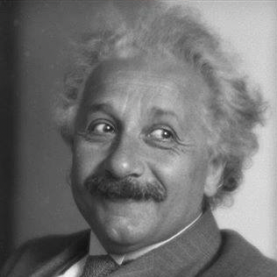
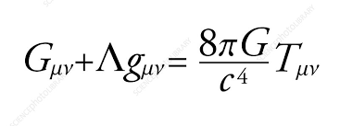
The expansion history of our Universe
𝚲CDM model
𝚲CDM works for measurements of the expansion of the Universe using:
Supernovae Ia
Formation of structures (e.g. BAO)
Weak gravitational lensing
CMB data
Big Bang
Today
𝚲CDM
Standard Cosmological model
General Relativity
Notes:
We have a model, a super simple one with only six free parameters that describes incredibly well almost the entire expansion history represented here. This model is built off general relativity and it is called Lambda CDM. It describes remarkably well the statistical properties of the cosmic microwave background and it works very well in describing the evolution of structures and the expansion of the following 13 billion years, regardless of which cosmological probes we use.
This model have been very successful in the past 15 years of cosmology

Slide 4
The expansion history of our Universe
What is Dark Energy?
Is General Relativity valid at cosmic scales?
Big Bang
Today
𝚲CDM
Standard Cosmological model
General Relativity
Notes:
, however it leaves us with the rather unsatisfying situation of having a Universe that it’s mostly dominated by this Dark Energy, a form of energy we understand very little about. The mysterious nature of dark energy has often called into question whether the problem is at the foundation of LambdaCDM model, the problem is that GR doesnt work at cosmic scales.

Slide 5
The expansion history of our Universe
Maria Vincenzi 2023
What is Dark Energy?
Is General Relativity valid at cosmic scales?
Why 𝚲CDM fails the “H0” test? What is the cause of the observed tension?
The DIRECT route
Big Bang
Today
…assuming 𝚲CDM
The INDIRECT route
𝚲CDM
Standard Cosmological model
How fast is the Universe expanding today (H0)?
General Relativity
Notes:
Another crack that called into questions the LambdaCDM model is that it fails a very basic test, which is predicting how fast the expansion of the Universe is today.
This tension have been a problem for almost ten years now and there are more or less 15 papers about this every month.

Slide 6



The golden era of modern cosmology
What is Dark Energy?
Is General Relativity valid at cosmic scales?
Why 𝚲CDM fails the “H0” test? What is the cause of the observed tension?
Billions of dollars have been invested to investigate these questions.
2014-2019
2023
Today
Starting as NHFellow!
2024
2027
Notes:
These are the questions I’m interested to answer with my research and it is a pretty exciting time to be working on this because for sure we are not suffering a lack of data.
Billions of dollars have been invested to design and build experiments that can find an answer. In the last decade, the most important ground-based cosmological experiment has been the dark energy, the very near future is observatories like Euclid and Roman gonna give us orders of magnitudes more data and I’ll talk about this in my talk.

Slide 7
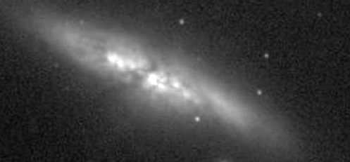

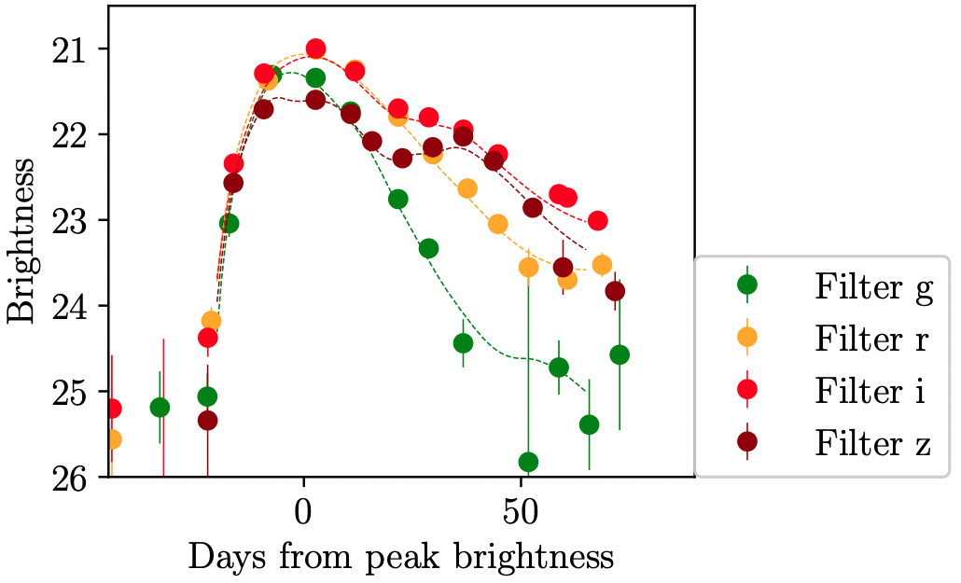
Type Ia Supernovae: the ideal tool to measure cosmic distances
Very homogeneous intrinsic brightness at peak (<10% scatter) after several empirical corrections.
pre SN discovery
SN detection
peak brightness
Notes:
The specific method I use to investigate these important questions about the universe are SNe Ia. We know that SNe Ia are thermonuclear explosions of carbon oxygen wide dwarfs. We don’t know exactly what the progenitor scenario and explosion mechanism that is behind SN Ia explosion but we know that their brightness is mainly powered by Ni56. Here I show the detection of a SN Ia and the typical lightcurve (brightness as a function of brightness), it reaches the peak in roughly 2 weeks and that peak brightness is remarkably homogeneous.
SNe Ia are extremely bright at peak (almost as the entire galaxy), fairly common and last few weeks. We are not entirely sure of the progenitor is.. But most importantly, their intrinsic brightness at peak is very homogeneous, this is the typical LC and when comparing many different SNIa events we observe less than 10 scatter at peak, after we implement some empirical corrections related to light-curve properties.

Slide 8
Type Ia Supernovae: the ideal tool to measure cosmic distances
Very homogeneous intrinsic brightness at peak (<10% scatter) after several empirical corrections.
pre SN discovery
SN detection
billion years ago
peak brightness
Distance
Today
Redshifts
Notes:
So from a SNe Ia we can extract the two information distances and redshifts and use this to trace the expansion of the Universe.
Usually we combined samples of local SNe and samples of higher redshift SNe to probe expansion now and billions of years ago.

Slide 9
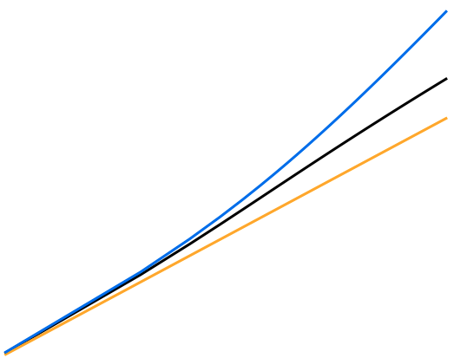
Type Ia Supernovae: the ideal tool to measure cosmic distances
Very homogeneous intrinsic brightness at peak (<10% scatter) after several empirical corrections.
~70% Dark Energy
~30% Matter
𝚲CDM
pre SN discovery
Accelerated expansion
Only Dark Energy
Dark Energy density Ω_{𝚲}
SN detection
billion years ago
peak brightness
Matter density Ω_{M}
Distance
w
w=−1
↓
𝚲CDM
Today
Dark Energy
Equation of State
Decelerated expansion
Only Matter
Redshifts
Matter density Ω_{M}
Notes:
We actually usually test an extension of the LambdaCDM model and add an extra degree of freedom and test whether Dark Energy is really a constant or it has been evolving. The equation of the redshift evolving Dark Energy is here, this extra parameter is w, and if w is -1 , we go back to LambdaCDM.

Slide 10
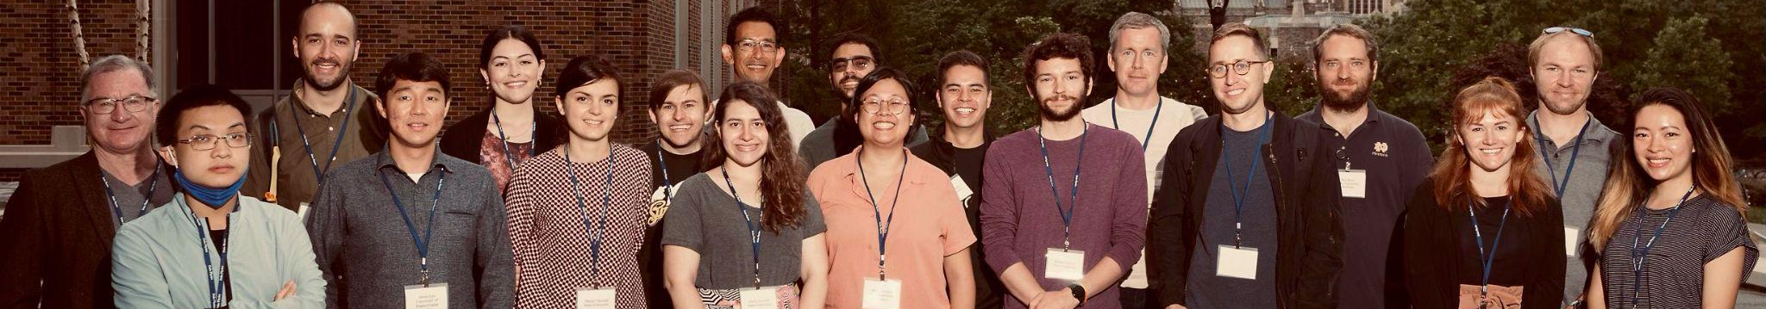
The golden era of modern cosmology
2014-2019
Today
Starting as NHFellow!
2024
2027
2023
The DES Supernova Working Group

Slide 11

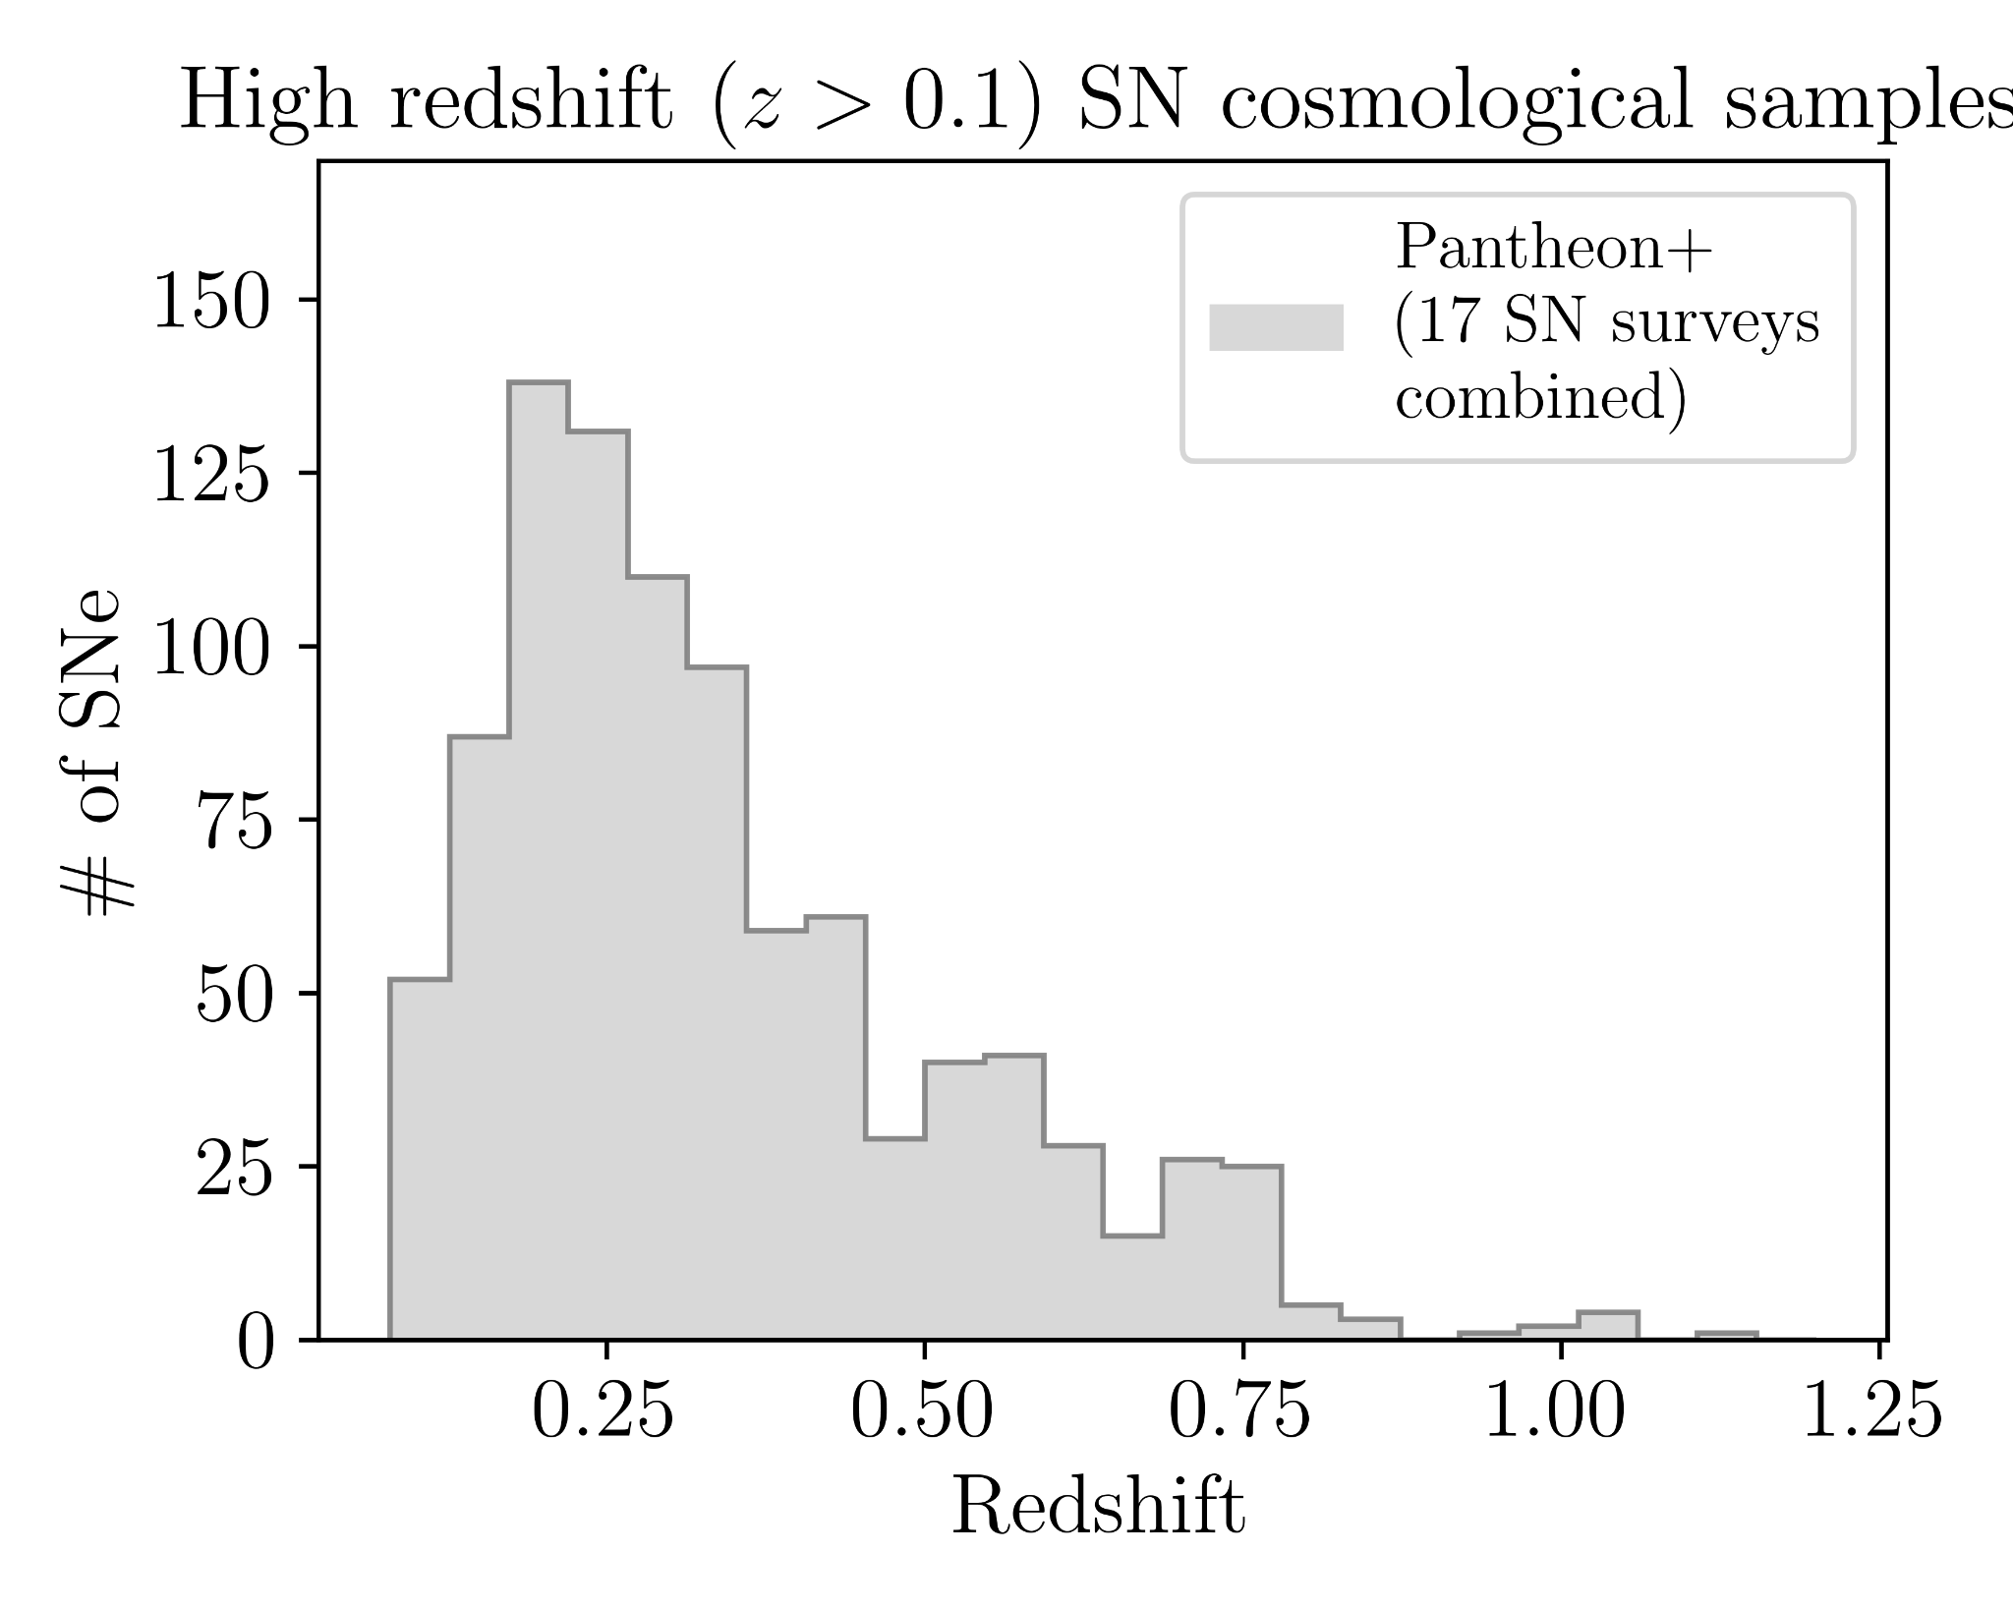
The Dark Energy Survey Supernova program
Before the DES Supernova program…
Vincenzi et al. (in Internal Review), DES Collaboration, in prep.
Notes:
This is the final DES Hubble diagram and the residuals.
Most surveys before have been more focused on selecting SNe for which the type is 100% certain (thanks to external spectroscopic data),
In this analysis, we include in the sample every SN for which we could reliably determine a distance and a redshift, regardless of whether we have external data that tells us these are Ias or not. This leaves room for potential contamination.
For this reason we implemented the most advance machine learning algorithms that determine the probability of each event of being a SN Ia or not.
The final DES sample will include almost ten times more SNe.
We refer to this sample as a photometric sample because we do not require a spectoscopic follow-up of each SN event in the sample.
Not requiring a spectroscopic follow up allows us to increase to 1700 the number of SNe in our sample, and just to put this number into context, all other published cosmological analysis from photometric SN samples included at most 1000 SNe. and the Pantheon sample, which is the largest compilation of spectroscopically identified SNe Ia is 1000 SNe.
This is also thanks to the fact that the number of low-z anchoring sample has also increased in the past years.
For each of this SN, the redshift has been measured from the likely host galaxy. The OzDES program, using the multi-object spectrograph AAT, collected thousends of redshifts of likely SN hosts and finished to collect them one year. Infact, while spectroscopic follow-up of SNe is all about timing, spectroscopic follow-up of galaxies is significantly easier.
So this final sample has better statistics,
State that 1700 is number of SNe AFTER SALT2 cuts i.e. their light curves must broadly look like a SN Ia in timescale (x1) and colour (c)

Slide 12
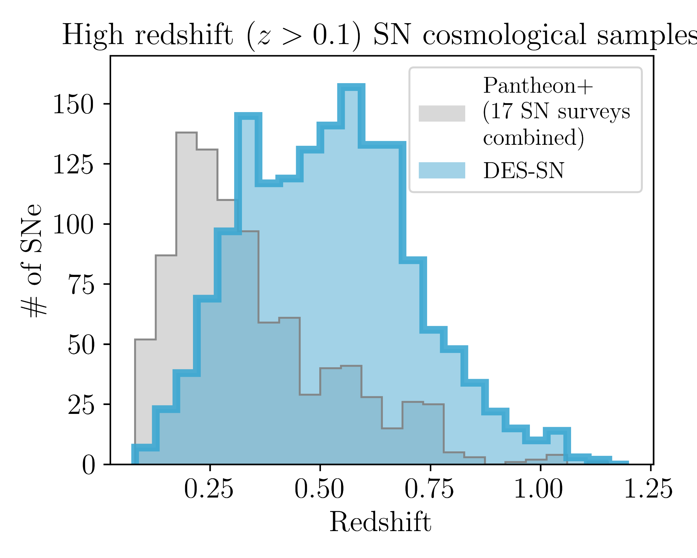
The Dark Energy Survey Supernova program
With the DES Supernova program…
~1600 SNe Ia
This is the largest and deepest SN sample from a single telescope ever compiled
Well defined sample selection
Spectroscopic redshifts from OzDES
Vincenzi et al. (in Internal Review), DES Collaboration, in prep.
Notes:
This is the final DES Hubble diagram and the residuals.
Most surveys before have been more focused on selecting SNe for which the type is 100% certain (thanks to external spectroscopic data),
In this analysis, we include in the sample every SN for which we could reliably determine a distance and a redshift, regardless of whether we have external data that tells us these are Ias or not. This leaves room for potential contamination.
For this reason we implemented the most advance machine learning algorithms that determine the probability of each event of being a SN Ia or not.
The final DES sample will include almost ten times more SNe.
We refer to this sample as a photometric sample because we do not require a spectoscopic follow-up of each SN event in the sample.
Not requiring a spectroscopic follow up allows us to increase to 1700 the number of SNe in our sample, and just to put this number into context, all other published cosmological analysis from photometric SN samples included at most 1000 SNe. and the Pantheon sample, which is the largest compilation of spectroscopically identified SNe Ia is 1000 SNe.
This is also thanks to the fact that the number of low-z anchoring sample has also increased in the past years.
For each of this SN, the redshift has been measured from the likely host galaxy. The OzDES program, using the multi-object spectrograph AAT, collected thousends of redshifts of likely SN hosts and finished to collect them one year. Infact, while spectroscopic follow-up of SNe is all about timing, spectroscopic follow-up of galaxies is significantly easier.
So this final sample has better statistics,
State that 1700 is number of SNe AFTER SALT2 cuts i.e. their light curves must broadly look like a SN Ia in timescale (x1) and colour (c)

Slide 13
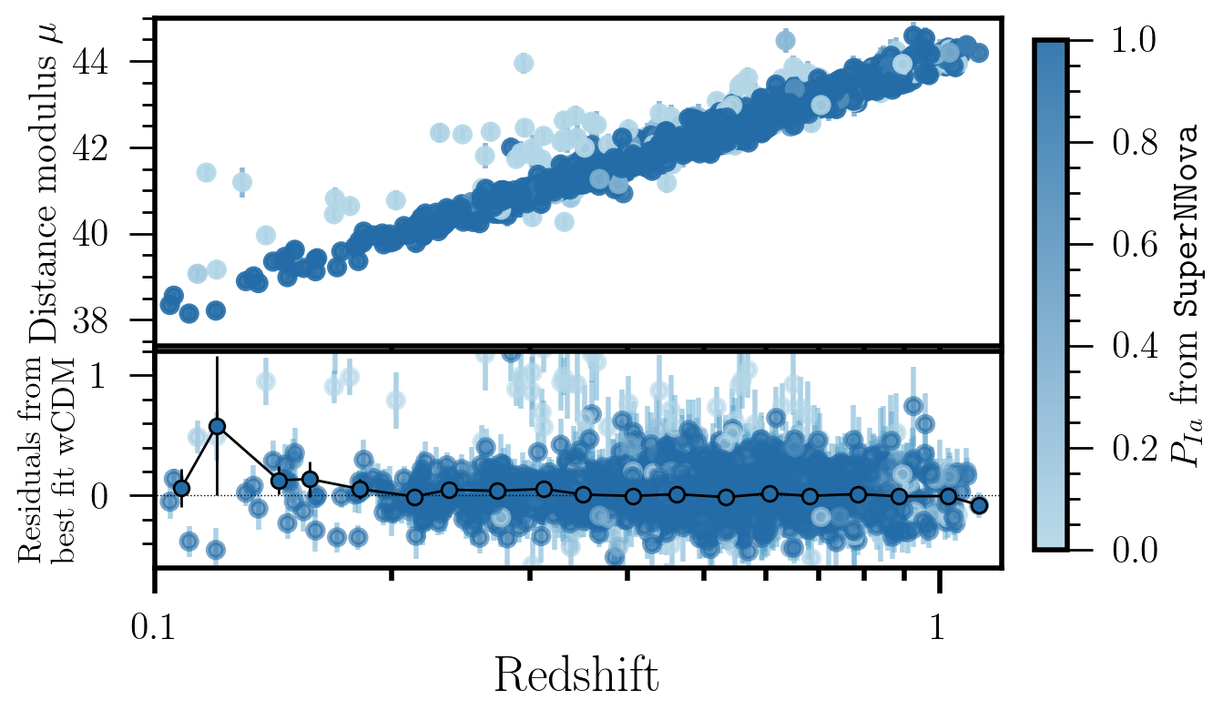
The Dark Energy Survey Supernova program
With the DES Supernova program…
Distance
~1600 SNe Ia
This is the largest and deepest SN sample from a single telescope ever compiled
Well defined sample selection
Spectroscopic redshifts from OzDES
Redshifts
Vincenzi et al. (in Internal Review), DES Collaboration, in prep.
Notes:
This is the final DES Hubble diagram and the residuals.
Most surveys before have been more focused on selecting SNe for which the type is 100% certain (thanks to external spectroscopic data),
In this analysis, we include in the sample every SN for which we could reliably determine a distance and a redshift, regardless of whether we have external data that tells us these are Ias or not. This leaves room for potential contamination.
For this reason we implemented the most advance machine learning algorithms that determine the probability of each event of being a SN Ia or not.
The final DES sample will include almost ten times more SNe.
We refer to this sample as a photometric sample because we do not require a spectoscopic follow-up of each SN event in the sample.
Not requiring a spectroscopic follow up allows us to increase to 1700 the number of SNe in our sample, and just to put this number into context, all other published cosmological analysis from photometric SN samples included at most 1000 SNe. and the Pantheon sample, which is the largest compilation of spectroscopically identified SNe Ia is 1000 SNe.
This is also thanks to the fact that the number of low-z anchoring sample has also increased in the past years.
For each of this SN, the redshift has been measured from the likely host galaxy. The OzDES program, using the multi-object spectrograph AAT, collected thousends of redshifts of likely SN hosts and finished to collect them one year. Infact, while spectroscopic follow-up of SNe is all about timing, spectroscopic follow-up of galaxies is significantly easier.
So this final sample has better statistics,
State that 1700 is number of SNe AFTER SALT2 cuts i.e. their light curves must broadly look like a SN Ia in timescale (x1) and colour (c)

Slide 14
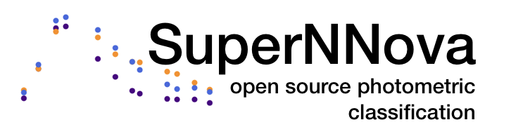
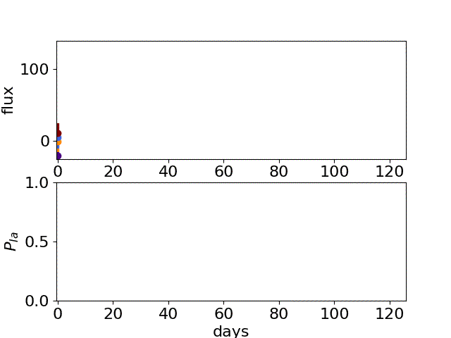
The Dark Energy Survey Supernova program
1) Machine learning to identify likely SN Ia
Distance
Probability of being a Type Ia
SN Ia
non-SN Ia
Redshifts
Vincenzi et al. (in Internal Review), DES Collaboration, in prep.
Notes:
This is the final DES Hubble diagram and the residuals.
Most surveys before have been more focused on selecting SNe for which the type is 100% certain (thanks to external spectroscopic data),
In this analysis, we include in the sample every SN for which we could reliably determine a distance and a redshift, regardless of whether we have external data that tells us these are Ias or not. This leaves room for potential contamination.
For this reason we implemented the most advance machine learning algorithms that determine the probability of each event of being a SN Ia or not.
The final DES sample will include almost ten times more SNe.
We refer to this sample as a photometric sample because we do not require a spectoscopic follow-up of each SN event in the sample.
Not requiring a spectroscopic follow up allows us to increase to 1700 the number of SNe in our sample, and just to put this number into context, all other published cosmological analysis from photometric SN samples included at most 1000 SNe. and the Pantheon sample, which is the largest compilation of spectroscopically identified SNe Ia is 1000 SNe.
This is also thanks to the fact that the number of low-z anchoring sample has also increased in the past years.
For each of this SN, the redshift has been measured from the likely host galaxy. The OzDES program, using the multi-object spectrograph AAT, collected thousends of redshifts of likely SN hosts and finished to collect them one year. Infact, while spectroscopic follow-up of SNe is all about timing, spectroscopic follow-up of galaxies is significantly easier.
So this final sample has better statistics,
State that 1700 is number of SNe AFTER SALT2 cuts i.e. their light curves must broadly look like a SN Ia in timescale (x1) and colour (c)

Slide 15
The Dark Energy Survey Supernova program
2) Modelling SN Ia intrinsic scatter
Distance
Probability of being a Type Ia
Redshifts
Vincenzi et al. (in Internal Review), DES Collaboration, in prep.
Notes:
the presence of this unexaplained intrinsic scatter is telling us that there’s something that alters the brightness of our standard candles.

Slide 16
The Dark Energy Survey Supernova program
2) Modelling SN Ia intrinsic scatter
- extrinsic origin?
galaxy dust extinction
- intrinsic origin? progenitor physics
Distance
Probability of being a Type Ia
Redshifts
Brout and Scolnic 2021
Popovic et al., 2021
Chen et al., 2022
Vincenzi et al. (in Internal Review), DES Collaboration, in prep.
Notes:
Our best bet for now is dust, because of how we see that this scatter increases when SNe Ia are redder, but there are still lots of open question and we spent lots of time trying to model dust and we include this in our measurements.

Slide 17
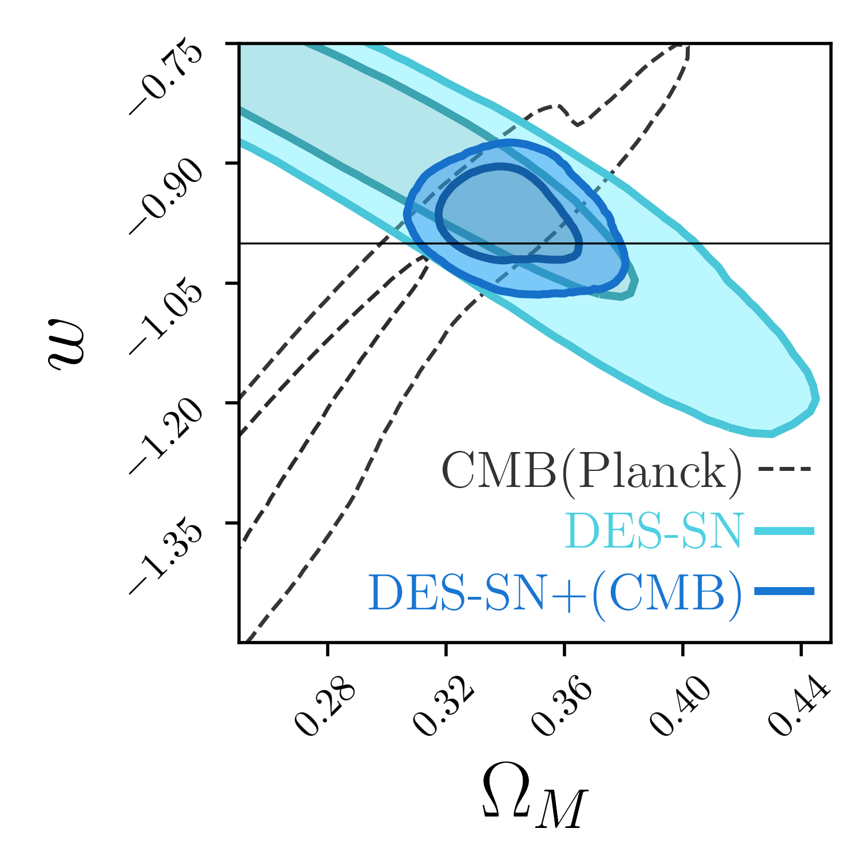
The Dark Energy Survey Supernova program
w
w=−1
Distance
↓
𝚲CDM
Dark Energy
Equation of State
Redshifts
Matter density Ω_{M}
_{−0.038}
w=−0.965^{+0.034}
Vincenzi et al. (in Internal Review), DES Collaboration, in prep.

Slide 18
The golden era of modern cosmology
2014-2019
2023
2024
2027
Notes:
These are the questions I’m interested to answer with my research and it is a pretty exciting time to be working on this because for sure we are not suffering a lack of data.
Billions of dollars have been invested to design and build experiments that can find an answer. In the last decade, the most important ground-based cosmological experiment has been the dark energy, the very near future is observatories like Euclid and Roman gonna give us orders of magnitudes more data and I’ll talk about this in my talk.

Slide 19
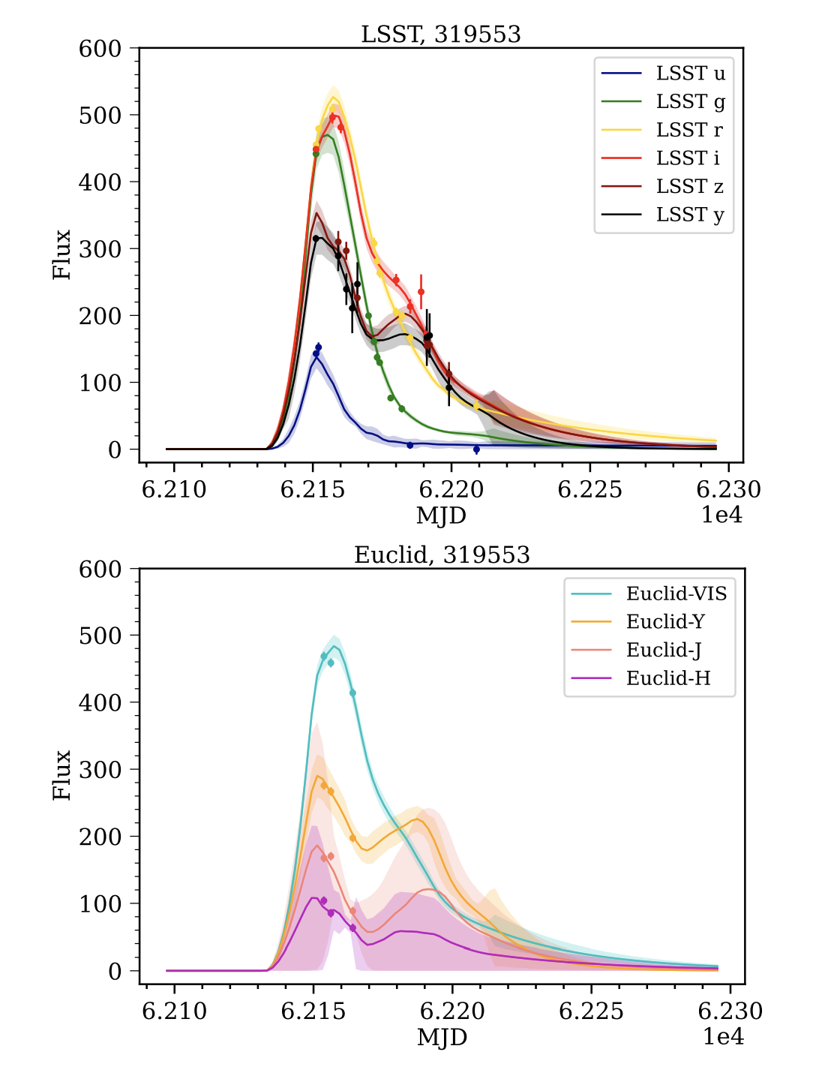
The golden era of modern cosmology
Go redder!
2014-2019
2023
2024
2027
Euclid NIR SN data
optical
Y
J
H
Disentangle
extrinsic dust and intrinsic SN properties
Notes:
These are the questions I’m interested to answer with my research and it is a pretty exciting time to be working on this because for sure we are not suffering a lack of data.
Billions of dollars have been invested to design and build experiments that can find an answer. In the last decade, the most important ground-based cosmological experiment has been the dark energy, the very near future is observatories like Euclid and Roman gonna give us orders of magnitudes more data and I’ll talk about this in my talk.

Slide 20
The golden era of modern cosmology
Go redder!
Go larger!
2014-2019
2023
2024
2027
x600 the Dark Energy Survey
~1 million SN Ia lightcurves 0.1<z<1
55k SN Ia spectra and redshifts using 4MOST
New tests for LCDM and GR
Notes:
These are the questions I’m interested to answer with my research and it is a pretty exciting time to be working on this because for sure we are not suffering a lack of data.
Billions of dollars have been invested to design and build experiments that can find an answer. In the last decade, the most important ground-based cosmological experiment has been the dark energy, the very near future is observatories like Euclid and Roman gonna give us orders of magnitudes more data and I’ll talk about this in my talk.

Slide 21
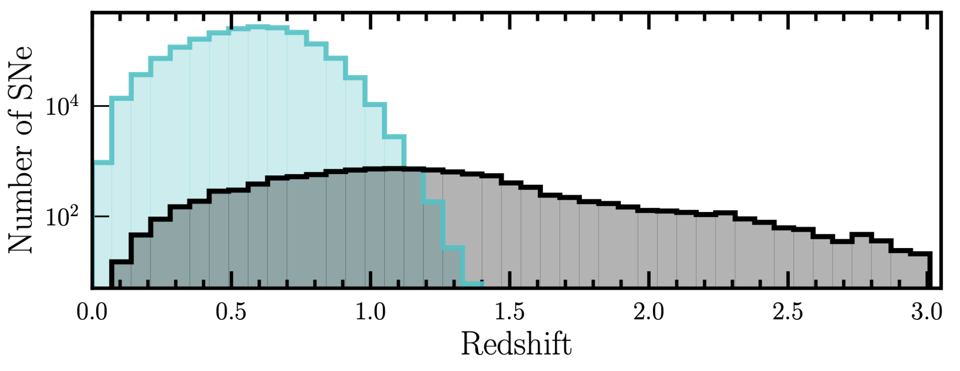
The golden era of modern cosmology
Go redder!
Go larger!
Go deeper!
2014-2019
2023
2024
2027
Rubin
~10k SN Ia at 0.3<z<3
2-day cadence in 4 bands
Roman
Notes:
These are the questions I’m interested to answer with my research and it is a pretty exciting time to be working on this because for sure we are not suffering a lack of data.
Billions of dollars have been invested to design and build experiments that can find an answer. In the last decade, the most important ground-based cosmological experiment has been the dark energy, the very near future is observatories like Euclid and Roman gonna give us orders of magnitudes more data and I’ll talk about this in my talk.

Slide 22
The golden era of modern cosmology
Largest SN sample from single survey to date
Go redder!
Go larger!
Go deeper!
2014-2019
2023
2024
2027
Thank you!
Notes:
These are the questions I’m interested to answer with my research and it is a pretty exciting time to be working on this because for sure we are not suffering a lack of data.
Billions of dollars have been invested to design and build experiments that can find an answer. In the last decade, the most important ground-based cosmological experiment has been the dark energy, the very near future is observatories like Euclid and Roman gonna give us orders of magnitudes more data and I’ll talk about this in my talk.

